Slide 1
Lending Club Case Study--info
Problem statement:
You work for a consumer finance company which specializes in lending various types of loans to urban customers. When the company receives a loan application, the company has to make a decision for loan approval based on the applicant’s profile. The data given contains information about past loan applicants and whether they ‘defaulted’ or not.
Client is looking to deep dive into the data and get insights to help them reduce the overall default cases.
Expected results:
The aim is to identify patterns which indicate if a person is likely to default, which may be used for taking actions such as denying the loan, reducing the amount of loan, lending (to risky applicants) at a higher interest rate, etc.
Data sets used for analysis:
Loan Data set with 39k records
Data dictionary explaining fields present in the loan data set
No third party data has been used during analysis

Slide 2
Data received
Below table represents various fields received in the data set. Fields highlighted in Yellow were considered to perform the analysis
# Total no of records : 39,717
# Data time frame : 06-Jan-2007 – 12-Jan-2011
# Total Disbursed Loan amount: 445,602,650
# Total defaulted loans : 4,312

Slide 3
Data preparation
Below are some of the data preparation/cleansing performed
Converted several fields to appropriate data types. Notable conversions include:
Dates were converted from object type to datetime for fields such as "issue_d", "earliest_cr_line", "last_pymnt_d", "last_credit_pull_d", and "next_pymnt_d".
Cleansed the "term" field by removing the keyword "months" and then converted its data type from object to integer.
Removed default values across all fields. Any missing values (NA) were replaced with blank values.
Cleansed the "int_rate" field by removing the "%" symbol and then converted its data type from object to float.
Additionally, a calculated field named "Isdefault" was created. This field was populated with the value "1" where the "delinq_2yrs" field is greater than or equal to 1.
Performed analysis using describe on the entire dataset to identify any outliers

Slide 4
Technologies used
Python 3.0
Excel
Various Python libraries
Pandas
Numpy
Matplotlib
Seaborn

Slide 5
Data Analysis

Slide 6


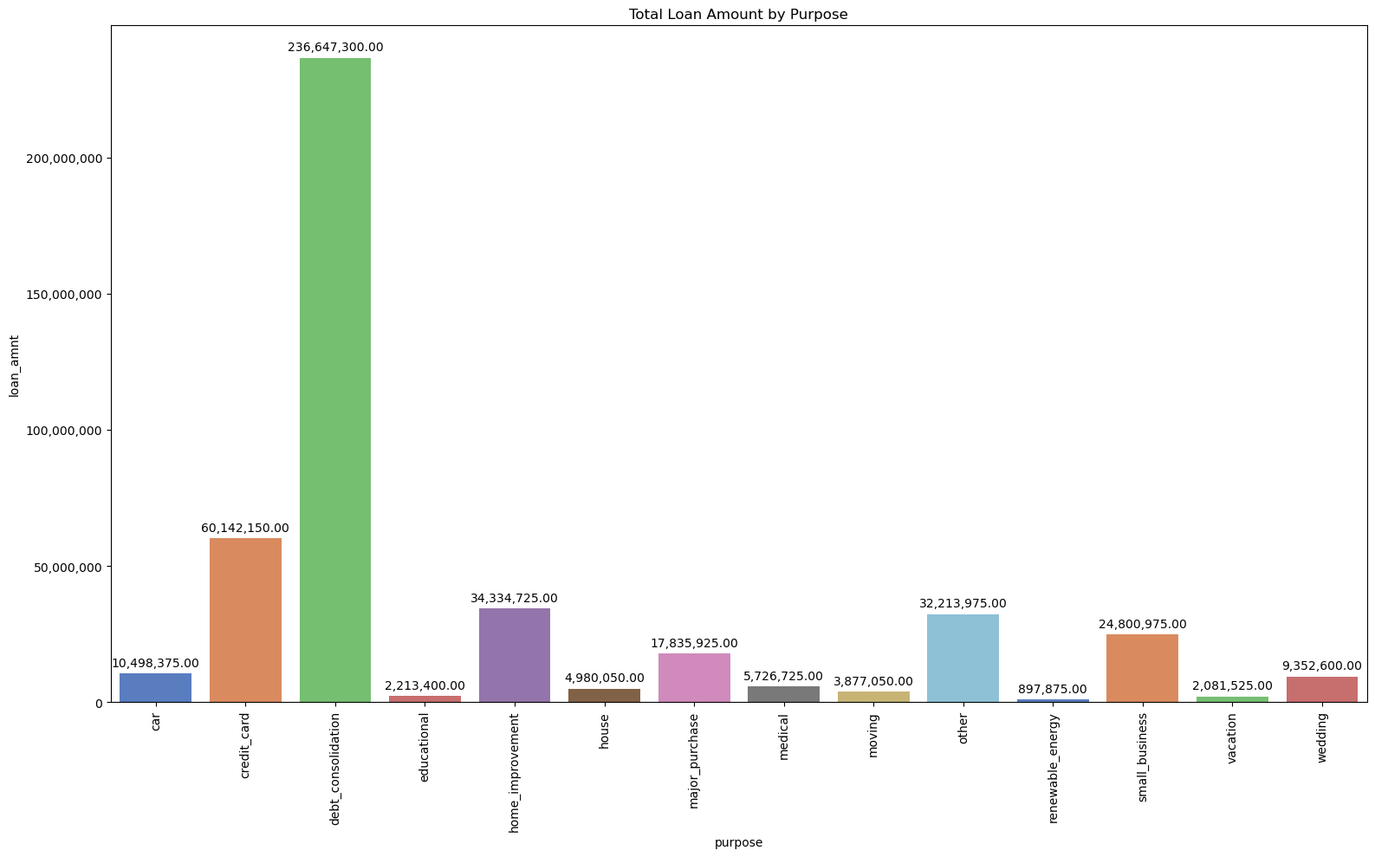

"Debt consolidation" is the common purpose used by 53% of the customers
53% of the loans approved(based on amount) have a generic purpose mentioned
Second in the list is to pay off credit card bill which is something to review as these loans are given to people from Urban areas
Agents should be instructed to provide proper details under purpose field which can lead to meaningful insights

Slide 7
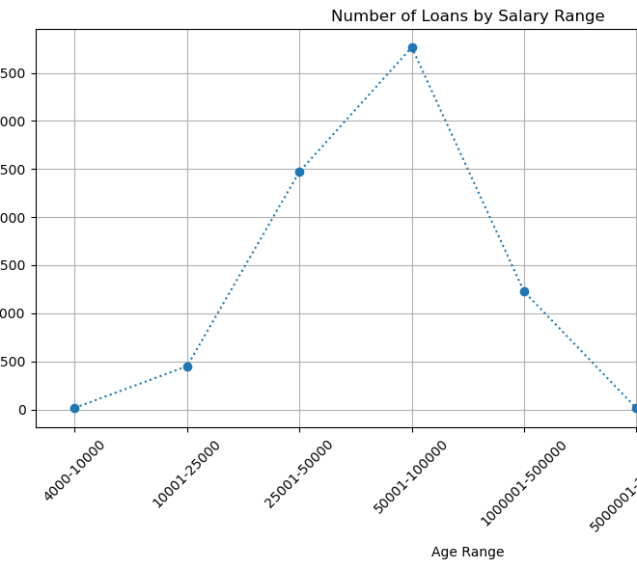
Majority of the loans are issued to customers between salary range of 50k-1 Lakh
~50% of the loans approved(based on amount) are to customers whose salary ranges between 50k to 1 Lakh per annum

Slide 8
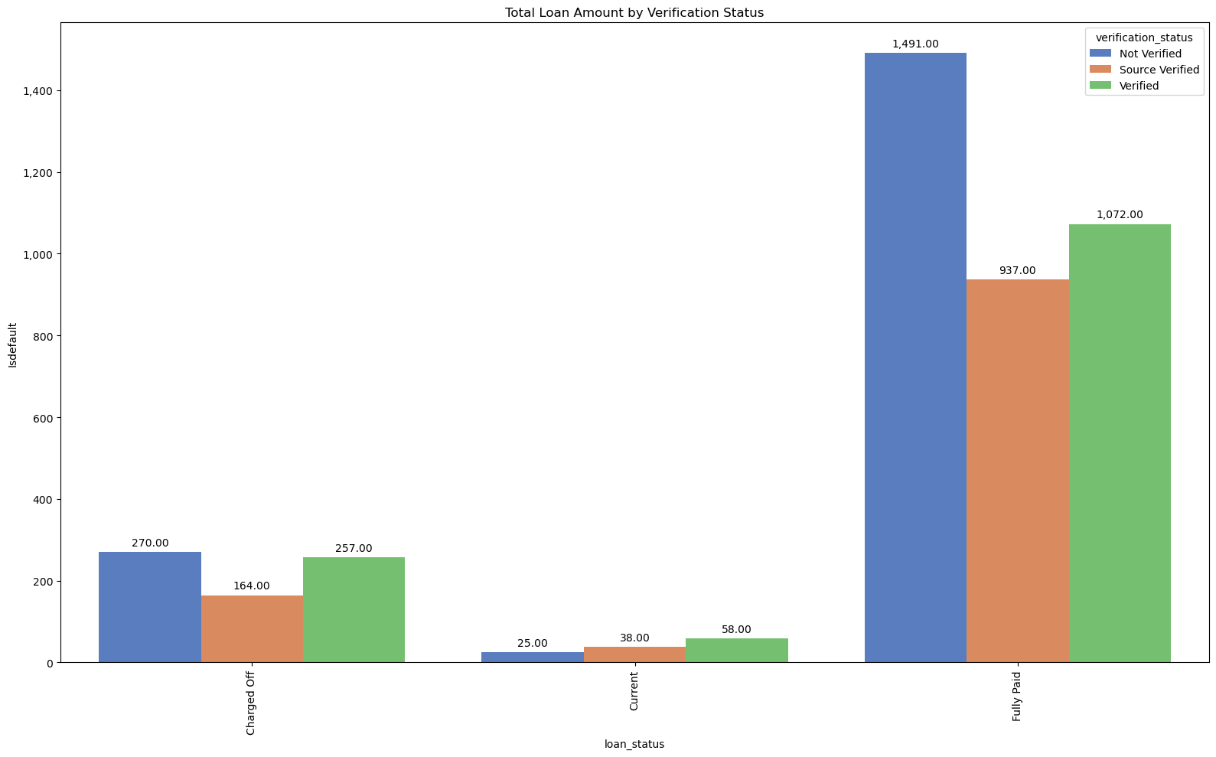
Analysis confirms loans to verified customers have less default rates
More than 40 % of the loans defaulted are from Non verified customers

Slide 9
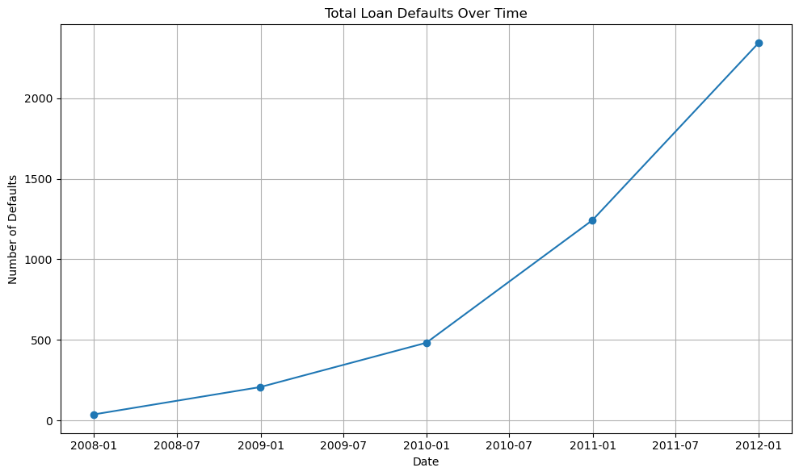
There is an exponential growth in the defaulted loans based on the issue date
More than 50 % of the loans defaulted are of loans which are issued in the year 2012
It is evident from the graph that whatever checks that were previously performed are no longer effective and are not reducing the defaulted cases

Slide 10
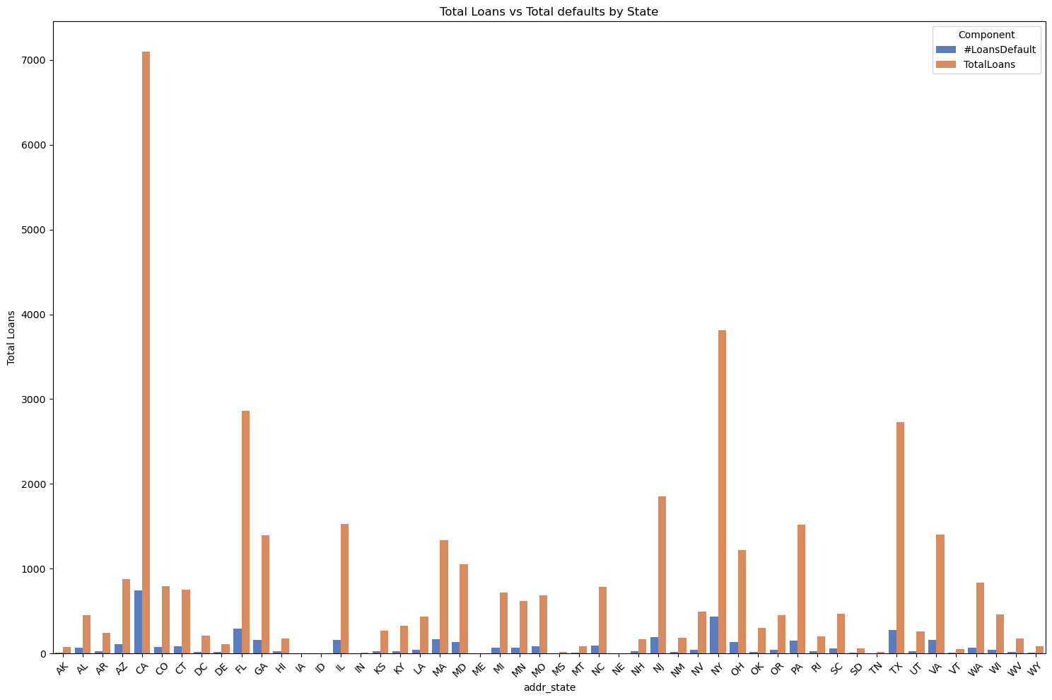
California(CA) has the max no of loans disbursed and in line defaults
Based on the analysis 15% of the loans from CA have defaulted
Overall the default rate of loans across locations is ~11%

Slide 11
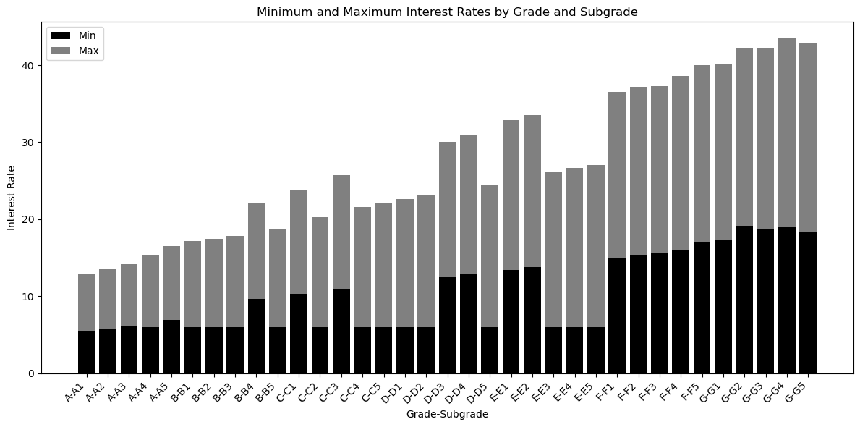
Loans to verified customers have less default rates
Inconsistent interest rates offered to customers. For E.g. customers with grades E3/E4/E5 are offered less interest rates than customers with Grade D3/D4

Slide 12
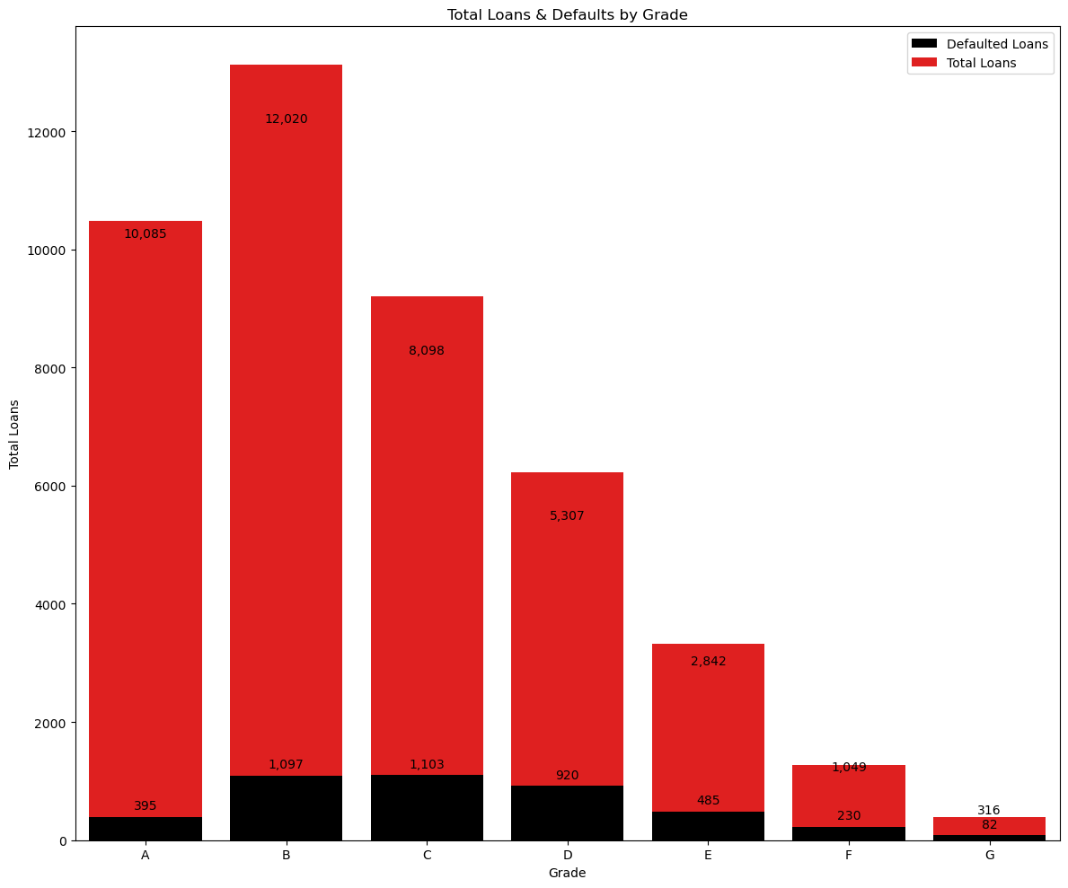
Loans to customers having good grades have less defaults
Grade can be leveraged as a factor to reduce the overall defaulted loans
Analysis confirms the default rates are higher in lower grades compared to others
Based on the data provided the default rates as per the analysis are as below
A—3%
B—9%
C—13%
D—17%
E—17%
F—21%
G—26%
Total loans given to customers with Grade "A","B","C" is ~30.2k out of which 2.5 K were defaulted i.e.~8% of loans
Total loans given to customers with Grade "D","E","F","G" is ~9.5k out of which 1.8 K were defaulted i.e.~18% of loans

Slide 13
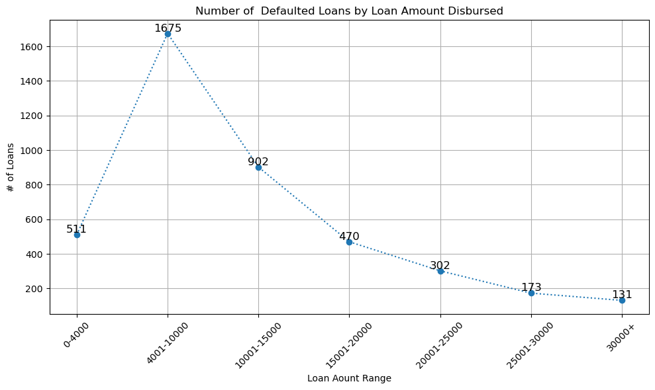
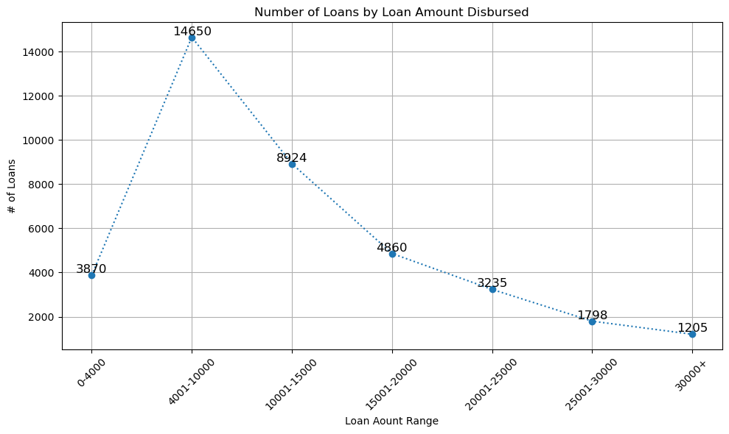
Higher loan amounts have less default rates
Loans less than 15k have higher default rates compared to loans more than 15k
So additional rules are required to risk score loans less than 15k
Loans Range | Total Loans | Defaulted Loans | % of default
0-4000 | 3,870 | 511 | 13.20%
4001-10000 | 14,650 | 1,675 | 11.43%
10001-15000 | 8,924 | 902 | 10.11%
15001-20000 | 4,860 | 470 | 9.67%
20001-25000 | 3,235 | 302 | 9.34%
25001-30000 | 1,798 | 173 | 9.62%
30001+ | 1,205 | 131 | 10.87%

Slide 14
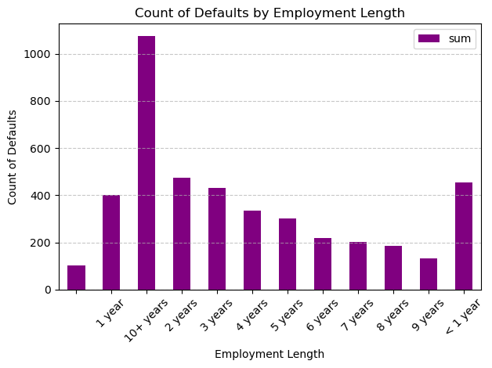
Customers having more than 10 years of employment length have higher default rates
This can be a feature considered to build the model to reduce the defaults

