Slide 1
PAWS
Presented By:
Kumar Sanskar (191500418)
Goldi Maurya (191500306)

Slide 2
OUTLINE
About the Project
Objective
Requirements
Snapshots from the website

Slide 3
ABOUT THE PROJECT
The purpose of this project is to build a web application program to reduce manual work of managing pet store and adoption as well as taking care of you pet while you are away.
This software contains 3 page :
1: Landing Page →
▪ Create account
▪ After creating account, it redirects to onboarding page
2:User Profile →
▪ login/signup
▪ pet profile
3: Atlas Database Page →
▪ user – this stores details of user taken during the on-boarding.
▪ message – it store data of chat made in app.

Slide 4
OBJECTIVE
The project provides simple way for letting them posting on the internet platform or searching nearby animal lovers.
Missions is to raise awareness towards pets and find loving homes for them.
This project is to automate the process of serving towards the welfare of the pets by giving the pets a place of shelter to live in, care for them with affection.

Slide 5
REQUIREMENTS
Software Specification Used:-
Technology Implemented: Web Development
Language Used: React JS CSS, JAVASCRIPT ,NODE.
Database: Atals Database.
User Interface Design: Graphical User Interface
Web Browser: Chrome/Firefox/Microsoft Edge

Slide 6
HARDWAREREQUIREMENTS •Processor: Intel-i3 or more •Operating System: Windows7 or Higher •RAM:4 GB or more •Hardware Devices: NIL •Harddisk:1TB or more •Display:13inch Laptop or Higher

Slide 7
THIS IS HOW OUR WEBSITE LOOKS
Hope you will like it :)

Slide 8
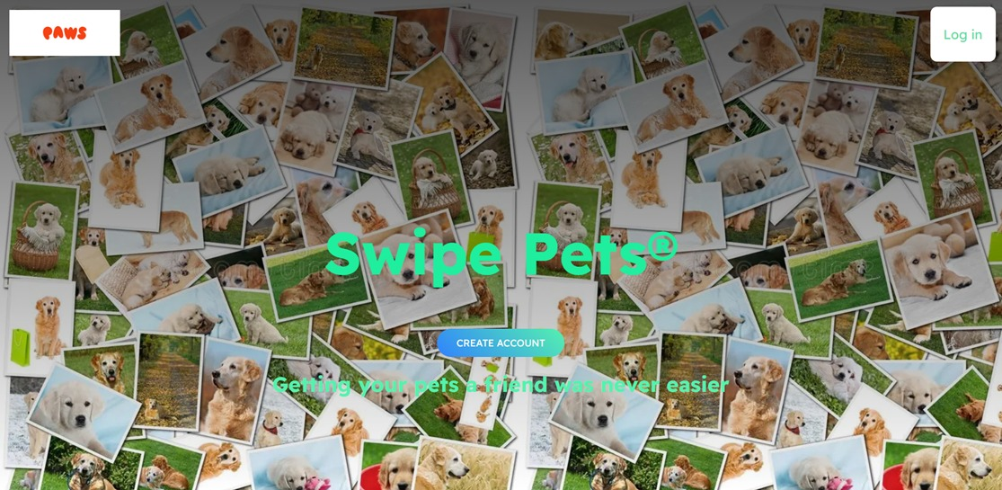
1. Landing Page

Slide 9
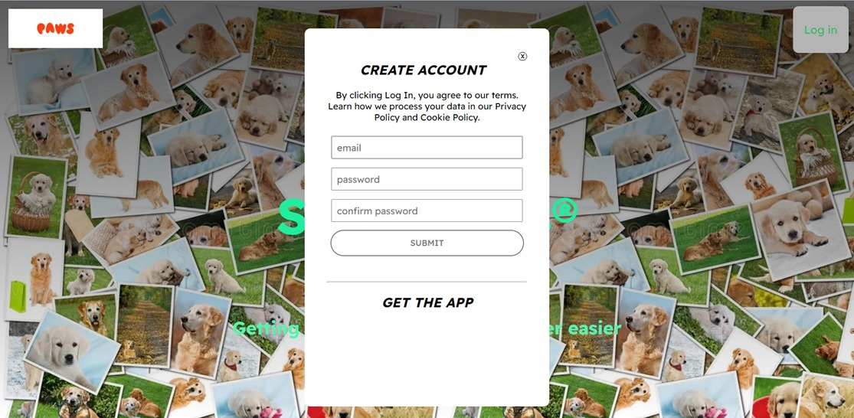
create account

Slide 10
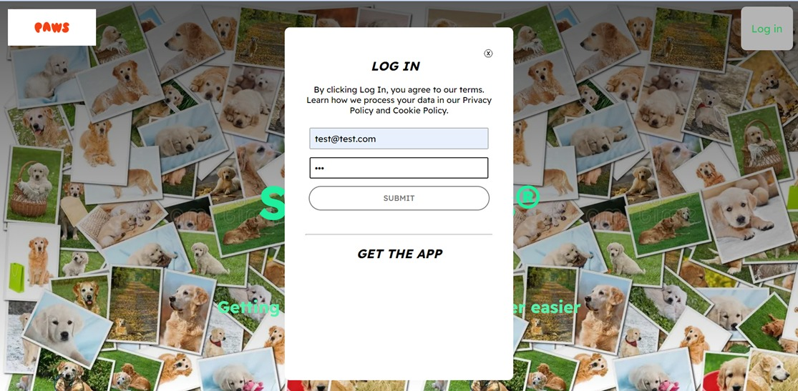
2.Login Page

Slide 11
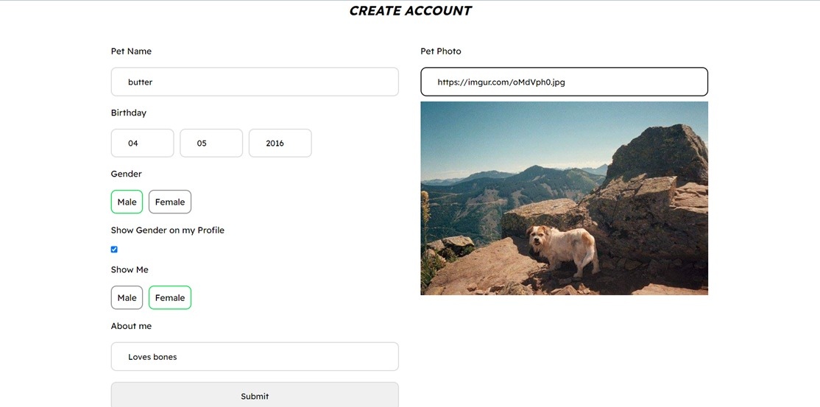
Account details (pet details)

Slide 12
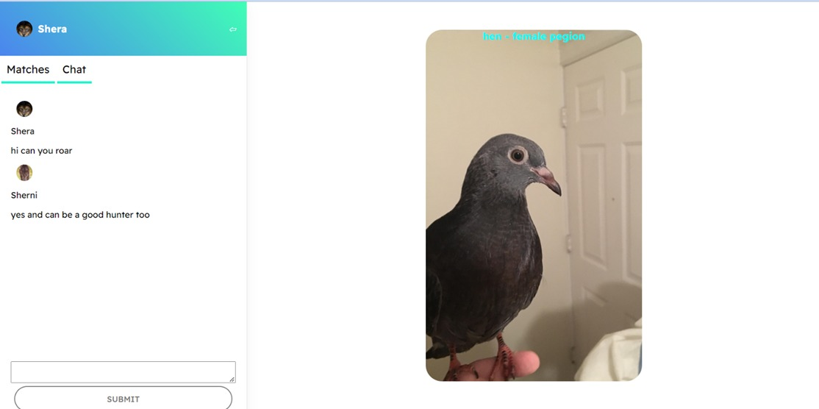
pet profile Page with chating system

Slide 13
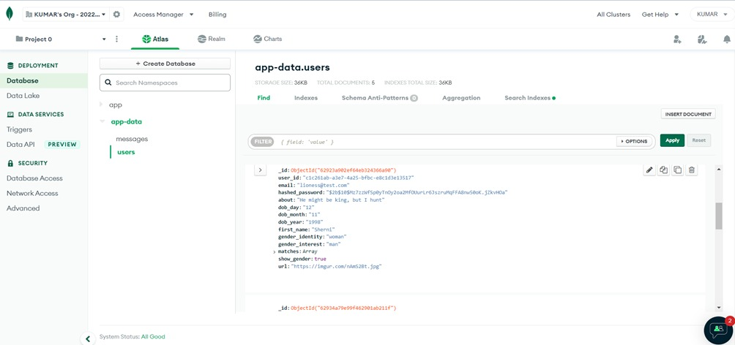
Atals DataBase with account and chat details

Slide 14
Thank You!!!

