Slide 1
PDE based Image Filters

Slide 2
Filtering
The term filtering is derived from frequency space methods where a spatial smoothing of the intensity values corresponds to a signal transform where high frequency components are filtered out.
The transformation of image to frequency is done using Fourier transform.

Slide 3
Spatial Domain Filtering
Filtering of the domain in the spatial domain can by an operator T:
where f denotes the input image and g denotes the processed image.
Typically T acts on spatial neighborhood, i.e. the value of the processed image g at a certain point depends on the value at vicinity of that point in the original image f.

Slide 4
Intensity Transform
Simplest form of T is an operator which simply models ‘local’ intensity transformation:
where:
r represents the input intensity at certain location.
s represents the respective intensity in the transformed image at that location.

Slide 5
Intensity Transform
In most cases, one can consider monotonically non – decreasing intensity transform which preserve the ordering:
In the case when , these transformations called strictly monotonous.
Strictly monotonous intensity transform are called ‘invertible’, i.e. original image data can be recovered from filtered image.

Slide 6
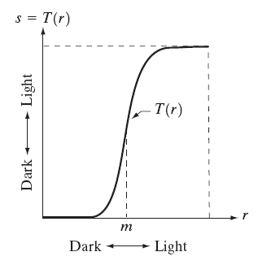
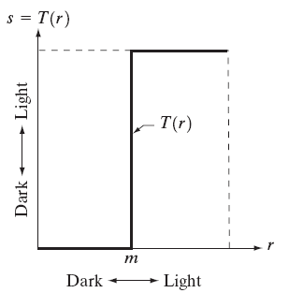
Examples of Intensity Transform
Contrast Stretching
Thresholding
Notes:
Not invertible. Medical imaging to locate where is the bone, cartiladge etc.

Slide 7
Thresholding
Thresholding can be seen as a limiting case of contrast stretching.
It provides the binary image as output which is useful for further processing.

Slide 8
Linear Filters
An operator T is called linear if:
For linear operators, the output intensity is the linear combination of input brightness values.
Among the common linear transformation is the convolution.

Slide 9
Convolution
In spatially discrete setting:

Slide 10
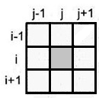
Discrete Vs Continuous Representation
In discrete representation, matrix of weights (i,j) is called mask.
For continuous representation, the weight function w(x’,y’) is called convolution kernel.

Slide 11
Smoothing filters
Smoothing or low pass filtering typically averages the brightness value in a spatial neighborhood.
Most common smoothing kernel is Gaussian kernel. It induces a weighted average of intensity values on the scale determined by a standard deviation σ.
Notes:
Larger sigma: more blurring

Slide 12
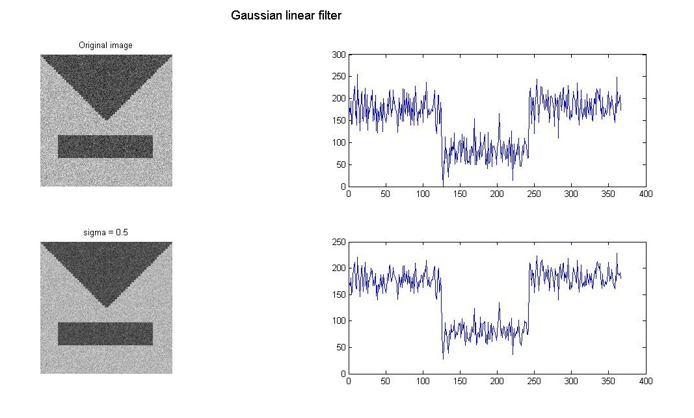
Gaussian Linear Filter
Notes:
Gaussian_test.m

Slide 13
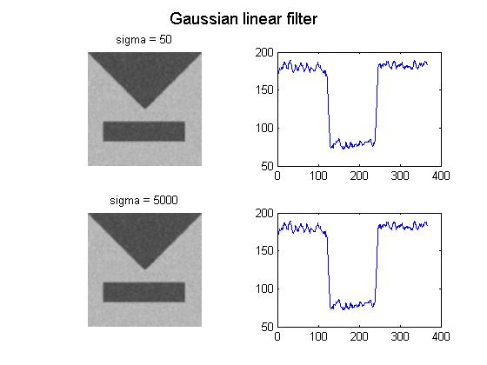
Gaussian Linear Filter
Notes:
Gaussian_test.m

Slide 14
Drawbacks of Linear Filters
Linear filters are often suboptimal.
In smoothening or denoising, for example, the Gaussian smoothening remove both noise and signal.
Relevant structure tends to disappear along with the noise.

Slide 15
Adaptive Gaussian filter
Unlike linear Gaussian filter, one would like to remove noise in an adaptive manner such that important structure remains unaffected.
In principle, this could be done with a Gaussian smoothening where the width σ is adapted to the local structure. (larger in noise & smaller at edges).

Slide 16
Adaptive Gaussian Filter
σ now depends on the intensity values in the local neighborhood.

Slide 17
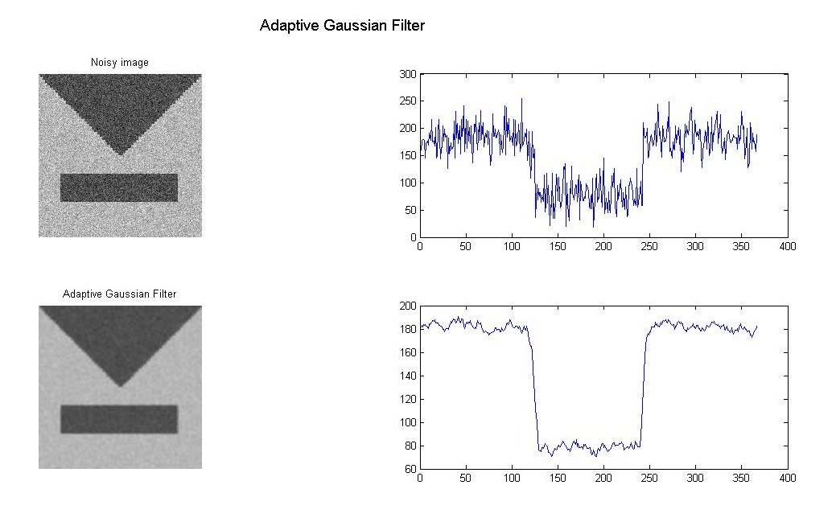
Adaptive Gaussian Filter
Notes:
Adap_driver.m

Slide 18
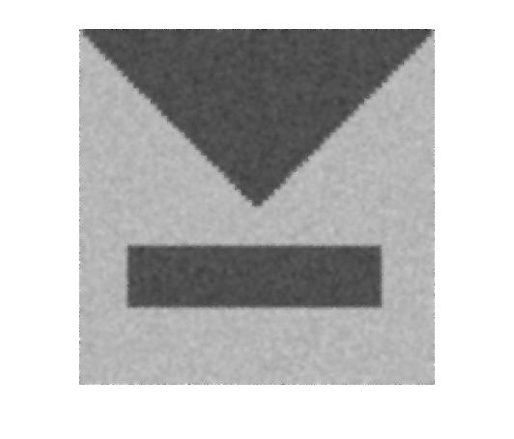
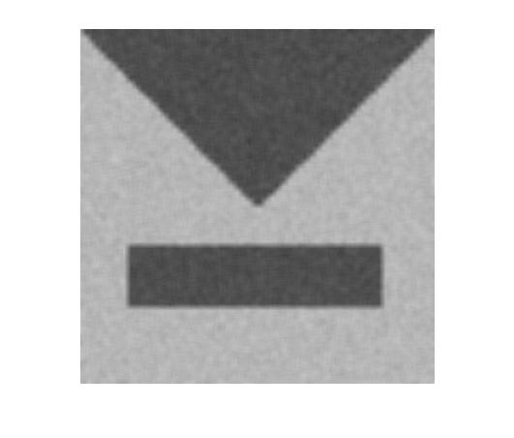

Slide 19
Properties of Linear Diffusion
Gray level shift Invariance:
Translation Invariance:
Isometry Invariance:

Slide 20
Properties of Linear Diffusion
Conservation of Average Value:
Comparison principle:

Slide 21
Derivative filters
Derivative filters capture the spatial variation of brightness.
In particular, they provide the information about the edges or corners in the image.
Vertical edges can be determined as the maximum of norm of the x- derivative.
Horizontal edges can be determined as maxima of the norm of the y – derivative.
It is very sensitive to noise.
Notes:
Deriv.m

Slide 22
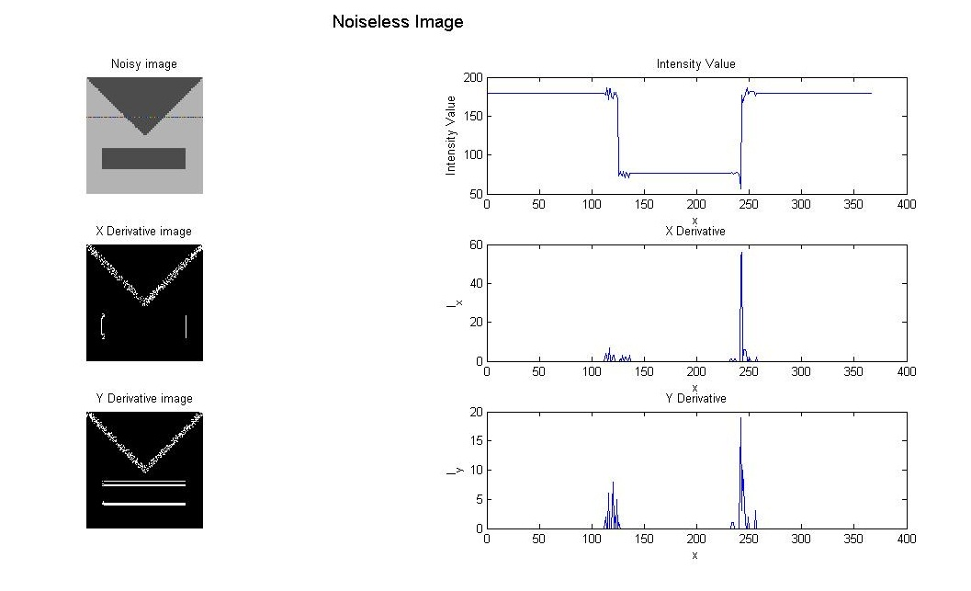
Derivative of noiseless image

Slide 23
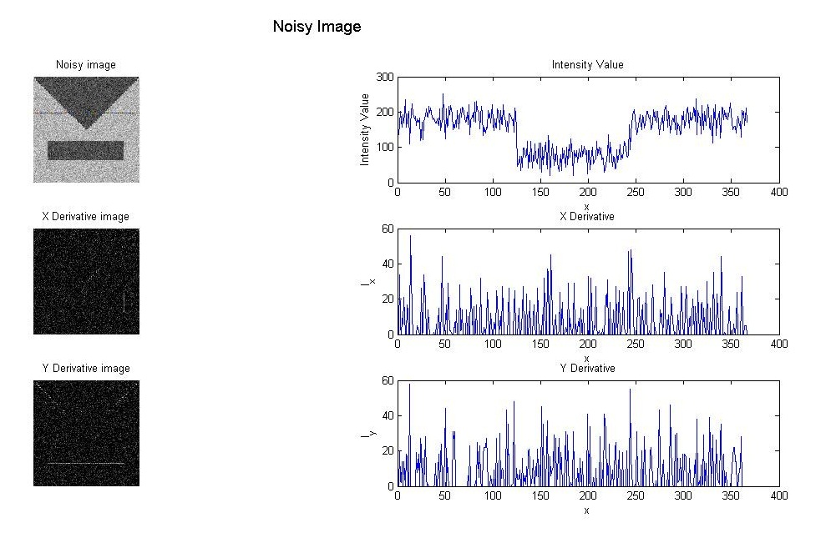
Derivative of noisy image

Slide 24
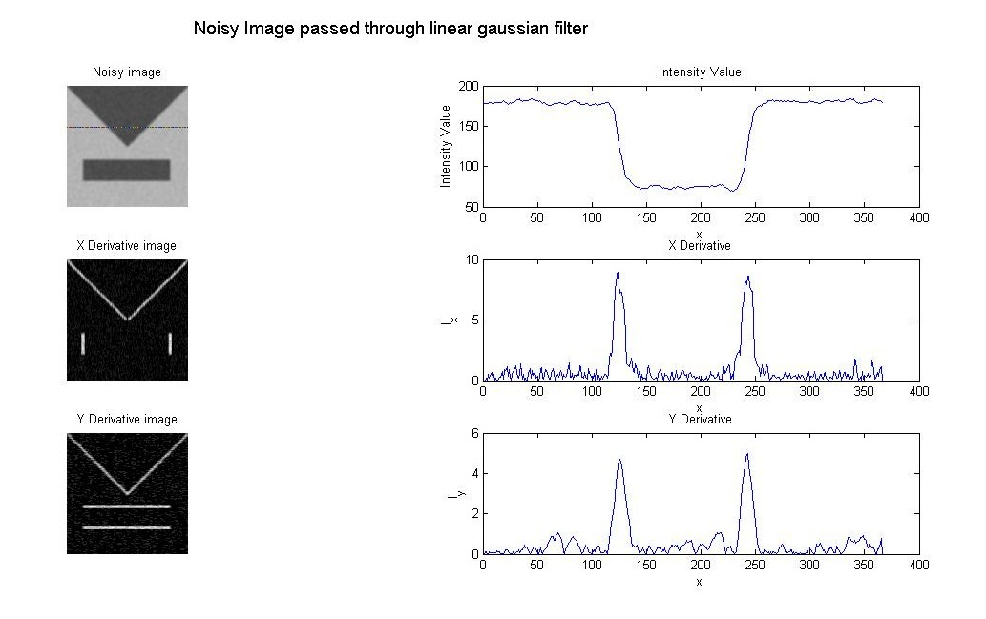
Derivative of Image pass through Gaussian Filter

Slide 25
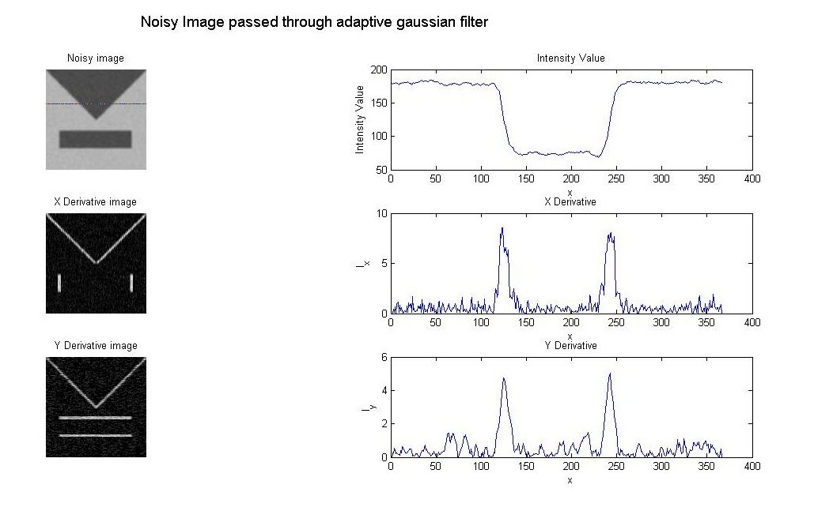
Derivative of image passed through adaptive Gaussian Filter

Slide 26
Diffusion filters
The key observation is that image smoothening can be modeled by the diffusion process.
In this process, the local brightness diffuses to the neighboring pixels due to the difference in the concentration of grey values.

Slide 27
Equations involving diffusion
Fick’s law: It states that concentration difference induces a flow j of the substance in the direction of negative concentration gradient.
Where
D is the diffusion tensor.
u represents the concentration gradient.

Slide 28
Equations involving diffusion
Continuity Equation: Preservation of mass can be expressed by continuity equation:
where t is the time.
Combining the equations (1) and (2):

Slide 29
Types of Diffusion
When j and u are parallel, the diffusion tensor is replaced by a positive scalar valued diffusivity g. Such types of diffusion are isotropic, homogeneous and linear.
If the diffusion coefficient D is space dependent, i.e. D = D(x), it is called inhomogeneous diffusion.

Slide 30
Types of Diffusion
If the diffusion tensor depends on u, i.e. D = D(u), then it is called non-linear diffusion.
If the diffusion tensor D is matrix–valued, j and u are not parallel, then the process is called anisotropic diffusion. This leads to the process where the diffusion is different in different direction.

Slide 31
Linear diffusion Equation
Consider 1-D linear diffusion:
with initial condition:
The above equation has a unique solution
where

Slide 32
Smoothening by diffusion
The previous result implies that smoothening with Gaussian kernel can be realized through the diffusion equation of the form:

Slide 33
Boundary Condition
The boundary condition states that the derivative of the intensity function u along the normal n at the image boundary ∂Ω must vanish.
This assures that no intensity either enter or leave the image, i.e. the average intensity will be preserved.
Notes:
Heat_explicit.m

Slide 34
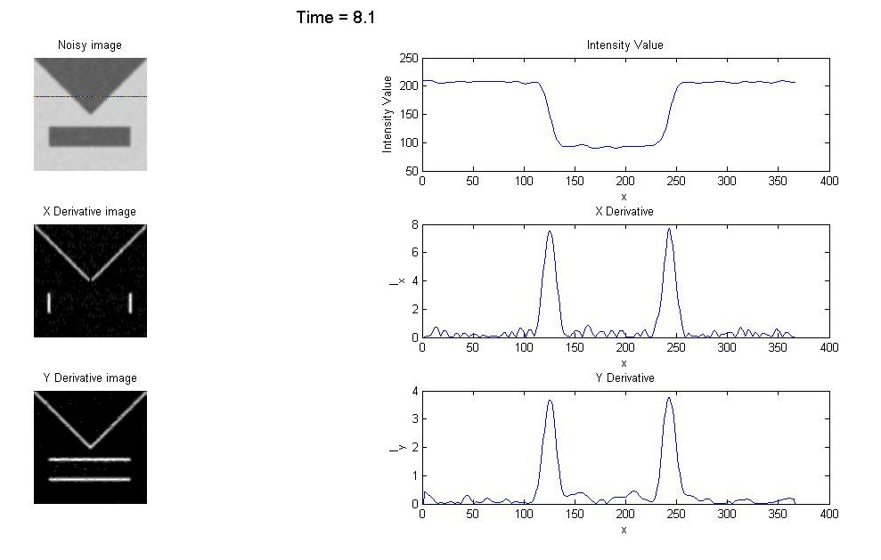
Heat Explicit Solution

Slide 35
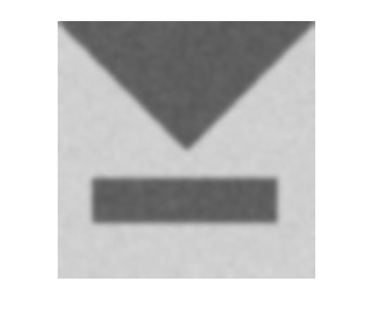
Heat Explicit Result

Slide 36
Edge Preserving Diffusion
Idea: Less diffusion (smoothening) in the location of strong edge information.
serves as an edge indicator.
Diffusion should decrease with increasing

Slide 37
Perona and Malik Model
with c(s) :[0,∞) → (0,∞)

Slide 38
Choice of c(s)
c(s) must be a decreasing function satisfying:

Slide 39
Choice of c(s)
With this choice:
Near the regular boundaries, where the magnitude of the gradient is large, the regularization is stopped and the edges are preserved.
Inside the regions where the gradient of u is weak, it acts like a heat equation resulting in isotropic smoothening.

Slide 40
Choice of c(s)
Interpreting the divergence operator using T, N associated to the image, we get:
where:
b(s) = c(s) + 2sc’(s)
It is better to smooth in the normal direction than in the tangential direction.

Slide 41
Choice of c(s)
Thus:
By the definition of b,

Slide 42
Model for c(s)
The model used for diffusivity are:
This model is both smoothening and enhancing.

Slide 43
1-D case
Let the flux:
Restricting to 1-D:

Slide 44
Perona – Malik is forward parabolic type for |s| ≤ λ and backward parabolic type for |s| ≥ λ.
Forward diffusion for |s| ≤ λ smoothes the contrast whereas backward diffusion for |s| ≥ λ enhances the contrast.

Slide 45
Numerical Scheme

Slide 46
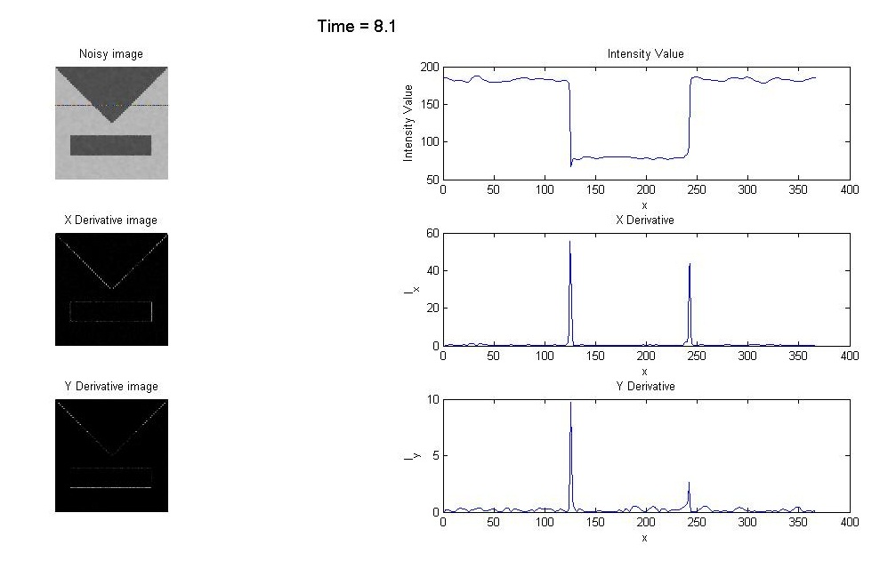
Perona Malik Result

Slide 47

Perona Malik Result

Slide 48
Drawback of Parona-Malik
It will misinterpret the noise as small scale edge and enhance the noise.
There is no theory that guarantees the well-posedness of the problem.

Slide 49
Regularization of the PM model
Regularized non-linear diffusion equation proposed by Catte:
Existence, uniqueness and regularity of the solution is proved.

Slide 50
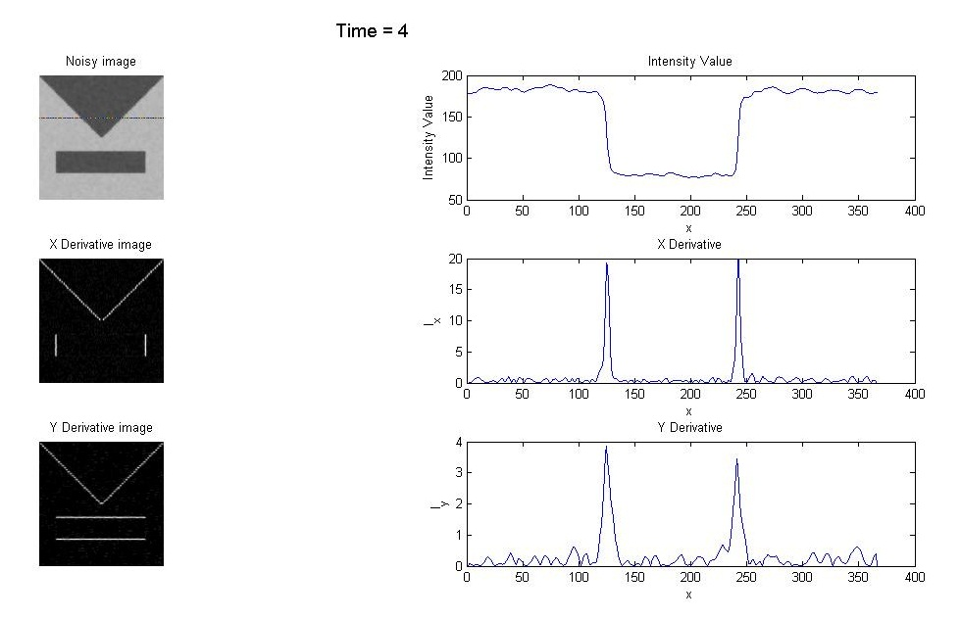
Result of Catte Model

Slide 51
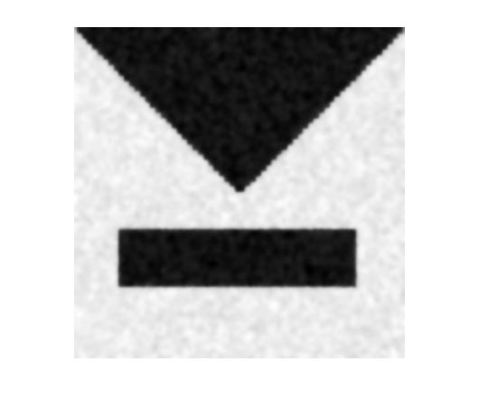
Result of Catte Model

Slide 52
Estimation of Parameter λ
Convolve the image.
Calculate the gradient.
Calculate the mean.
λ = 1.8*mean

Slide 53

Adaptive Perona Malik

Slide 54
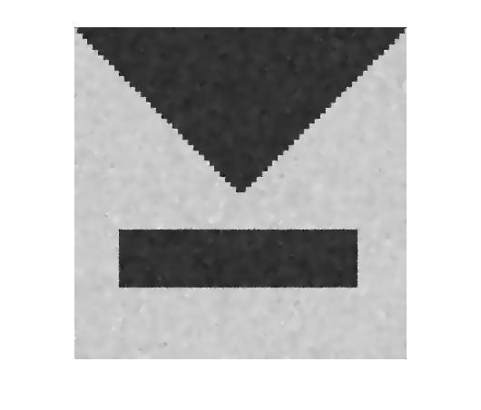

Slide 55
Adaptive Perona Malik
Black et al. suggested the parameter λ to be calculated as follows:
Notes:
MAD

Slide 56
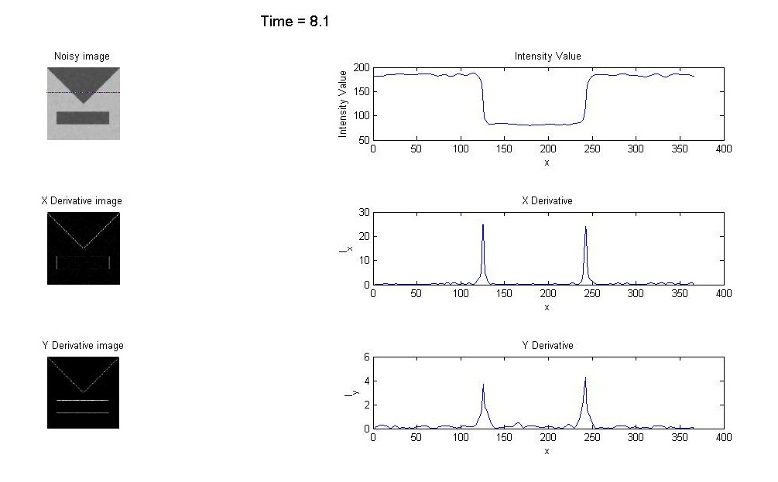
Adaptive Perona Malik
Notes:
MAD

Slide 57

Adaptive Perona Malik
Notes:
MAD

Slide 58
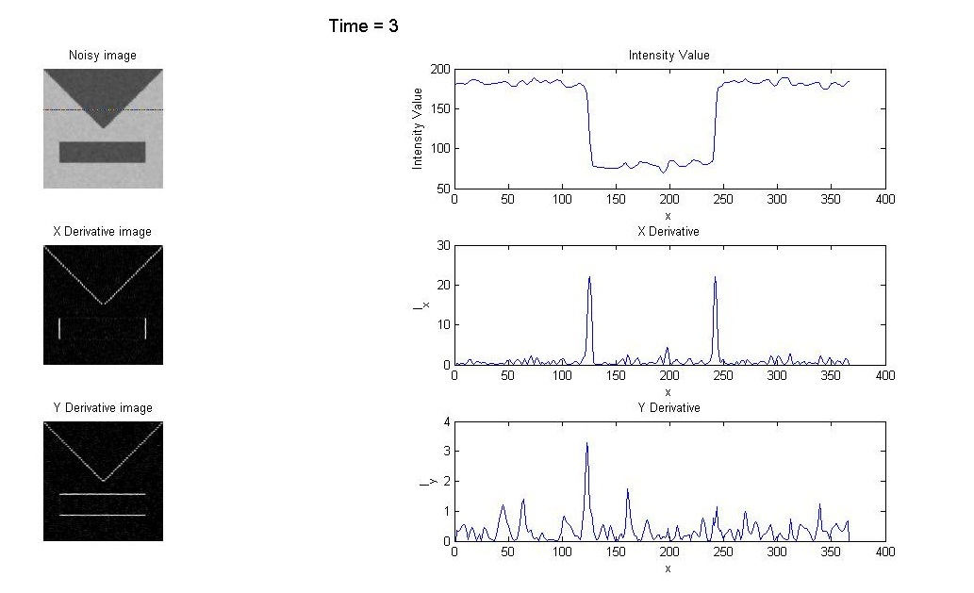
Adaptive Catte Result

Slide 59
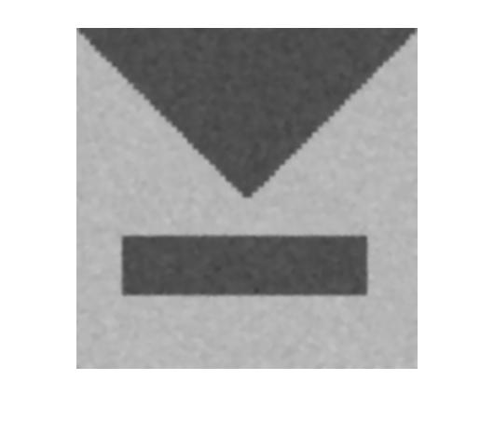
Adaptive Catte Result

Slide 60
Edge Enhancing Diffusion
This model is proposed by Wickert.
Anisotropic diffusion.
We want smoothening in the tangential direction and not in the normal direction.
Construct an orthonormal eigen vectors v₁ and v₂ of D such that v₁|| and v₂ ⊥ .
Choose the corresponding eigen values:

Slide 61
Edge Enhancing Diffusion
With eigen vectors:

Slide 62
Edge Enhancing Diffusion
EED diffusion tensor:
EED:

Slide 63
Diffusion Tensor

Slide 64
Numerical Scheme
The diffusion tensor D is assumed to be of the form:
In Cartesian co-ordinates:

Slide 65
Numerical Scheme

Slide 66
Numerical Scheme

Slide 67
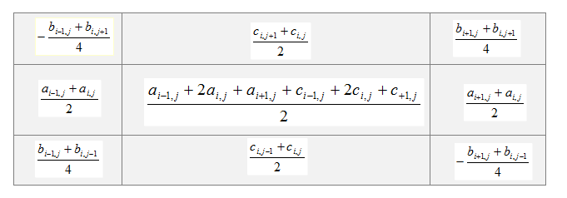
Numerical Scheme

Slide 68
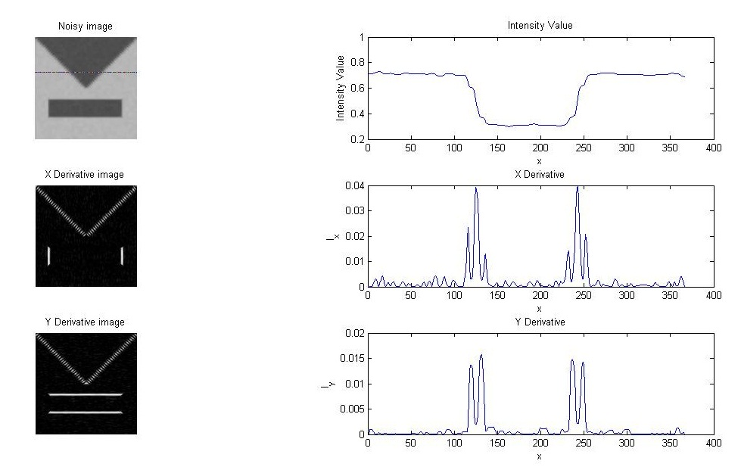
EED result

Slide 69
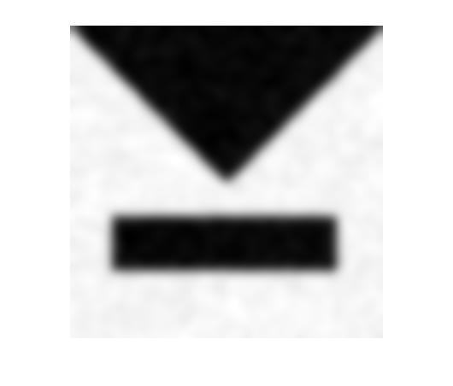
EED result

