Slide 1
Traffic Flow

Slide 2
Traffic engineering pertains to the analysis and behavior of the traffic and to design the operation for smooth, safe and economical operation of the traffic.

Slide 3
Flow
The flow is defined as the number of vehicles that pass a point on a highway or a given lane or direction of a highway during a specific time interval.
The measurement is carried out by counting the number of vehicles, n_{t ,} passing a particular point in a defined period t. The flow q expressed in vehicles/time is given by

Slide 4
Density
Density is defined as the number of vehicles occupying a given length of highway or lane and is generally expressed as vehicles per km.
One can photograph a length of road x, count the number of vehicles, n_{x,} in one lane of a road at that point of time and derive the density ρ as:

Slide 5
Time Headway
Time headway is defined as the time difference between any two successive vehicles when they cross a given point.
The reciprocal of flow gives the average time headway between vehicles at that point.
Time headway is often referred to as simply the headway.

Slide 6
Space Headway
Space headway is defined as the distance between corresponding points of two successive vehicles at any given time.
The reciprocal of density gives the space headway between vehicles at that time.
It is sometimes called as spacing.

Slide 7
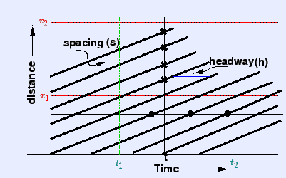
Time Space diagram for multiple vehicles

Slide 8
Modeling Approaches
Microscopic model
Models that continuously predict the state of the individual vehicles, like individual vehicle speeds and locations.
Macroscopic model:
These models aggregate the description of traffic flow. Macroscopic measures are speed, flow and density.
Mesoscopic model:
Models that have aspects of both macro and microscopic models.

Slide 9
Macroscopic traffic flow modeling
The traffic flow is conserved, or in other words vehicles are not created or destroyed. The continuity or conservation equation can be applied.
There is one to one relationship between speed and density.

Slide 10
Formulation:
From continuity equation:
Lighthill and Whitham adopted in their landmark study is to assume that the flow rate q is determined primarily by the local density ρ.

Slide 11
Flow – Density Curve:
When the density is zero, flow will also be zero, since there is no vehicles on the road.
When the number of vehicles gradually increases the density as well as flow increases.
When more and more vehicles are added, it reaches a situation where vehicles can’t move. This is referred to as the jam density or the maximum density. At jam density, flow will be zero because the vehicles are not moving.
There will be some density between zero density and jam density, when the flow is maximum.

Slide 12
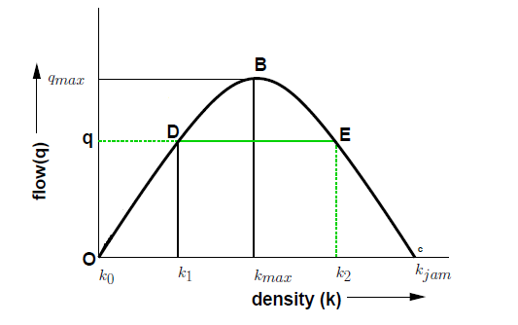
Flow – Density Curve
The relationship can be represented as:

Slide 13
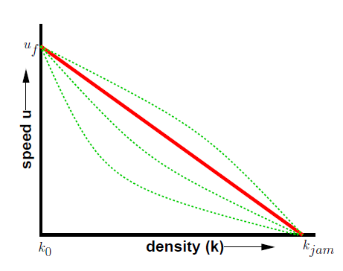
Speed – Density Relationship
Speed will be maximum when density is minimum and zero when density is maximum.

Slide 14
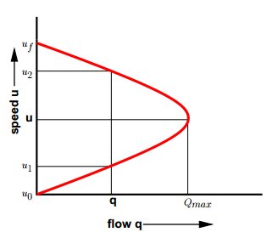
Speed – Flow Relationship
The flow is zero either because there is no vehicles or there are too many vehicles so that they cannot move.
At maximum flow, the speed will be in between zero and free flow speed

Slide 15
Modeling Speed – Density Relationship.
Macroscopic stream models represent how the behavior of one parameter of traffic flow changes with respect to another.
Most important among them is the relation between speed and density.

Slide 16
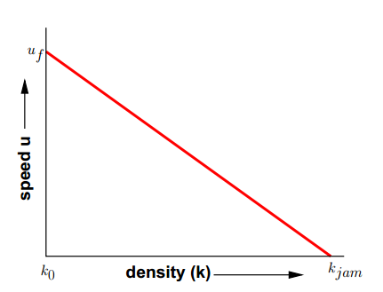
Greenshield’s linear stream model:
Drawback: Linear relationship of the model.

Slide 17
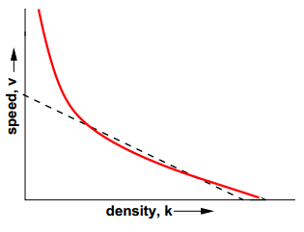
Greenberg’s logarithmic stream model:
Drawback of this model is that as density tends to zero, speed tends to infinity. This shows the inability of the model to predict the speeds at lower densities.

Slide 18
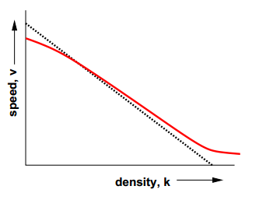
Underwood Exponential Model
Drawback of this model is that speed becomes zero only when density reaches infinity. Hence this cannot be used for predicting speeds at high densities.

Slide 19
Pipe’s Generalized Model
n = 1: Greenshield model

Slide 20
General Motor’s Car Following model
The research team of General Motor’s develop the model which took the form
The response is represented by the acceleration (or de-acceleration) of the following vehicle while the stimuli is represented by the relative velocity of the lead and following vehicle.

Slide 21
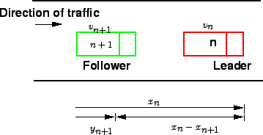
Assuming K_{p} (sensitivity parameter) to be constant, above equation leads to:
Assuming all cars are of the same length (L) :

Slide 22
Let N_{R} be the number of cars in the stretch of length L_{R} ,i.e.:
Density (ρ) is macro:
Converting the unit according to traffic engineers:

Slide 23
Steady flow
Assume traffic is steady:
C_{n+1} is same for any adjacent cars.

Slide 24
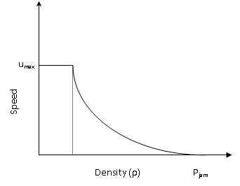
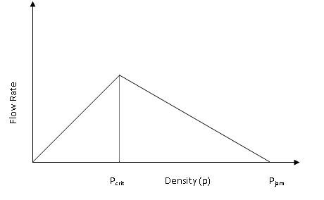

Slide 25
Scalar Conservation Law
Initial Condition:

Slide 26
Method of Characteristics:
Characteristic Equations:

Slide 27
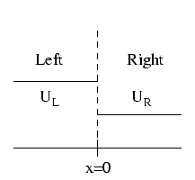
Riemann Problem

Slide 28
Rankine–Hugoniot conditions
C: speed of the shock.

Slide 29
Entropy Condition
A shock situation arises in a system where its characteristics intersect.
Under these conditions a requirement for a unique single-valued solution is that the solution should satisfy the admissibility condition or entropy condition.

Slide 30
Numerical Approximation of Scalar Conservation Laws
Consider the following linear scalar conservation law:
The simplest of approximations to the solution at these grid points is the finite difference approximation i.e., to replace partial derivatives by difference quotients by using Taylor’s Series Expansion.

Slide 31

Central Difference Scheme:
Explicit Scheme:
Order: O(∆t,h²)
Amplification factor:
Stability: Unconditionally unstable.
Consistency: Consistent.

Slide 32
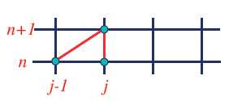
Upwind Scheme
Explicit Formulation:
Order: O(∆t, h)
Amplification factor:
Stability: Conditionally stable. λ≤1
Consistency: Consistent.

Slide 33
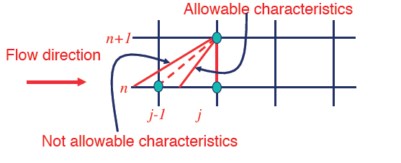
CFL Condition
The CFL condition implies that signal has to travel less than one grid spacing in one time step.

Slide 34

Lax – Friedrich’s Scheme
Explicit Formulation:
Order: O(∆t, h)
Amplification factor (A):
Stability: Conditionally stable. λ≤1
Consistency: Conditionally consistent

Slide 35
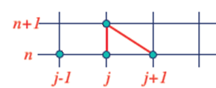
Downwind Scheme
Explicit Formulation:
Order: O(∆t, h)
Amplification Factor:
Stability: Unconditionally unstable.
Consistency: Consistent.

Slide 36
Conservative and Non-Conservative form
Conservative form
Flux in = Flux out
Flux in = (uΦ)_{i-1}
Flux out = (uΦ)_{i}
Non-Conservative form
Flux in ≠ Flux out.
Flux in = u_{i} (Φ)_{i-1}
Flux out = u_{i} (Φ)_{i}

Slide 37
Shock Solution
Conservative schemes are guaranteed to give the correct Shock Speed since they correspond to a direct application of conservation principles.
Non- conservative schemes may or may not do so.

