Slide 1
WIPRO NGA Program – MERN – FY27 – C1
Capstone Project Presentation - 12th June 2026
Project Title Here – Music Library
Presented by – Sunil Kumar
Under the guidance of Amisha Gupta

Slide 2
INTRODUCTION
Introduce the application as a capstone project showcasing full-stack programming skills. Highlight the dual roles of Admin and User, their respective features, and the sprint-based development plan. Emphasize how the project integrates backend, frontend, and security to deliver a responsive and scalable music management system.

Slide 3
PROBLEM STATEMENT
Existing music platforms mainly focus on song streaming.
Managing playlists and organizing songs can be difficult.
Users need quick search by artist, album, and music director.
Admin control for song visibility and notifications is limited.
A secure platform is needed with playlist management and role-based access.

Slide 4
PROJECT OBJECTIVE
Develop a secure music library application with JWT-based authentication and role-based access.
Enable users to search songs by name, artist, album, and music director.
Provide playlist creation, management, and song organization features.
Allow admins to manage songs, control visibility, and send notifications.
Build a scalable, responsive, and user-friendly platform using modern full-stack technologies.

Slide 5
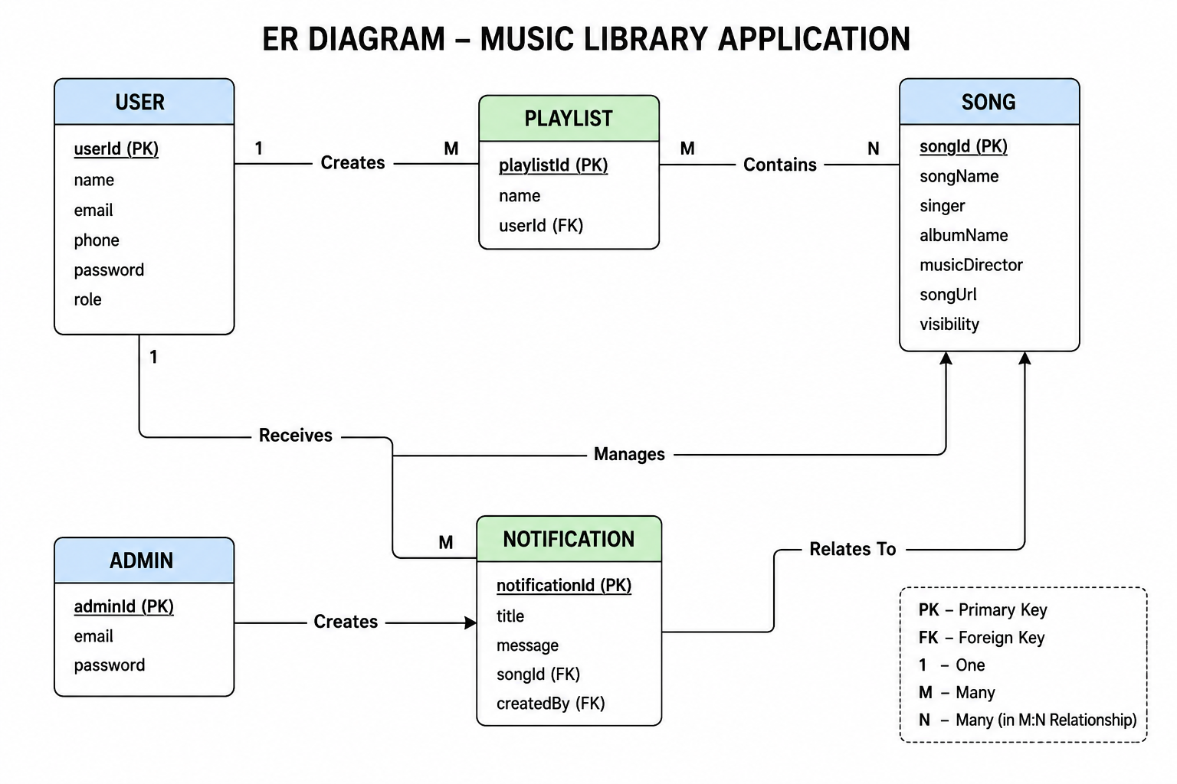
ER DIAGRAM

Slide 6
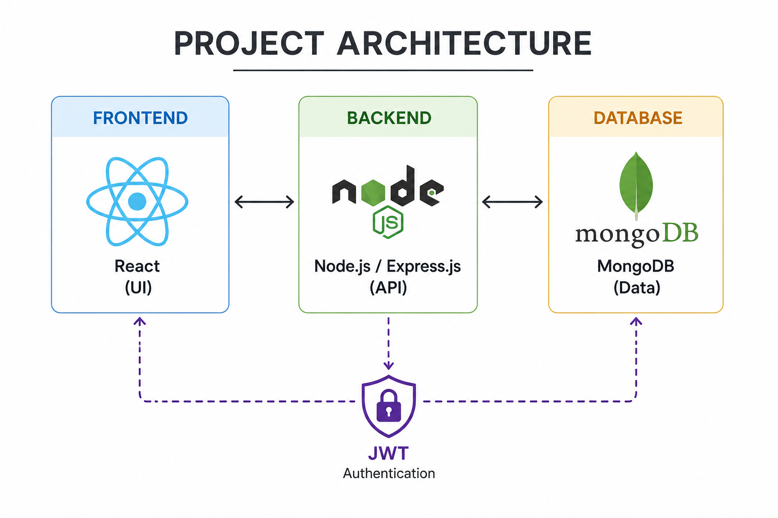
PROJECT ARCHITECTURE

Slide 7
TECH STACK
React.js builds the interactive user interface.
Node.js & Express.js handle backend logic and APIs.
MongoDB stores users, songs, and playlists.
JWT provides secure authentication and role-based access.
Jest & Cypress ensure application reliability through testing.

Slide 8
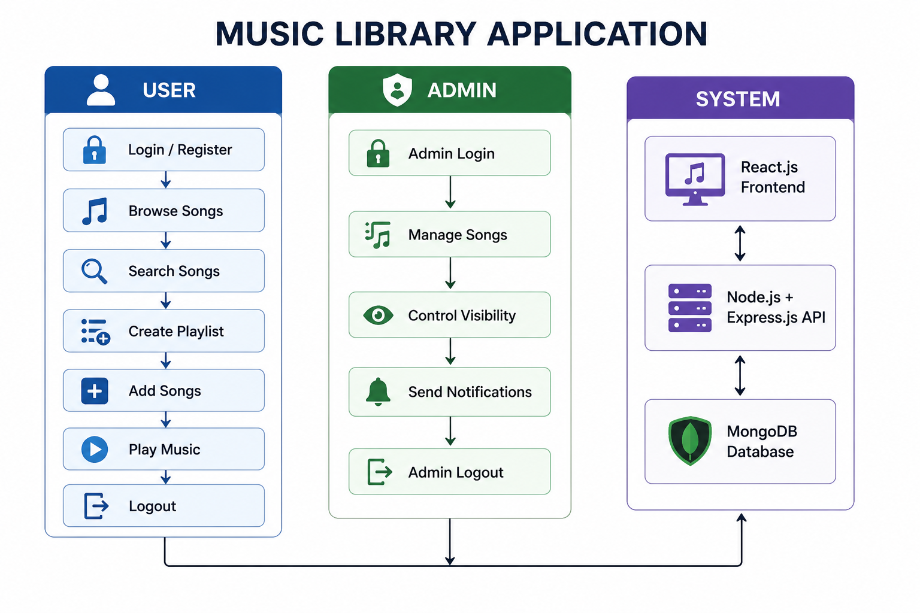
FLOW DIAGRAM

Slide 9
USER STORIES
Users can register, log in, and securely access the application.
Browse and search songs by name, artist, album, or music director.
Create, update, delete, and manage multiple playlists.
Add songs to playlists and use play, repeat, stop, and shuffle features.
Admins can manage songs, control song visibility, and send notifications about newly added songs.

Slide 10
ADMIN STORIES
Admin can securely log in and access the dashboard.
Perform CRUD operations on songs in the library.
Control song visibility for users.
Send notifications when new songs are added.
Manage content efficiently to maintain a better user experience and platform quality.

Slide 11
SPRINT PLAN
Sprint I: Designed database schema and implemented User/Admin authentication.
Sprint II: Developed search functionality, playlist management, and song CRUD operations.
Sprint III: Added JWT security, notifications, and frontend-backend integration.
Improved responsiveness, testing, and overall application performance.

Slide 12
TESTING & SECURITY
Conducted unit testing using Jest and React Testing Library.
Performed end-to-end testing with Cypress.
Implemented secure JWT-based authentication.
Applied role-based access control for Users and Admins.
Ensured application reliability, security, and protected routes.

Slide 13
CONCLUSION & FUTURE SCOPE
Successfully developed a full-stack Music Library Application using the MERN stack.
Implemented secure authentication, song management, search functionality, and playlist CRUD operations.
Enabled role-based access for Users and Admins.
Future enhancements include AI-based recommendations, cloud deployment, and social playlist sharing.

Slide 14


