Slide 1


2nd Stage Evaluation
Prototype Title: Sensing Of Stress On Flyovers & Give A Warning If The Situation Turns (Stress Limits) Abnormal
Theme: Other Emerging area Innovation for Start-up
URL:https://drive.google.com/file/d/1FD6slgsbA29UpIw5oWL91XCd5vUkvlFF/view?usp=sharing
Team Lead Name (Student): Gourab Banerjee
Team Members: Sayak Mandal, Anandan Basu, Kumar Suryamauli Shah, Nand Kumar Nitesh
IIC Institute Name: Indian Institute of Engineering Science& Technology, Shibpur
Mentors Name: Dr. Lilly Raamesh

Slide 2
PROBLEM STATEMENT
Overloading of bridge or flyover has always been a problem of human civilisation. For the past few years, we have seen the rate of such accidents per year has increased in our country. The major reasons are-
Incorrect load estimation and sometimes error in design.
Improper maintenance
Frequent accidents are occurring since the status of the bridge can’t be understood instantly.

Slide 3
OBJECTIVE
The Double Diamond approach has been adopted to address the problem and find out the solution. The main objective of our innovation is-
To find out the stress on the flyover or bridge continuously,
To check if the stress is under safe limit &
To generate an alarm signal, when the flyover/bridge is overloaded.

Slide 4
BASIC IDEA OF THE SYSTEM
The system needs to fetch data from the field on a constant basis, process them in as fast as possible and smooth decision making. Therefore the solution will have certain parts-
Pressure Transducer
Data Acquisition System
Computational Unit
Actuating Components

Slide 5
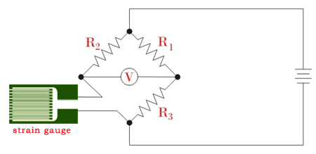
PRESSURE TRANSDUCER
Firstly, the bridge/flyover will be divided into certain parts depending upon its length. For each section, a strain gauge will be mounted each at the entry and exit point of that section. These transducers will continuously measure the moving loads on them and convert them into proportional analog voltage.

Slide 6
DATA ACQUISITION SYSTEM
This portion of the circuit consists of several data processing equipments-
Anti-aliasing Filter
Sample & Hold Circuit
Multiplexer
A-D Converter
In these stages, the analog voltage will be processed through many stages to remove noise and they will be discretized to feed in a controller.

Slide 7
COMPUTATIONAL UNIT
This part can be a micro-controller, can be a micro-computer or a processor with an interface. Its main job is-
Calculate the stress on each section of the bridge.
Compare the values with preset reference values. (The reference values correspond to critical stress of each section)
If, for any section, the current value exceeds the reference value, the controller will generate a low-to-high transition.

Slide 8
ACTUATING COMPONENTS
The output of the controller is fed to a transistorized relay & buffer circuit, which is connected to the supply terminals of an alarm circuit.
When the output of the controller is high, it will activate the relay and energise the coil of the alarm circuit, thereby causing the alarm to blow.

Slide 9
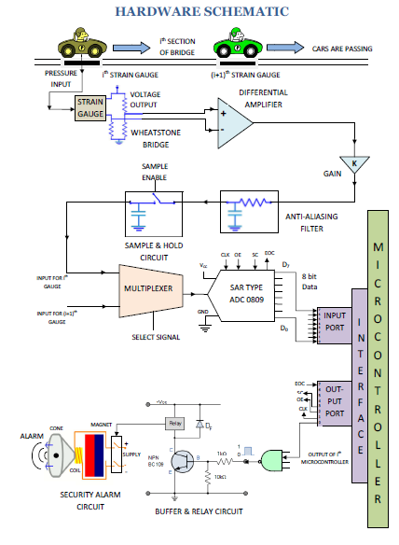

Slide 10
CONTROL OPERATION STEPS
Data collected by Strain Gauge & converted to voltage.
Signal Conditioning & A-D conversion of the data.
Compare the values for each section with the corresponding reference values.
Generate a low-to-high transition in output, if at least one of the data exceeds its corresponding limit.
The alarm circuit is excited with the low-to high transition of the controller output.

Slide 11
VALUE ADDITION
From the analysis of Product Innovation Hypothesis, following benefits of the product can be pointed out-
The proposed system increases safety for human being and vehicles.
It can also estimate the health of a bridge over a long period.
With constant monitoring, the system will ensure reduction of bridge collapse; thereby it will reduce the maintenance cost too.
It can give us a dataset on total number of vehicles in a particular route on hourly, daily and weekly basis.

Slide 12
COST ESTIMATE
First of all, this is a value-driven product. From the analysis of Business Model Canvas, the estimate will be as follows-
For Strain Gauge, ADC & the controller will be 500/- each, other components can be gotten under 1000/-, so for the total setup the cost is 2500. Now if the bridge requires 10 similar setups, it will require 25000/-. This may vary depending upon the length, since the number of system will be different then.
There might be some small variable cost too initially, mainly because of testing etc. purpose.

Slide 13
PROS & CONS
PROS
CONS
Stress values can be accurately measured by the transducer.
Data acquisition system can provide fast response.
Can be capable of dealing with values in long range.
Durability of the transducer is an issue.
Complex internal circuit, hence to find out any system error will be difficult.
Can arise certain difficulties in complex bridge configurations.

Slide 14
FUTURE IMPLICATIONS
One of the attractive and popular implication may be use of Internet of Things. The advantage will be lesser number of components and cost. Also, the operation will be easier. But in remote areas, use of IoT may not be very useful because of the network issue.

Slide 15
ACKNOWLEDGEMENT
Firstly, we would like to thank MHRD for organizing this contest, which gave us the opportunity to innovate and present our idea.
We would like to acknowledge our mentor Dr. Lilly Raamesh for her constant guidance and help.
We would also like to acknowledge our Professors’ support that helped us to think in a more innovative approach.

Slide 16
THANK YOU

