Slide 1

SCHOOL OF COMPUTER SCIENCE AND ENGINEERING
Internship Report
Junior ReactJS Developer at YuvaIntern
IILM University, Greater Noida, U.P. | In partial fulfilment of the requirement of the degree of B.Tech CSE
SUBMITTED BY
ROLL NUMBER
PROGRAMME
BATCH
Kumar Swatantra
2410030882
B.Tech CSE
2026–27

Slide 2
PRELIMINARY
Candidate's Declaration & Acknowledgement
Candidate's Declaration
Acknowledgement
I, Kumar Swatantra, declare that this internship report, “Internship as Junior ReactJS Developer at YuvaIntern,” has been completed by me for the award of the degree of Bachelor of Technology in CSE. All references have been duly acknowledged, and the report has not been submitted elsewhere for any other degree or diploma.
I take this opportunity to express my gratitude to everyone who supported me throughout the internship programme. I am thankful for their guidance, constructive feedback, and encouragement, which shaped this report and the work behind it. I also thank my parents for their continued blessings and support.
Kumar Swatantra | Roll No. 2410030882
Kumar Swatantra | Roll No. 2410030882
Kumar Swatantra • 2410030882 • IILM University, Greater Noida
2

Slide 3
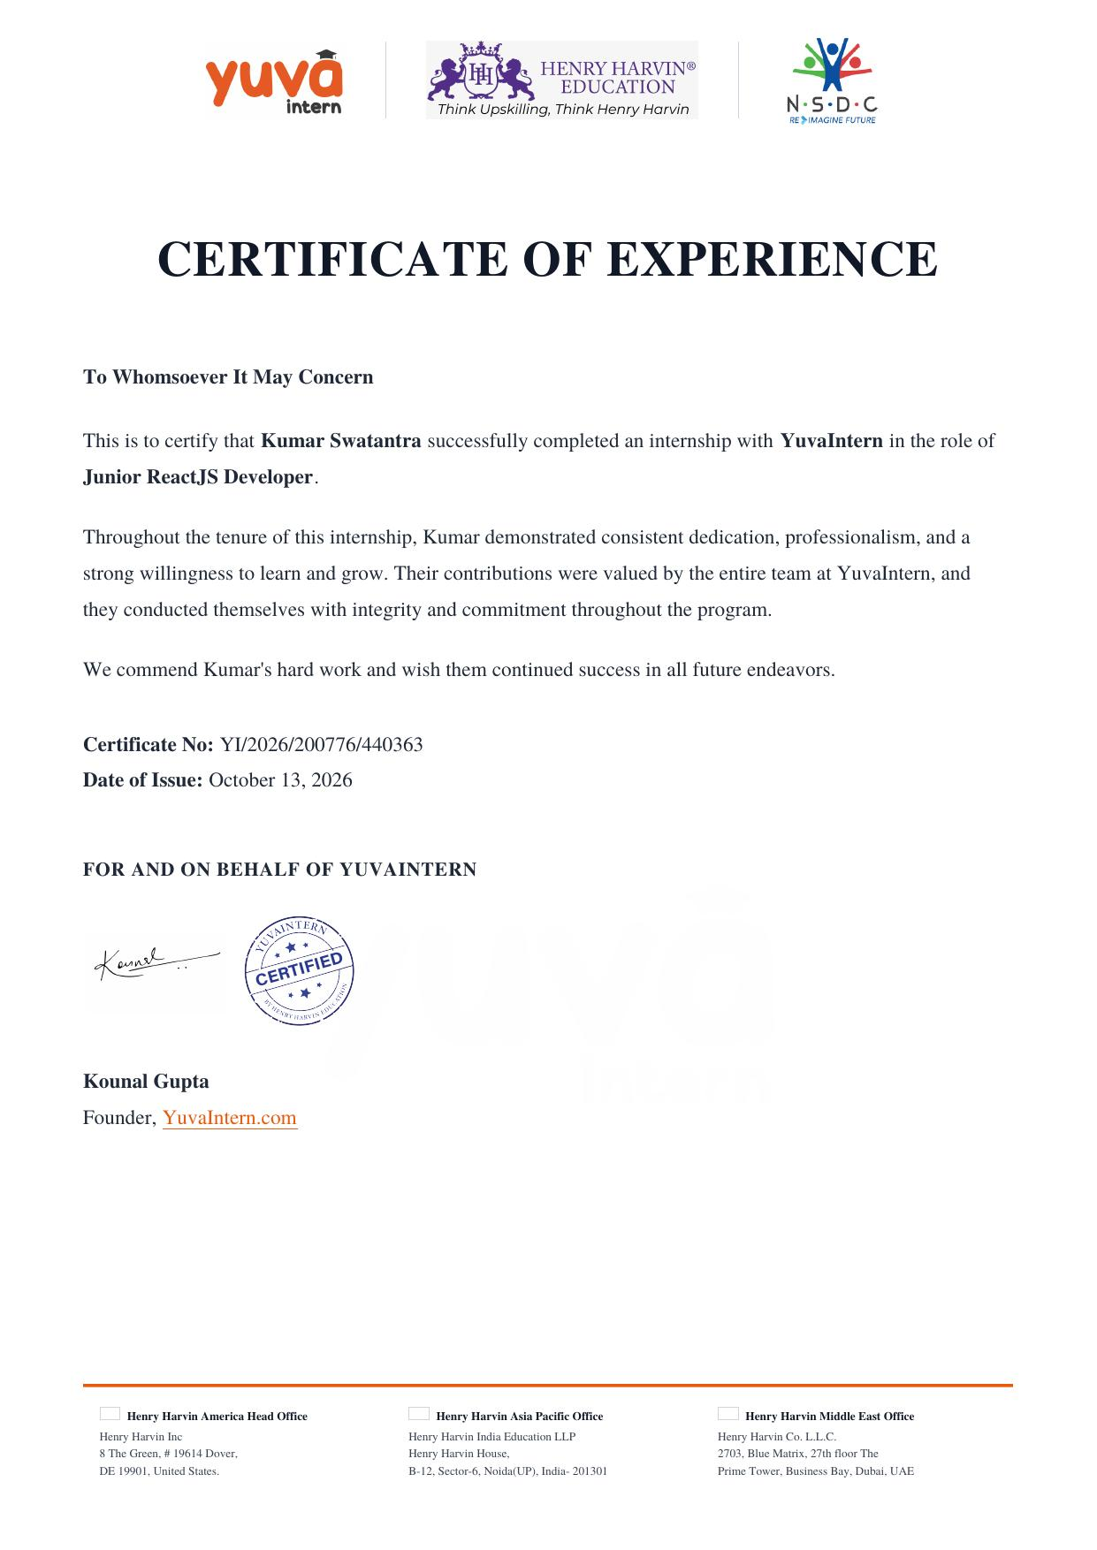
CHAPTER 3
Internship Completion Certificate
Certificate No. YI/2026/200776/440363 confirms successful completion of the internship in the role of Junior ReactJS Developer.
ORGANIZATION
YuvaIntern
ROLE
Junior ReactJS Developer
CERTIFICATE NO.
YI/2026/200776/440363
DATE OF ISSUE
October 13, 2026
ISSUED BY
Kounal Gupta, Founder — YuvaIntern.com
Kumar Swatantra • 2410030882 • IILM University, Greater Noida
3

Slide 4
SECTION 4.1 – 4.2
Introduction & Organization Profile
4.1 Introduction
This report presents the internship undertaken as a Junior ReactJS Developer at YuvaIntern during the 2026–27 academic year. The internship focused on building and enhancing user-facing web features using ReactJS, giving hands-on exposure to real-world front-end development practices alongside academic learning at IILM University.
4.2 Organization Profile
YuvaIntern
YuvaIntern is an internship platform that places students in skill-based virtual internships, run in association with Henry Harvin Education and aligned with the National Skill Development Corporation (NSDC). The internship was completed within the platform's web development track.
Role:
Junior ReactJS Developer
Organization:
YuvaIntern
Domain:
Web / Front-End Development
PLACEMENT
Duration:
Academic Year 2026–27
Web Development track
CERTIFICATION PARTNER
Henry Harvin Education
SKILLS ALIGNMENT
NSDC
Kumar Swatantra • 2410030882 • IILM University, Greater Noida
4

Slide 5
SECTION 4.3 – 4.5
Problem Statement, Objectives & Scope
1
2
3
4.3
4.4 – 4.5
APPROACH
Problem Statement
Objectives & Scope
Guiding Principles
Manual, repetitive front-end tasks slowed feature delivery for the product team.
Needed reusable, component-based UI that could scale across the application.
Build and enhance user-facing features with ReactJS.
Apply component-based design and state management.
Work within the assigned web application module, following existing design and code standards.
Write clean, maintainable, reusable code.
Collaborate using version control (Git/GitHub).
Test and refine features against feedback before merging.
Kumar Swatantra • 2410030882 • IILM University, Greater Noida
5

Slide 6
SECTION 4.6 – 4.8
Technologies, Tools & Methodology
4.6 Technologies & Tools Used
4.8 Methodology
1
Plan
Requirements reviewed and broken into short, sprint-style tasks.
ReactJS
JavaScript (ES6+)
2
Build
Features developed iteratively with reusable React components.
HTML5 / CSS3
Git & GitHub
3
Version & Review
Code tracked via Git/GitHub; changes reviewed before merging.
4
Refine
Features tested and refined based on feedback (Agile approach).
Kumar Swatantra • 2410030882 • IILM University, Greater Noida
6

Slide 7
SECTION 4.9
Expected Outcomes
1
2
Practical React Proficiency
Industry Workflow Exposure
Stronger hands-on command of ReactJS, component design, and state handling.
First-hand experience with Git-based collaboration and iterative delivery.
3
4
Applied Problem-Solving
Career Readiness
Ability to translate requirements into working, maintainable UI features.
A stronger foundation for future front-end development roles.
Kumar Swatantra • 2410030882 • IILM University, Greater Noida
7

Slide 8
CONCLUSION
A strong first step into front-end engineering
The internship as a Junior ReactJS Developer at YuvaIntern gave practical, project-based exposure to modern front-end development — complementing the academic foundation built at IILM University’s School of Computer Science and Engineering.
Thank You
Kumar Swatantra | Roll No. 2410030882 | B.Tech CSE, Batch 2026–27

