Slide 1
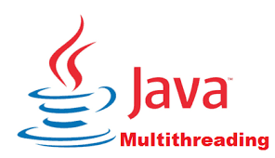
Multithreading in Java

Slide 2
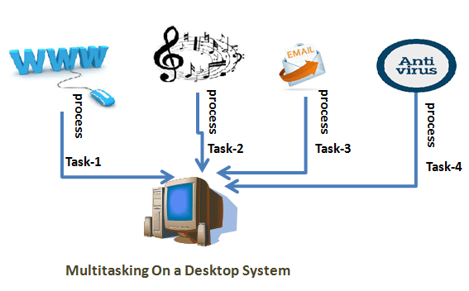
Multithreading in java is a process of executing two or more threads simultaneously to maximum utilization of CPU.
Multithreaded applications are where two or more threads run concurrently; hence it is also known as Concurrency in Java.
This multitasking is done, when multiple processes share common resources like CPU, memory, etc.
Each thread runs parallel to each other.
Threads don't allocate separate memory area
Hence it saves memory. Also, context switching between threads
takes less time.

Slide 3
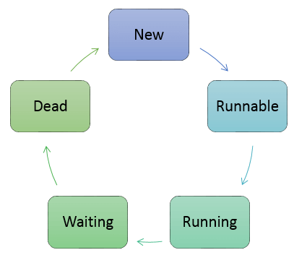
Thread Life Cycle in Java
There are various stages of life cycle of thread as shown in above diagram:
New
Runnable
Running
Waiting
Dead

Slide 4
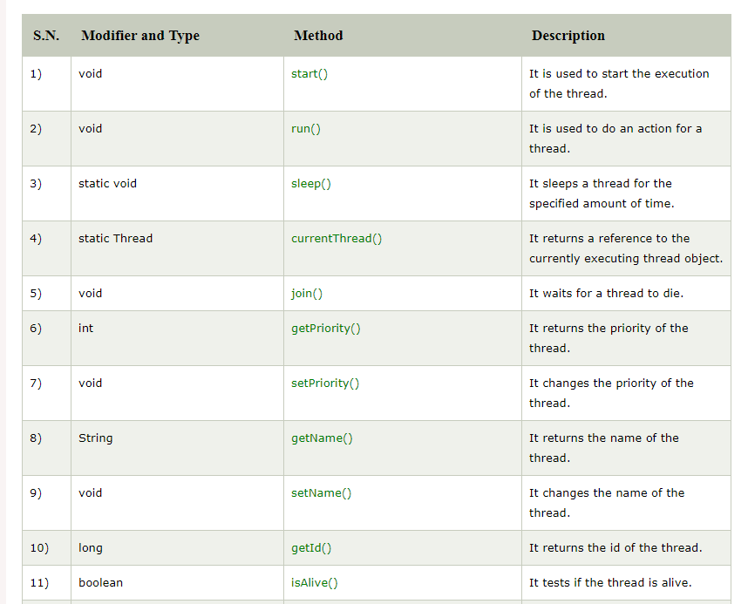
Java Thread Methods

Slide 5
Advantages of Java Multithreading
It doesn't block the user because threads are independent and you can perform multiple operations at the same time.
You can perform many operations together, so it saves time.
Threads are independent, so it doesn't affect other threads if an exception occurs in a single thread.

