Slide 1
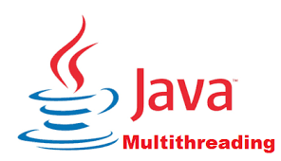
Multithreading in Java

Slide 2
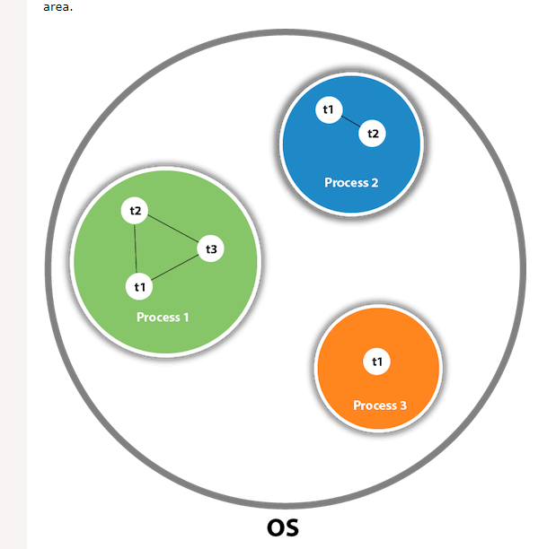
Multithreading in java →A thread is a lightweight sub-process, the smallest unit of processing. Multiprocessing and multithreading, both are used to achieve multitasking.
Multitasking is a process of executing multiple tasks simultaneously. We use multitasking to utilize the CPU. Multitasking can be achieved in two ways:
Process-based Multitasking (Multiprocessing)
Thread-based Multitasking (Multithreading)

Slide 3
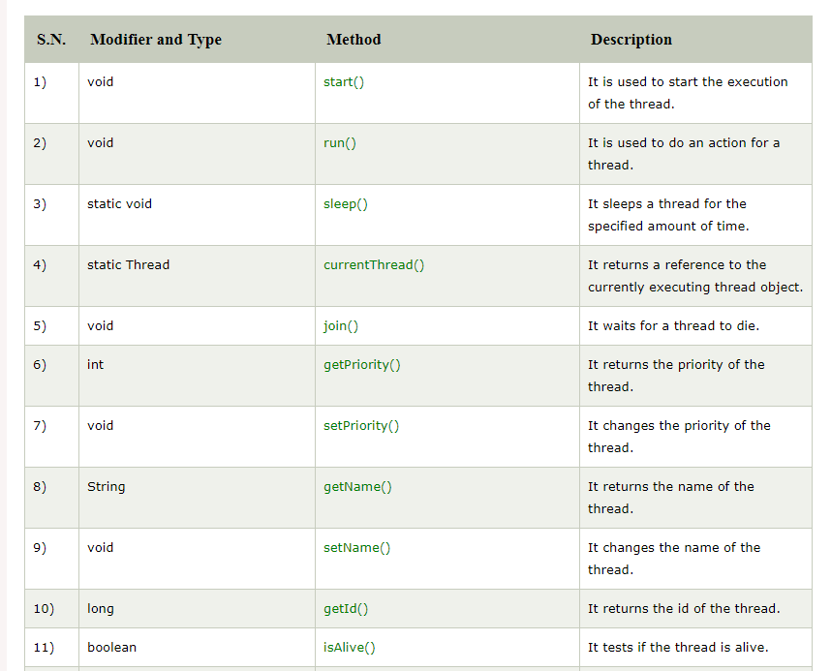
Java Thread Methods

Slide 4
Advantages of Java Multithreading
It doesn't block the user because threads are independent and you can perform multiple operations at the same time.
You can perform many operations together, so it saves time.
Threads are independent, so it doesn't affect other threads if an exception occurs in a single thread.

