Slide 1
INVESTMENT ASSIGNMENT SUBMISSION
Name: KUMARAGURU MUTHURAJ

Slide 2
Abstract of the analysis
Spark Funds CEO will be enabled with the right set of data, based on data analytics, done out of investment data across the globe to help her arrive at a conclusion on list of prospective companies to invest, based on the following factors:
Investment type – Venture, Angel, Seed or Private Equity, for investment range of USD5M to 15M.
Sectors that are most sought by global investors.
Top 3 English speaking countries for ease of communication.
The analysis is done with 95000 investments done across the globe in different countries.

Slide 3
How did I solve?
Data from crunchbase.com – Companies, Investments done in companies and Company category mapping data.
Decide the Type of
Investment. Check this from different perspectives – Quantile ranges.
Understand the domain of investment and types of investment
Understand the data and the relationships between CSV files
Clean data and make sense out of it. Apply practices from CRISP
Merge the companies with sectors
Use Pandas, Seaborn, matplotlib for all slicing-dicing, mathematical-statistical analysis and plotting
Wherever possible use Excel to validate the programmatic decisions.
Figures are in the order of millions and billions. Format them for good readability and brain friendliness.

Slide 4
Critical Analysis – Cleaning data
The final decisions are made out of number of investments made. Eliminating perceived bad data has to be done with care.
Only data that is bad and impacts the decisions are removed like NaN values in investment amounts.
Blank values in categories are to be retained as such and mapped to BLANKs main_sector.
Fixing the category name spelling errors was mandatory for a smooth merging of data.
Getting a list of English speaking countries and cleaning them was important as we might miss a few that are listed on top.

Slide 5
Critical Analysis – Identifying investment type
Representative amount for each of the 4 funding types ['ANGEL', 'SEED', 'VENTURE', 'PRIVATE_EQUITY'] - Records with NaN values investment amounts are removed. Median is the most representative amount for a population of numeric values. The median along with the boxplots are calculated and displayed for each of the following range of Quantiles.
100% data is considered without removing outliers. [400K, 275K, 5M, 20M]
Data between 0 to 95th percentile. [368K, 250K, 4.75M, 18M]
Data between 5 to 95th percentile. [400K, 280K, 5M, 20M]
Data between 25 to 75th percentile. [439K, 300K, 5M, 20M]
The result is that the Median for the 4 cases don't change drastically. The data clearly indicates that the only investment type that falls close/under 5M to 15M is VENTURE. We choose to move with this type.
Because, the decisions are based out of investment counts, removing outliers is NOT a good idea, for the reason that they will adversely impact the sector that we arrive at. Outliers for the type VENTURE is not removed for processing further.

Slide 6
Critical Analysis – Choice of programming constructs
Pandas is extensively used to work through this analytics assignment.
Dataframes are completely sliced-diced with Pandas, Pivot-tables extensively. Seaborn and Matplotlib are used for display.
Usage of built-in functions are done in most of the places for performance.
Formatting the dollar amounts are done to give a more realistic, brain-friendly display that is easy to understand.
This entire analysis fits in to the case of Segmented Univariate Quantitative analysis, where investment amount was analysed from different sectors, countries and investment types.

Slide 7
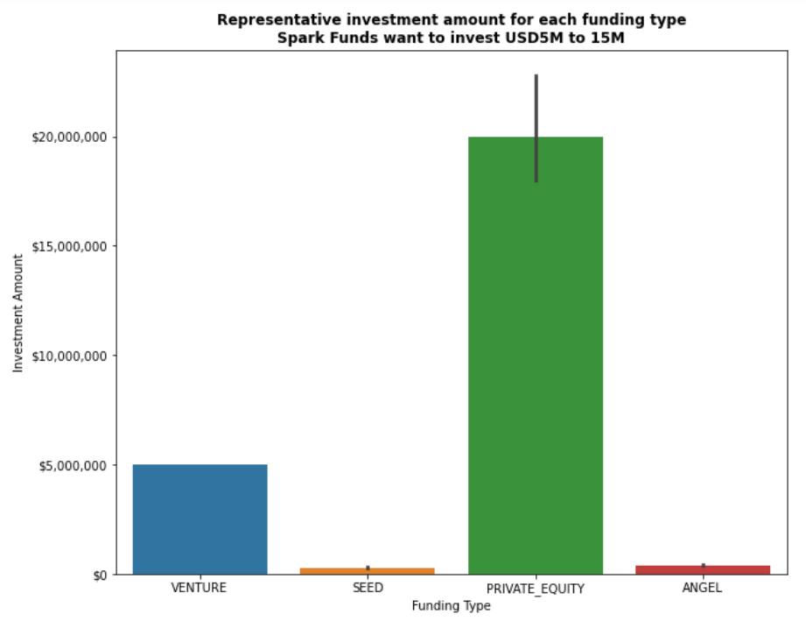
Venture capital type funding is best suited

Slide 8
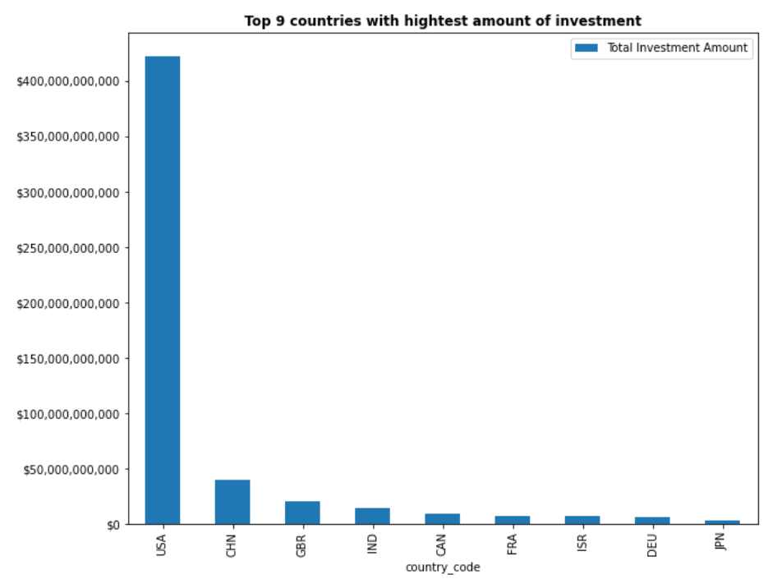
Top 9 countries where investments are heavily made

Slide 9
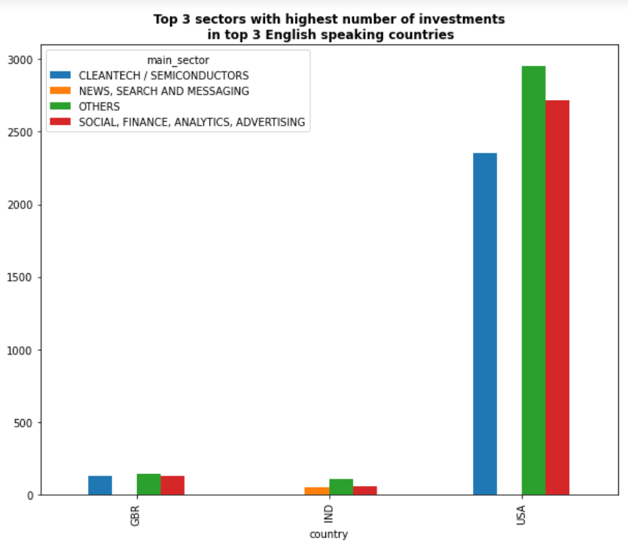
Top 3 sectors in top 3 English speaking countries. USA is most sought and Britain – India trail by multi-fold times

Slide 10
Conclusions
The top countries to choose from for Spark funds to invest are USA, Great Britain and India.
The investment type is Venture, because this is the type that falls between 5M to 15M out of the pattern seen in the investment data.
The top 9 countries where investments were made actively are USA, China, Great Britain, India, Canada, France, Israel, Germany and Japan. Of these, the top 3 English speaking countries to go after are USA, Great Britain and India.
The top sectors in these 3 countries are cleantech - semiconductors, news search – messaging, social-finance-analytics-advertising and others.

