Slide 1
DIGITAL PORTFOLIO
Student Name : M.Kumaraguru
Register no & NMID : asanm20124132010500121059
Department : BCA (Bachelor of Computer Application)
College : Arignar Anna Govt Arts College, Villupuram / ANNAMALAI UNIVERSITY

Slide 2
PROJECT TITLE
My Journey as a Student:
A Portfolio of Learning
and Growth

Slide 3
AGENDA
PROBLEM STATEMENT
PROJECT OVERVIEW
END USERS
TOOLS AND TECHNOLOGIES
PORTFOLIO DESIGN AND LAYOUT
FEATURES AND FUNCTIONALITY
RESULTS AND SCREENSHOTS
CONCLUSION
GITHUB LINK

Slide 4
PROBLEM STATEMENT
Every project starts with a problem. In our case, the problem is that many beginners in web development do not have a simple, structured portfolio to showcase their skills. Without an online presence, it becomes difficult for them to stand out in job interviews or internships. Our project addresses this gap by creating a user-friendly, customizable portfolio website.

Slide 5
PROJECT OVERVIEW
Our project is a responsive portfolio website built using HTML, CSS, and JavaScript. The main objective is to provide a platform where an individual can highlight their education, skills, projects, and achievements. The portfolio is designed to be clean, modern, and easy to navigate.

Slide 6
END USERS
The primary end users of our portfolio project are students, job seekers, and professionals who want to showcase their skills. Recruiters and hiring managers are the secondary end users who can quickly view the candidate’s profile and achievements through the portfolio.

Slide 7
TOOLS AND TECHNOLOGIES
For developing this portfolio, we used HTML for structure, CSS for styling, and JavaScript for interactivity. We designed and tested the project using Visual Studio Code. For version control and project hosting, we used Git and GitHub. These technologies ensured that the project was lightweight, efficient, and accessible.

Slide 8
PORTFOLIO DESIGN AND LAYOUT
The portfolio design follows a clean and structured layout with simple navigation, making it easy for visitors to explore sections like About, Education, Skills, and Projects. The hero section introduces the creator clearly, while each segment is organized in a straightforward manner that highlights key information without clutter. Overall, the design is minimalist, user-friendly, and leaves room for future growth.

Slide 9
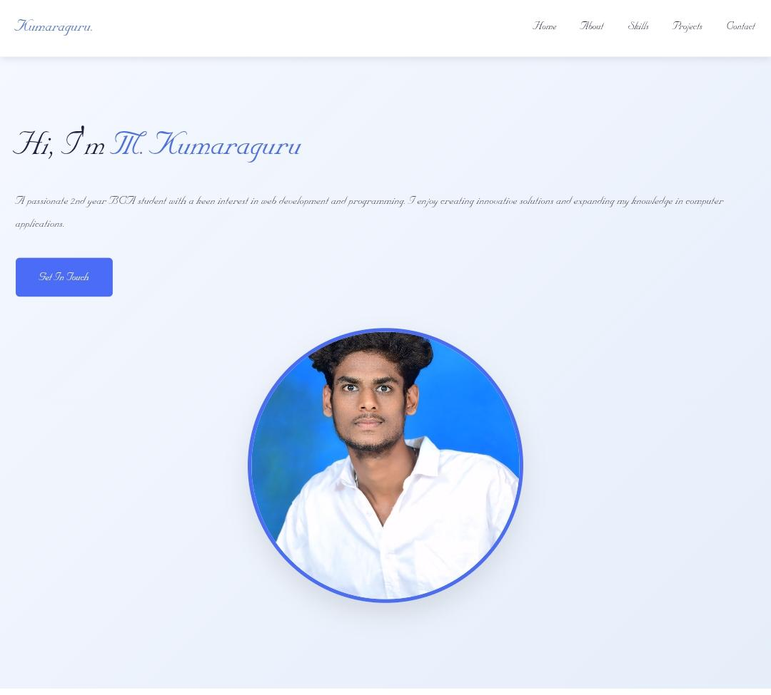
RESULT’S AND SCREENSHOT

Slide 10
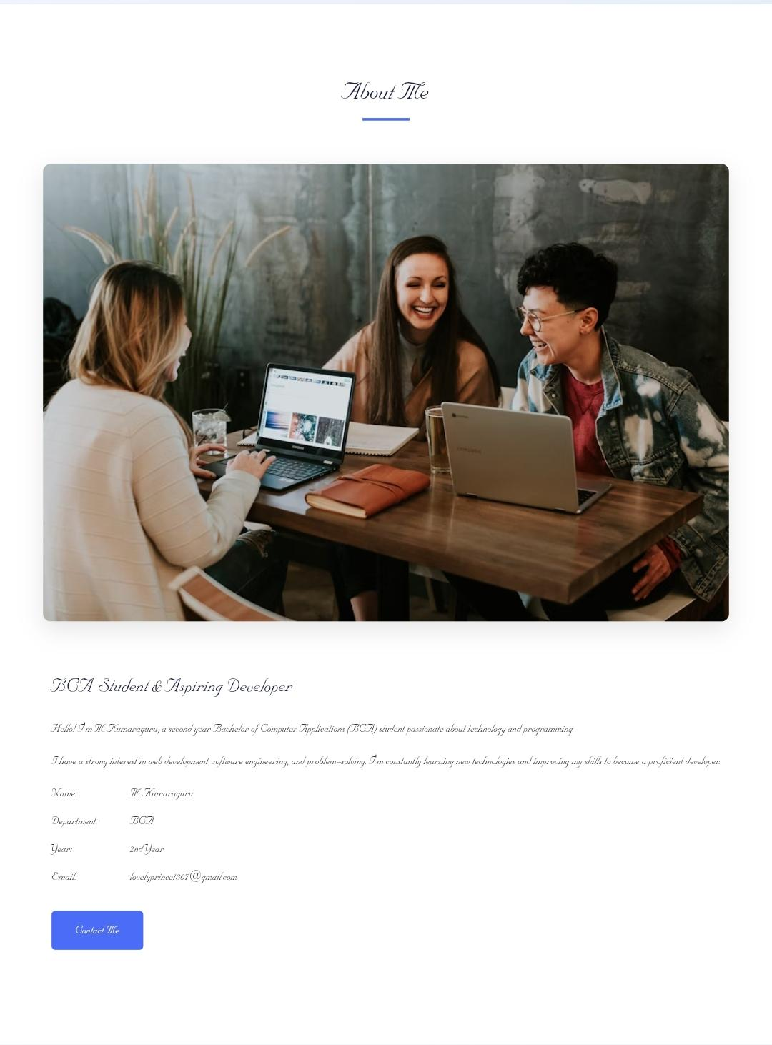
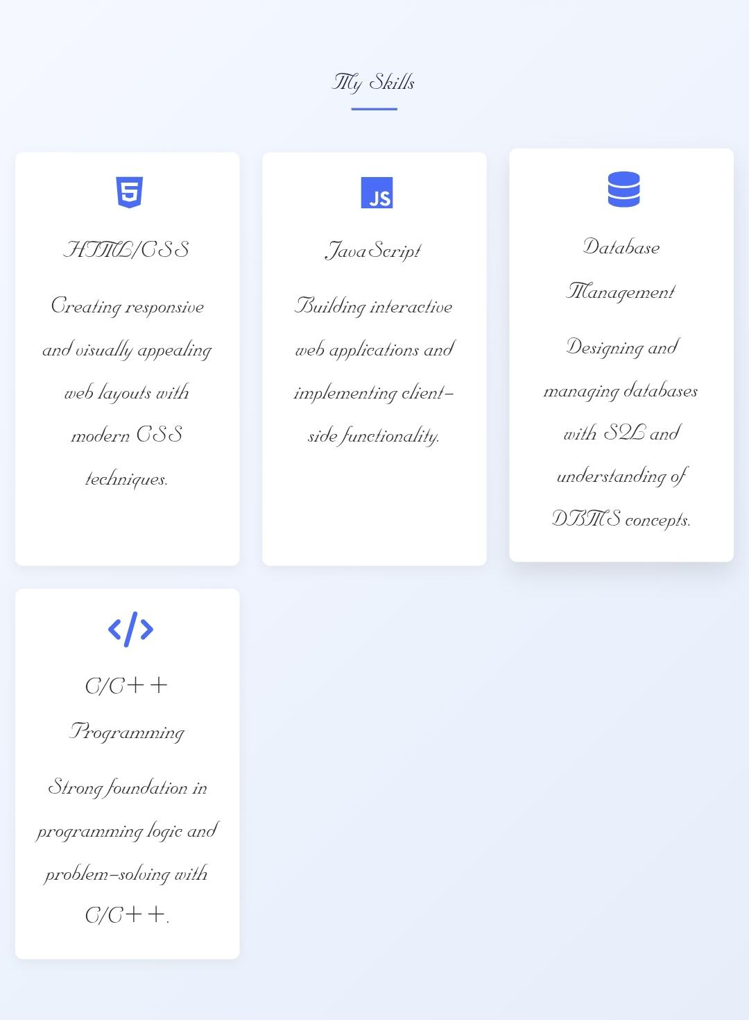

Slide 11
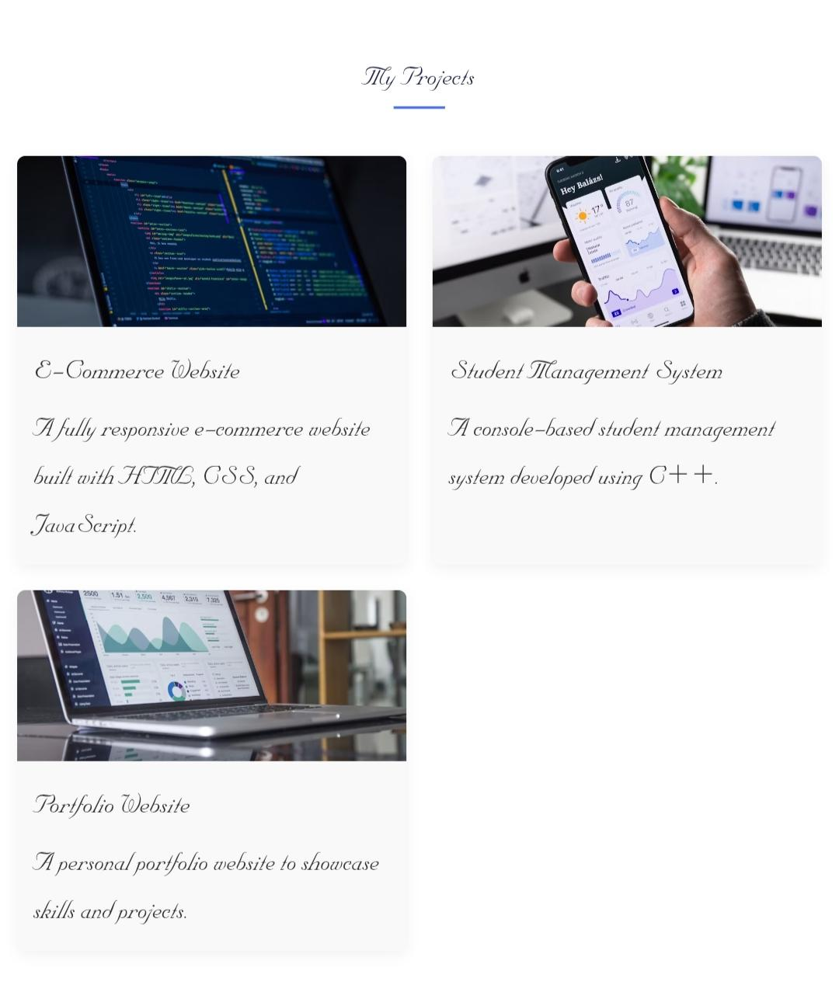
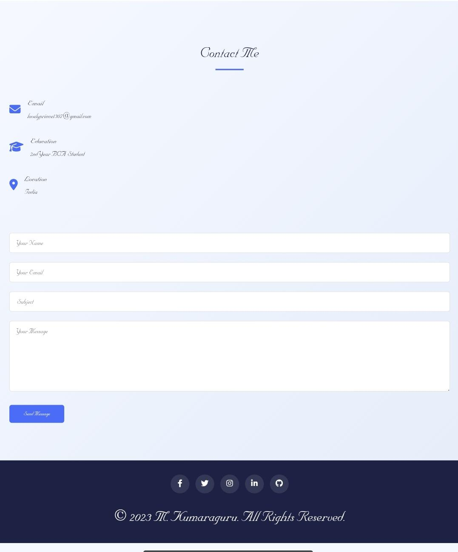

Slide 12
CONCLUSION
In conclusion, our project successfully demonstrates how a well-designed portfolio can enhance an individual’s professional presence. It is lightweight, responsive, and customizable. In the future, we plan to enhance the portfolio with more animations, integration with LinkedIn or GitHub APIs, and adding a blog section for knowledge sharing.

