Slide 1
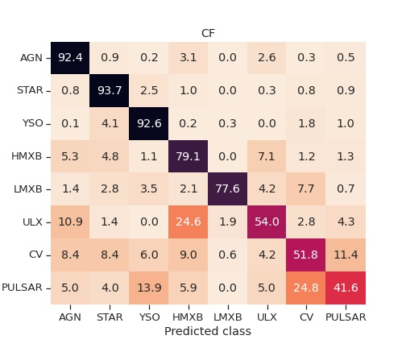
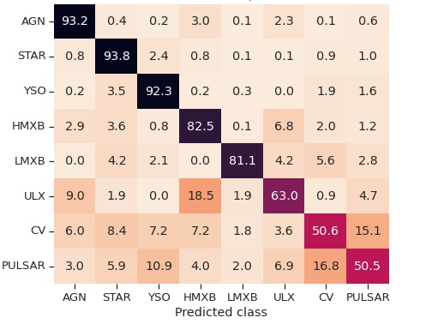
Imputation Issue
RF Classifier Tuned for Iterative Imputation
RF Classifier Tuned for Mode Imputation

Slide 2
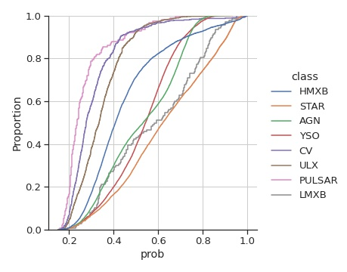
RF -> GB
RF Classifier Tuned for Iterative Imputation
RF Classifier Tuned for Mode Imputation

