Slide 1
Chandra-ML

Slide 2
What We have done so far.
Accumulated MW data for ~ 300,000 sources in CSC-2.0
After trying combination of various data-processing pippelines and various classifiers, identified LightGBM as the ideal classifier.
Trained and validated LightGBM classifier.
Classified and identified sources of CSC with various degree of confidence.
Paper-1:
Described our dataset
Described our method of collection of MW data
Described our classification and validation methodology
Gave a brief descriptionof the newly identified sources and discussed about the class-wise classification confidence.
Promised to release the classified catalog and more details on the properties of the newly identified sources.

Slide 3
Theme for the second paper
Present the name and coordinates (and other vital properties) as a table in the paper (top 100 for majority class and above (3 sigma) for minority class).
Present online portal (or via CDS) for MW data and classification sharing.
Discuss the properties of newly identified sources class-wise.
Go in some more detail on the features which are important to identify the object in various classes and explore physical reasoning behind them.

Slide 4
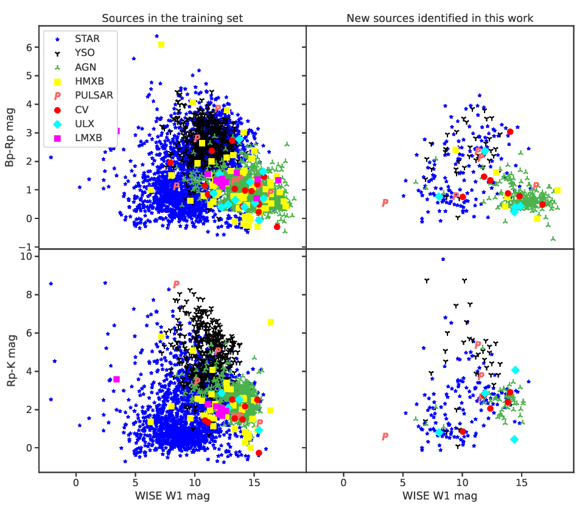
Work done so far for second paper
Prepared the table of sources to be published.
Overleaf paper draft shared
Online portal is ready to be hosted.
Color-Magnitude diagram
Seperation in hardness ratio

Slide 5
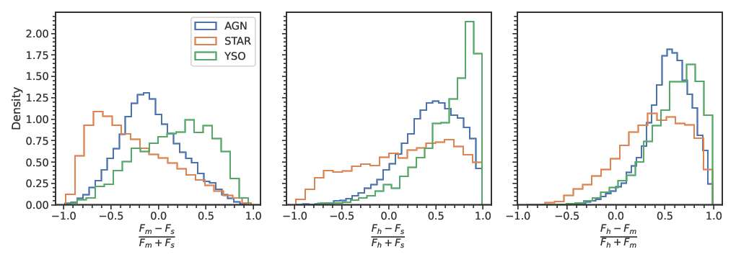
Work done so far for second paper
Prepared the table of sources to be published.
Overleaf paper draft shared
Online portal is ready to be hosted.
Color-Magnitude diagram
Seperation in hardness ratio
KS-statistic

Slide 6
Second Paper timeline
Finalise the content for the second paper : 15 Feb (2 Weeks)
X-ray color magnitude diagram
KS and KP statistic for feature histogram
variability histogram, selected based on variability index
Comparison of variability histogram
Identifying the reasining for two-peaks in the CMP-PDFs for LMXB and HMXB.
Inter-obs variability seems to be one of the factor: we randomise the feature and see the effect of pdf.
Feature randomization and the corresponding effect on the PDF curve can also be used to study the feature importance for other classes as well
If some feature is identified, then we can explore the literature for its physical interpretation
We can look for other properties from Chandra Archive.
Complete the required work : 1 March (2 Weeks)
Prepare the paper draft : 15 March (2 Weeks)
Submit the paper : 22 March (1 Week)

Slide 7
Constraints
Thin-client in office (hopefully)
Office work ()

