Slide 1
Classification of Faint X-ray Sources Associated with Globular Cluster Using Machine Learning
December 2021
Shivam Kumaran
Indian Institute of Space Science and Technology

Slide 2
We Need to classify X-ray sources associated with Globular cluster using properties available in Chandra Source Catalogue 2.0
Problem Statement

Slide 3
Introduction
Data Collection
Data Processing
Design classifier
Optimize classifier
Result / Application

Slide 4
Introduction
Data Collection
Data Processing
Design classifier
Optimize classifier
Result / Application

Slide 5
Globular Cluster
System of stars gravitationally bound together
GC dynamical Evolution
simulation of dynamic evolution of GC^{[1]}
Without XRB - mean collapse time scale < mean time scale of Galactic GC
[1]Carretta, et al .(2000). THE ASTROPHYSICAL
JOURNAL,
Introduction
Data Collection
Data Processing
Design classifier
Optimize classifier
Result / Application
Notes:
"binary burning" phase, in which the cluster core is supported against collapse by super-elastic dynamical scattering interactions of binary stars. More recently it has been realized that pure point-mass interactions of binaries result in equilibrium cluster core radii in the binary burning phase that are a factor of ∼10 smaller than what is observed,

Slide 6
Globular Cluster
Improved Simulation
Included XRB
Mean time scale matches
Hypothesis -
XRB helps in stability against gravitational collapse
Dynamical evolution process with XRB^{[1]}
Core contraction phase
binary burning phase - collapse halts
After max-possible binaries formed, collapse restarts
binary burning phase restarts
[1] .Pooley, D. (2009). Globular cluster x-ray sources. PNAS
Introduction
Data Collection
Data Processing
Design classifier
Optimize classifier
Result / Application

Slide 7
Globular Cluster Evolution
Binary Burning phase and dynamical evolution governed by - Encounter Frequency
Directly correlated with population distribution of XRB.
Understanding XRB Population distribution
Understanding Encounter Frequency
Globular cluster Dynamics and Evolution
Introduction
Data Collection
Data Processing
Design classifier
Optimize classifier
Result / Application

Slide 8
GC X-ray Binaries
Low Mass X-ray Binary
Companion Neutron star or Black hole
Donating star mass < 1.5 M_{solar}
Identification : specteal studies , mostly during outburst
Cataclysmic Variable
Binary system accretion onto White Dwarf
Identification : Bright in UV , soft-X-ray
Millisecond Pulsar
Rapidly rotating Neutron Star
Formed from LMXB
Identification : using radio timing
Introduction
Data Collection
Data Processing
Design classifier
Optimize classifier
Result / Application
cite -

Slide 9
Example : 47-TUC , Heinke, et.al (2005)
Class | Identification Method | No of sources | No Expected
CV | Optical identification | 30 | 24-113
MSP | Radio cross match | 27 | ~ 700
qLMXB | Spectral studies | 5 | ~ 300
About 47-TUC
Mass : 10⁶ M☉
Distance : 4.85 kpc
Size : core radius 24”
Manual Identification is not easy.
Need Better identification
Heinke, et.al (2005). A deep
chandra survey of the globular cluster 47 tucanae: Catalog of point
sources.
Introduction
Data Collection
Data Processing
Design classifier
Optimize classifier
Result / Application

Slide 10
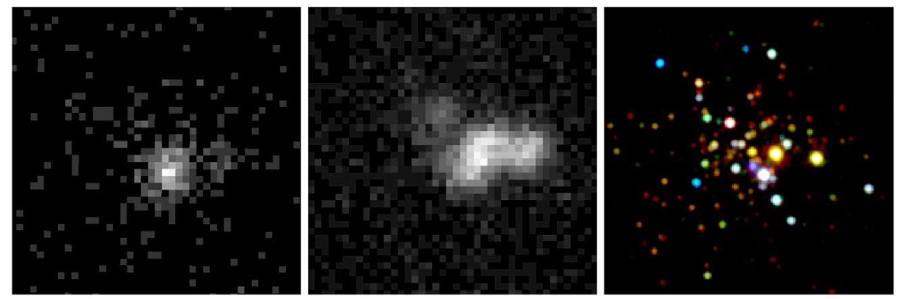
Why Chandra ?
ω-Centauri
For any such identification we need telescope like Chandra
Higher sensitivity
Better resolution
Images of the core of 47-Tuc made from 8 ks of Einstein data (Left),
77 ks of ROSAT data (Center), and 240 ks of Chandra data (Right) . Image and
caption credits (Pooley, 2009)
Introduction
Data Collection
Data Processing
Design classifier
Optimize classifier
Result / Application

Slide 11
Chandra : Instruments
Advanced CCD Imageing Spectograph (ACIS)
Resolution : 0.5 arcsec on-axis
Sensitivity : 4 × 10⁻¹⁵ ergs/cm²/s - integration time 104 sec
Energy Band :
broad band (b): 0.5-7.0 keV
ultrasoft (u): 0.2-0.5 keV
soft (s): 0.5-1.2 keV
medium (m): 1.2-2.0 keV
hard (h): 2.0-7.0 keV
High Resolution Camera (HRC)
Energy band :
wide band (w) - 0.1-10keV
ACIS Energy bands
0.2 keV
0.5 keV
1.2 keV
2.0 keV
7.0 keV
u
s
m
h
b
Introduction
Data Collection
Data Processing
Design classifier
Optimize classifier
Result / Application
Notes:
4 × 10⁻¹⁵ ergs/cm²/s - (0.4to 6.0 keV) - integration time 104 sec

Slide 12
Chandra : Chandra Source catalogue
Number of sources - 317,000
Number of sources associated with GC ~ 1700
Per-Obs Detection Table
contains detection properties based on observational data extracted independently from each individual observation
Master Source Table
'best estimate' sources properties for each unique X-ray source in the catalog
source | Obs | properties
s1 | obs1
 | obs2
 | obs3
s2 | obs1
s3 | obs1
 | obs2
source | properties
s1
s2
s3
s4
s5
...
Per-Stack Detection Table
The Stacked Observation Detections Table
Introduction
Data Collection
Data Processing
Design classifier
Optimize classifier
Result / Application
Notes:
per-stack detection table can have multiple entries for same source

Slide 13
Chandra Source catalogue : features
source | Obs | properties
s1 | obs1
 | obs2
 | obs3
s2 | obs1
s3 | obs1
 | obs2
 | obs3
 | ....
...
What are these “ Properties “ ?
Introduction
Data Collection
Data Processing
Design classifier
Optimize classifier
Result / Application

Slide 14
Chandra Source catalogue : features
Variability
Inter observation Variability
Intra Observation variability
Aparture Photometry
Photon Flux
Energy Flux
Spectral Properties
Hardness Ratio
Hardness hm
Hardness ms
Hardness hs
Model-Fit properties
Black Body model
Bremestralung model
Powerlaw model
Introduction
Data Collection
Data Processing
Design classifier
Optimize classifier
Result / Application

Slide 15
Chandra Source catalogue : features
Hardness
hard hm
hard ms
hard hs
source | Obs | properties
s1 | obs1
 | obs2
 | obs3
s2 | obs1
s3 | obs1
 | obs2
 | obs3
 | ....
...
Hardness calculation details
Slope of the energy band vs flux curve
0.5 keV
1.2 keV
2.0 keV
7.0 keV
s
m
h
Introduction
Data Collection
Data Processing
Design classifier
Optimize classifier
Result / Application

Slide 16
Data
Collection
Introduction
Introduction
Data Collection
Data Processing
Design classifier
Optimize classifier
Result / Application

Slide 17
Data Collection
Problem
We do not have class labels in CSC
Solution
Look for other catalogue and in published literature
Introduction
Data Collection
Data Processing
Design classifier
Optimize classifier
Result / Application

Slide 18
Data Collection
For a givne class -
LMXB / CV / MPS
LMXB
CSC
Find RA/DEC for Known source
GC
Cross-Match with CSC
CV - 314
LMXB - 99
Pulsar - 265
Download data from CSC
Introduction
Data Collection
Data Processing
Design classifier
Optimize classifier
Result / Application

Slide 19
Data Preprocessing
Data Collection

Slide 20
Data Preprocessing
Make data-type uniform
Remove duplicate cross matches
identify NaN Values
Remove order of magnitude variation
Pileup-sources
streak sources
Data collected
Sanitize Data
Normalize data
Flag-filter
Processed data
significance filter
Log(flux)
Flux-filter
To keep obs only above
3-σdetection
To remove non-quiscent obs
max flux - 10⁻¹² erg/cm²/s
Introduction
Data Collection
Data Processing
Design classifier
Optimize classifier
Result / Application

Slide 21
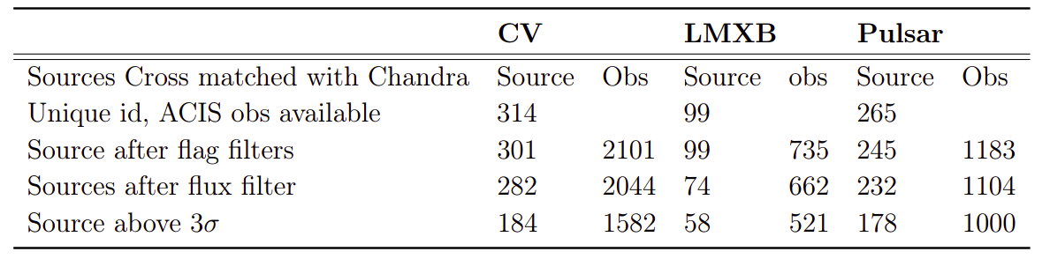
Data Preprocessing
Introduction
Data Collection
Data Processing
Design classifier
Optimize classifier
Result / Application

Slide 22
Machine Learning
Finally we have Data and labels as well.
We need to learn feature-class label relation
Typical Machine learning problem
Is it that simple ?
NO
source | Obs | properties | Class label
s1 | obs1
 | obs2
 | obs3
s2 | obs1
s3 | obs1
 | obs2
 | obs3
 | ....
...
We need to learn feature-class label relation
Introduction
Data Collection
Data Processing
Design classifier
Optimize classifier
Result / Application

Slide 23
Data Preprocessing
Problems
Very small dataset
CV - 184
MSP - 178
LMXB - 58
Missing data
About 50% missing values
NO feature column with zero missing values
only 7 Sources with zero missing values
Reason for missing values
Source may be faint in some bands
Introduction
Data Collection
Data Processing
Design classifier
Optimize classifier
Result / Application

Slide 24
We Need to fill in Missing values

Slide 25
Data Imputation
Statistical Imputation
Impute with column mean
Impute with column median
Impute with zeros.
Correlation Imputation
Regression Imputation
Introduction
Data Collection
Data Processing
Design classifier
Optimize classifier
Result / Application

Slide 26
Data Imputation
src | properties
 | flux | variability | hardness | .........
s1
s2
s3
s4
s5
s6
s7
s8
...
Regression Imputation
Introduction
Data Collection
Data Processing
Design classifier
Optimize classifier
Result / Application

Slide 27
Data Imputation
How to compare which regression method works correctly for classification
Need to do classification
Need a classifier.
Introduction
Data Collection
Data Processing
Design classifier
Optimize classifier
Result / Application

Slide 28
Classifier
Logistic Regression
K-Nearest Neighbour
Fully Connected Network
Convolution Neural Network
Random Forest Classifier
Introduction
Data Collection
Data Processing
Design classifier
Optimize classifier
Result / Application

Slide 29
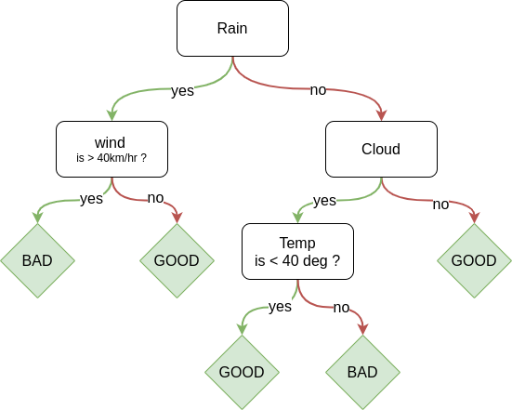
Classifier : Random Forest
Day | Rain | Wind | cloud | Temp | How is the day
Day 0 | yes | 30 | yes | 10 | good
Day 1 | yes | 55 | yes | 10 | Bad
Day 2 | no | 10 | no | 55 | bad
Day 4 | no | 30 | yes | 20 | Good
... | ... | .... | .... | .... | ....
Introduction
Data Collection
Data Processing
Design classifier
Optimize classifier
Result / Application

Slide 30
Classifier : Random Forest
good/bad
Introduction
Data Collection
Data Processing
Design classifier
Optimize classifier
Result / Application

Slide 31
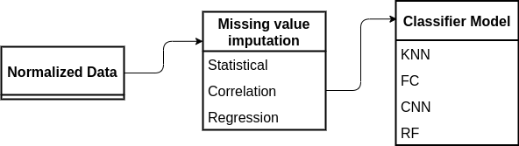
Classifier Pipeline
How to select which one works the best ?
Introduction
Data Collection
Data Processing
Design classifier
Optimize classifier
Result / Application

Slide 32
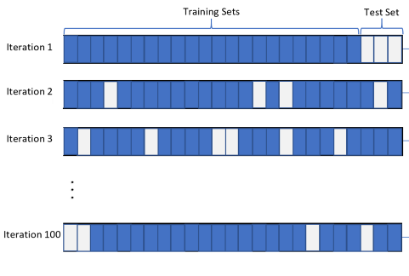
Cross Validation
Algorithm
Take randomly sampled examples
keep them aside
train on rest of the sample
check preformance on the kept-aside sample
A good model
Higher mean accuracy
Least std in accuracy.
Introduction
Data Collection
Data Processing
Design classifier
Optimize classifier
Result / Application

Slide 33
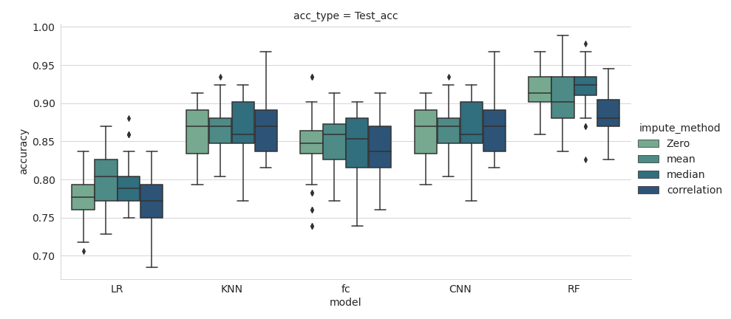
Monte-Carlo Evolution : Result
Introduction
Data Collection
Data Processing
Design classifier
Optimize classifier
Result / Application

Slide 34
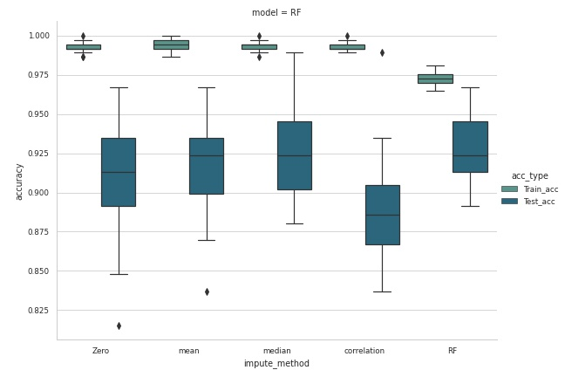
Imputer+ Classifier Result
Introduction
Data Collection
Data Processing
Design classifier
Optimize classifier
Result / Application

Slide 35
Classifier selected
Validation Accuracy score
Mean - 66.1
Std - 4.3
Min - 51.46
Max - 71.31
Preprocesssed data
Fill missing values with random forest regressor
Random Forest Classifier
Introduction
Data Collection
Data Processing
Design classifier
Optimize classifier
Result / Application

Slide 36
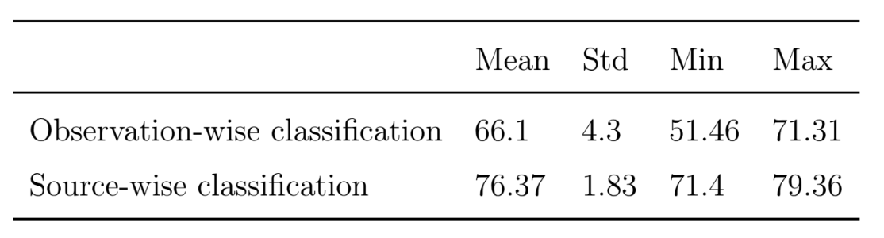
Classifier selected
Combine Observation
Improved statistics
Introduction
Data Collection
Data Processing
Design classifier
Optimize classifier
Result / Application

Slide 37
Optimising
Classifier
Classifier Designed..

Slide 38
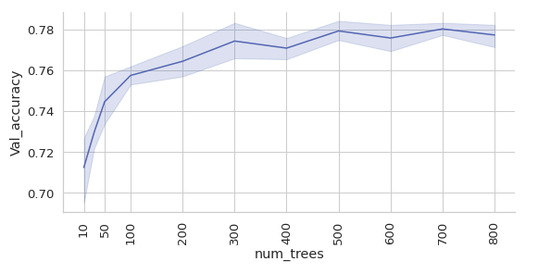
Optimizing RF
Hyperparameter tuning
Parameters to tune
Number of trees
Max-depth
Introduction
Data Collection
Data Processing
Design classifier
Optimize classifier
Result / Application

Slide 39
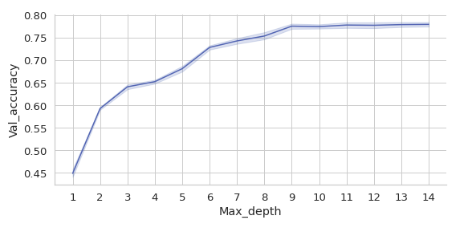
Optimizing RF
Hyperparameter tuning
Parameters to tune
Number of trees - 500
Max-depth - 10
Introduction
Data Collection
Data Processing
Design classifier
Optimize classifier
Result / Application

Slide 40
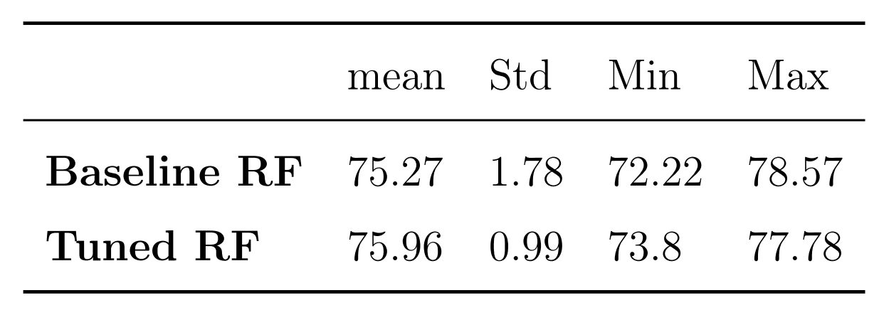
Tuned RF Result: Score
Best Random forest
Number of trees - 500
Max-depth - 10
Result
Accuracy :
Introduction
Data Collection
Data Processing
Design classifier
Optimize classifier
Result / Application

Slide 41
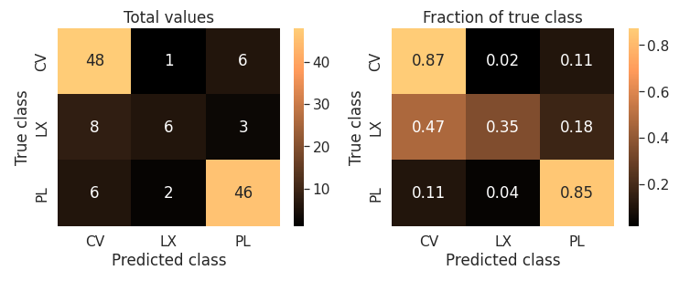
Tuned RF Result : Confusion Matrix
Confusion Matrix
Probability quality
Problem
Class imbalance
not able to learn LMXB
Introduction
Data Collection
Data Processing
Design classifier
Optimize classifier
Result / Application

Slide 42
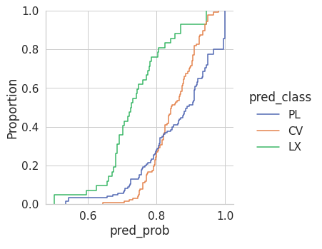
Tuned RF Result : Probability quality
Probability quality
Problem
Class imbalance
not able to learn LMXB class.
Introduction
Data Collection
Data Processing
Design classifier
Optimize classifier
Result / Application

Slide 43
Balancing Class : SMOTE
SMOTE : Synthetic Minority Oversampling Technique
Algorithm
In higher dimension feature space
Each point represent one source
Linear interpolation between these points (source)
Sample points from nearest interpolations
Make each class equal.
Introduction
Data Collection
Data Processing
Design classifier
Optimize classifier
Result / Application

Slide 44
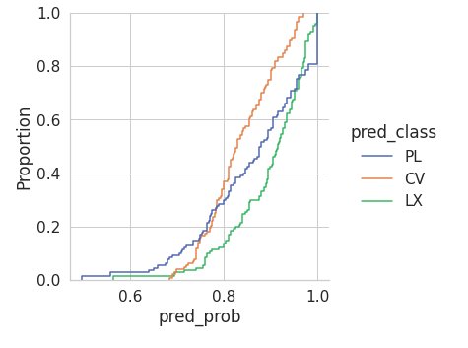
Balancing Class : SMOTE
SMOTE result
Introduction
Data Collection
Data Processing
Design classifier
Optimize classifier
Result / Application

Slide 45
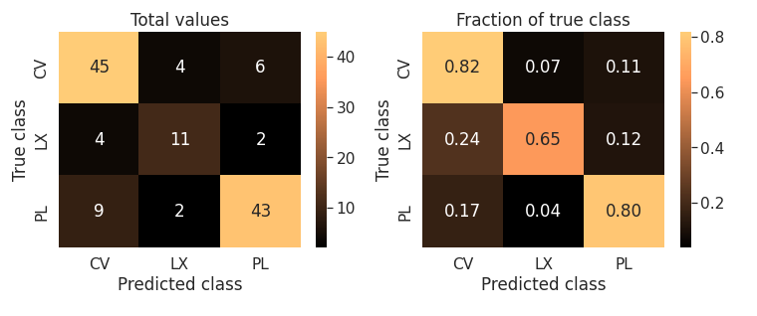
Balancing Class : SMOTE
Introduction
Data Collection
Data Processing
Design classifier
Optimize classifier
Result / Application

Slide 46
Balancing Class : SMOTE
Introduction
Data Collection
Data Processing
Design classifier
Optimize classifier
Result / Application

Slide 47
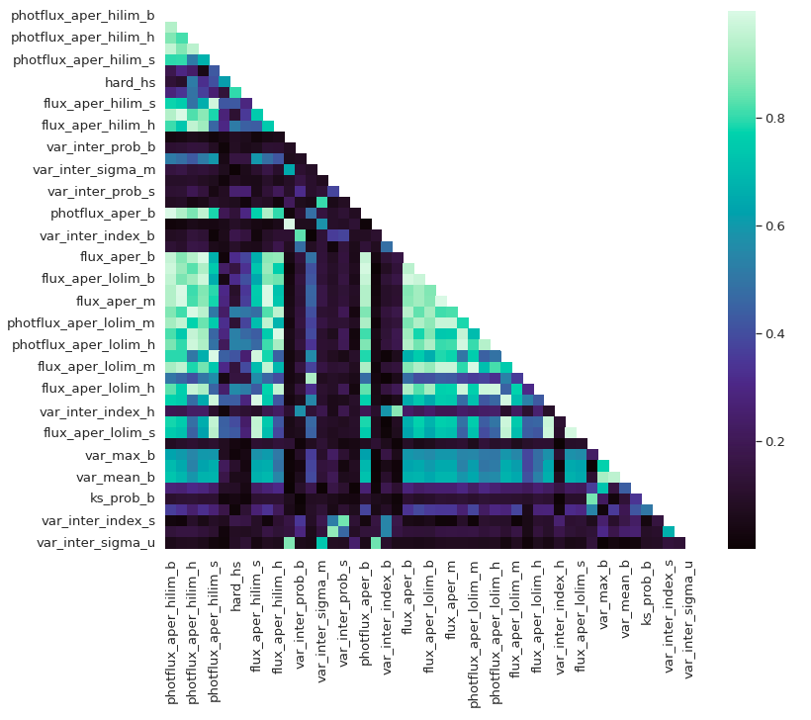
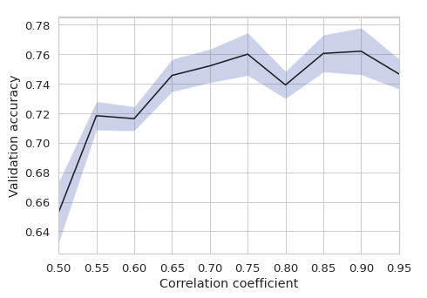
Feature optimization
Feature-feature correlation
Need to remove correlated features.
Introduction
Data Collection
Data Processing
Design classifier
Optimize classifier
Result / Application

Slide 48
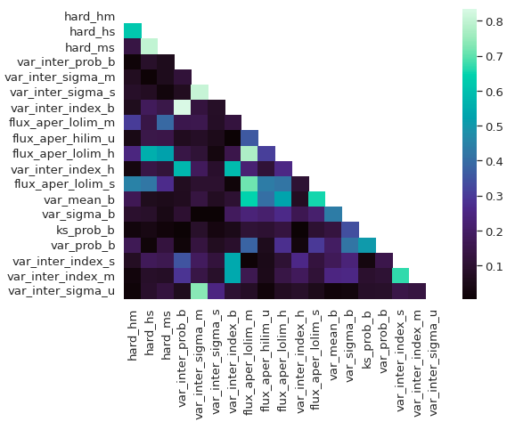
Feature optimization
Feature-feature correlation
Need to remove correlated features.
Introduction
Data Collection
Data Processing
Design classifier
Optimize classifier
Result / Application

Slide 49
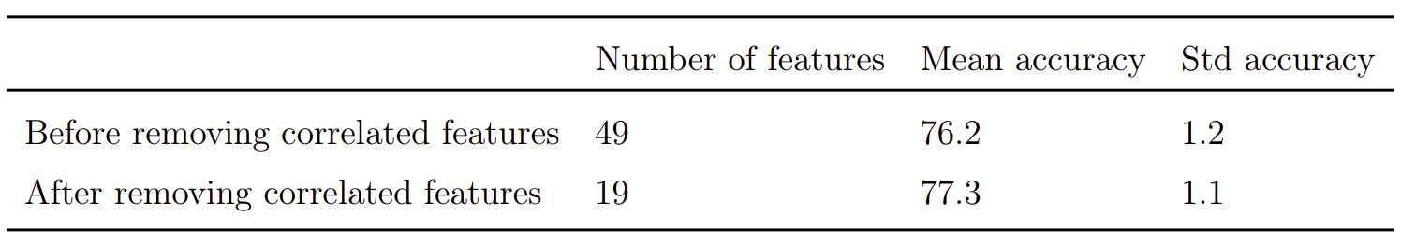
Feature optimization
Feature -feature correlation
why we need to remove correlated features
Comparison of result -
Introduction
Data Collection
Data Processing
Design classifier
Optimize classifier
Result / Application

Slide 50
Feature Importance
Contribution of each feature for classification
Understanding physical significance
Learn what machine has learnt.
Introduction
Data Collection
Data Processing
Design classifier
Optimize classifier
Result / Application

Slide 51
Feature Importance
Algorithm
src | properties |  |  |  | Class label
 | flux | variability | hardness | .........
s1
s2
s3
s4
s5
s6
s7
s8
...
Original dataset
Randomize feat
Do Training
Cross validation
Val Accuracy
Val Accuracy
Drop In accuracy
Introduction
Data Collection
Data Processing
Design classifier
Optimize classifier
Result / Application

Slide 52
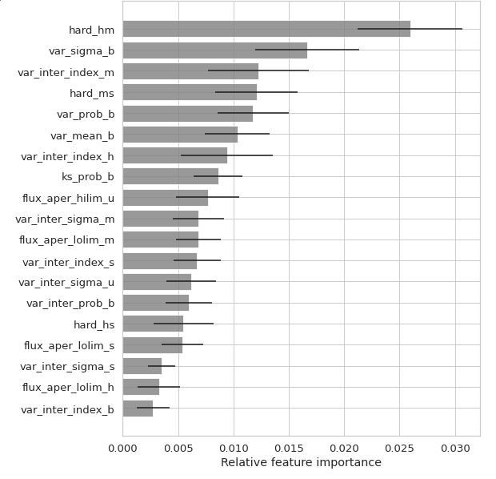
Feature Importance
Result
Discussion
Important feature
Hardness in hm band
Short term variability
Long term variability
Introduction
Data Collection
Data Processing
Design classifier
Optimize classifier
Result / Application

Slide 53
Result significance
Problem with validation result
small sample available for validation
LMXB - 17
CV - 55
MSP - 54
Validation result - training quality tradeoff
Other method
Permutation Significance
Training sample
validation sample
Training sample
validation sample
Introduction
Data Collection
Data Processing
Design classifier
Optimize classifier
Result / Application

Slide 54
Permutation - Test
Null Hypothesis -
No relation between features and the class label
p-Score
Probability that accuracy on label-permuted data will be more than or equal to accuracy on original data
Null-hypothesis p-score ~ 0.5
S1
features s1
LMXB
S2
features s2
CV
S3
features s3
CV
S4
features s4
LMXB
S5
features s5
MSP
S6
features s6
CV
S7
features s7
MSP
S8
features s8
CV
S9
features s9
MSP
S10
features s10
LMXB
Introduction
Data Collection
Data Processing
Design classifier
Optimize classifier
Result / Application

Slide 55
Permutation - Test : Algorithm
acc on original labels
S1
features s1
LMXB
S2
features s2
CV
Permute label
S3
features s3
CV
S4
features s4
LMXB
S5
features s5
MSP
S6
features s6
CV
S7
features s7
MSP
S8
features s8
CV
S9
features s9
MSP
S10
features s10
LMXB
Introduction
Data Collection
Data Processing
Design classifier
Optimize classifier
Result / Application

Slide 56
Permutation - Test
acc on original labels
S1
features s1
MSP
S2
features s2
CV
Permute label
S3
features s3
LMXB
S4
features s4
MSP
S5
features s5
CV
Cross validation
S6
features s6
CV
S7
features s7
LMXB
Val Accuracy
S8
features s8
CV
S9
features s9
LMXB
S10
features s10
MSP
Val accuracy dist.
Introduction
Data Collection
Data Processing
Design classifier
Optimize classifier
Result / Application

Slide 57
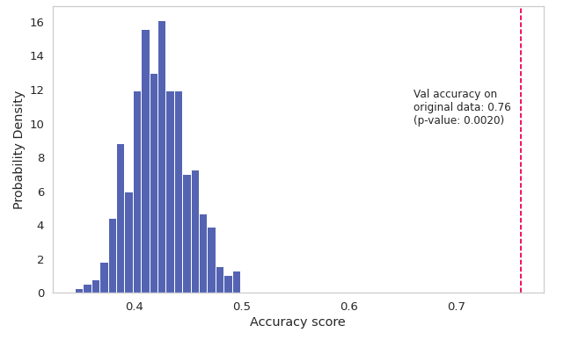
Permutation - Test : Result
Permutation test result
p-score: 0.002
Introduction
Data Collection
Data Processing
Design classifier
Optimize classifier
Result / Application

Slide 58
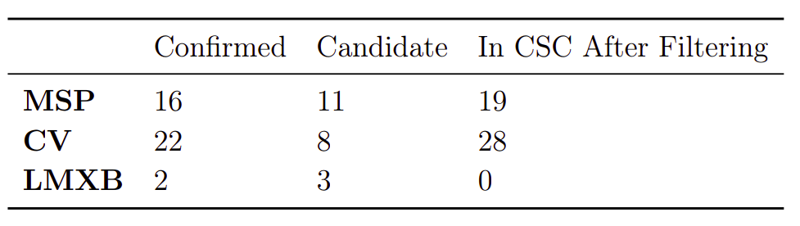
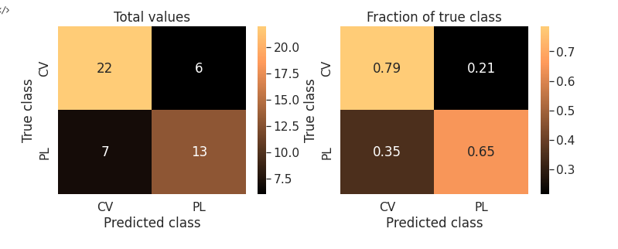
Application on 47-TUC
Introduction
Data Collection
Data Processing
Design classifier
Optimize classifier
Result / Application

Slide 59
Conclusion
Using Published catalogues , literature survey a subset catalog of CSC was created.
Explored various methods of filling in missing values
Imputation with RF works best
Explored various classifier models. > RF chosen
Classification result
Validation accuracy ~ 75%
Permutation test p-score 0.002
Applied to 47-TUC
Road Blocks
Result not accurate enough
Predicted probabilities are low
Data sample is small

Slide 60
Future Plan
Immediate Future
Gaussian Resampling of minority class
Upsampling of all classes
Deep Learning - Auto Encoder for missing value prediction
Cross match with NED
Ahead
Application on other Globular clusters
Understanding GC dynamics
Adding more classes
Classification on entire Chandra Source Catalogue

Slide 61
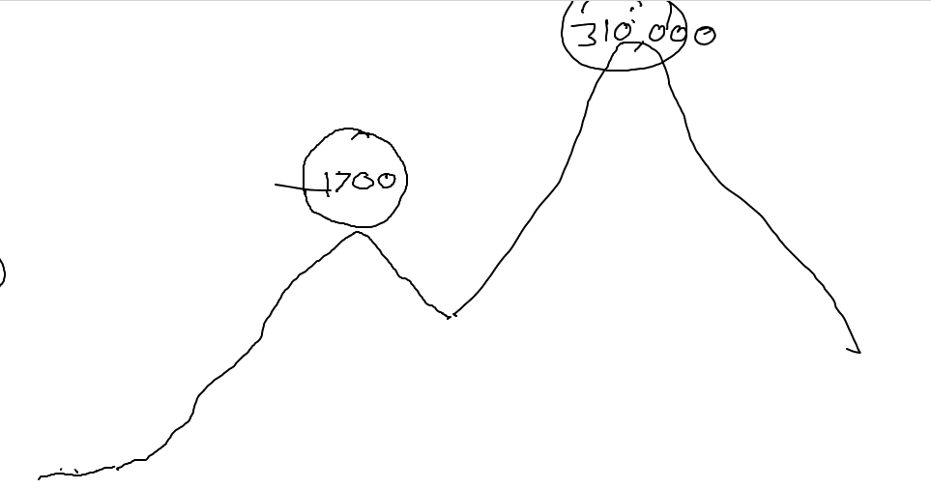
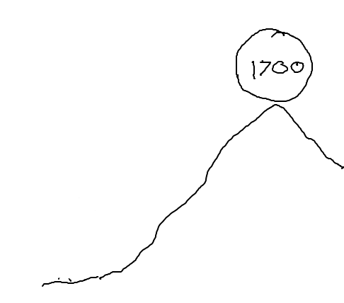

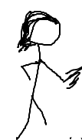

Slide 62
Thank You
until next time....

Slide 63
Data Imputation
Correlation Imputation
Feature-wise imputation
Correlation between features
Fill in missing value using highest correlated feature
Introduction
Data Collection
Data Processing
Design classifier
Optimize classifier
Result / Application

Slide 64
Limitations of SMOTE
Can not infinitely upsample
Available data should be able to represent parent distribution
Introduction
Data Collection
Data Processing
Design classifier
Optimize classifier
Result / Application

Slide 65
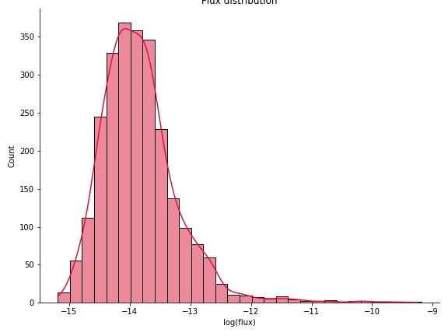
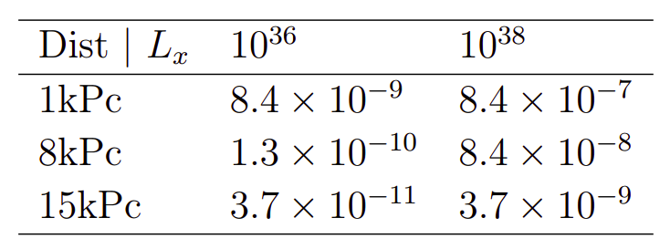
How flux threshold is decided
Introduction
Data Collection
Data Processing
Design classifier
Optimize classifier
Result / Application

Slide 66
Data Imputation
Similarity Imputation using RF
Introduction
Data Collection
Data Processing
Design classifier
Optimize classifier
Result / Application

Slide 67
AdaBoost
Ensamble classifier
Can we improve further
No further improvement.
RF is able to capture as much information as possible
Introduction
Data Collection
Data Processing
Design classifier
Optimize classifier
Result / Application

Slide 68
Globular Cluster
Improved Simulation
Included XRB
Mean time scale matches
Hypothesis -
XRB helps in stability against gravitational collapse
Dynamical evolution process with XRB^{[1]}
Core contraction phase
binary burning phase - collapse halts
After max-possible binaries formed, collapse restarts
binary burning phase restarts
[1] .Pooley, D. (2009). Globular cluster x-ray sources. PNAS
Introduction
Data Collection
Data Processing
Design classifier
Optimize classifier
Result / Application

Slide 69
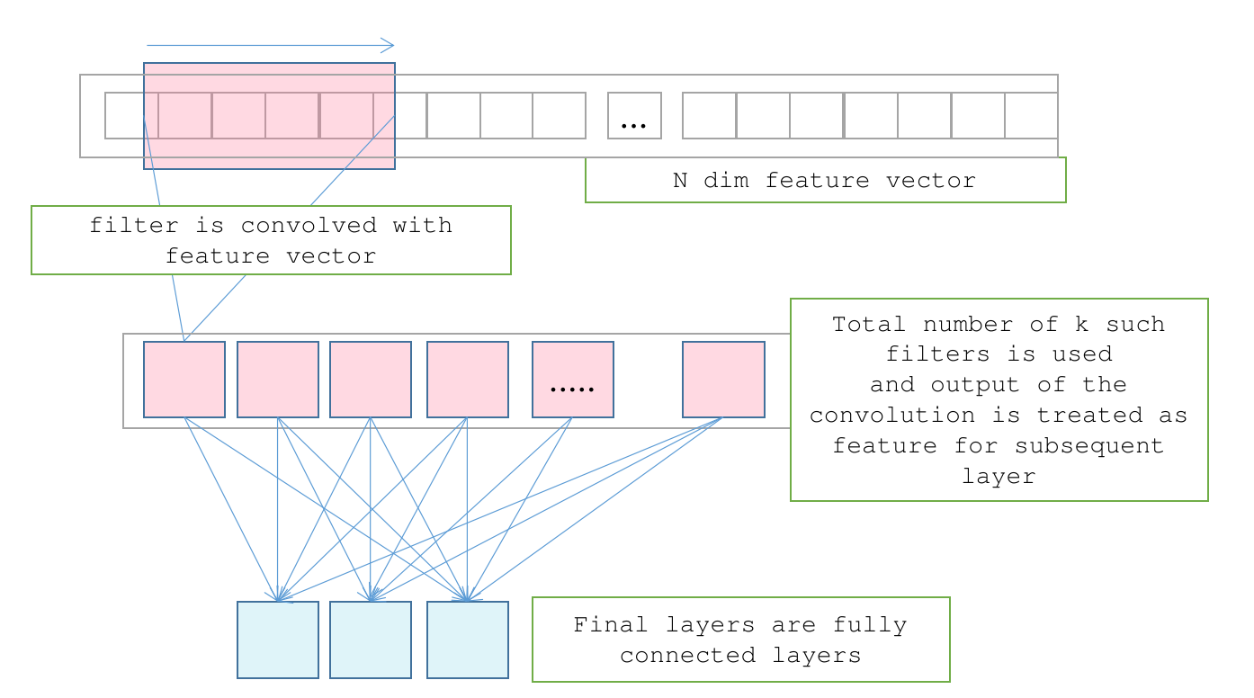
Classifier : Fully Connected Net
Working
Reason to try-on
Caveats
Introduction
Data Collection
Data Processing
Design classifier
Optimize classifier
Result / Application

Slide 70
Classifier : Convolution Neural Network
Working
Reason to try-on
We have correlated features
can take adantage if arranged feature-wise
Caveats
Sensitive to missing values
Introduction
Data Collection
Data Processing
Design classifier
Optimize classifier
Result / Application

