Slide 1
Chandra X-ray sources Classification using Machine Learning
Shivam Kumaran
Indian Institute of Space Science and Technology,
Thiruvananthapuram

Slide 2
To classify Globular cluster X-ray sources available in Chandra Source catalogue

Slide 3
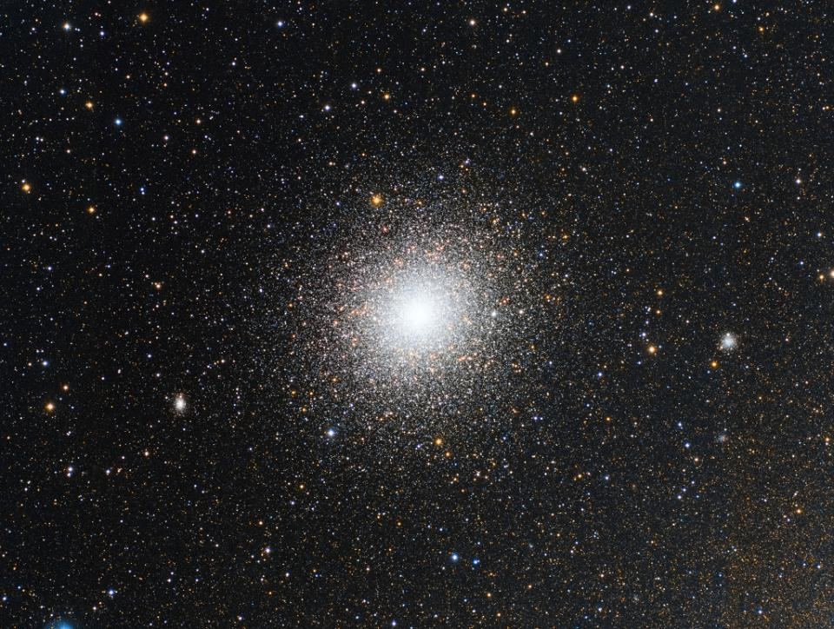
Globular Cluster -
Gravitaionaly bound system of cluster of stars.
Large number of close encounters.
Classes -
CV – Cataclysmic variable : Binary system with accretion onto a White Dwarf
LMXRB – Accretion of a star onto BH or NS
MSP – Milli second pulsar : Periodic rotation
Other classes – AB , Stars
Image Credit Copyright: Jose Mtanous

Slide 4
Chandra Source Catalogue
X-ray sources :
317,167 unique sources -
In 90 GC - 8275 sources
Instruments :
ACIS - 5 energy bands
• broad band (b): 0.5-7.0 keV
• ultrasoft (u): 0.2-0.5 keV
• soft (s): 0.5-1.2 keV
• medium (m): 1.2-2.0 keV
• hard (h): 2.0-7.0 keV
HRC
Wide Band : 0.1-10 keV

Slide 5
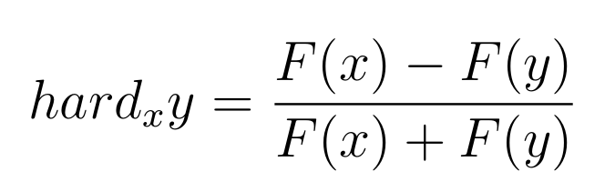
Chandra Source Catalogue
Source Information
RA-DEC
Galactic-coordinates
Exposure timings
Flux significance
Source Fluxes
Photon flux
Energy flux
Spectral Properties
Black Body
Powerlaw
Bremsstrahlung
Hardness Ratio
Source variability
Source Falgs

Slide 6
Chandra Source Catalogue
 | Feature 1 | Feature 2 | Feature 3 | ... | Feature m | CLASS
Source 1
Source 2 | Nan | NAN
...
Source n | NAN
How do we get labels

Slide 7
Using Other catalogues
Find RA-DEC
Cross-Match with
CSC
Cross match using HEASARC web tool
Radius – 3 arcsec
Choose Best cross-match
Select sources , assign class labels

Slide 8
Chandra Source Catalogue
We got training data with labels
 | Feature 1 | Feature 2 | Feature 3 | ... | Feature m | CLASS
Source 1
Source 2 | Nan | NAN
...
Source n | NAN
 |  | Feature 1 | Feature 2 | Feature 3 | ... | Feature m | CLASS
Source 1 | Obs 1 |  |  | nan
 | Obs 2 | Nan
 | Obs 3
Source 2 | Obs 1 | Nan | NAN
 | ...

Slide 9
Introduction
Problem
Using Other catalogues
Find RA-DEC
Data
Preprocessing
Chandra Source
catalogue
Cross-Match with
CSC
Cross match using HEASARC web tool
Radius – 3 arcsec
Training
Finding Labels
Result
Analysis
Ideal Source list
Choose Best cross-match
Select sources , assign class labels
Future Roadmap

Slide 10
Dataset
​ | Num Sources​ | Num obs​
CV​ | 66 | 516
NS​ | 48 | 302
BH​ | 28 | 160
PULSAR​ | 118 | 319
Number of Features – 56 , not using model-fit parameters
Photon flux (b,h,m,s,u)
Energy flux (b,h,m,s,u)
Variability
Hardness ratio

Slide 11
Data Processing
Data Processing
Data Scaling
No-scaling
Normalisation
Standardisatsation
Data Scaling
Standardisatsation
Data Imputation
Zero
Mean
Median
Correlation
Random Forest
Data Imputation
Random Forest
Classifier
LR
KNN
FC
CNN
RF
Classifier
RF

Slide 12
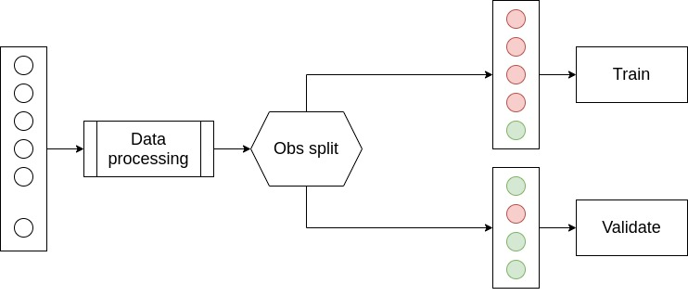
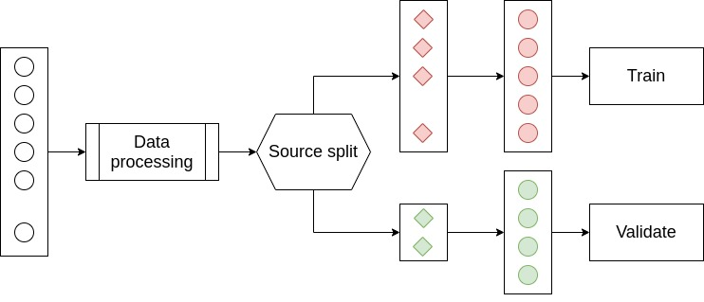
Pipeline
Validation accuracy
Mean - 0.85
Std - 0.02
Validation accuracy –
Mean – 0.45
Std – 0.02

Slide 13
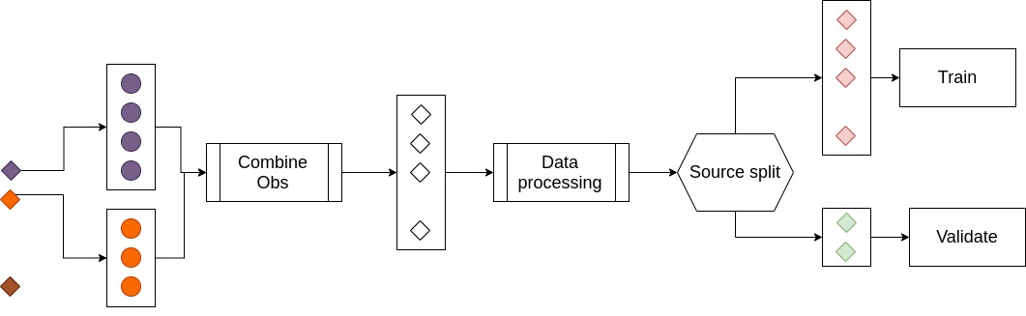
Combined observatios
Validation accuracy –
Mean – 0.73
Std – 0.08

Slide 14
Validation accuracy – 0.85+/-0.02

Slide 16
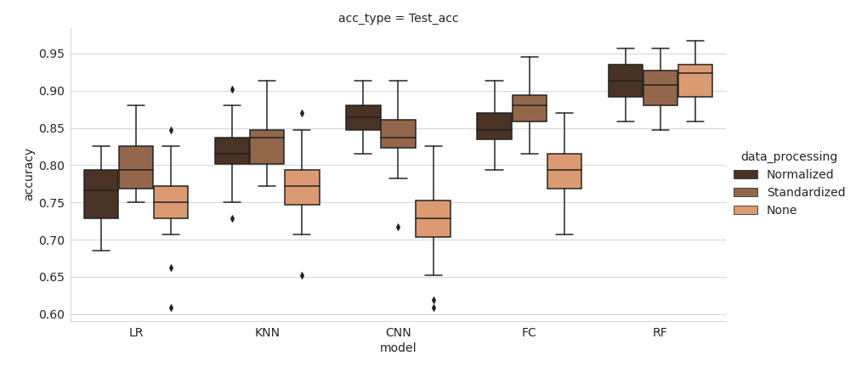
Introduction
Data Scaling
Data Scaling
No-scaling
Normalisation
Standardisatsation
Data Imputation
Zero
Mean
Median
Correlation
Random Forest
Classifier
LR
KNN
FC
CNN
RF
Data
Preprocessing
Data Imputation
Classifiers
Accuracy variations over data-scaling and classifier
Training
Best Schematic
Result
Analysis
Future Roadmap

Slide 17
Introduction
Data
Preprocessing
Training
Result
Analysis
Future Roadmap

Slide 18
Introduction
Problem
Chandra Source Catalogue
Data
Preprocessing
We got training data with labels
Chandra Source
catalogue
 | Feature 1 | Feature 2 | Feature 3 | ... | Feature m | CLASS
Source 1
Source 2 | Nan | NAN
...
Source n | NAN
Training
Finding Labels
Result
Analysis
Ideal Source list
Future Roadmap

Slide 19
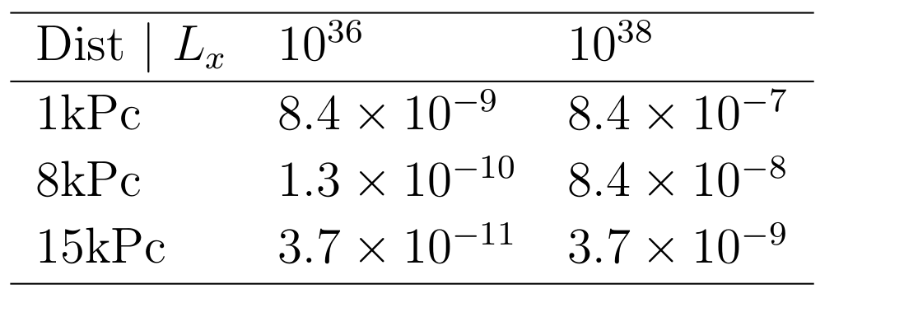
Introduction
Problem
Quiescent / Outburst / Persistent source
Data
Preprocessing
In quiescent state LMXRB x-ray luminosity : 10³² erg/s
During outburst – luminosity : 10³⁶ – 10³⁸ erg/s
But we have only flux information and not luminosity
We are considering only galactic sources , distance is constrained
Chandra Source
catalogue
Training
Finding Labels
Result
Analysis
Source List
In quiescent state LMXRB x-ray luminosity : 10³² erg/s
During outburst – luminosity : 10³⁶ – 10³⁸ erg/s
We are considering only galactic sources
10⁻¹² erg/s/cm²
Future Roadmap

Slide 20
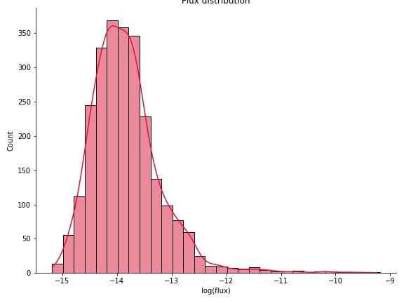
Introduction
Problem
Quiescent / Outburst / Persistent source
Data
Preprocessing
Globular cluster sources
Chandra Source
catalogue
Training
Finding Labels
Result
Analysis
Source List
Future Roadmap

Slide 21
Quiescent / Outburst / Persistent source
Introduction
Problem
Data
Preprocessing
Chandra source catalogue
Master Table
Per observation Table
Identify individual observations.
Chandra Source
catalogue
Training
Finding Labels
Result
Analysis
Source List
 |  | Feature 1 | Feature 2 | Feature 3 | ... | Feature m | CLASS
Source 1 | Obs 1
 | Obs 2
 | Obs 3
Source 2 | Obs 1 | Nan | NAN
 | ...
 | Obs n
...
Source n |  | NAN
Future Roadmap

Slide 22
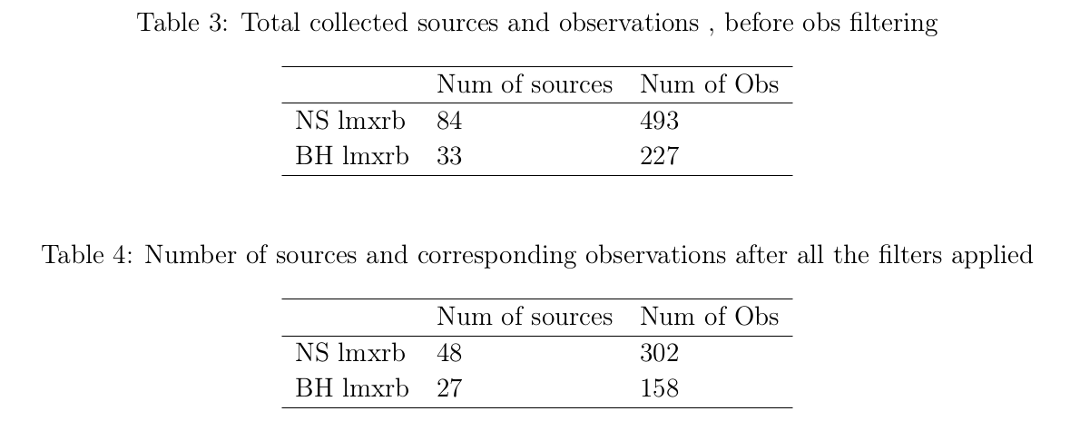
Quiescent / Outburst / Persistent source
Introduction
Problem
Data
Preprocessing
Filtering
Flux filter
Pileup- flag
Streak source flag
Chandra Source
catalogue
Training
Finding Labels
Result
Analysis
Source List
Future Roadmap

Slide 23
Order of Magnitude problem
Introduction
Data Scaling
Data
Preprocessing
Data Imputation
 |  | Feature 1 | Feature 2 | Feature 3 | ... | Feature m | CLASS
Source 1 | Obs 1
 | Obs 2
 | Obs 3
Source 2 | Obs 1
 | ...
Classifiers
Training
Magnitude scale difference :
Flux features : 10⁻¹²
Variance : 10¹
Hardness : -1 , 1
Uneven weight for network based classifiers
Incorrect feature importance
Solution :
Data Normalization : xi = (xi − max)/(max − min)
Data Standardization : xi = (xi − mean)/var
Result
Analysis
Future Roadmap

Slide 24
Missing data problem
Introduction
Data Scaling
Data
Preprocessing
Data Imputation
 |  | Feature 1 | Feature 2 | Feature 3 | ... | Feature m | CLASS
Source 1 | Obs 1 |  |  | nan
 | Obs 2 | Nan
 | Obs 3
Source 2 | Obs 1 | Nan | NAN
 | ...
Classifiers
Training
Data Sparsity > 50%
Why missing data
Not all obs are made in all bands
Model fit not done for observations made in <= 2 bands
Solution
Impute with Zeros
Impute with feature mean
Impute with feature median
Imputation using feat correlation
Imputation using Random Forest
Result
Analysis
Future Roadmap

Slide 25
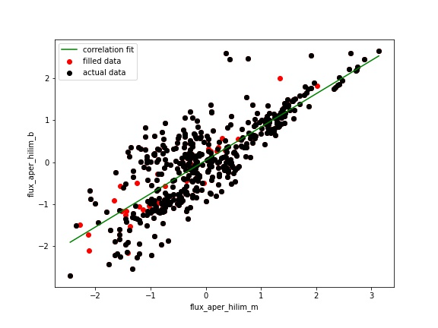
Missing data problem
Introduction
Data Scaling
Data
Preprocessing
Data Imputation
 |  | Feature 1 | Feature 2 | Feature 3 | ... | Feature m | CLASS
Source 1 | Obs 1 |  |  | nan
 | Obs 2 | Nan
 | Obs 3
Source 2 | Obs 1 | Nan | NAN
 | ...
Classifiers
Training
Imputation Using correlation
Find feature-feature correlation coefficient matrix
For each obs , fill in missing value using highest available correlated feature
Result
Analysis
Future Roadmap

Slide 26
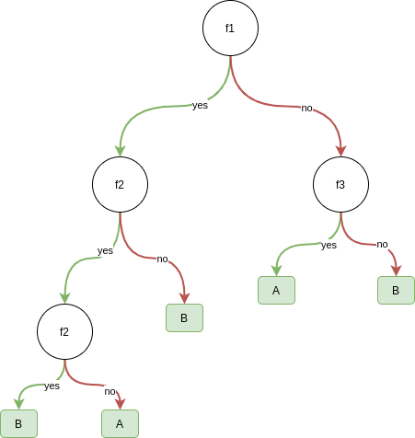
Missing data problem
Introduction
Data Scaling
Data
Preprocessing
Data Imputation
 |  | Feature 1 | Feature 2 | Feature 3 | ... | Feature m | CLASS
Source 1 | Obs 1 |  |  | nan
 | Obs 2 | Nan
 | Obs 3
Source 2 | Obs 1 | Nan | NAN
 | ...
Classifiers
Training
Imputation Using Random Forest
Fill in missing value with median
Calculate proximity matrix
Fill in missing value as weighted average of corresponding feature across all observation ,
Weighing factor is proximity values
Recalculate proximity matrix
..
..
Result
Analysis
 | x1 | x2 | ... | xn
x1 | 1.0
x2
...
xn
Future Roadmap

Slide 27
Classifiers
Introduction
Data Scaling
Data
Preprocessing
Data Imputation
Logistic Regression
K- Nearest Neighbour
Fully connected network
Convolution Neural Network
Random Forest classifier
Classifiers
Training
Best Schematic
Result
Analysis
Future Roadmap

Slide 28
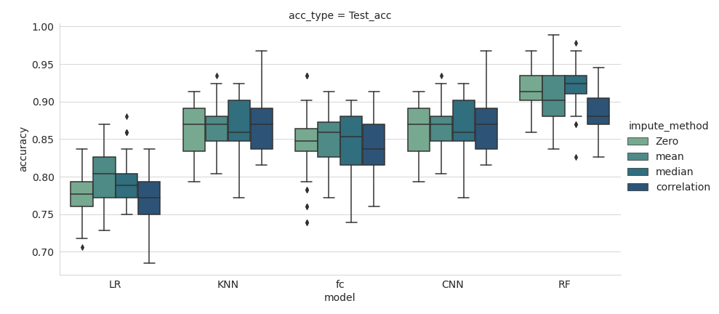
Introduction
Data Scaling
Data Scaling
No-scaling
Normalisation
Standardisatsation
Data Imputation
Zero
Mean
Median
Correlation
Random Forest
Classifier
LR
KNN
FC
CNN
RF
Data
Preprocessing
Data Imputation
Classifiers
Accuracy variations over data-Imputation and classifier
Training
Best Schematic
Result
Analysis
Future Roadmap

Slide 29
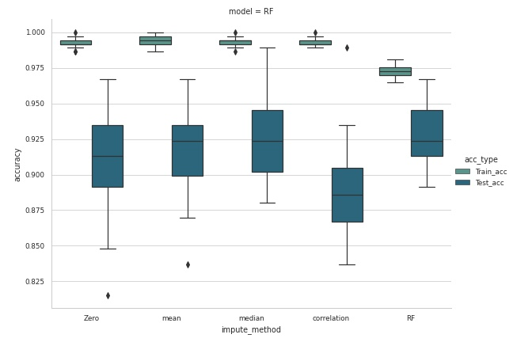
Introduction
Data Scaling
Data Scaling
No-scaling
Normalisation
Standardisatsation
Data Imputation
Zero
Mean
Median
Correlation
Random Forest
Classifier
LR
KNN
FC
CNN
RF
Data
Preprocessing
Data Imputation
Classifiers
Accuracy variations over data-Imputation for Random forest classifier
Training
Best Schematic
Result
Analysis
Future Roadmap

Slide 30
Introduction
Data Scaling
Best Classifier schematic
Data
Preprocessing
Data Imputation
Data Scaling
No-scaling
Normalisation
Standardisatsation
Data Imputation
Zero
Mean
Median
Correlation
Random Forest
Classifier
LR
KNN
FC
CNN
RF
Classifiers
Training
Best Schematic
Result
Analysis
Normalisation
Random forest Imputation
Random Forest Classifier
Future Roadmap

Slide 31
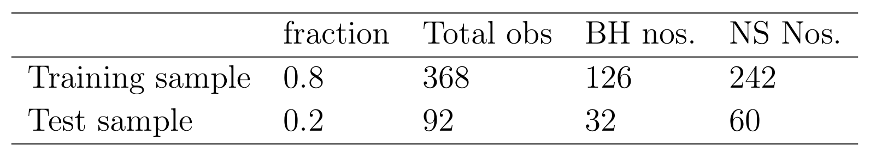
Classifier
Introduction
Tuning RF
Data
Preprocessing
Result qualifier
Normalisation
Random forest Imputation
Result
Training
Result
Analysis
Random Forest classifier
Hyper- Parameter tuning
Number of decision trees
Maximum depth
Random search method
Grid-search method
Random Forest classifier
Best Hyperparameters
Number of trees – 288
Max depth - 150
Future Roadmap

Slide 32
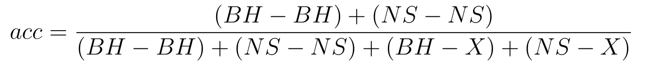
Prediction Scheme
Introduction
Tuning RF
Data
Preprocessing
Result qualifier
Probability threshold for reporting classification
Reduce chances of miss-classification
Set probability threshold for classification
Threshold is decided to keep false positive rate minimum
Prediction classes :
NS
BH
Ambiguous
Accuracy defined as
Result
Training
Result
Analysis
Future Roadmap

Slide 33
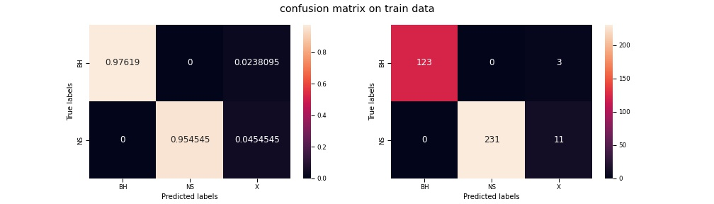
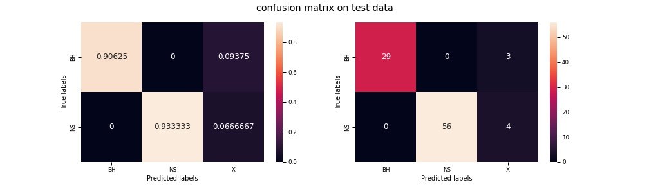
Result
Introduction
Tuning RF
Data
Preprocessing
Result qualifier
Result
Training
Result
Analysis
Future Roadmap

Slide 34
Result
Introduction
Tuning RF
Data
Preprocessing
Result qualifier
With probability threshold for true positive set as 0.8 accuracy is :
Training accuracy : 96.2 %
Test accuracy : 92.1%
Result
Training
Training data
Total predictions – 368
True prediction – 354
Ambiguous predictions – 14
Incorrect predictions - 0
Test data
Total predictions – 92
True prediction – 85
Ambiguous predictions – 7
Incorrect predictions - 0
Result
Analysis
Future Roadmap

Slide 35
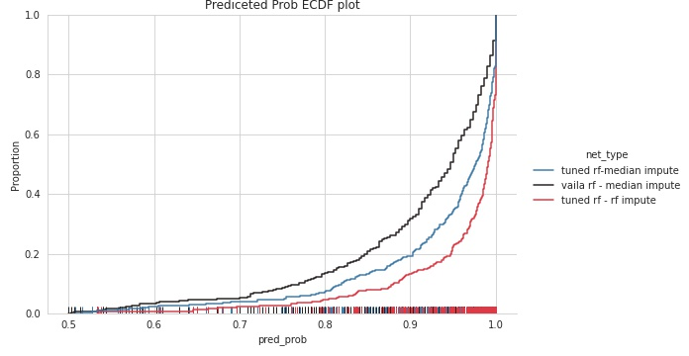
Predicted probability quality
Introduction
Probability
quality
Data
Preprocessing
Feature
Importace
With probability threshold for true positive set as 0.8 accuracy is :
Training accuracy : 96.2 %
Test accuracy : 92.1%
Training
Result
Analysis
Future Roadmap

Slide 36
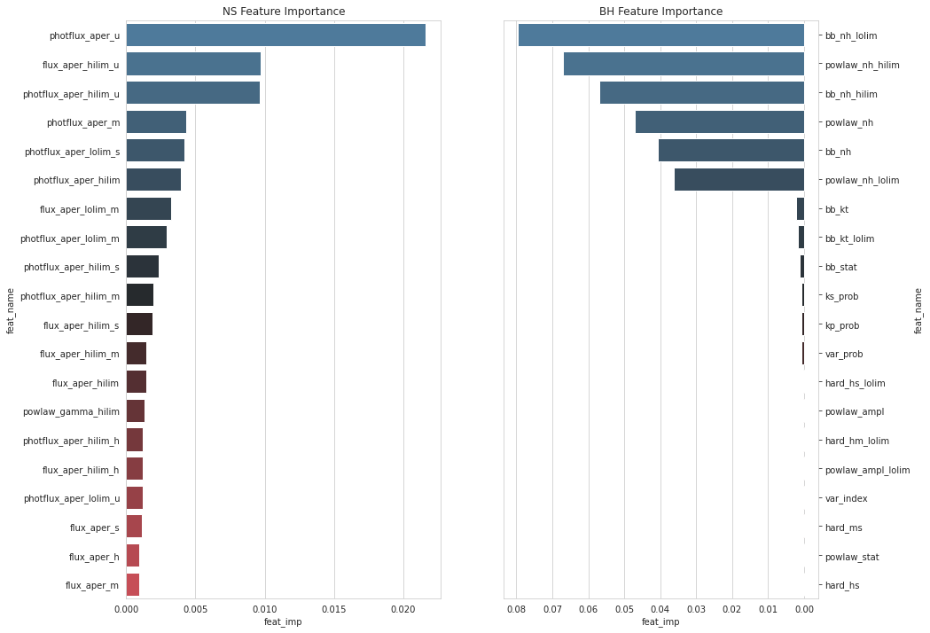
Feature Importance
Introduction
Probability
quality
Data
Preprocessing
Feature
Importace
RF gives feature importance to each feature
Class-wise feature Importance :
Training
Result
Analysis
Future Roadmap

Slide 37
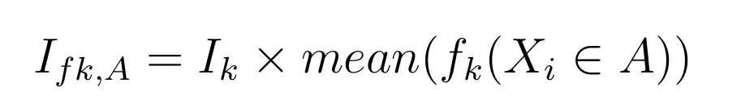
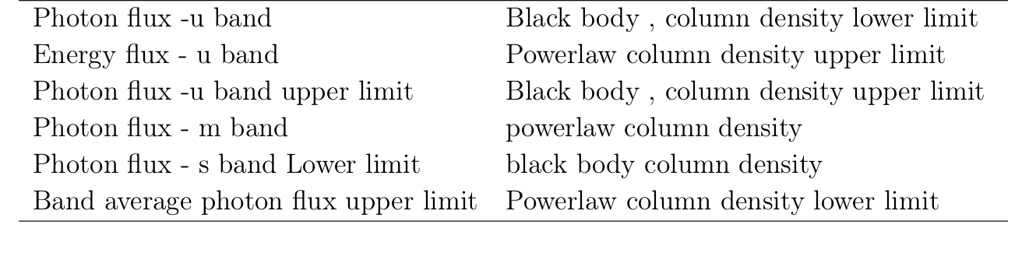
Feature Importance
Introduction
Probability
quality
Data
Preprocessing
Feature
Importance
Based on Gini Impurity
Class-wise feature Importance :
Training
NS
BH
Result
Analysis
Future Roadmap

Slide 38
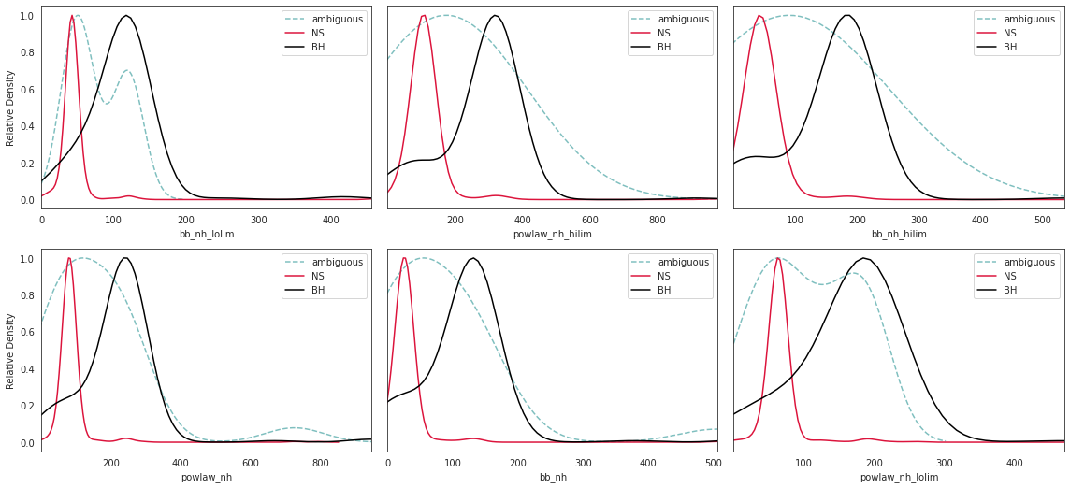
Feature Importance
Introduction
Probability
quality
Data
Preprocessing
Feature
Importace
Black Hole lmxrb important features
Training
Result
Analysis
Future Roadmap

Slide 39
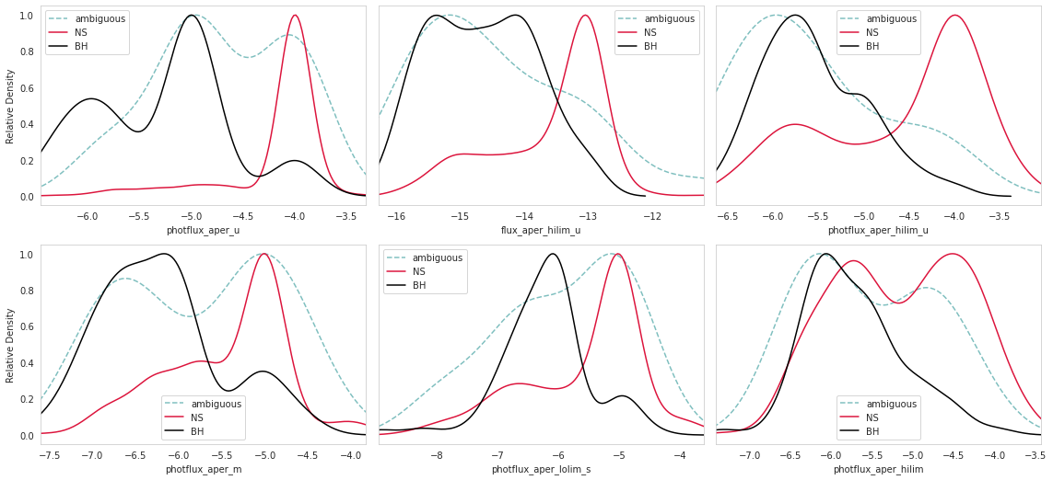
Feature Importance
Introduction
Probability
quality
Data
Preprocessing
Feature
Importace
Neutron Star important features
Training
Result
Analysis
Future Roadmap

Slide 40
Conclusion and Future
Introduction
Data
Preprocessing
Conclusion
Identified best schematic for LMXRB classification into NS and BH
Achieved test accuracy – 92 %
Future Work Plan
Study feature-feature correlation to drop not-so important features
Physical significane of the result
Phase –02 :
Add CVs and Mili second puldars to classification
Phase –03 :
Try Unsupervised learning with observations of all the GC sources in CSC
Phase –04 :
Expand classification to non-gc and extraglactic sources also
Training
Result
Analysis
Future Roadmap

Slide 41
Thank You

Slide 42
Introduction
Problem
Why Globular cluster X-ray sources
Data
Preprocessing
Motivation
Chandra Source
catalogue
Training
Finding Labels
Result
Analysis
Ideal Source list
Future Roadmap

Slide 43
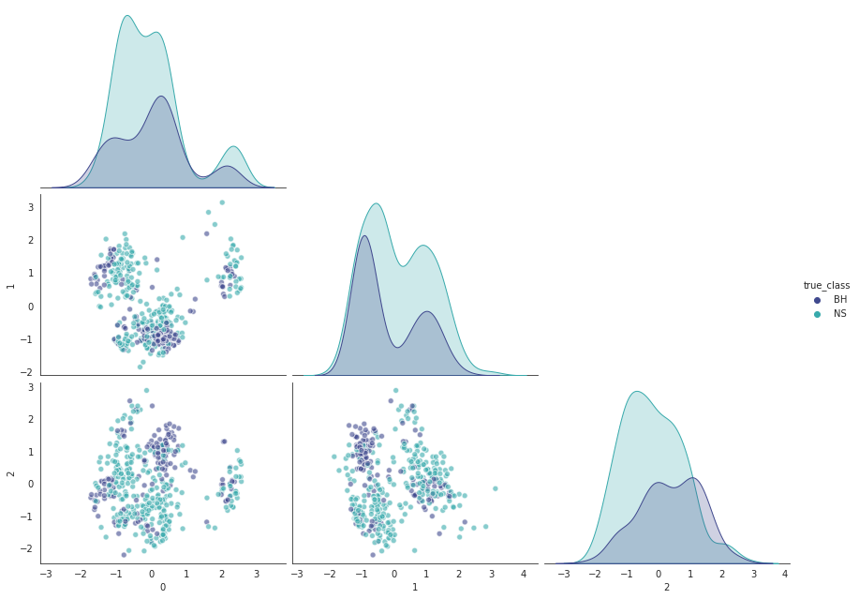
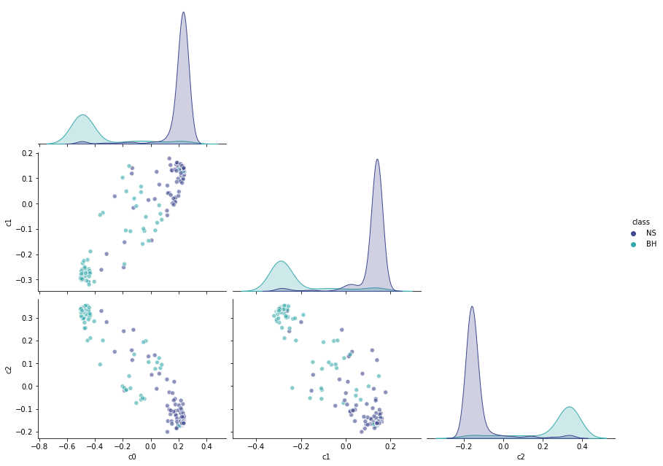
Why Probability improved
Introduction
Probability
quality
Data
Preprocessing
Feature
Importace
Training
Result
Analysis
Future Roadmap

Slide 44
Feature Importance
Introduction
Probability
quality
Data
Preprocessing
Feature
Importace
RF gives feature importance to each feature
Class-wise feature Importance :
Training
Result
Analysis
Future Roadmap

