Slide 2
Contents
Recap
Obs-wise vs Source-wise comparison
Balancing class
Feature reduction
Classification significance
Why we need
Validation stat - training score trade off
Permutation test
Application on 47-Tuc
Next steps
Multi-wavelength using NED
Improving algorithms

Slide 3
Recap
Methods tried
Source imputation
Adaboost
Increse training data
Reason for improvement
Class imbalnce

Slide 4
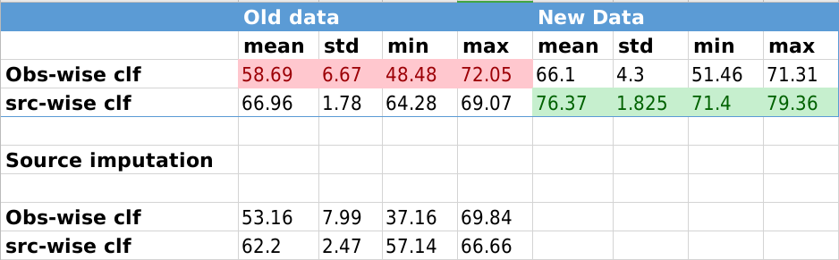
Reason
Source - vs - all imputation
Source-wise vs obs-wise classification
New data vs old data

Slide 5
Balancong data : SMOTE
Issue - class imbalance
CV - 184
LMXB - 58
PULSAR - 178
Solution - Oversampling of minority class
SMOTE algorithm

Slide 6
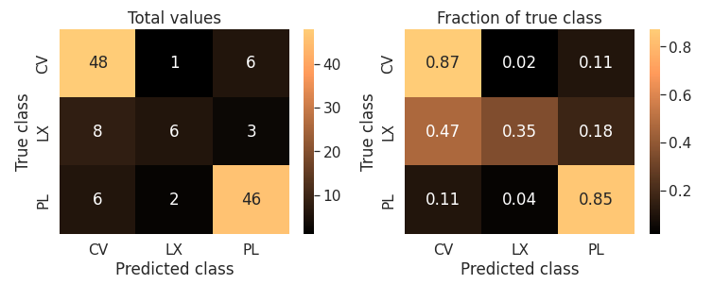
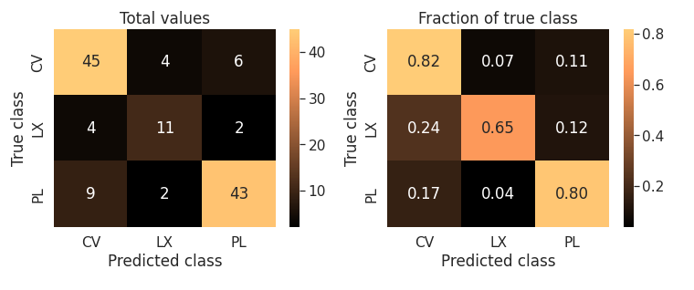
Balancong data : SMOTE
Issue
Solution
Result

Slide 7
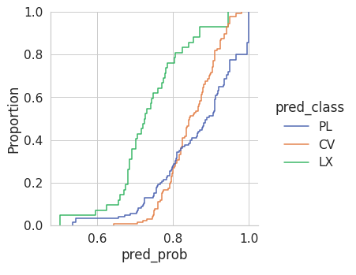
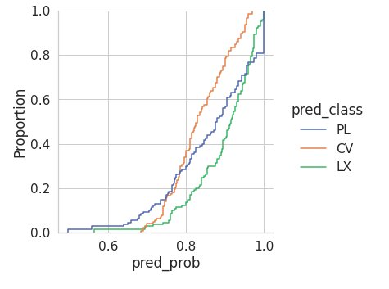
Balancong data : SMOTE
Issue
Solution
Result

Slide 8
Classification significance
Training set
val-set
Validation statistic - Training accuracy trade-off.
Training set
val-set

Slide 9
Classification significance
 | Features | class
Permutation test.
Null hypothesis - No relation between class labels and feature values exist.
p-score : probability that accuracy on permuted data will be more than or equal to original-data accuracy.

Slide 10
Classification significance
 | Features | class
Permutation test.
Null hypothesis - No relation between class labels and feature values exist.
p-score : probability that accuracy on permuted data will be more than or equal to original-data accuracy.

Slide 11
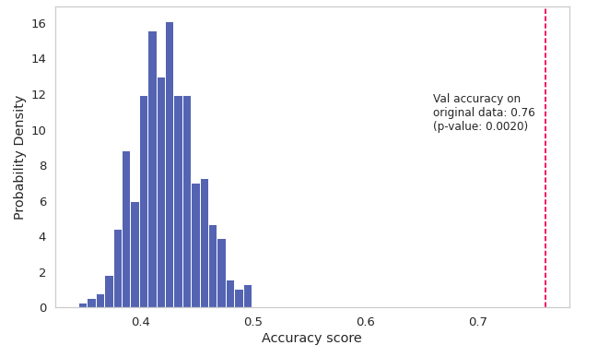
Classification significance
Permutation test.
Null hypothesis - No relation between class labels and feature values exist.
p-score : probability that accuracy on permuted data will be more than or equal to original-data accuracy.

Slide 12
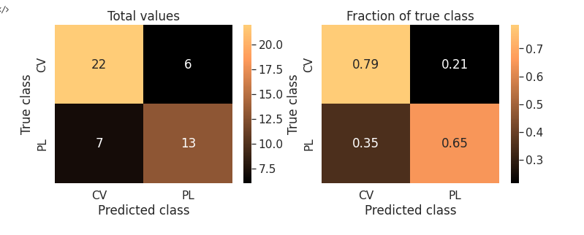
Application on 47 TUC
 | Sources in 47-TUC | after filtering
Pulsar |  | 21
CV |  | 27
LMXB | 5 | 0

Slide 13
Next steps

