Slide 1
Classification of Faint X-ray Sources Associated with Globular Cluster Using Machine Learning
December 2020
Shivam Kumaran
Indian Institute of Space Science and Technology

Slide 2
We Need to classify X-ray sources associated with Globular cluster using properties available given in Chandra Source Catalogue 2.0
Problem Statement
Introduction
Data Collection
Data Processing
Design classifier
Optimize classifier
Result / Application

Slide 3
Globular Cluster
System of stars gravitationally bound together.
GC dynamical Evolution
Carretta et al > MC simulation of dynamic evolution of GC
Without XRB - mean collapse timesscale shorter than mean timescale of Galactic GC - 11.2Gyr
Carretta, E., Gratton, R. G., Astronomico, O., and Bologna, D.
(2000). Distances, ages, and epoch of formation of globular clusters THE ASTROPHYSICAL
JOURNAL, 533:215–235.
Introduction
Data Collection
Data Processing
Design classifier
Optimize classifier
Result / Application

Slide 4
Globular Cluster
Improved simulation
Included XRB
Mean time-scale matches
Hypothesis -
XRB helps in stability against gravitational collapse
Dynamical evolution process with XRB^{[1]}
Core contraction phase
binary burning phase - collapse halts
After max-possible binaries formed, collapse restarts
binary burning phase restarts
[1] .Pooley, D. (2009). Globular cluster x-ray sources. PNAS
Introduction
Data Collection
Data Processing
Design classifier
Optimize classifier
Result / Application

Slide 5
Globular Cluster Evolution
Binary Burning phase and dynamical evolution governed by - Encounter Frequency
Directly correlated with population distribution of XRB.
Understanding XRB Population distribution
Understanding Encounter Frequency
Globular cluster Dynamics and Evolution
Introduction
Data Collection
Data Processing
Design classifier
Optimize classifier
Result / Application

Slide 6
X-ray Binaries
Low Mass X-ray binary
Companion Neutron star or Black hole
Donating star mass < 1.5 M_{solar}
Cataclysmic Variable
Binary Accreting System
Accretion onto White Dwarf
Identification is done mainly using optical counterpart
Millisecond Pulsar
Rapidly rotating Neutron Star
May or may not be binary
Formed from LMXB
Rotation powered emission
Identification mainly using radio timing
Introduction
Data Collection
Data Processing
Design classifier
Optimize classifier
Result / Application
cite -

Slide 7
Example : 47-TUC
Class | Identification Method | # sources
CV | Optical identification | 30
MSP | Radio cross match | 27
qLMXB | Spectral studies | 5
About 47-TUC
Mass : 10⁶ M☉
Distance : 4.85 kpc
Size : core radius 24``
Pointed Observation
2400 KS
Estimated population
CV : 24-113
MSP ~ 700
LMXB ~ 300
Manual Identification is not easy.
Need Better identification
Heinke, et.al (2005). A deep
chandra survey of the globular cluster 47 tucanae: Catalog of point
sources.
Introduction
Data Collection
Data Processing
Design classifier
Optimize classifier
Result / Application

Slide 8
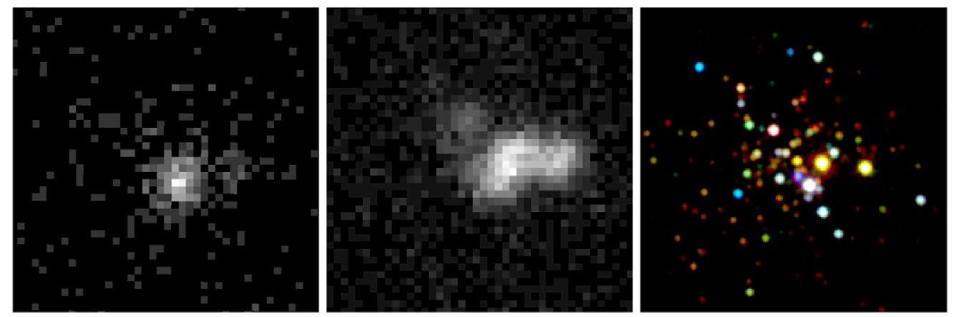
Chandra X-ray telescope
ω-Centauri
For any such identification we need telescope like Chandra
Higher sensitivity
Better resolution
Introduction
Data Collection
Data Processing
Design classifier
Optimize classifier
Result / Application

Slide 9
Chandra : Instruments
High Resolution Camera (HRC)
Energy band :
wide band (w) -
Advanced CCD Imageing Spectograph (ACIS)
Resolution :
Sensitivity : 4 × 10−15 ergs/cm2/s in energy band (0.4
to 6.0 keV) for an integration time of 104 sec
Energy Band :
broad band (b)-
ultrasoft band (u) -
soft band (s)-
medium band (m)-
hard band (h)-
Introduction
Data Collection
Data Processing
Design classifier
Optimize classifier
Result / Application

Slide 10
Chandra : Chandra Source catalogue
Master Source Table
Per-Obs Detection Table
source | properties
s1
s2
s3
s4
s5
...
..
..
source | Obs | properties
s1 | obs1
 | obs2
 | obs3
s2 | obs1
s3 | obs1
 | obs2
 | obs3
 | ....
...
Per-Stack Detection Table
Introduction
Data Collection
Data Processing
Design classifier
Optimize classifier
Result / Application

Slide 11
Chandra Source catalogue : features
Source Info
Flux
Variability
Spectral
Introduction
Data Collection
Data Processing
Design classifier
Optimize classifier
Result / Application

Slide 12
Data
Collection
Introduction
Introduction
Data Collection
Data Processing
Design classifier
Optimize classifier
Result / Application

Slide 13
Data Collection
For a givne class -
LMXB / CV / MPS
Problem
We do not have class labels in CSC
Find RA/DEC for Known source
Solution
Look for other catalogue and in published literature
Cross-Match with CSC
Download data from CSC
Introduction
Data Collection
Data Processing
Design classifier
Optimize classifier
Result / Application

Slide 14
Data Collection
For a givne class -
LMXB / CV / MPS
LMXB
CSC
Find RA/DEC for Known source
GC
Cross-Match with CSC
Download data from CSC
Introduction
Data Collection
Data Processing
Design classifier
Optimize classifier
Result / Application

Slide 15
Data Collection
For a givne class -
LMXB / CV / MPS
Write about catalogues and literature survey ?
Find RA/DEC for Known source
Cross-Match with CSC
Download data from CSC
Introduction
Data Collection
Data Processing
Design classifier
Optimize classifier
Result / Application

Slide 16
Data Preprocessing
Data Collection

Slide 17
Data Preprocessing
Sanitize Data
Normalize data
To remove non-quiscent obs
max flux - 10² erg/cm²/s
Flux-filter
To keep obs only above
3-σdetection
Log(flux)
Pre-processed data
significance filter
Introduction
Data Collection
Data Processing
Design classifier
Optimize classifier
Result / Application

Slide 18
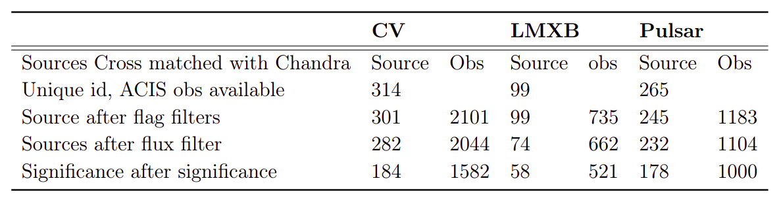
Data Preprocessing
Introduction
Data Collection
Data Processing
Design classifier
Optimize classifier
Result / Application

Slide 19
Machine Learning
Finally we have Data and labels as well.
We need to learn feature-class label relation
Typical Machine learning problem
Is it that simple ?
NO
source | Obs | properties | Class label
s1 | obs1
 | obs2
 | obs3
s2 | obs1
s3 | obs1
 | obs2
 | obs3
 | ....
...
We need to learn feature-class label relation
Introduction
Data Collection
Data Processing
Design classifier
Optimize classifier
Result / Application

Slide 20
Data Preprocessing
Problems
Very small dataset
Missing data
About 50% missing values
Reason for missing values
Source may be faint in some bands
plot here showing amount of missing data
Introduction
Data Collection
Data Processing
Design classifier
Optimize classifier
Result / Application

Slide 21
Data Imputation :Correlation Imputation
Algorithm
Find feature-feature correlation
For a missing value for a given source in feature column, find next best correlated feature
Fit linear regression b/w these two features
Fill in missing value using linear regression.
Introduction
Data Collection
Data Processing
Design classifier
Optimize classifier
Result / Application

Slide 22
Data Imputation
Similarity Imputation using RF
Introduction
Data Collection
Data Processing
Design classifier
Optimize classifier
Result / Application

Slide 23
Data Imputation
Regression Imputation
Introduction
Data Collection
Data Processing
Design classifier
Optimize classifier
Result / Application

Slide 24
Data Imputation
How to compare which regression method works correctly for classification
Need to do classification
Need a classifier.
Introduction
Data Collection
Data Processing
Design classifier
Optimize classifier
Result / Application

Slide 25
Classifier
K-Nearest Neighbour
Fully Connected Network
Convolution Neural Network
Random Forest Classifier
Introduction
Data Collection
Data Processing
Design classifier
Optimize classifier
Result / Application

Slide 26
Classifier : KNN
Working
Reason to try-on
Caveats
Introduction
Data Collection
Data Processing
Design classifier
Optimize classifier
Result / Application

Slide 27
Classifier : Fully Connected Net
Working
Reason to try-on
Caveats
Introduction
Data Collection
Data Processing
Design classifier
Optimize classifier
Result / Application

Slide 28
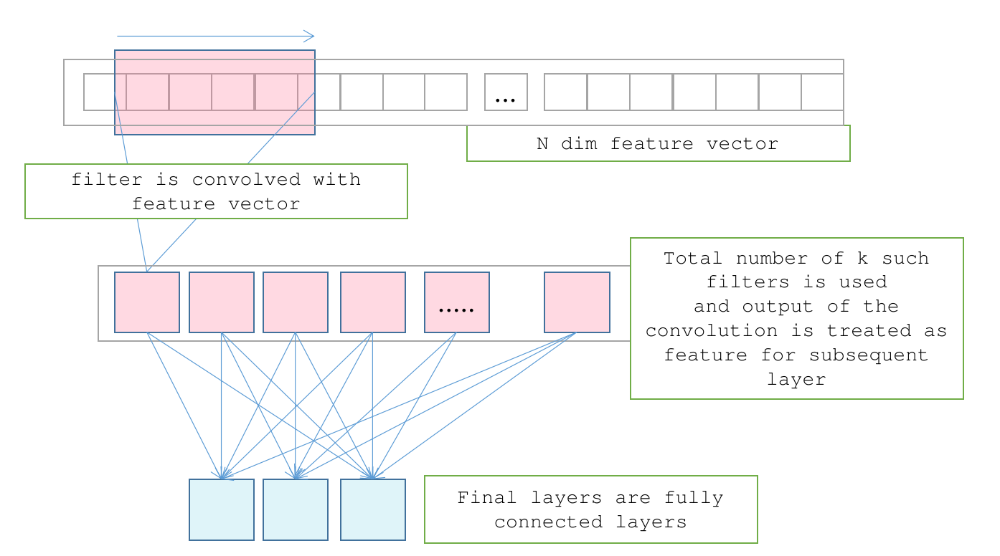
Classifier : Convolution Neural Network
Working
Reason to try-on
Caveats
Introduction
Data Collection
Data Processing
Design classifier
Optimize classifier
Result / Application

Slide 29
Classifier : Random Forest
Working (Explain with sufficient detail)
Reason to try-on
Caveats
Introduction
Data Collection
Data Processing
Design classifier
Optimize classifier
Result / Application

Slide 30
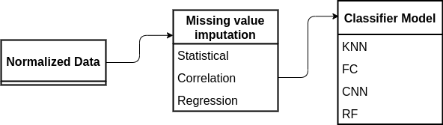
Classifier Pipeline
How to select which one works the best ?
Introduction
Data Collection
Data Processing
Design classifier
Optimize classifier
Result / Application

Slide 31
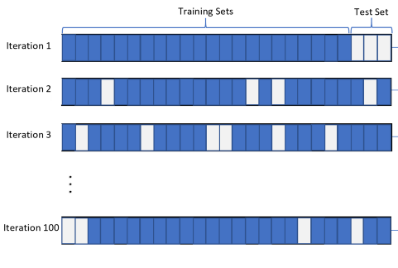
Monte-Carlo Cross Validation
Algorithm
Randomly reshuffle rows
Randomly sample 0.3 of the data-set and keep aside as validation set
Train on rest of the sample
Check accuracy on validation sample
Do this for N iteration
Distribution of validation accuracy
A good model
Higher mean accuracy
Least std in accuracy.
Introduction
Data Collection
Data Processing
Design classifier
Optimize classifier
Result / Application

Slide 32
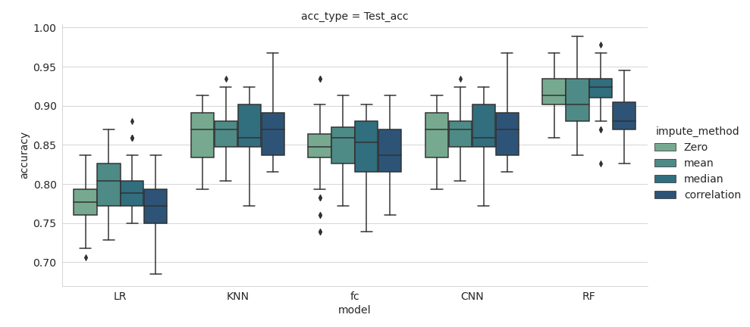
Monte-Carlo Evolution : Result
Introduction
Data Collection
Data Processing
Design classifier
Optimize classifier
Result / Application

Slide 33
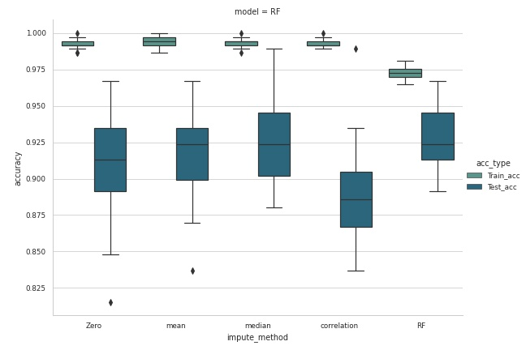
Imputer+ Classifier Result
Introduction
Data Collection
Data Processing
Design classifier
Optimize classifier
Result / Application

Slide 34
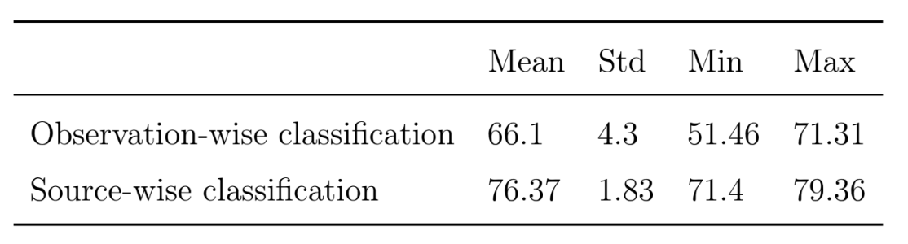
Classifier selected
Preprocesssed data
Fill missing values with random forest regressor
Random Forest Classifier
Introduction
Data Collection
Data Processing
Design classifier
Optimize classifier
Result / Application

Slide 35
Optimising
Classifier
Data Processing

Slide 36
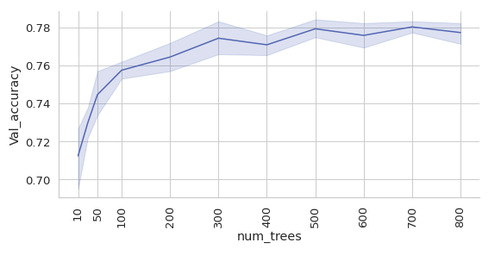
Optimizing RF
Hyperparameter tuning
Parameters to tune
Number of trees
Max-depth
...
...
Number of trees
Introduction
Data Collection
Data Processing
Design classifier
Optimize classifier
Result / Application

Slide 37
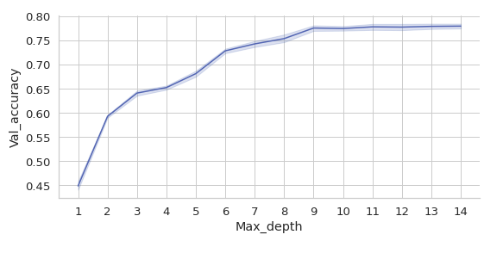
Optimizing RF
Hyperparameter tuning
Parameters to tune
Number of trees - 500
Max-depth - 10
Max depth
Introduction
Data Collection
Data Processing
Design classifier
Optimize classifier
Result / Application

Slide 38
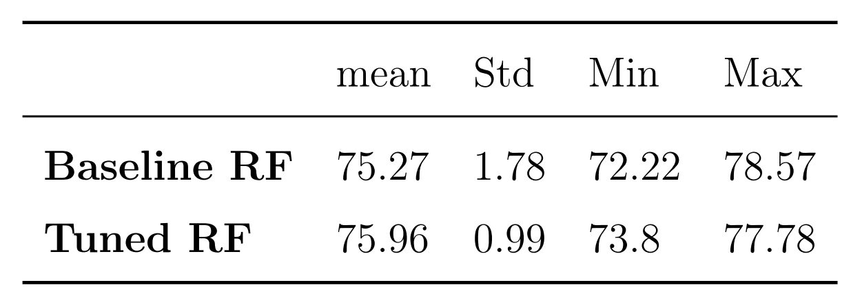
Tuned RF Result: Score
Best Random forest
Number of trees - 500
Max-depth - 10
Result
Accuracy :
precision Recall
Confusion Matrix
Probability quality
Problem
Class imbalance
not able to learn LMXB class.
Introduction
Data Collection
Data Processing
Design classifier
Optimize classifier
Result / Application

Slide 39
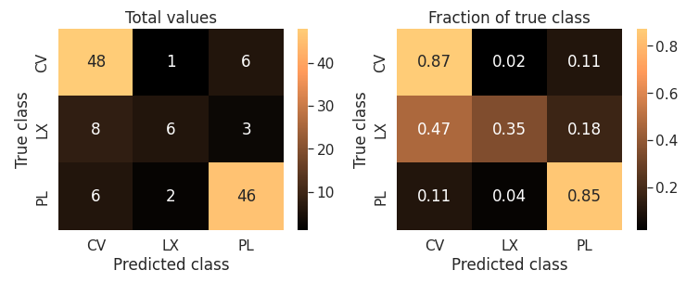
Tuned RF Result : Confusion Matrix
Result
Accuracy :
precision Recall
Confusion Matrix
Probability quality
Problem
Class imbalance
not able to learn LMXB class.
Introduction
Data Collection
Data Processing
Design classifier
Optimize classifier
Result / Application

Slide 40
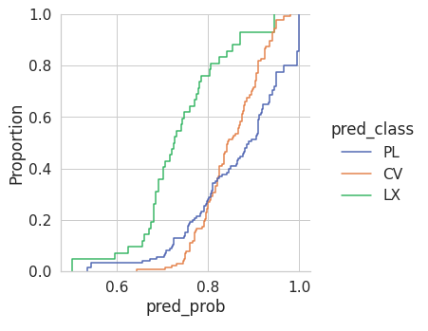
Tuned RF Result : Probability quality
Result
Accuracy :
precision Recall
Confusion Matrix
Probability quality
Problem
Class imbalance
not able to learn LMXB class.
Introduction
Data Collection
Data Processing
Design classifier
Optimize classifier
Result / Application

Slide 41
Balancing Class : SMOTE
SMOTE : Synthetic Minority Oversampling Technique
Algorithm
In higher dimension feature space
Each point represent one source
Linear interpolation between these points (source)
Sample points from nearest interpolations
Make each class equal.
Introduction
Data Collection
Data Processing
Design classifier
Optimize classifier
Result / Application

Slide 42
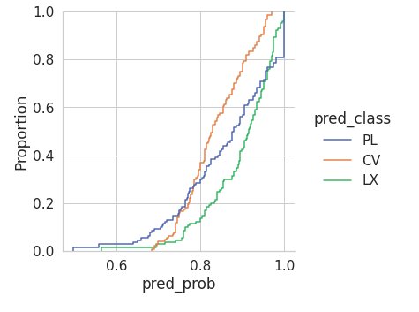
Balancing Class : SMOTE
SMOTE result
Introduction
Data Collection
Data Processing
Design classifier
Optimize classifier
Result / Application

Slide 43
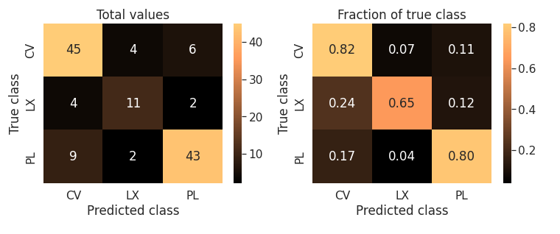
Balancing Class : SMOTE
SMOTE result
Accuracy
precision
recall
Introduction
Data Collection
Data Processing
Design classifier
Optimize classifier
Result / Application

Slide 44
Balancing Class : SMOTE
SMOTE result
Accuracy
precision
recall
Introduction
Data Collection
Data Processing
Design classifier
Optimize classifier
Result / Application

Slide 45
Limitations of SMOTE
Can not infinitely upsample
Available data should be able to represent parent distribution
Introduction
Data Collection
Data Processing
Design classifier
Optimize classifier
Result / Application

Slide 46
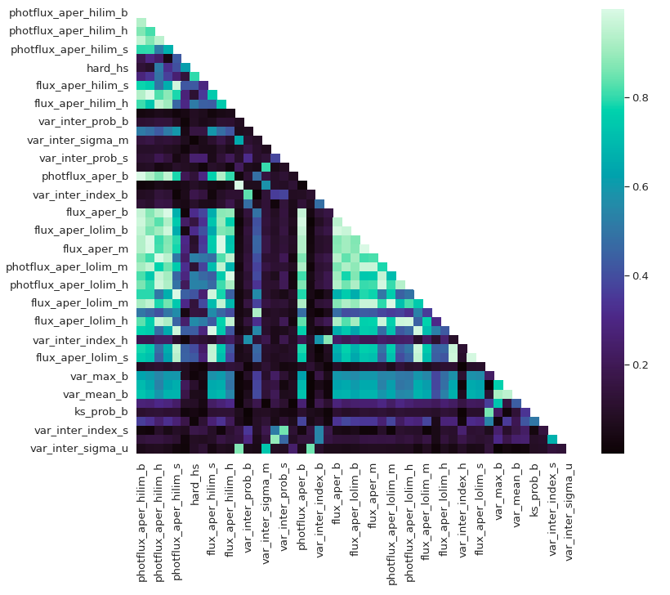
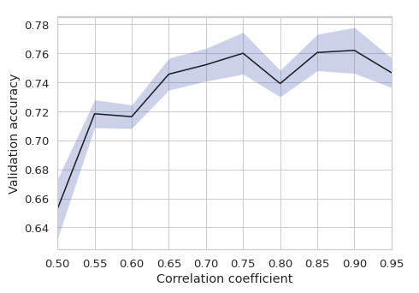
Feature optimization
Feature-feature correlation
why we need to remove correlated features
Introduction
Data Collection
Data Processing
Design classifier
Optimize classifier
Result / Application

Slide 47
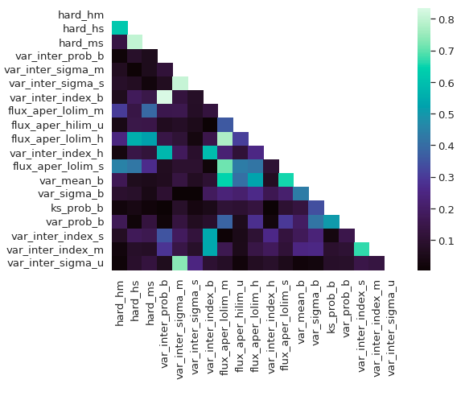
Feature optimization
Feature-feature correlation
why we need to remove correlated features
Introduction
Data Collection
Data Processing
Design classifier
Optimize classifier
Result / Application

Slide 48
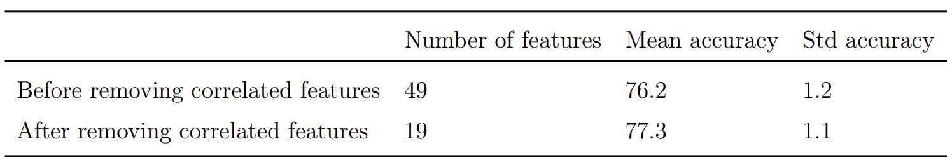
Feature optimization
Feature -feature correlation
why we need to remove correlated features
Comparison of result -
Introduction
Data Collection
Data Processing
Design classifier
Optimize classifier
Result / Application

Slide 49
Feature Importance
Contribution of each feature for classification
Understanding physical significance
Learn what machine has learnt.
Introduction
Data Collection
Data Processing
Design classifier
Optimize classifier
Result / Application

Slide 50
Feature Importance
Algorithm
src | properties |  |  |  | Class label
 | flux | variability | hardness | .........
s1
s2
s3
s4
s5
s6
s7
s8
...
Original dataset
Randomize feat
Do Training
Cross validation
Val Accuracy
Val Accuracy
Drop In accuracy
Introduction
Data Collection
Data Processing
Design classifier
Optimize classifier
Result / Application

Slide 51
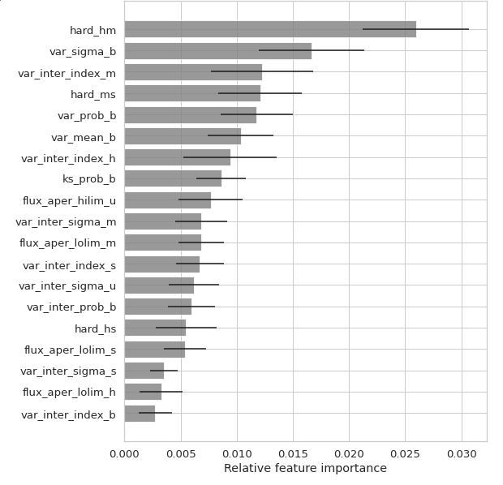
Feature Importance
Result
Discussion
Important feature
Hardness in hm band
Short term variability
Long term variability
Introduction
Data Collection
Data Processing
Design classifier
Optimize classifier
Result / Application

Slide 52
AdaBoost
Ensamble classifier
Can we improve further
No further improvement.
RF is able to capture as much information as possible
Introduction
Data Collection
Data Processing
Design classifier
Optimize classifier
Result / Application

Slide 53
Result significance
Problem with validation result
small sample available for validation
LMXB - 17
CV - 55
MSP - 54
Validation result - training quality tradeoff
Other method
Permutation Significance
Training sample
validation sample
Training sample
validation sample
Introduction
Data Collection
Data Processing
Design classifier
Optimize classifier
Result / Application

Slide 54
Permutation - Test
Null Hypothesis -
No relation between features and the class label
p-Score
Probability that accuracy on label-permuted data will be more than or equal to accuracy on original data
Null-hypothesis p-score ~ 0.5
S1
features s1
LMXB
S2
features s2
CV
S3
features s3
CV
S4
features s4
LMXB
S5
features s5
MSP
S6
features s6
CV
S7
features s7
MSP
S8
features s8
CV
S9
features s9
MSP
S10
features s10
LMXB
Introduction
Data Collection
Data Processing
Design classifier
Optimize classifier
Result / Application

Slide 55
Permutation - Test : Algorithm
acc on original labels
S1
features s1
LMXB
S2
features s2
CV
Permute label
S3
features s3
CV
S4
features s4
LMXB
S5
features s5
MSP
S6
features s6
CV
S7
features s7
MSP
S8
features s8
CV
S9
features s9
MSP
S10
features s10
LMXB
Introduction
Data Collection
Data Processing
Design classifier
Optimize classifier
Result / Application

Slide 56
Permutation - Test
acc on original labels
S1
features s1
MSP
S2
features s2
CV
Permute label
S3
features s3
LMXB
S4
features s4
MSP
S5
features s5
CV
Cross validation
S6
features s6
CV
S7
features s7
LMXB
Val Accuracy
S8
features s8
CV
S9
features s9
LMXB
S10
features s10
MSP
Val accuracy dist.
Introduction
Data Collection
Data Processing
Design classifier
Optimize classifier
Result / Application

Slide 57
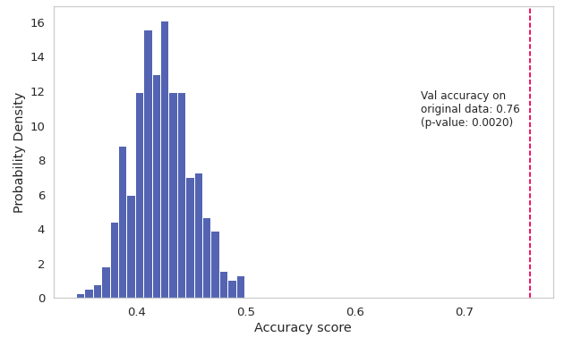
Permutation - Test : Result
Permutation test result
p-score: 0.002
Introduction
Data Collection
Data Processing
Design classifier
Optimize classifier
Result / Application

Slide 58
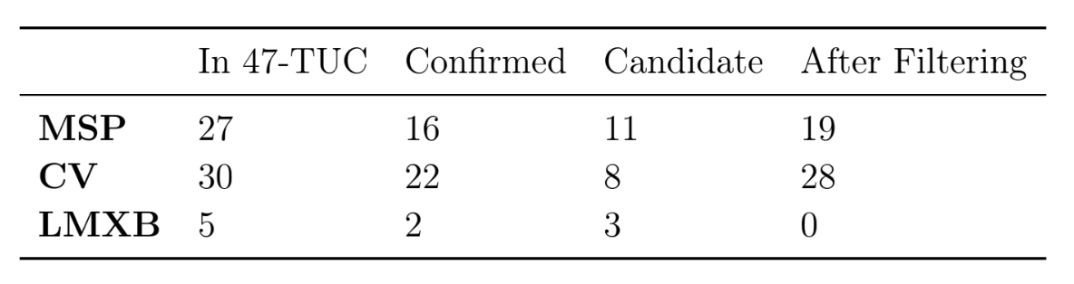
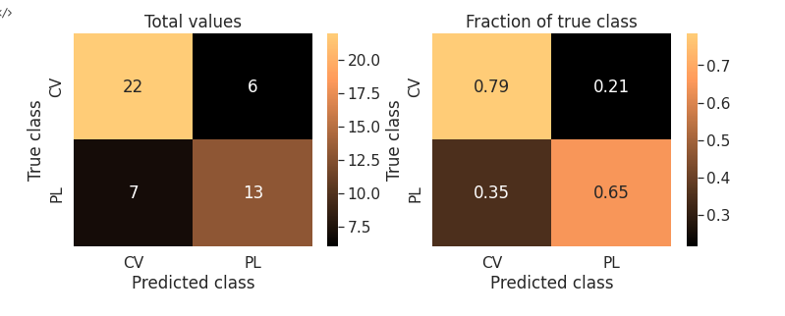
Application on 47-TUC
Introduction
Data Collection
Data Processing
Design classifier
Optimize classifier
Result / Application

Slide 59
Conclusion
Using Published catalogues , literature survey a subset catalog of CSC was created.
Explored various methods of filling in missing values
Imputation with RF works best
Explored various classifier models. > RF chosen
Classification result
Validation accuracy ~ 75%
Permutation test p-score 0.002
Applied to 47-TUC
Road Blocks
Result not accurate enough
Predicted probabilities are low
Data sample is small

Slide 60
Future Plan
Immediate
Gaussian Resampling of minority class
Upsampling of all classes
Deep Learning - Auto Encoder for missing value prediction
Cross match with NED
Ahead
Application on other Globular clusters
Understanding GC dynamics
Adding more classes
Classification on entire Chandra Source Catalogue

Slide 61
Animation

Slide 62
Thank You
until next time....

