Slide 1
Transmission Compound Index
Components Inspected | Total Components Count | Components Defect Count
Jumper | 3 | 3
Crossarm | 6 | 0
Gwjumper | 1 | 0
Anticlimb | 1 | 0
Insulator | 6 | 0
Vibrationdamper | 8 | 0
Foundationleg | 4 | 1
Arcinghorn | 12 | 0
Dangersign | 1 | 0
Page No : 1

Slide 2
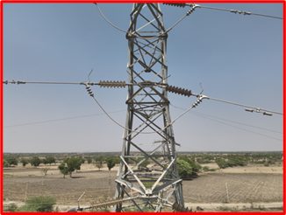
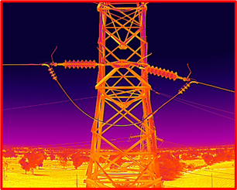
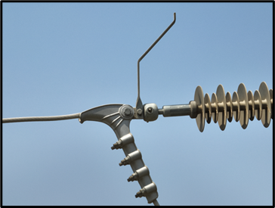
Jumper 1
Compound | Sp1 | Sp2 | Sp3 | Status
Jumper 1 | 35.40Â°C | 39.80Â°C | 45.30Â°C | Yet To Start
We are identified and resolved the defects
Page No : 2

Slide 3
Jumper 2
Compound | Sp1 | Sp2 | Sp3 | Status
Jumper 2 | 35.20Â°C | 35.70Â°C | 44.20Â°C | Yet To Start
Page No : 4

Slide 4
Jumper 3
Compound | Sp1 | Sp2 | Sp3 | Status
Jumper 3 | 34.50Â°C | 36.70Â°C | 43.30Â°C | Yet To Start
We are identified and resolved the defects
Page No : 5

Slide 5
Cross Arm 1
Page No : 6

Slide 6
Cross Arm 2
Page No : 7

Slide 7
Cross Arm 3
Page No : 8

Slide 8
Cross Arm 4
Page No : 9

Slide 9
Cross Arm 5
Page No : 10

Slide 10
Cross Arm 6
Page No : 11

Slide 11
GW Jumper 1
Page No : 12

Slide 12
Anti Climb Fence 1
We are identified and resolved the defects
Page No : 13

Slide 13
Insulator 1
Compound | Min Temp | Aug Temp | Max Temp | Status
Insulator 1 | 43.30Â°C | 44.00Â°C | 45.20Â°C | Yet To Start
Page No : 14

Slide 14
Insulator 2
Compound | Min Temp | Aug Temp | Max Temp | Status
Insulator 2 | 41.10Â°C | 42.10Â°C | 44.30Â°C | Yet To Start
Page No : 15

Slide 15
Insulator 3
Compound | Min Temp | Aug Temp | Max Temp | Status
Insulator 3 | 42.70Â°C | 43.30Â°C | 44.40Â°C | Yet To Start
Page No : 16

Slide 16
Insulator 4
Compound | Min Temp | Aug Temp | Max Temp | Status
Insulator 4 | 41.10Â°C | 42.00Â°C | 43.40Â°C | Yet To Start
Page No : 17

Slide 17
Insulator 5
Compound | Min Temp | Aug Temp | Max Temp | Status
Insulator 5 | 44.70Â°C | 45.70Â°C | 47.00Â°C | Yet To Start
Page No : 18

Slide 18
Insulator 6
Compound | Min Temp | Aug Temp | Max Temp | Status
Insulator 6 | 43.20Â°C | 44.10Â°C | 45.70Â°C | Yet To Start
Page No : 19

Slide 19
Vibration Damper 1
Page No : 20

Slide 20
Vibration Damper 2
Page No : 21

Slide 21
Vibration Damper 3
Page No : 22

Slide 22
Vibration Damper 4
Page No : 23

Slide 23
Vibration Damper 5
Page No : 24

Slide 24
Vibration Damper 6
Page No : 25

Slide 25
Vibration Damper 7
Page No : 26

Slide 26
Vibration Damper 8
Page No : 27

Slide 27
Foundation Leg 1
Page No : 28

Slide 28
Foundation Leg 2
Page No : 29

Slide 29
Foundation Leg 3
Page No : 30

Slide 30
Foundation Leg 4
Page No : 31

Slide 31
Arcing Horn 1
Page No : 32

Slide 32
Arcing Horn 2
Page No : 33

Slide 33
Arcing Horn 3
Page No : 34

Slide 34
Arcing Horn 4
Page No : 35

Slide 35
Arcing Horn 5
Page No : 36

Slide 36
Arcing Horn 6
Page No : 37

Slide 37
Arcing Horn 7
Page No : 38

Slide 38
Arcing Horn 8
Page No : 39

Slide 39
Arcing Horn 9
Page No : 40

Slide 40
Arcing Horn 10
Page No : 41

Slide 41
Arcing Horn 11
Page No : 42

Slide 42
Arcing Horn 12
Page No : 43

Slide 43
Danger Sign 1
Page No : 44

