Slide 1
LAPP Products Used in Equipment
Component Integration Overview (With Images)

Slide 2
Drag Chains
Matching LAPP Product: LAPP SILVYN® CHAIN
  LAPP's SILVYN® CHAIN systems are designed for cable protection and management in dynamic applications.

Slide 3
Continuous Movement Cables
Matching LAPP Product: LAPP ÖLFLEX® SERVO FD
  ÖLFLEX® FD cables are highly flexible cables specifically engineered for continuous movement within drag chains. Suitable for applications due to their high flexibility and durability in constantly moving parts.

Slide 4
Control Cabinet and Cable Glands
Matching LAPP Product: LAPP SKINTOP® Cable Gland
  SKINTOP® cable glands provide secure, strain-relieved, and often liquid-tight cable entry into control cabinets.

Slide 5
Control Cabinet Wiring
Matching LAPP Product: LAPP ÖLFLEX® UNIPLUS
  ÖLFLEX® UNIPLUS single-core cables are ideal for internal wiring of devices and control cabinets.

Slide 6
Cable Bundling
Matching LAPP Product: LAPP KW Plastic Coil
  KW plastic coils are used for easy and quick bundling of cables, providing mechanical protection and organization.

Slide 7
Circular Connectors
Matching LAPP Product: LAPP EPIC® M12
  EPIC® circular connectors, such as M12 connectors, are suitable for robust data, signal, and power connections in industrial applications, offering vibration protection and easy assembly.

Slide 8
Laptop Connection and Data Cables
Matching LAPP Product: UNITRONIC® & ETHERLINE®
  UNITRONIC® (Data & Communication Cables) and ETHERLINE® (Industrial Ethernet Cables) are used for reliable data transmission and network connectivity.

Slide 9
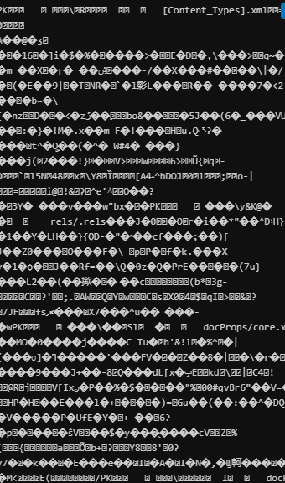
Equipment & Product Images

Slide 10
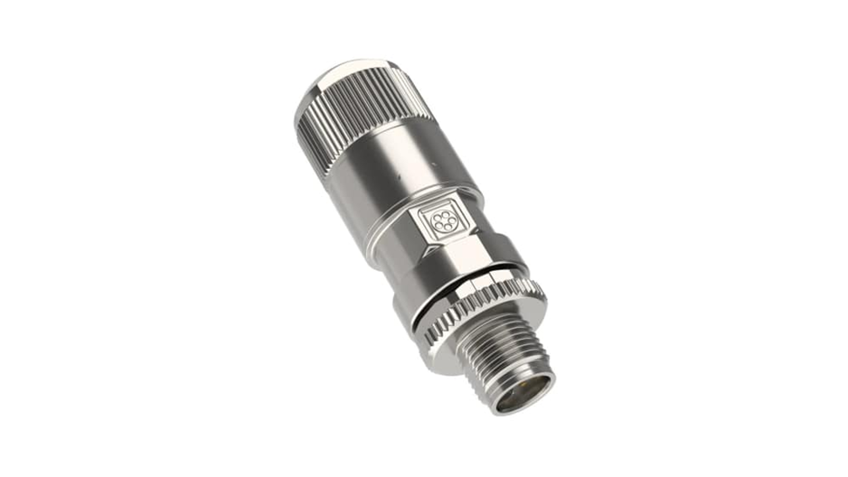
Equipment & Product Images

Slide 11
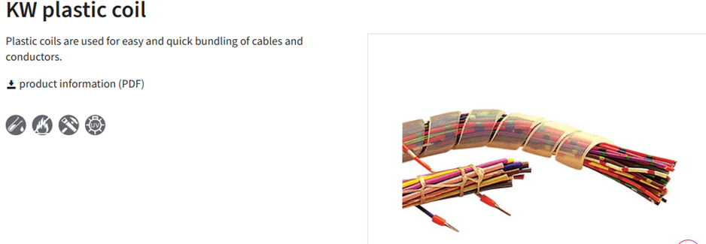
Equipment & Product Images

Slide 12
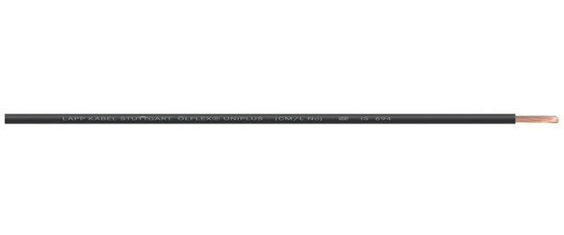
Equipment & Product Images

Slide 13
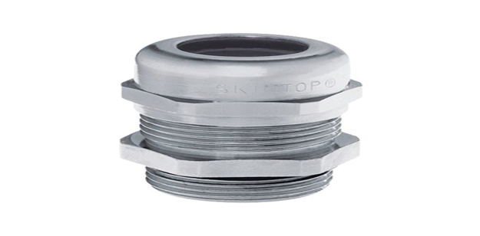
Equipment & Product Images

Slide 14
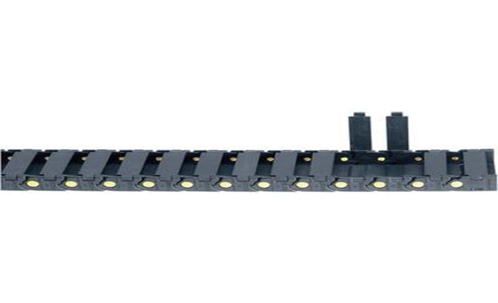
Equipment & Product Images

Slide 15
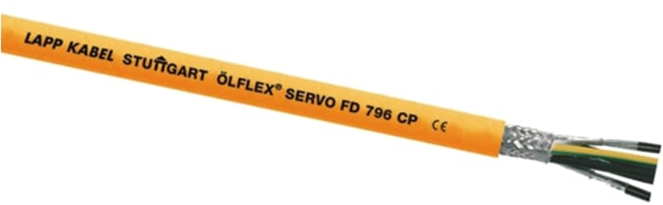
Equipment & Product Images

Slide 16
Equipment & Product Images

Slide 17
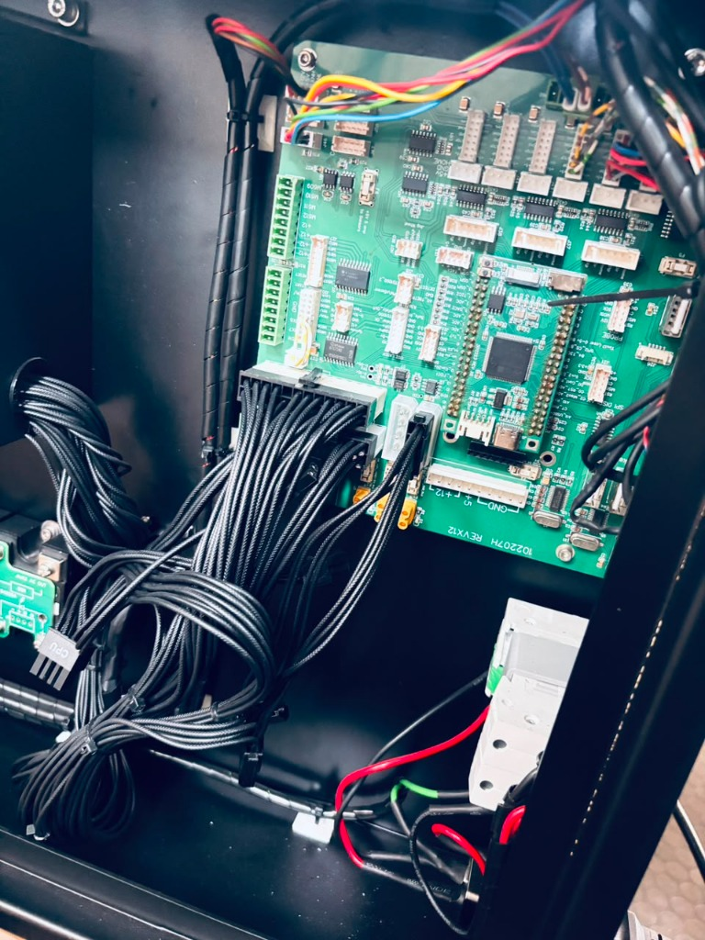
Equipment & Product Images

Slide 18
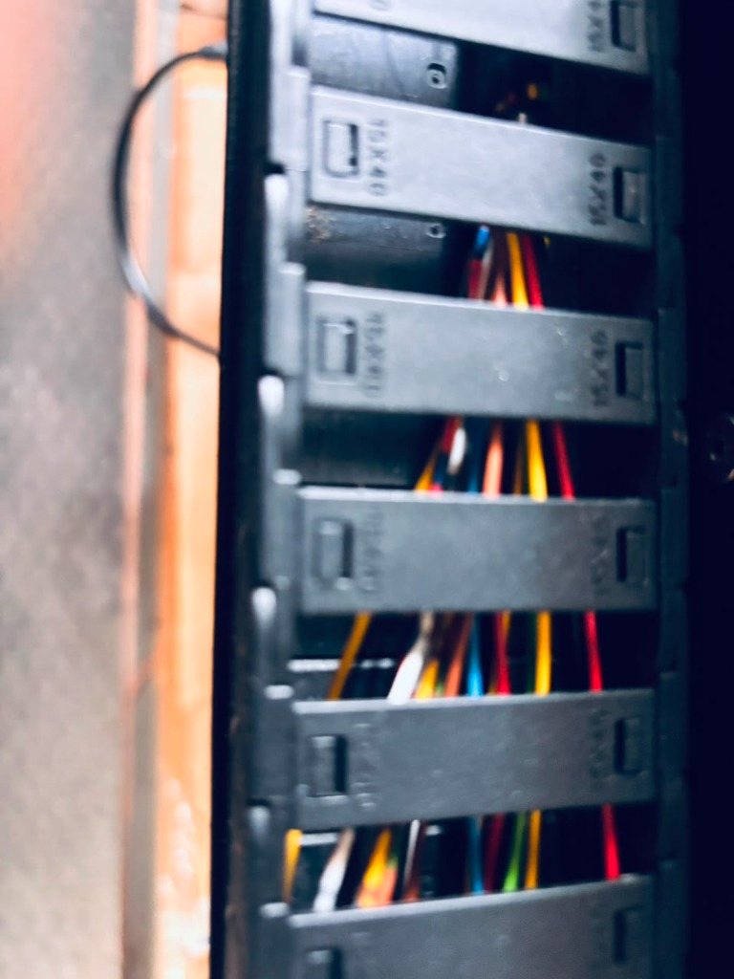
Equipment & Product Images

Slide 19
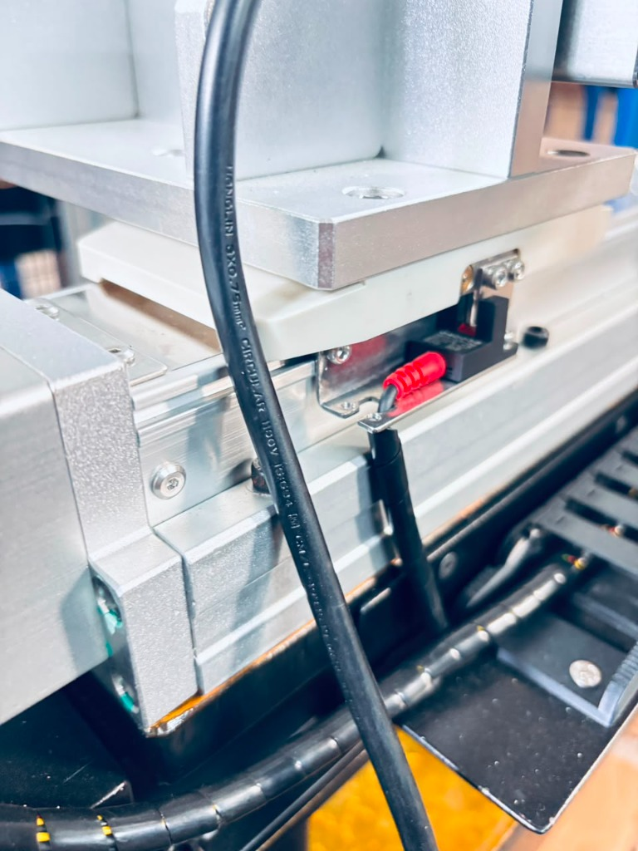
Equipment & Product Images

Slide 20
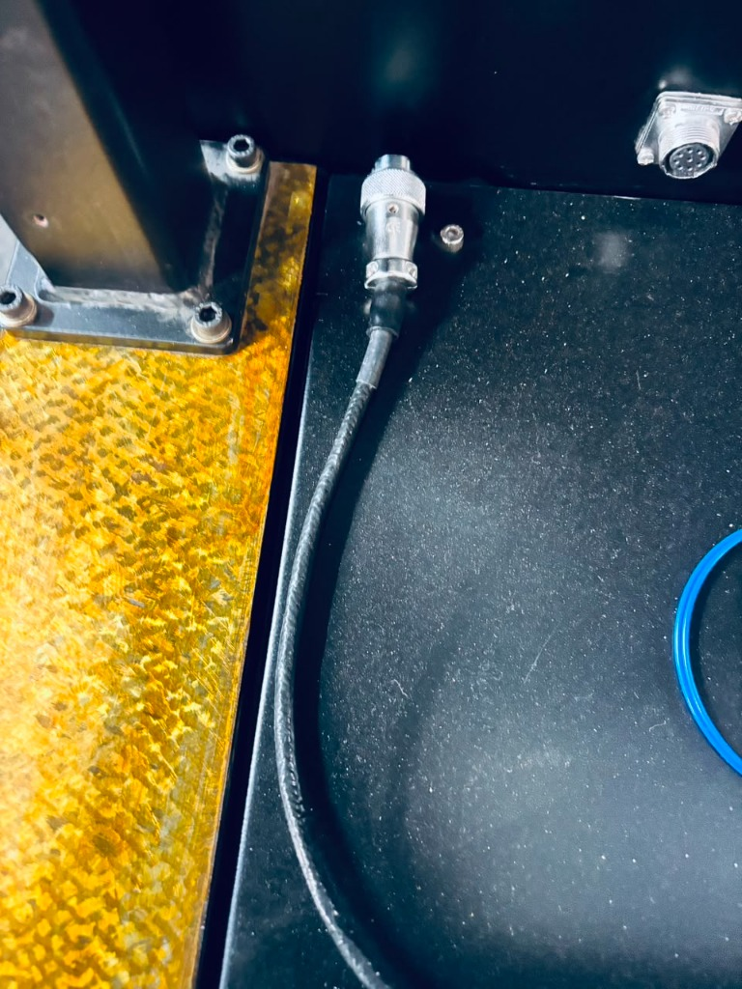
Equipment & Product Images

