Slide 1
Aerothermochemistry and Combustion
DAY 5
Kumaresh
2024/03/08

Slide 2
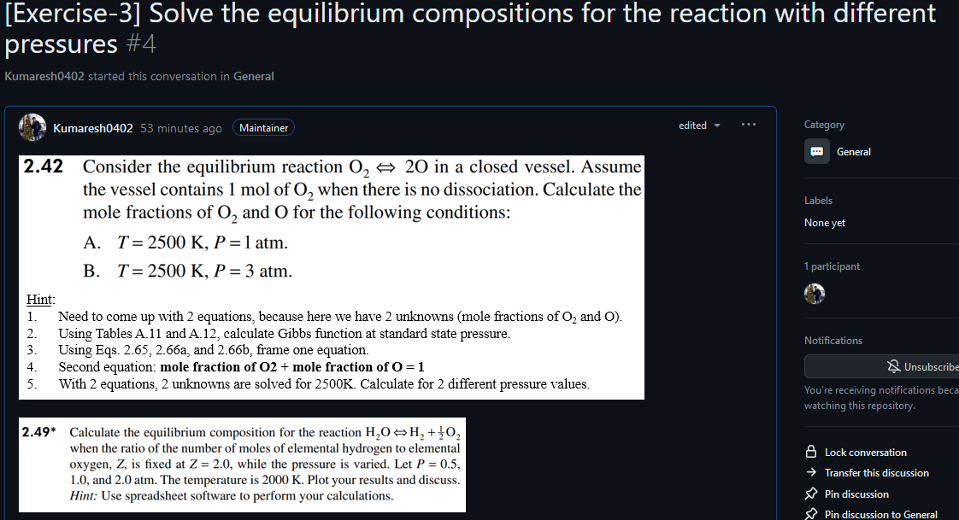
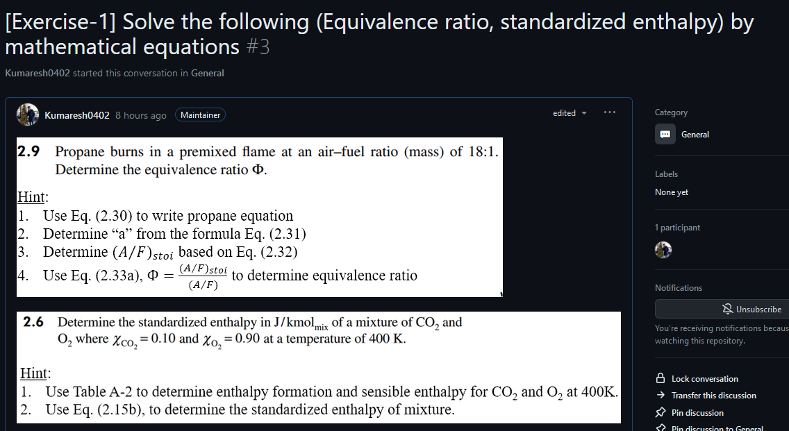
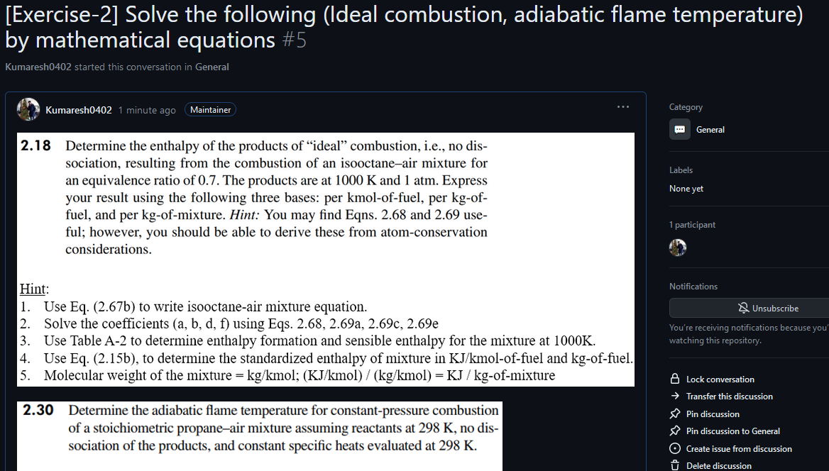
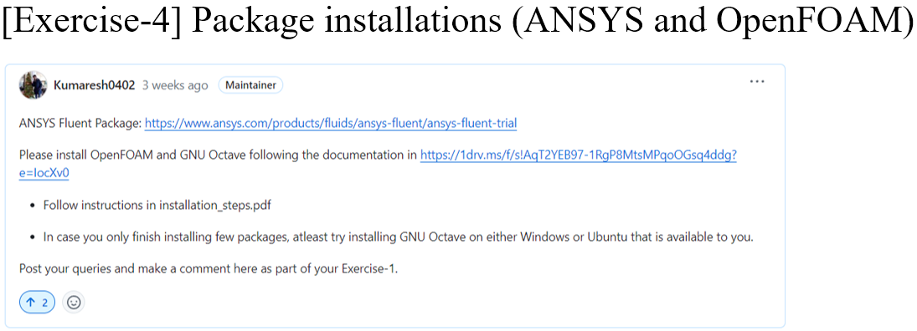
Quick Recap
Notes:
https://ezgif.com/maker
Dirichlet boundary conditions assume the solution to the variable.
In Neumann boundary conditions, a solution is assumed for the derivative of the variable.
https://en.wikipedia.org/wiki/Von_Neumann_stability_analysis

Slide 3
Contents
Introduction to Mass Transfer
Mass and Heat Diffusion
Species Conservation
The Stefan Problem
Liquid–Vapor Interface Boundary Conditions
Droplet Mass Conservation
Solve Exercises – 5 and 6 problems

Slide 4
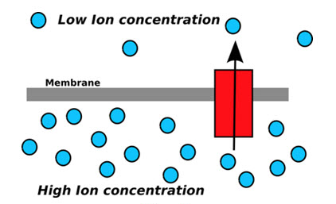
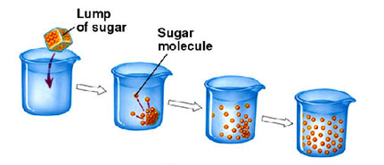
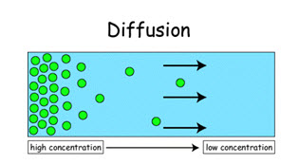
Rudiments of Mass Transfer
Like heat transfer and momentum transfer, mass may be transported by molecular processes (e.g., collisions in an ideal gas) and /or turbulent processes. The molecular processes are relatively slow and operate on small spatial scales, whereas turbulent transport depends upon the velocity and size of an eddy carrying the transported material. Our focus here is on molecular transport.
Presence of thermal gradient and is termed as thermal diffusion
Presence of pressure gradient and is termed as pressure diffusion
Presence of external forces and is termed as forced diffusion
within a medium for example sugar dissolves in a cup of tea to sweeten the entire tea cup
across an interface for example from one medium to another i.e. spreading of food odour in the entire house

Slide 5
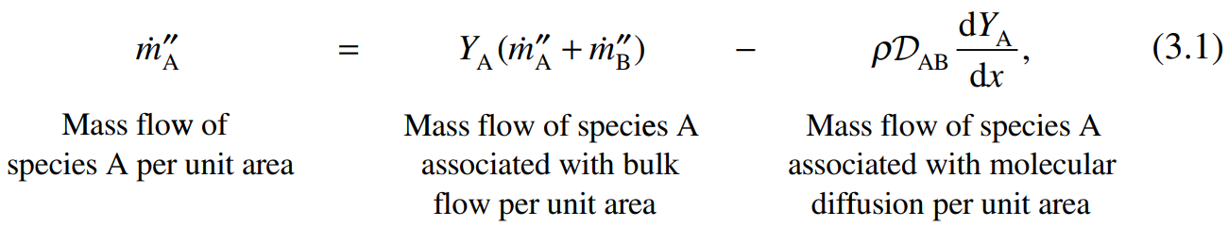
Mass Transfer Rate laws
Fick’s Law of Diffusion Let us consider a nonreacting gas mixture comprising just two molecular species: species A and B.
Fick’s law describes the rate at which one species diffuses through the other.
For the case of one-dimensional binary diffusion, Fick’s law on a mass basis is:
Diffusion flux
Absence of diffusion
The units of ${\dot{m}}_{A}^{′′}$are kg /s-m². The binary diffusivity, D_{AB}, is a property of the mixture and has units of m²/s.

Slide 6
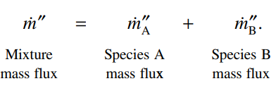
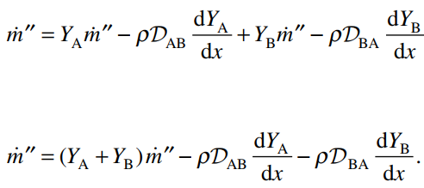
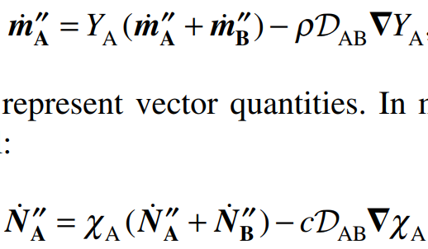
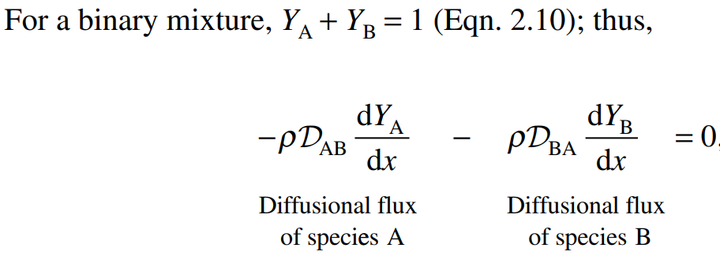
Mass Transfer Rate laws
Mass fraction
Mole fraction

Slide 7
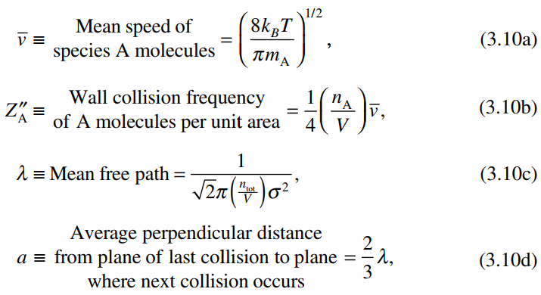
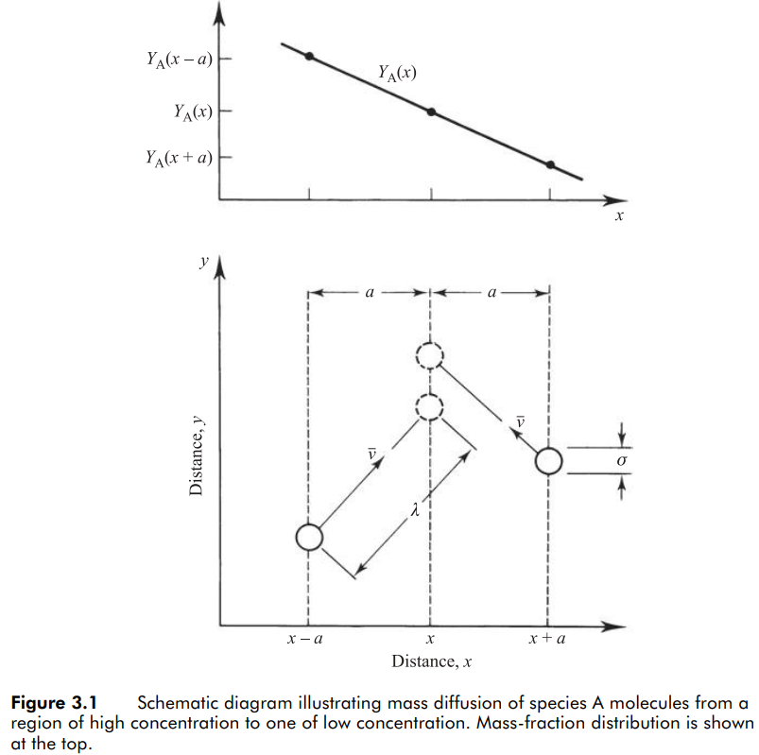
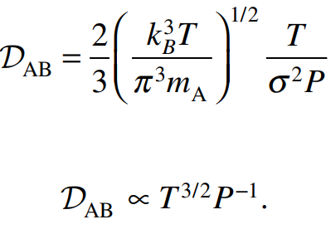
Molecular Basis of Diffusion
where k_{B} is Boltzmann’s constant, m_{A} the mass of a single A molecule, n_{A} /V the number of A molecules per unit volume, n_{tot} / V the total number of molecules per unit volume, and σ the diameter of both A and B molecules.
Diffusivity

Slide 8
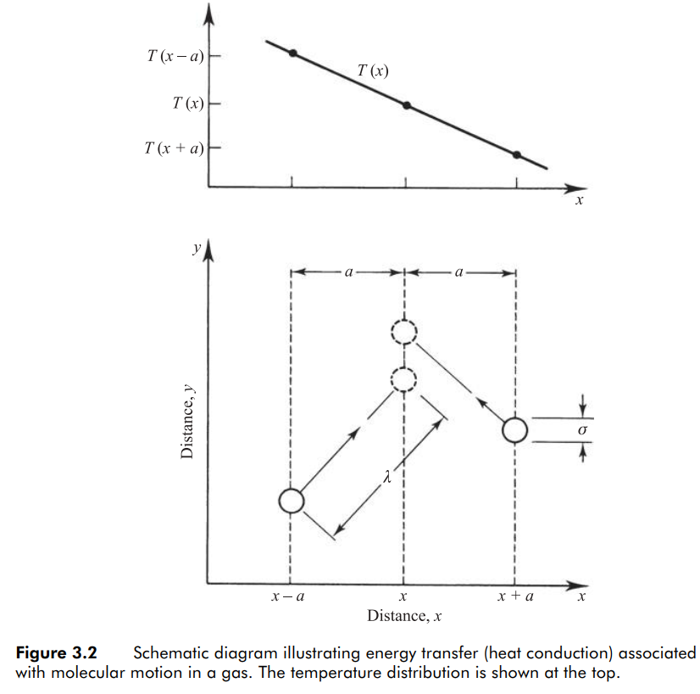
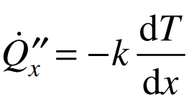
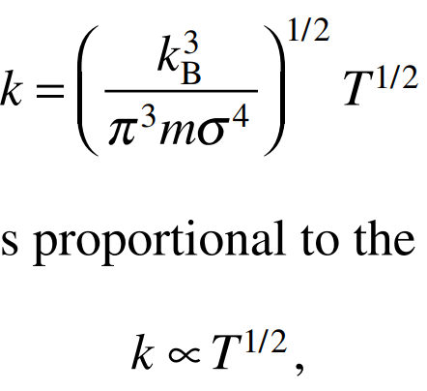
Heat Conduction (Fourier’s law of conduction)
Thermal conductivity
Solve this problem in Octave and OpenFOAM

Slide 9
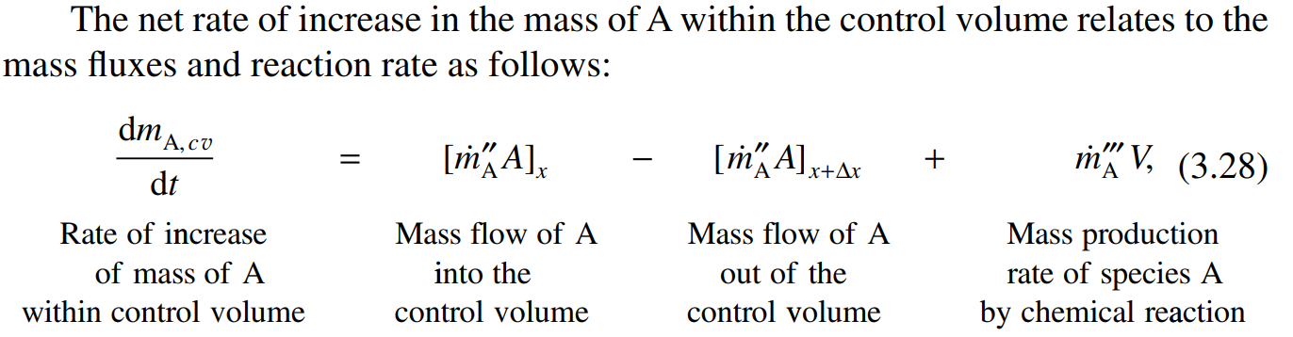
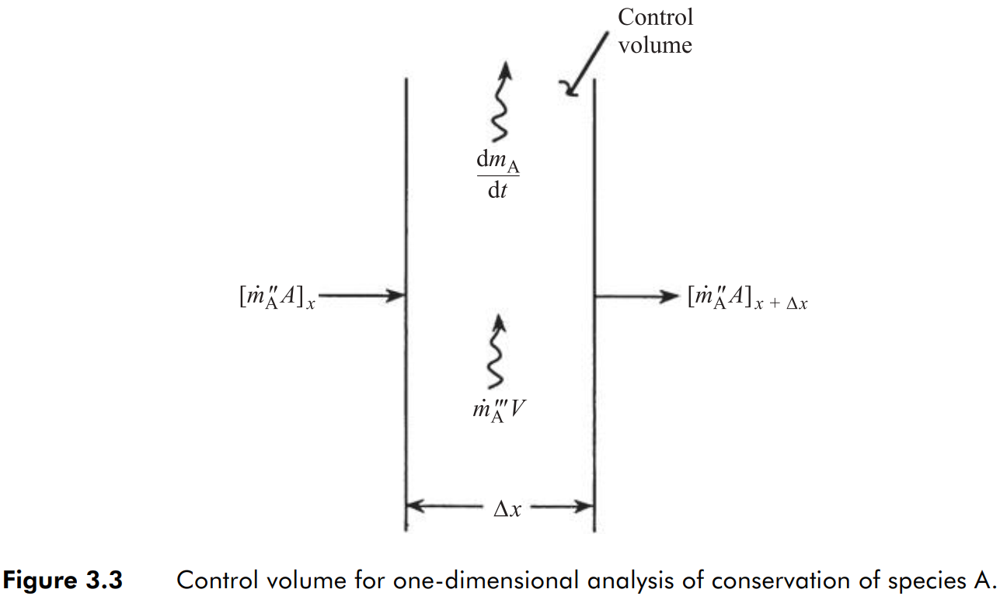
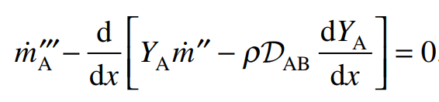
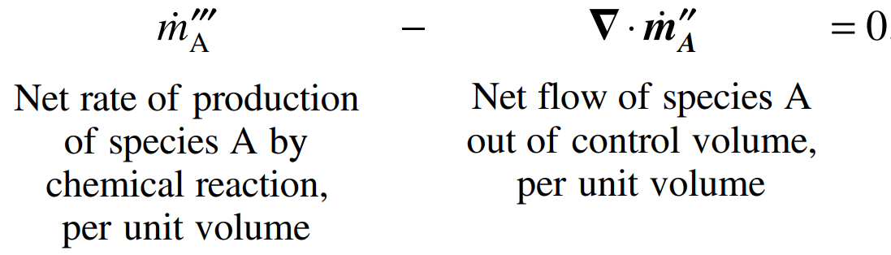
Species Conservation
In this section, we employ the rate law of species transport (Fick’s law) to develop a basic species mass conservation expression. Consider the one-dimensional control volume of Fig. 3.3, a plane layer Δx thick. Species A flows into and out of the control volume as a result of the combined action of bulk flow and diffusion. Within the control volume, species A may be created or destroyed as a result of chemical reaction.
For the steady case,
For the multidimensional case,

Slide 10
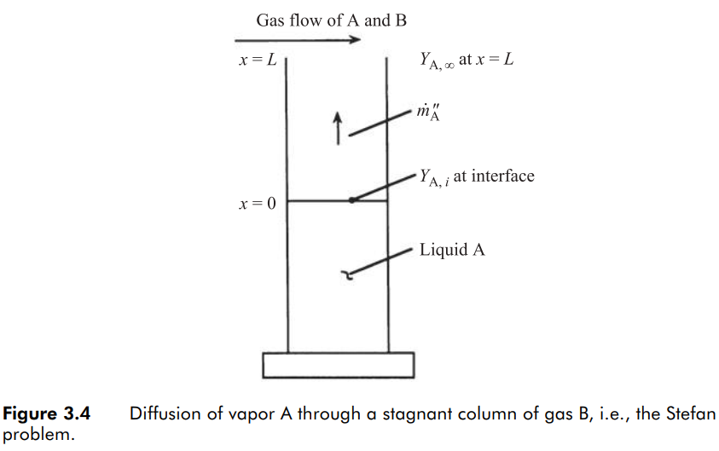



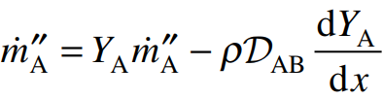
The Stefan Problem
Consider liquid A, maintained at a fixed height in a glass cylinder as illustrated in Fig. 3.4. A mixture of gas A and gas B flow across the top of the cylinder. If the concentration of A in the flowing gas is less than the concentration of A at the liquid–vapor interface, a driving force for mass transfer exists and species A will diffuse from the liquid–gas interface to the open end of the cylinder.
If we assume a steady state exists (i.e., the liquid is replenished at a rate to keep the liquid level constant, or the interface regresses so slowly that its movement can be neglected) and, furthermore, assume that B is insoluble in liquid A, then there will be no net transport of B in the tube, producing a stagnant layer of B in the column.

Slide 11
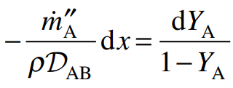
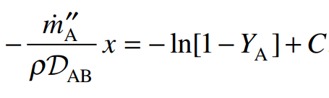
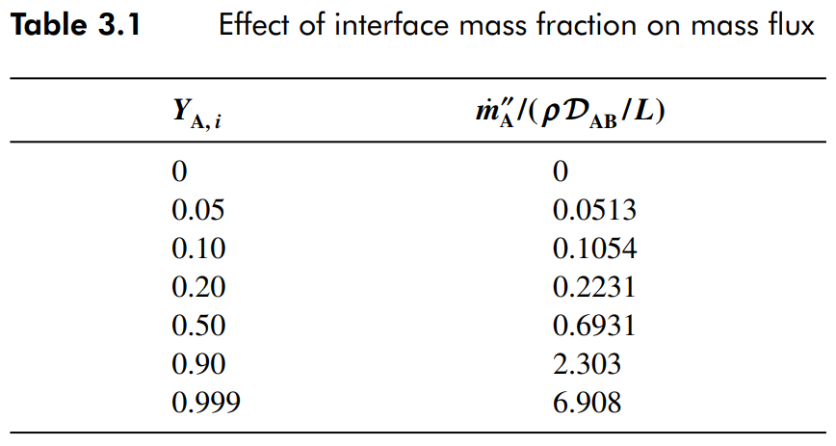


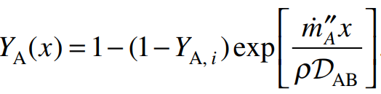
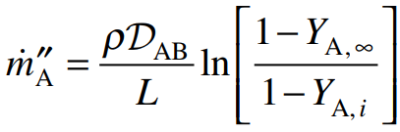
The Stefan Problem (moving boundary problem)
Rearranging and separating variables, we obtain
where C is the constant of integration. With the boundary condition

Slide 12
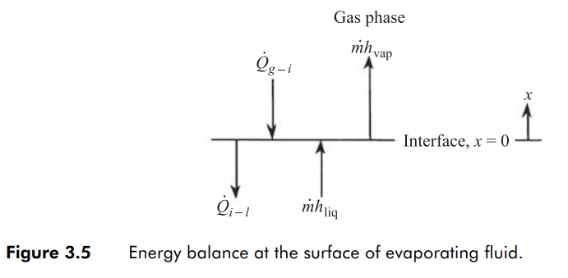


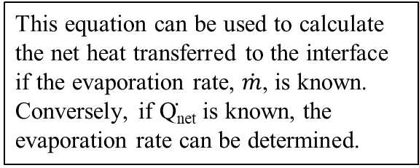
Liquid–Vapor Interface Boundary Conditions
Heat is transferred from the gas to the liquid surface, Qg-i. Some of this energy goes into heating the liquid, Qi-l, while the remainder causes the phase change. This energy balance is expressed as
This equation can be used to calculate the net heat transferred to the interface if the evaporation rate, $\dot{m}$, is known. Conversely, if Q̇_{net} is known, the evaporation rate can be determined.

Slide 13
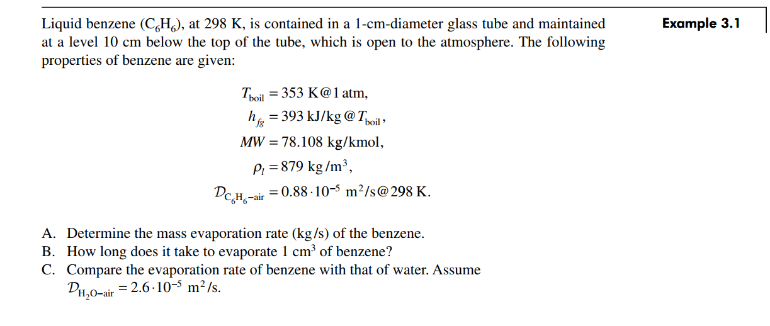
Example – 3.1

Slide 14
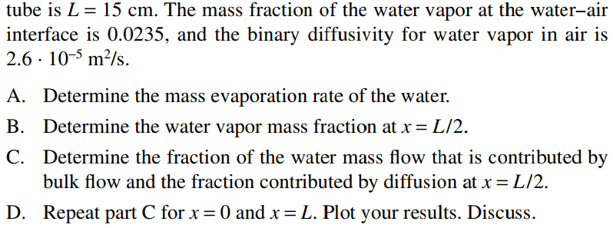
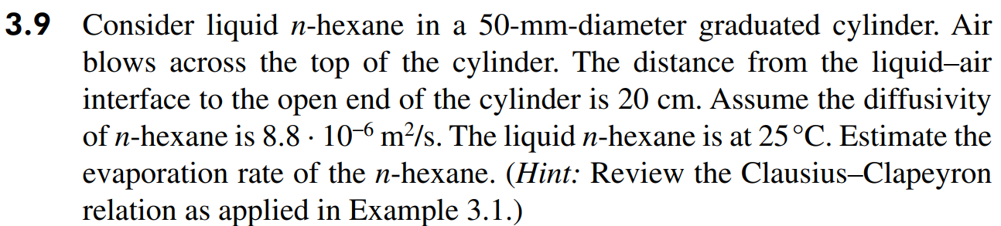
Exercise – 5

Slide 15
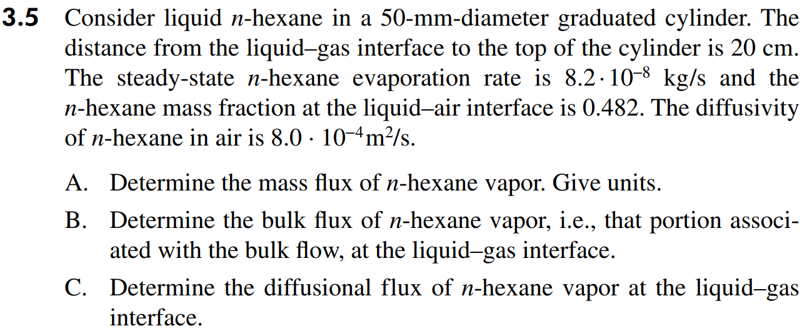
Exercise – 5

Slide 16
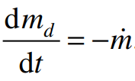
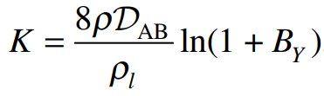


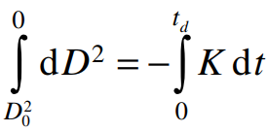

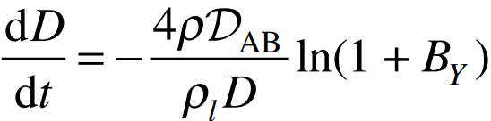
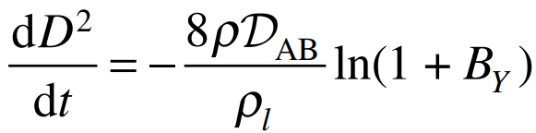

Droplet Mass Conservation
We obtain the droplet radius (or diameter) history by writing a mass balance that states that the rate at which the mass of the droplet decreases is equal to the rate at which the liquid is vaporized; i.e.
Droplet Mass Balance
Evaporation rate based on transfer number B_{Y}
Evaporation constant
Droplet life time
Droplet diameter (D² law)

Slide 17
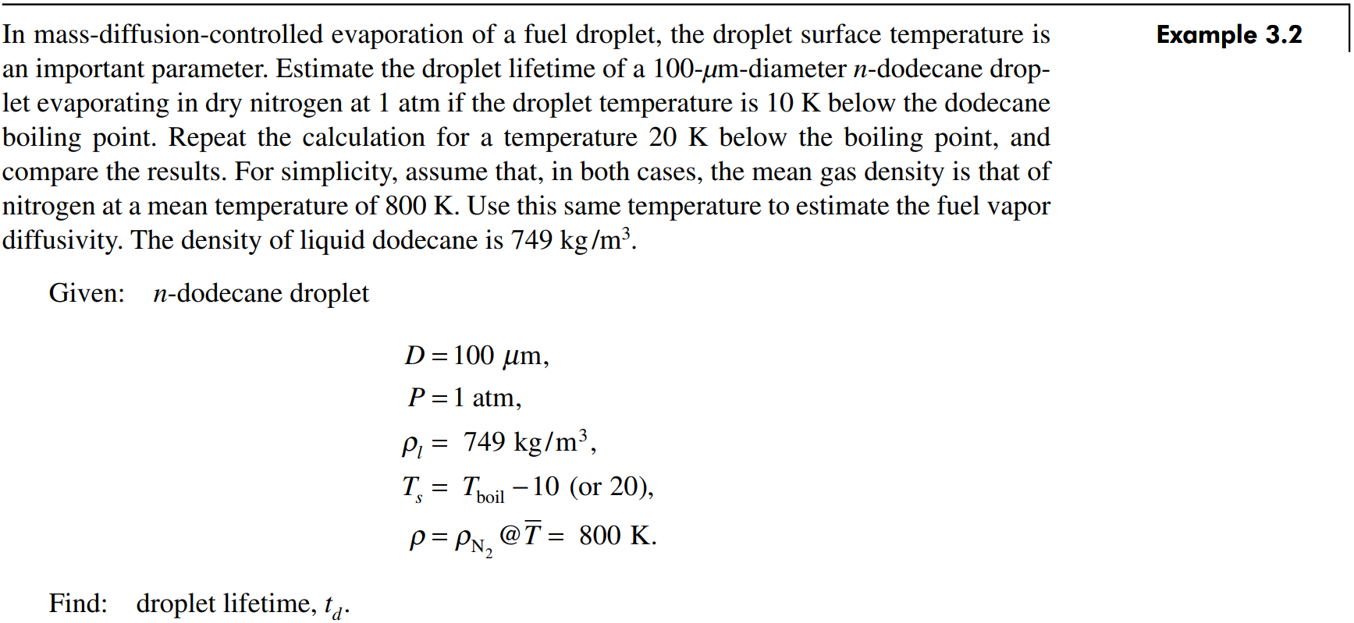
Example – 3.2

Slide 18
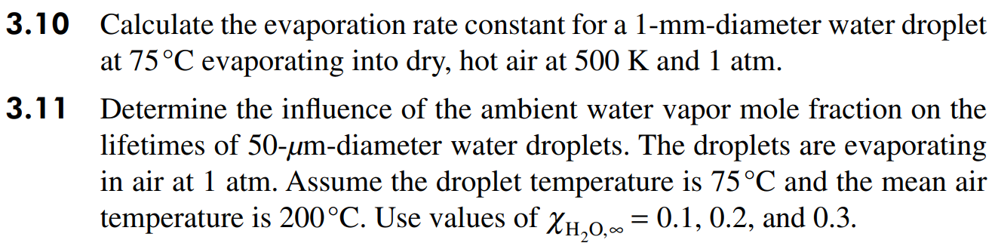
Exercise – 6

Slide 19
Next week → Exercise – 7
Use Octave and OpenFOAM to solve “Heat conduction” problem
Use OpenFOAM to solve “Stefan problem”
Finish Exercise – 4 before coming next class.

