Slide 1


Pulsating heat pipe and embedded heat pipe heat spreaders for modular electronics cooling
Class: Aerothermochemistry And Combustion
Presenter: Thanh Phuong Nguyen
ID: 202355342
Department: Energy Storage and Conversion Engineering Department
13th May 2024

Slide 2
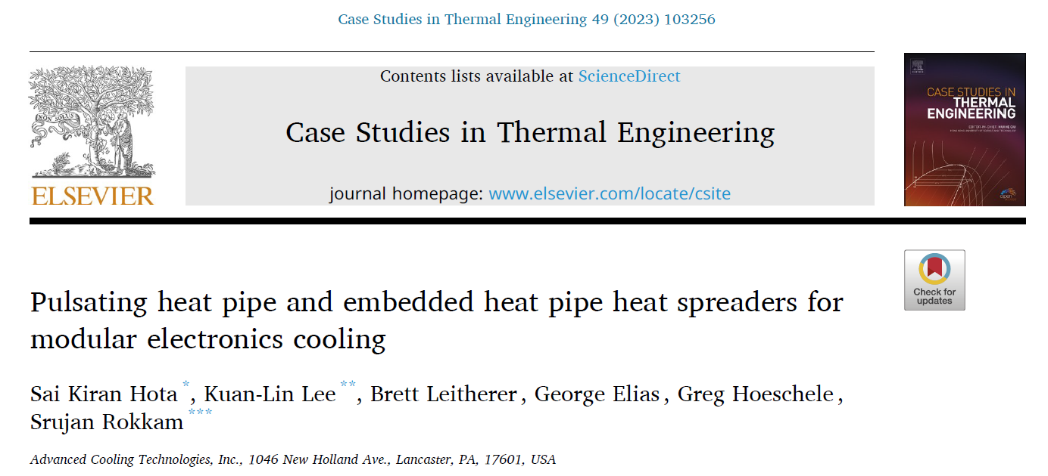

Slide 3


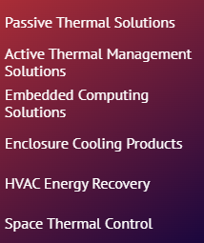
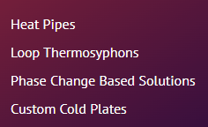
1. Introduction
Notes:
2003
applications of two-phase heat transfer technology.
Technical paper, journal paper and patent

Slide 4
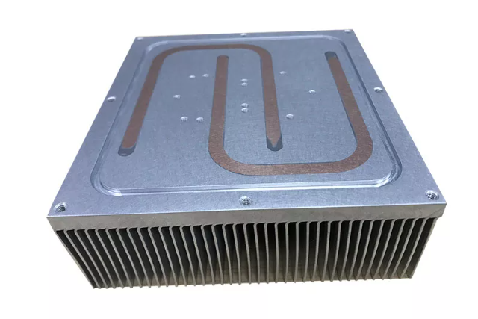
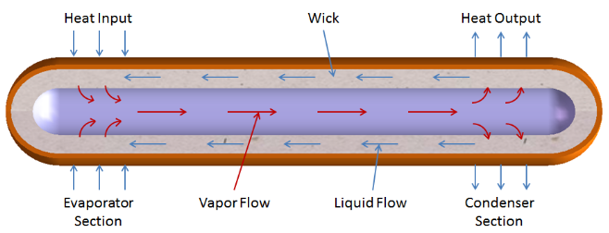
1. Introduction
Miniaturization of high-density power electronics requires advanced thermal management solutions that can handle high heat fluxes.
Two-phase based heat spreader in electronic cooling.
Heat pipes have been developed commercially due to their good size, weight, and thermal performance attributes.
Embedded heat pipe (EHP) is the heat pipes can be embedded into the base plate.
High thermal conductivity
Low thermal resistance
Copper envelope
Various types of wick structure
Aluminum/Polymer base plate
Embedded heat pipe
Notes:
EHP The heat transfer in a heat pipe is by vaporization of the working fluid at the evaporator and simultaneous returning condensed liquid from the condenser through the wick structure.
Artery, screen mesh, copper powder sintering, groove, corrugated screen

Slide 5
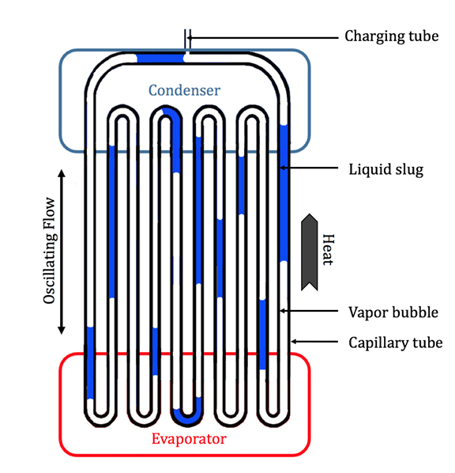
1. Introduction
Pulsating heat pipe (PHP) with capillary serpentine channels, transport heat by pulsation of liquid slugs and vapor plugs.
Thickness, shape matching, cost, high thermal conductivity.
Envelope material: copper, aluminum, glass
Working fluid
dP/dT saturated state
Latent heat of vaporization
Density
Filling ratio
Dimension
Channel diameter
Evaporator and condenser length
Orientation relative to gravity
In this study, authors provides discussion on performance improvement and comparison of PHP and EHP heat spreaders against conventional conduction only plate.
Analytical model was developed to predict PHP thermal performance.

Slide 6
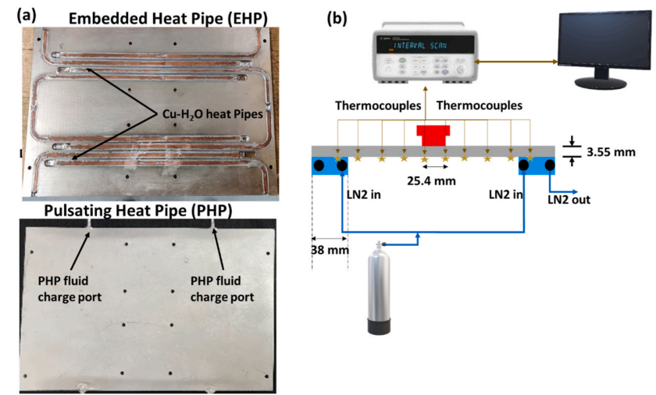
2.1. Experimental setup
Fig. 1. (a) Flat plate EHP and PHP heat spreaders; (b) Schematic of the experimental test system for comparative heat spreader performance characterization.
Notes:
The PHP was fabricated by vacuum brazing of engraved aluminum plates.
silicone thermal paste thermal interface between the heater block and the heat spreader to reduce the thermal contact resistance, grafoil sheet between the heat spreader and the cold plate
A heater blocks at the center of the heat spreaders to supply desired heat input. DC power measurement
Two cold plates attached to the edges of the heat spreaders, maintained at a constant temperature by flowing liquid nitrogen (LN2) through tube in colde plate
TC type T
8 copper-water heat pipes, 1.6 mm PHP dia, max temp 70C

Slide 7
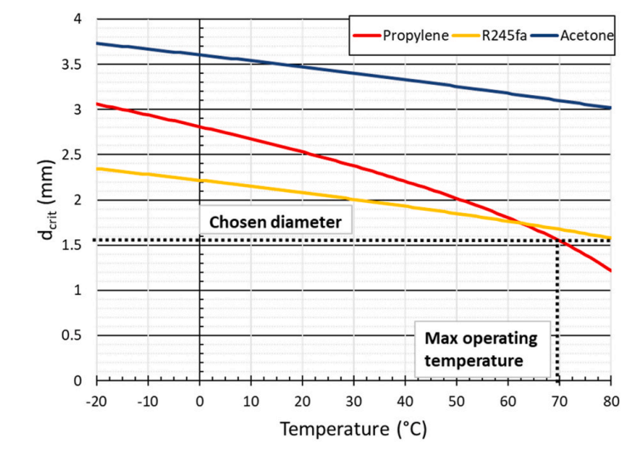



2.2. Data reduction
Thermal performance evaluation
Channel diameter
Fig. 2. Critical diameter of the chosen working fluids.
Notes:
temperature difference bet the average evaporator and the average condenser wall temperatures
maximum Bond number limit of 4
Bond number (Bo), is a dimensionless number measuring the importance of gravitational forces compared to surface tension forces for the movement of liquid front.
Acetone higher dia, filling ratio 50%

Slide 8
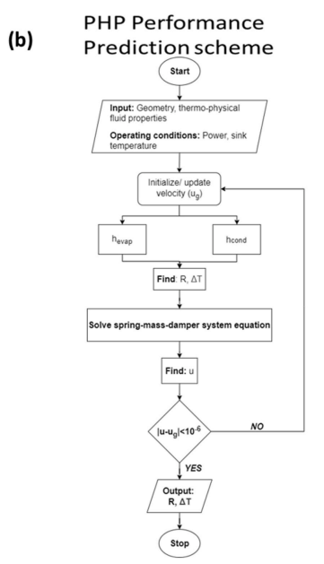
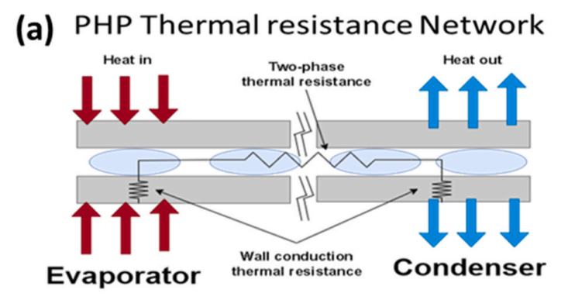
2.3. Analytical model for PHP performance prediction
Notes:
based on the spring-mass-damper approach to solve the second-order differential equation to determine the oscillation and thereby the PHP performance.

Slide 9



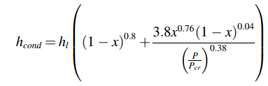
2.3. Analytical model for PHP performance prediction
Evaporator heat transfer
Condenser heat transfer
Notes:
S two-phase suppression factor calculated by two-phase Reynolds number
h mac marcroscopic HTC by convective flow of bulk fluid
hl is the convective liquid heat transfer coefficient calculated according to the Dittus-Boelter correlation.
Spring-mass-damper theory applies the basic physics of F=ma to define suspension motion and response on bump impacts.
The three forces of spring, mass and damping completely describe suspension motion. Springs make the suspension bounce up and down. Damping stops the bouncing motion. There are no other forces acting on the suspension. In that sense the spring-mass-damper system equation provides an exact description of suspension motion.

Slide 10





2.3. Analytical model for PHP performance prediction
Fluid pulsation in the PHP channels
Spring-mass-damper system:
Forces acting on the liquid result in the equation of motion:
Driving force
Spring restoring force coefficient
Damping coefficient
Notes:
interfacial, viscous damping, gravity, and vapor restoring forces
B driving force arising from overall pressure drop due to evaporator and condenser temperature
The first term on the right side corresponds to the viscous damping and the second term on the right-hand side corresponds to the pressure losses due to bends.

Slide 11
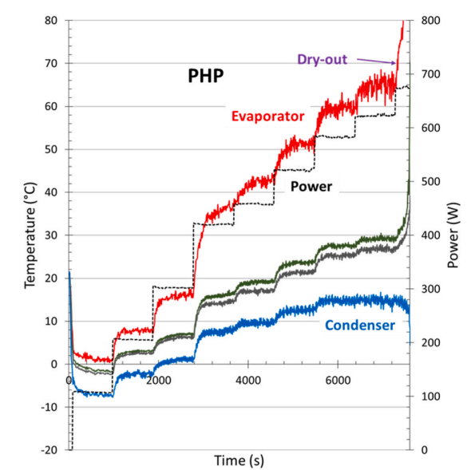
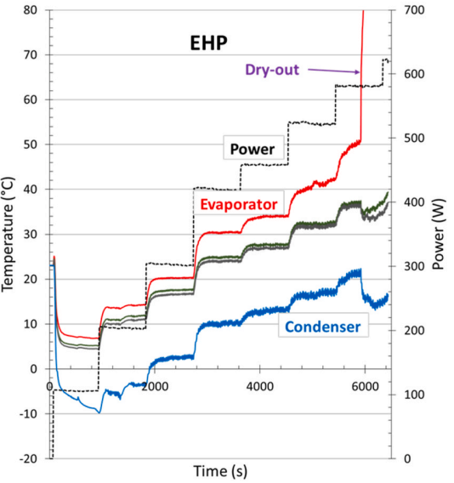
3. Results
3.1. Thermal performance of EHP and PHP heat spreader with heat sink at − 10 ◦C
Condenser temperature increased with increasing heater power.
Oscillation frequency in the PHP wall temperatures more pronounced at higher temp.
Dry-out condition at 600 W.
Fig. 4. Wall temperature profile of (a) PHP and (b) EHP heat spreaders.
Notes:
-10 C propylene-charged PHP
heater power indicating good heat transfer characteristics due to pulsation of the working fluid.
At around 600 W, the evaporator wall temperature drastically increased, while, at the same time, the condenser wall temperature decreased for both PHP and the EHP heat spreaders, indicating dry-out condition.

Slide 12
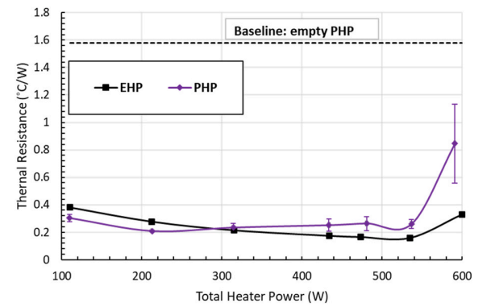
3. Results
3.1. Thermal performance of EHP and PHP heat spreader with heat sink at − 10 ◦C
Below 300 W, the thermal resistance of the PHP was lower than the EHP heat spreader.
PHP showed dry-out characteristics at lower heat input than EHP.
EHPs become more effective at a higher temperature.
Fig. 5. Thermal performance of EHP and PHP heat spreaders.
Notes:
Thermal resistance decreases with increasing heater power as the EHPs
propylene PHP was better than or similar to EHP at − 10 ◦C sink temperature.

Slide 13
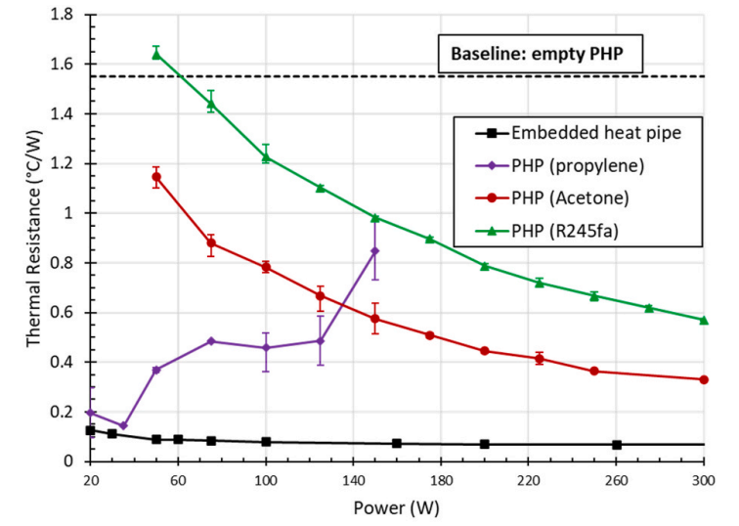
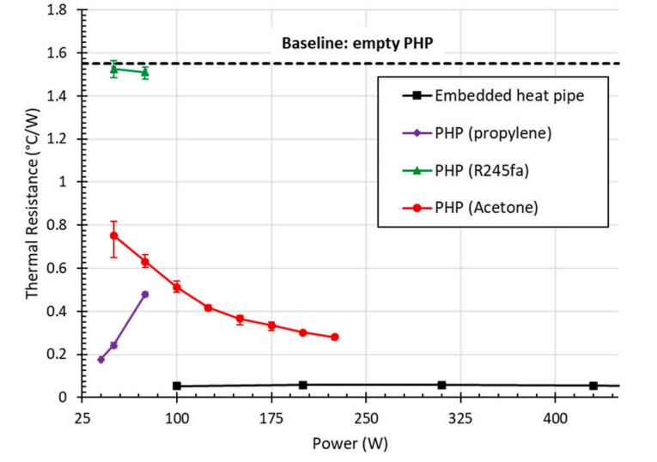
3. Results
3.2. Thermal performance of the EHP and the PHP heat spreaders at other operating conditions
Fig. 6. Thermal performance curves of heat spreaders at (a) 40 ◦C and (b) 70 ◦C.
At 40 ◦C heat sink, propylene PHP showed thermal resistance in different trend with two others WF.
R245fa and acetone were suitable for higher temperatures.
EHP heat spreader on the other hand showed almost constant thermal resistance.
At 70 ◦C heat sink, R245fa not operate and PP dryout at 40W.
Notes:
The thermal performance of R245fa and acetone PHP improved with increasing heater power. This meant that R245fa and acetone were suitable for higher temperatures
acetone PHP performed well compared to R245fa PHP at 40 ◦C nominal operating temperature and 70 ◦C higher operating

Slide 14
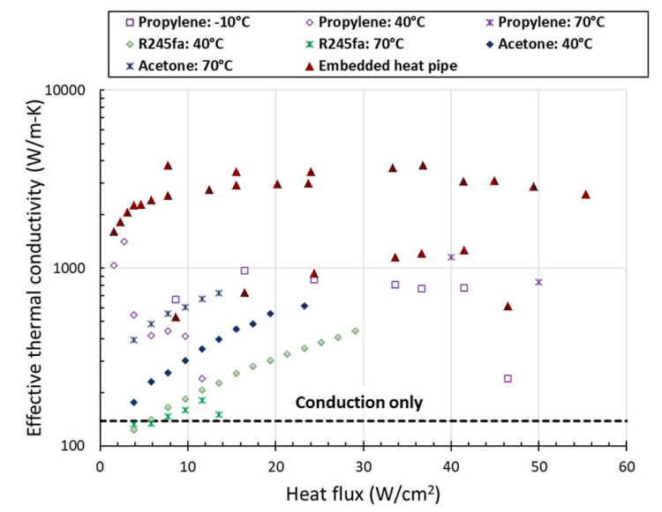
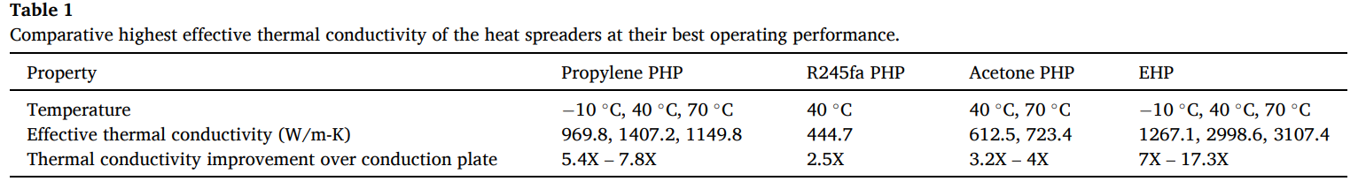
3. Results
3.3. Thermal conductivity of PHP and EHP heat spreaders
- The highest thermal conductivity of 1400 W/m-K was achieved with propylene at 40 ◦C sink temperature at 2.7 W/cm2 heater power.
- Effective thermal conductivity gradually increased with a flattening trend for R245fa and acetone PHPs up to 34–38 W/cm2 heat flux.
The thermal conductivity of EHPs was mostly greater than 1000 W/m-K.
Notes:
At low heater powers below the PHP startup, the thermal conductivity can be lower than the control, because of additional fluid thermal resistance in the channels. However, after the startup, the thermal conductivity increases due to the two-phase operation of the working fluid.
propylene PHP can yield effective thermal conductivity up to 7.8 times
EHP shows up to 7 times improvement over the conduction plate at − 10 ◦C which increases up to 17.3 times at 70 ◦C sink temperature.

Slide 15
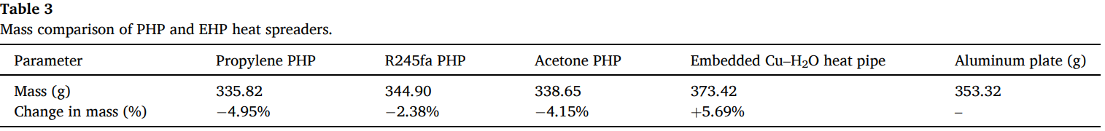
3. Results
3.3. Mass consideration of PHP and EHP heat spreaders

Slide 16
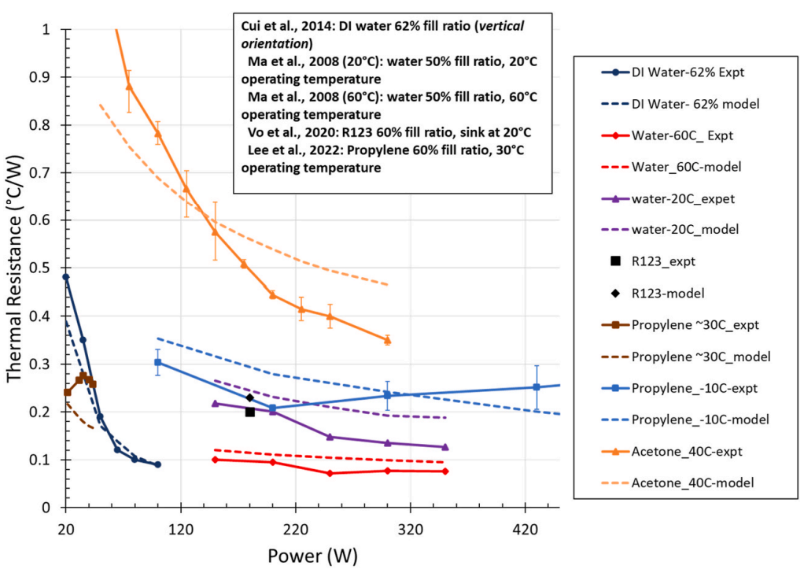
3. Results
3.4. Performance comparison of numerical code against experimental data
For acetone, some deviation in predicted thermal resistance at lower powers-near start-up conditions and errors associated with correlations at small operating powers and low temperatures.
Increasing heater power, good agreement between the experimental data and the model was obtained.

Slide 17
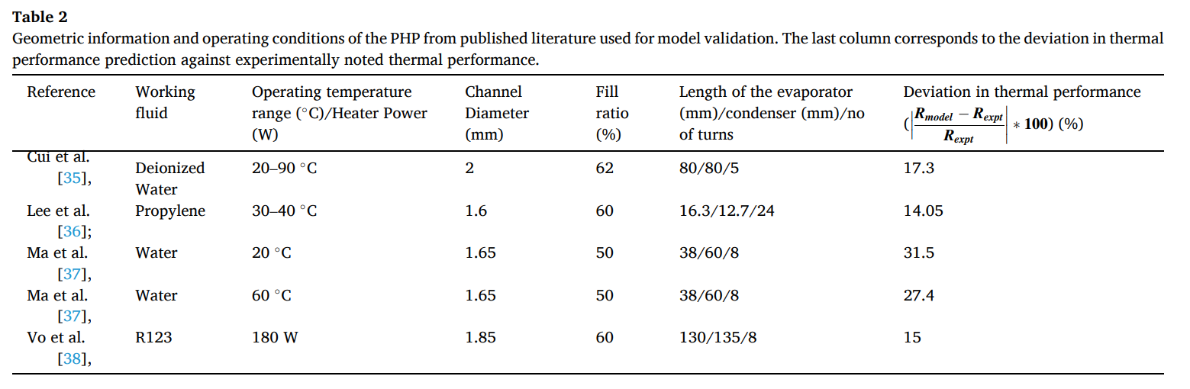
3. Results
3.4. Performance comparison of numerical code against experimental data
Notes:
The overall maximum deviation was found to be <33 which is considered to be provide good validity of the developed mathematic model

Slide 18
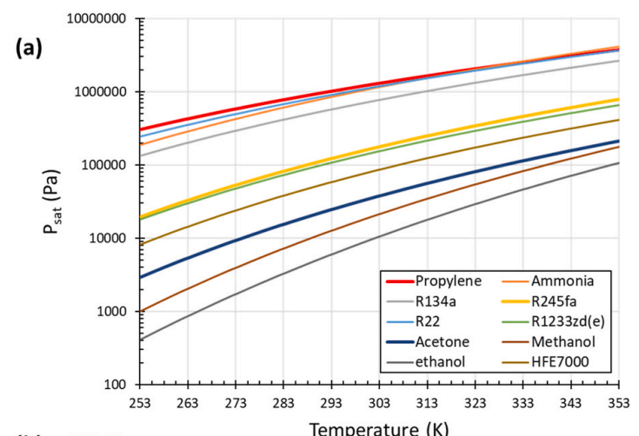
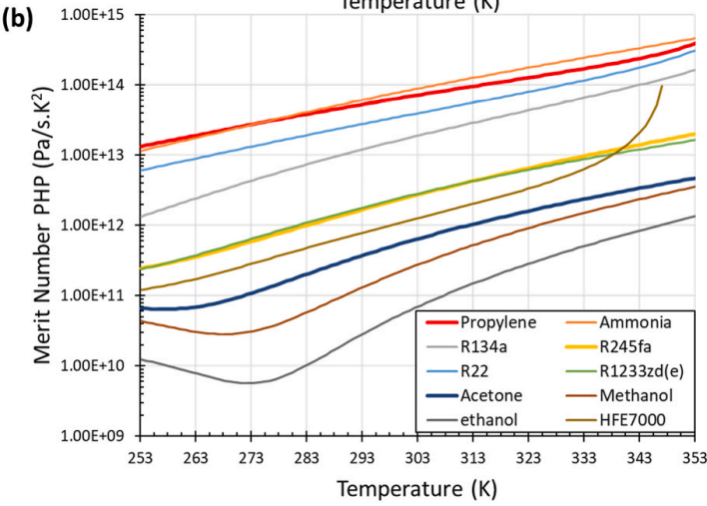
3. Results
3.4. Discussion of working fluid selection for PHP performance optimization
Fig. 9. (a) Saturation pressure curves and (b) Merit number of applicable PHP working fluids.
Propylene has a high saturation pressure and merit number, on par with ammonia and slightly greater than R134a.
Critical diameter ammonia (3mm) > PP (1.6mm), larger channel diameter can improve thermal performance.
Ammonia, R134a, PP are flammable, GWP PP < Ammonia < refrigerant.
For moderate (e.g., >40 ◦C) to high-temperature applications, R245fa has better properties than acetone.
Up to 90 ◦C –HFO-1234yf, HFO-1336mzz(z) could potentially make PHP competitive with EHPs.
Notes:
Water is not shown here due to its incompatibility with aluminum.
the global warming potential (GWP) of propylene is only 2. GWP of ammonia is slightly higher at 3.1 but for R134a is 1430.
charging them requires stringent safety protocols
However, from experiments and Fig. 2, it was determined that the performance of R245fa-charged PHP was lower than acetone partly due to channel limitations.

Slide 19
4. Conclusion
At low temperatures, the performance of propylene PHP was better than or similar to EHPs, 7.8 times higher effective thermal conductivity over conventional aluminum conduction.
The performance of R245fa and acetone PHP improved with increasing heater power but was lower than EHPs at temperatures higher than 40 ◦C, effective thermal conductivity improvement of up to 17.3 times can be obtained with EHPs over a conduction plate. The performance of PHP, in general, was better than the aluminum conduction plate.
PHP has the potential to perform better than EHP but the performance depends on several parameters like geometry, working fluid, operating temperature etc.

