Slide 1
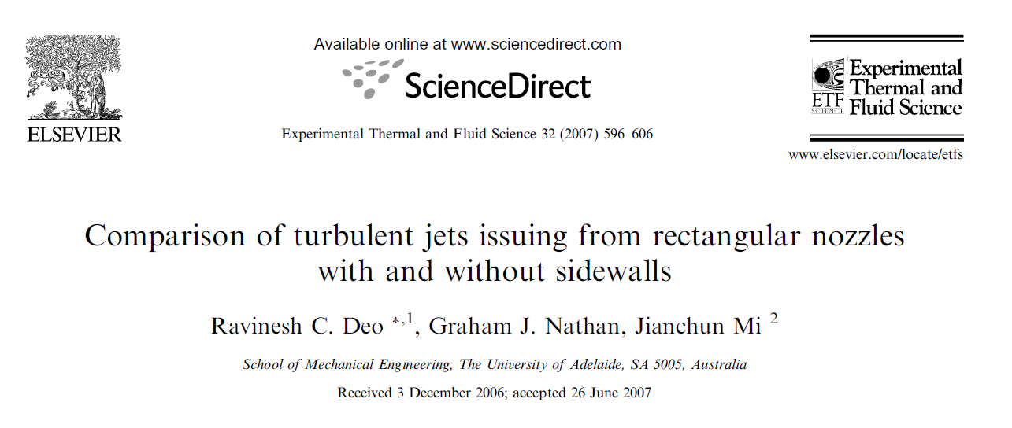


Slide 2
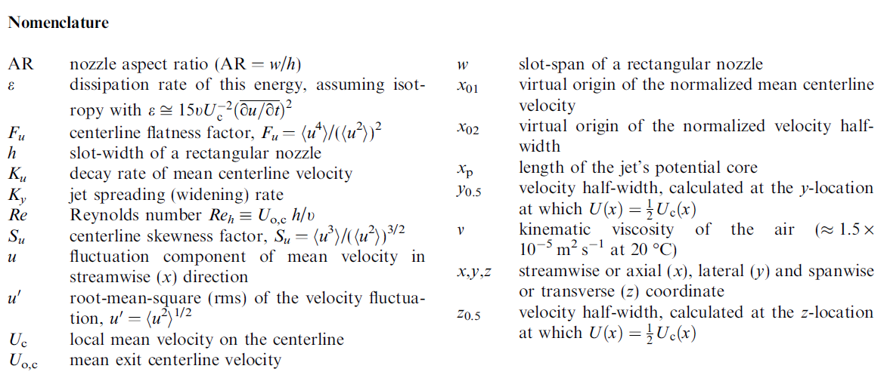
Introduction
This paper reports a systematic study of a turbulent jet issuing from a rectangular slot nozzle of high-aspect ratio, AR ( w/h, where w and h are the long and short sides of the slot, respectively) tested with and without sidewalls.
Hot-wire measurements were conducted at a Reynolds number based on slot-width (h) and exit centerline velocity of Re_{h} ≈ 7000 (for AR = 30 and 60) and at 10,000 (for AR = 30) up to 160 h downstream.

Slide 3
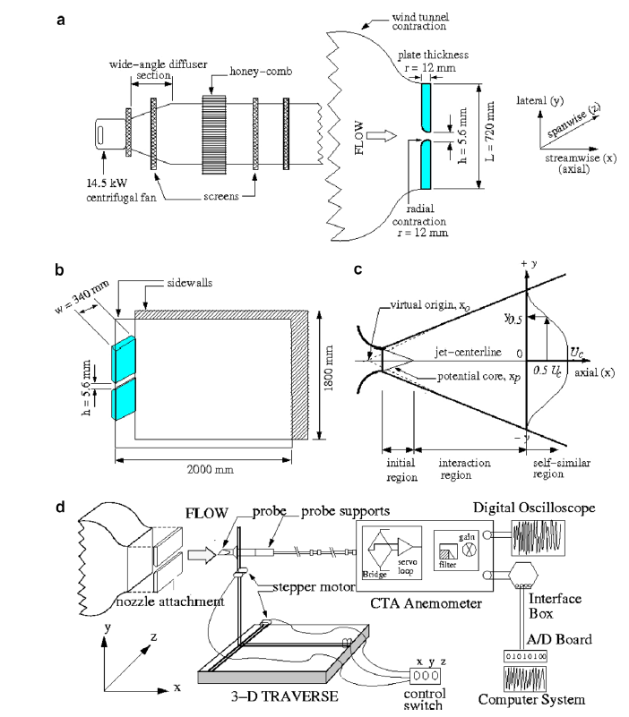
Experiment details
The test section consisted of a rectangular nozzle with a 12 mm radial contraction profile on its long sides (Fig. 1a).
The sidewalls extended 2000 mm downstream and 1800 mm vertically, and were secured tightly by bolts to the laboratory ceiling to avoid vibrations during the tunnel operation.
The slot-width (h), aligned with the lateral direction (y-coordinate) of the nozzle, was fixed at 5.60 mm. The slot-span (w), aligned along the z-direction, was 340 mm for the large aspect ratio, AR w/h = 60, which was tested with and without sidewalls.

Slide 4
Experiment details
The smaller nozzle had a 36-mm radial contraction profile and 5 mm slot-height but half the span, so that w = 170 mm and the sidewalls were moved inwards so that AR = 30. This was only tested without sidewalls so that the effect of slot aspect ratio on statistical two-dimensionality of the jet could be assessed.
The normalized radius of curvature of r/h ≈ 2.14, and 7.20 conforms to our previous finding that a nozzle’s mean exit flow closely approximates ‘‘top-hat’’ profile for r/h > 2.0
The entire jet facility was located in a laboratory of dimensions 18 m (long) x 7 m (wide) x 2.5 m (high), and was acoustically isolated from externally driven noise.

Slide 5
Experiment details
The distance from the jet exit to the front wall of the room was approximately 1400h and that between the jet and the ceiling/floor was approximately 125h, allowing these isothermal jets to entrain stagnant air freely.
The facility was operated at a jet discharge velocity of U_{o,c}=18.4 m/s for AR = 60 (with and without sidewalls) and 26.3 m/s for AR = 30 (without sidewalls), resulting in Reynolds numbers, Re_{h} = U_{o,c} h/ ν ≈ 7000 and 10,000, respectively.
Velocity measurements were performed over the axial (x) range from 0≤x/h ≤ 160 using a hot-wire anemometer under isothermal conditions of ambient temperature of approximately 20 ºC.

Slide 6

Experiment details
The custom-built hot-wire (tungsten) sensor used was 5 μm in diameter and 0.8 mm long, aligned parallel to the long side of the nozzle.
The overheat ratio of the hot wire was kept fixed at 1.5.
To optimize the bandwidth of the sensor and/or anemometer, and to check its operation, a square wave test was performed, revealing a sensor frequency response of 15 kHz.
Calibrations of the hot wire were conducted using a standard Pitot static tube connected to a digital manometer, located side by side with the hot-wire probe at the exit plane (where ) prior to and after each measurement.

Slide 7
Experiment details
Velocity signals obtained were low-pass filtered with a high and identical cut-off frequency of f_{c} = 9.2 kHz at all the measured locations to remove excessive high-frequency noise.
The voltage signals were offset to within 0– 3 V and amplified and then digitized on a personal computer at fs = 18.4 kHz via a 16 channel, 12-bit PC-30F A/D converter (Fig. 1d) of signal input range 0–5 V as a precautionary measure to avoid signal clipping
The sampling period was approximately 22 s, during which 400,000 instantaneous data points were gathered.

Slide 8
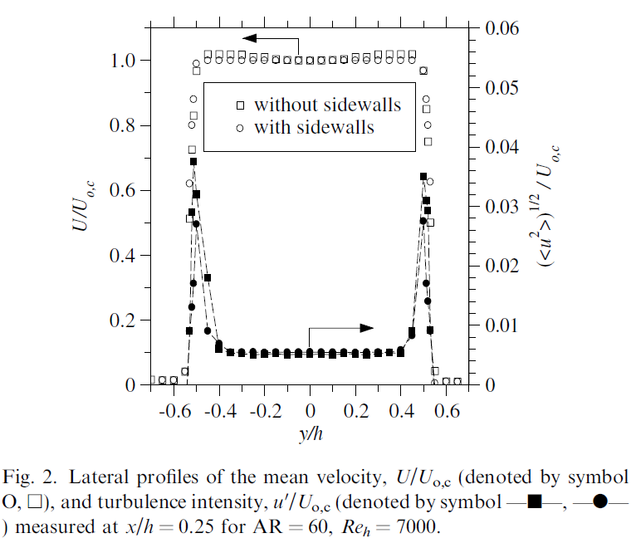
Results and discussion
The exit flows of the nozzle of AR = 60 were characterized by measuring the velocity profiles in each isothermal jet with and without sidewalls at x/h ≈ 0.25 along the lateral (y) direction over the range 0.70 ≤ y/h ≤ 0.70.
The profile measured with sidewalls being slightly flatter than that measured without sidewalls.
Turbulence intensity within jet shear layers vary from about 3.6% for the jet without sidewalls to about 2.8% for the jet with sidewalls which demonstrate that the sidewalls, and probably also the shape of the contraction, do influence the initial shear layer intensities.

Slide 9



Results and discussion
The jet exit conditions is characterize by estimating the boundary-layer displacement and momentum thickness using the mean exit velocity profiles.
For both cases, the present values of boundary-layer displacement and momentum thickness are about 0.15h and 0.059h.
shape factors, which represents the flatness (uniformity) of the mean velocity profiles, are 2.55 compared with a value of 2.60 for a Blasius exit velocity profile.
Given the closeness of the shape factors to that of an ideally uniform mean exit velocity profile, both jets are characterized as having laminar boundary layers at their nozzle exit

Slide 10
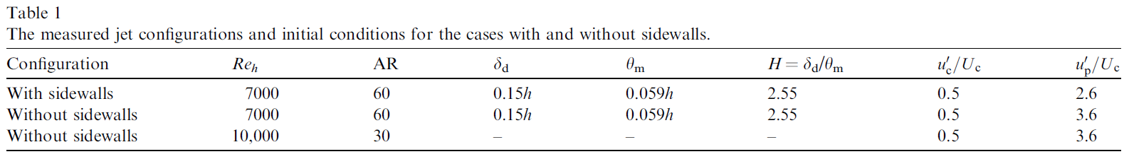
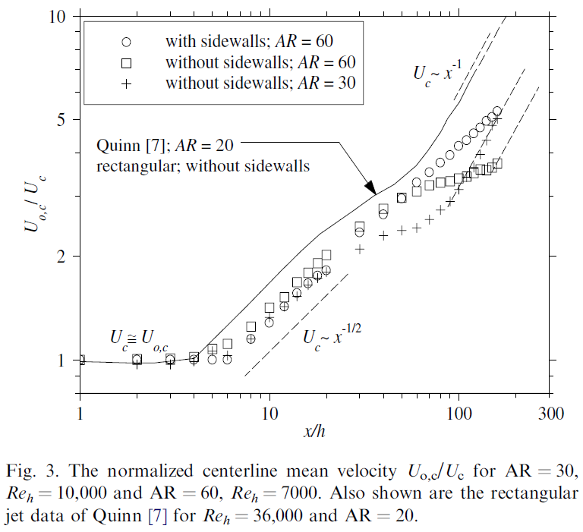
Results and discussion
The jets are qualitatively similar, but quantitatively different in the first 40 slot-heights downstream and then diverge significantly from each other into the far field.
Both jets exhibit the well-known non-decaying potential core region, i.e. U_{c} ≈ U_{o,c}, followed by a 1/2-power law inverse decaying region, where Uc ~ x^{-1/2}.
Further downstream, the jet without sidewalls exhibits a transition region, where U_{c} does not appear to obey any systematic dependence on x, to an inversely-linear decaying region, where Uc ~ x⁻¹

Slide 11
Results and discussion
also plots the decay of the AR = 30-jet without sidewalls, which exhibits statistically two-dimensional behavior only up to x/h ≈ 30.
the present work shows that, without sidewalls, a jet has a longer region of statistically two-dimensional flow only if the nozzle aspect ratio is sufficiently large.
Importantly, the mean field implies that without sidewalls, the jet appears to transform into an axisymmetric form, characterized by Uc ~ x⁻¹, in the far field.

Slide 12
Results and discussion
The length of the jet’s potential core, x_{p} (the maximum axial (x) distance up to which U_{c}≈ U_{o,c}) is different for the jets with and without sidewalls. For the case without sidewalls, x_{p} ≈ 4h, while for that with sidewalls, x_{p} ≈ 6h. This Difference implies a significantly higher rate of near field entrainment by the jet without sidewalls.
The influence of the sidewalls on the spread in the spanwise direction cannot explain such a dramatic difference in x_{p} on the nozzle axis for this high-aspect ratio jet.

Slide 13
Results and discussion
Rather it is important to note that the initial shear layer of the jet without sidewalls has higher turbulence intensity than that with sidewalls (Fig. 2b).
Since the length of the potential core is dominated by the growth of the shear layer in the x–y plane, the higher initial turbulence intensity of the jet without sidewalls is consistent with its shorter potential core.

Slide 14
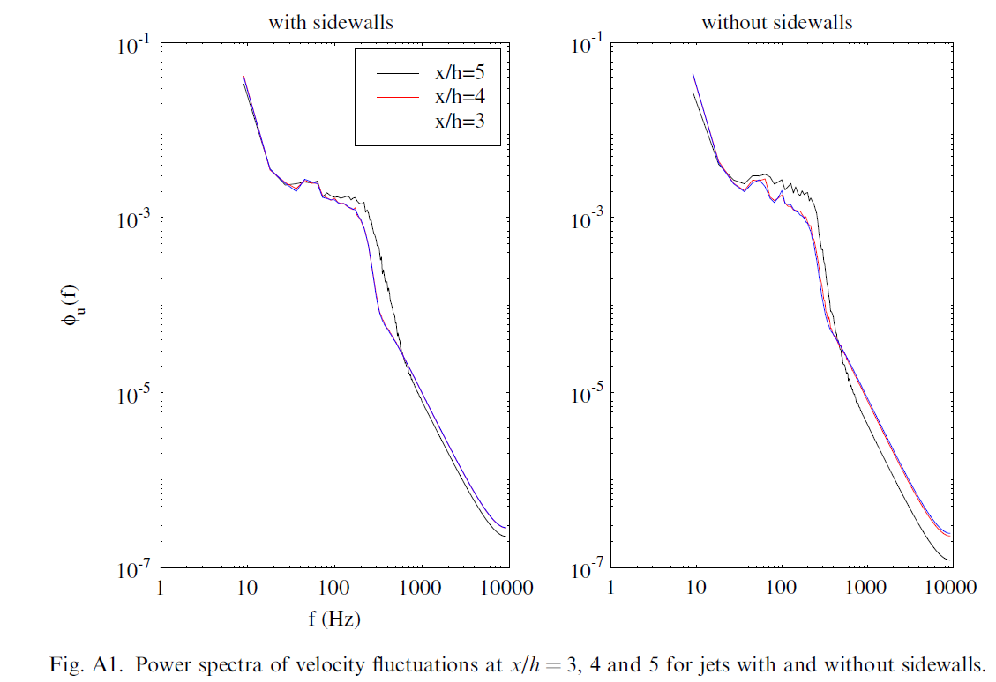
Results and discussion
Next, they assess whether the higher shear exit layer turbulence intensity (Fig. 2) and a consistently shorter potential core (Fig. 3) might be caused by the jet without sidewalls undergoing larger amplitude near field flapping than the jet with sidewalls. Were such a flapping to be present, it would be evident in a low-frequency oscillation in the power spectrum.
The spectra shows no genuine significant difference in the low-frequency spectra, and no significant peaks for either case. Hence it is deduced that the higher shear layer intensity is not attributable to such flapping motions, but rather to increased three-dimensionality of the jet without sidewalls, due to differences in their underlying vortex motions

Slide 15
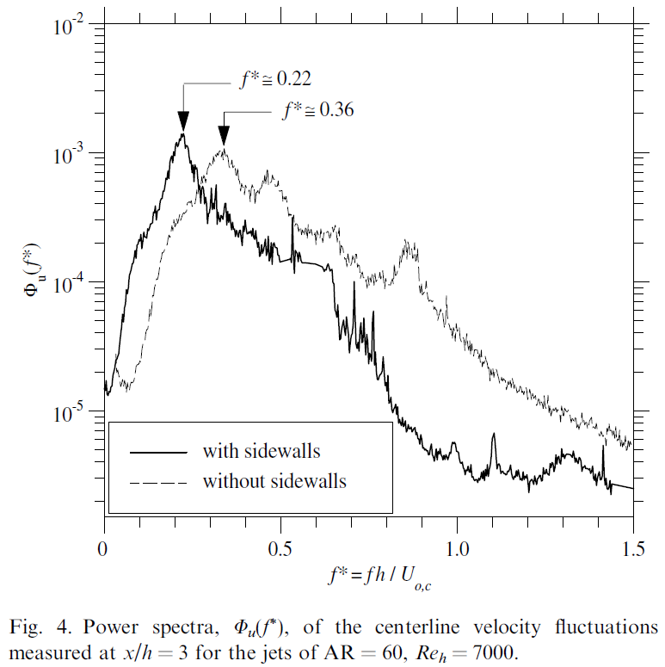
Results and discussion
To investigate the near field flow structure of the two AR = 60 jets more closely, we have plotted the power spectra of the centerline velocity fluctuations within the potential core region (i.e. at x/h = 3)
The appearance of broad peaks in power spectra confirms that both nozzles generate regularly-occurring primary vortices
The present jet without sidewalls sheds vortices at f* = 0.36 whereas, for the jet with sidewalls, vortex shedding occurs at f* = 0.22. This significant difference in f* confirms distinct differences in their underlying near field flow structure.

Slide 16
Results and discussion
It is hypothesized that the differences in spectral peaks can be attributed to structural differences in vortices (e.g. a higher degree of three-dimensionality) in the near field flow of the jet without sidewalls .
It is known that a rectangular jet, configured without sidewalls, is known to produce ‘‘ring-like’’ three-dimensional primary vortices while the 2-D roller-like vortices are found in a planar jet, configured with sidewalls.

Slide 17


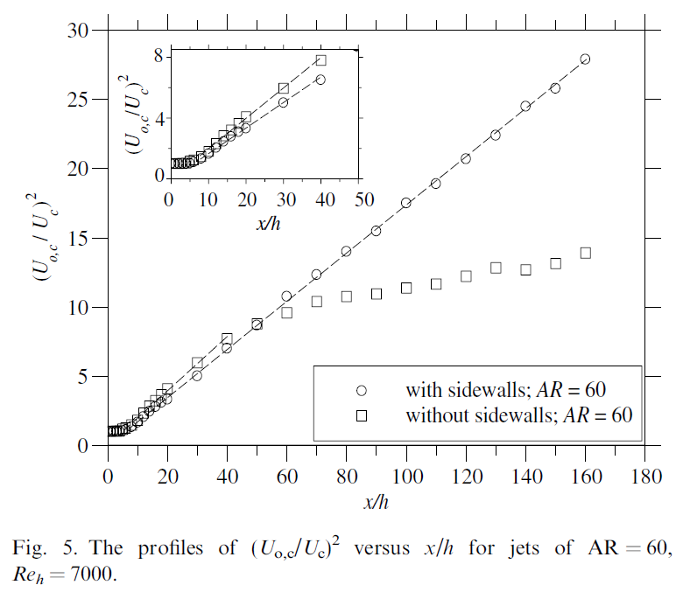
Results and discussion
Fig. 5 investigates the decaying behavior of the mean velocity field by presenting
versus x/h within the statistically two-dimensional region of the jets with and without sidewalls.
The self-similar relationship of the form
holds true over the axial range 10 ≤ x/h ≤ 40.
K_{u} and x₀₁ are the jet decay rate and virtual origin, respectively.
In particular, the jet without sidewalls (K_{u} ≈ 0.20) decays at a rate of some 15% higher than does the jet with sidewalls (K_{u} ≈ 0.17). This implies that the far field entrainment rate of the jet with sidewalls is lower than the jet without sidewalls.

Slide 18
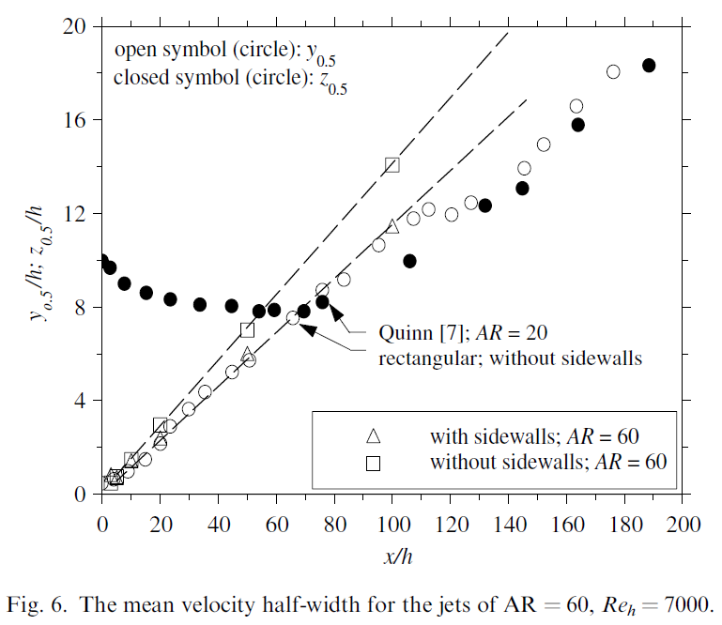

Results and discussion
To assess the spreading behavior of both jets, Fig. 6 presents the axial evolution of velocity half-widths, y_{0.5} in the lateral (y) direction.
The values of y0.5 vary linearly with x, and follow the relationship
where K_{y} is a measure of the spreading rate and x₀₂ is the virtual origin of that jet spread.
In the self-similar region, y_{0.5}~x, further confirming statistical two-dimensionality.
The jet without sidewalls spreads at a rate of about 24% higher (Ky ≈ 0.14) than does the jet with sidewalls (Ky ≈ 0.11).

Slide 19
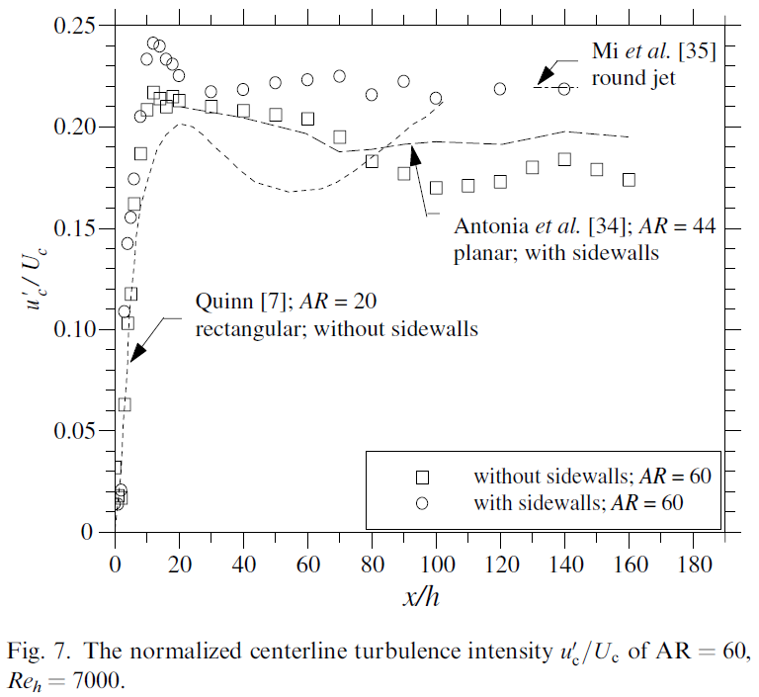


Results and discussion
The overall shape of graph of the data of Quinn [7] is similar to that of our jet without sidewalls. The qualitative features in the data of Quinn [7] are similar to that of our jet without sidewalls. This is despite the fact that the magnitudes and axial locations of major features (e.g. ‘‘humps’’) are different.
The differences reflect the different initial conditions between our jet without sidewalls and that of Quinn [7] (i.e. nozzle aspect ratio, AR = 60 versus 20, Reynolds number, Reh = 7000 versus 36,000, nozzle contraction profile, radially contoured versus sharp-edged orifice plate).

Slide 20

Results and discussion
All jets exhibit a rapid increase of in the near field, reflecting the streamwise growth of the shear-layer instabilities associated with the large-scale structures.
Such large-scale structures produce large-scale engulfment of ambient fluid, resulting in higher velocity fluctuations and greater decay of jet’s mean velocity.
Although, both jets produce a hump in
between 10 ≤ x/h ≤ 12, the hump for the jet without sidewalls is discernibly higher than the jet with sidewalls. It also appears that for both jets, this hump is about 10% higher than their respective asymptotic values.

Slide 21
Results and discussion
The appearance of the humps in both jets is attributable to the collision of double roller structures, emanating from alternate sides of the shear layers beyond the potential core region
The difference in the magnitude of the humps suggests that the presence of sidewalls increases the coherence of the shear layer vortex structures in the jet with sidewalls.
For example, a smoothly contoured round nozzle produces analogous coherent vortex structures and also exhibits a near field hump, while a pipe jet with much less coherent vortices does not
The magnitude of the humps is expected to reflect the strength of the overall interaction between coherent vortical structures and the induced ambient fluid

Slide 22
Results and discussion
The turbulence intensity of the jet with sidewalls reaches an asymptotic value of about 0.21, which is very close to that of a round smooth contraction jet. In contrast, for the jet without sidewalls, it decreases significantly to values of about 75% of those with sidewalls over the range 30 ≤ x/h ≤ 100.
The convergence of the turbulence intensity of present jet with sidewalls to an asymptotic value is consistent with the planar jet of Antonia of (Reh, AR) = (7000, 44) issuing from a smoothly contoured nozzle although their asymptotic value is somewhat 10% lower.

Slide 23
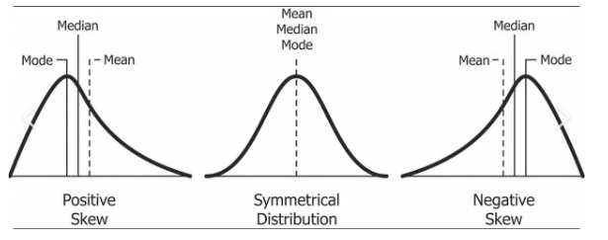
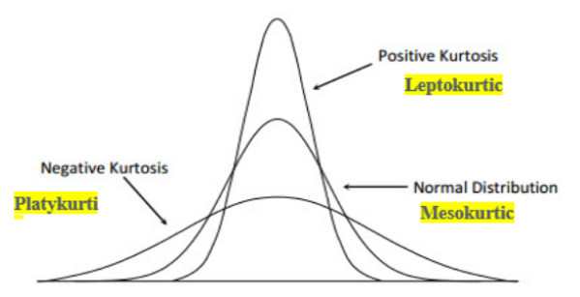
Results and discussion
Skewness measures the asymmetry of the distribution of data around its mean.
Flatness (Kurtosis) measures the peakedness and thickness of the tails of the distribution compared to a normal distribution.

Slide 24
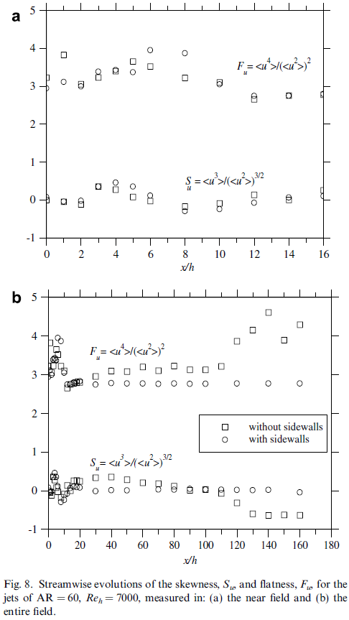



Results and discussion
For each jet, S_{u} displays a local maximum at x/h ≈ 4 (without sidewalls) and x/h ≈ 4 (with sidewalls) and a local minimum at x/h = 5 (without sidewalls) and x/h = 7 (with sidewalls).
Within the region where the two jets both exhibit statistically two-dimensional behavior in the mean field
(10 ≤ x/h ≤ 40), both F_{u} and S_{u} are significantly different for the jets with and without sidewalls.
For example, at x/h = 30, their respective values are 2.7 and 2.9 for F_{u} and 0.02 and 0.34 for S_{u} for the jets with and without sidewalls, respectively.

Slide 25
Results and discussion
Further downstream, the S_{u} and F_{u} factors of the jet with sidewalls remains approximately constant, at values close to the Gaussian, as has been reported previously. In contrast, those for the jet without sidewalls are never truly Gaussian anywhere in the measured range, although they are closest to it in the range 30 ≤ x/h ≤ 110.
For x/h > 120, Su and Fu depart significantly from the Gaussian values, consistent with jet having not yet completed to its transition to the a symmetric flow

Slide 26
CONCLUSIONS
* The flow fields of jets with and without sidewalls from rectangular nozzles are consistently statistically different and the exit velocity profiles very close to the exit (x = 0.25h) are also changed slightly by the presence or absence of sidewalls.
* The near field flow also reveals clear distinctions in the length of the potential core being greater for the case with sidewalls which implies a lower rate of near field entrainment.
The near field vortex shedding rate of the jet with sidewalls has both a lower dominant shedding frequency and higher frequency peaks. This, together with low-frequency spectra, implies that a jet with sidewalls has a less three-dimensional near field structure. These differences in the near field flow structure are possibly to be caused by different vortex types (ring-like in jet without sidewalls and roller-like in jet with sidewalls).
Both jets have characteristic regions of two-dimensional (2-D) mean velocity decay, which follow the scaling U_{c} ~ x^{-1/2} in their respective self-similar fields. However, The decaying and spreading rates are lower for the case with sidewalls than the jet without sidewalls. This is also consistent with a more three-dimensional underlying structure for the case without sidewalls.

Slide 27
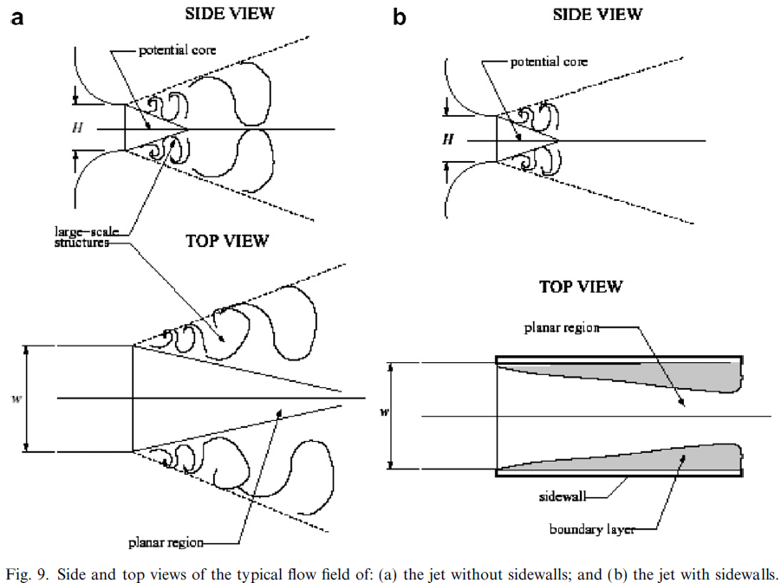
CONCLUSIONS
Further downstream following the 2-D region, the mean velocity decay of the jet without sidewalls follows the scale U_{c} ~ x⁻¹ after an apparent transition zone. This provides further evidence that a jet unbounded by sidewalls following axis switching, undergoes a transition to axisymmetric flow.
Although rectangular nozzles without sidewalls of sufficiently large aspect ratio generate statistically two-dimensional mean velocity fields, their other flow development characteristics do not resemble those of planar nozzles which are configured with sidewalls.
The far field of flows from rectangular nozzles without sidewalls exhibit more three-dimensional underlying large-scale coherent motions than those from rectangular nozzles with sidewalls, which produce more two-dimensional coherent structures

