Slide 1
Aerothermochemistry and Combustion
DAY 7
Kumaresh
2024/04/21

Slide 2
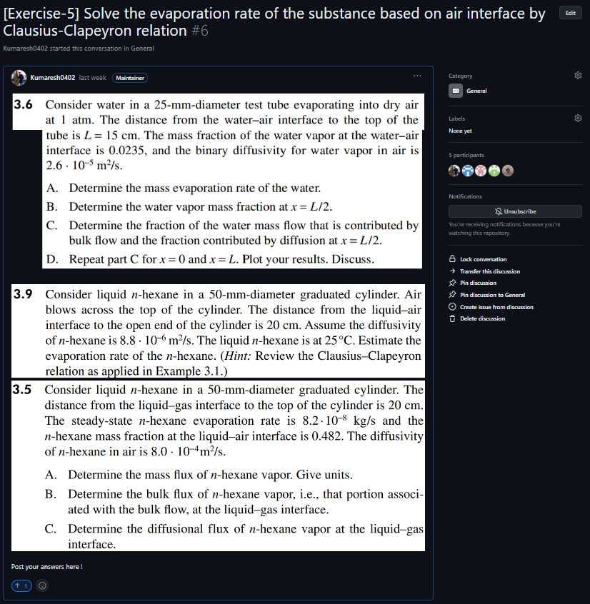
Quick Recap
Notes:
https://ezgif.com/maker
Dirichlet boundary conditions assume the solution to the variable.
In Neumann boundary conditions, a solution is assumed for the derivative of the variable.
https://en.wikipedia.org/wiki/Von_Neumann_stability_analysis

Slide 3
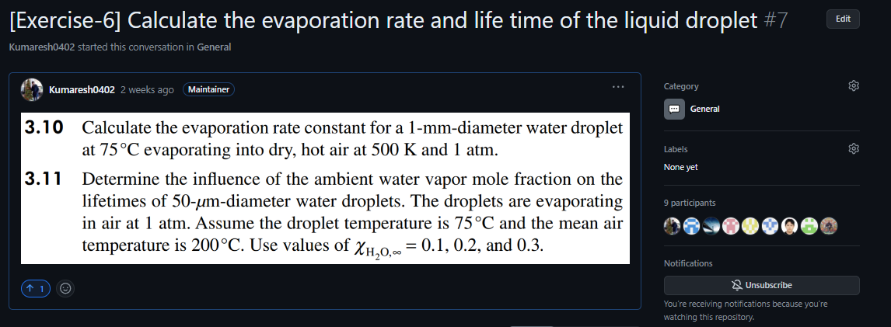
Quick Recap
Notes:
https://ezgif.com/maker
Dirichlet boundary conditions assume the solution to the variable.
In Neumann boundary conditions, a solution is assumed for the derivative of the variable.
https://en.wikipedia.org/wiki/Von_Neumann_stability_analysis

Slide 4
Contents
Numerical discretization (Grid layout)
Taylor series expansion
Mathematical Operations
Governing Equations
Gauss-Divergence theorem
Numerical Solution to Diffusion Equation
Solve Exercise – 7 in Octave

Slide 5
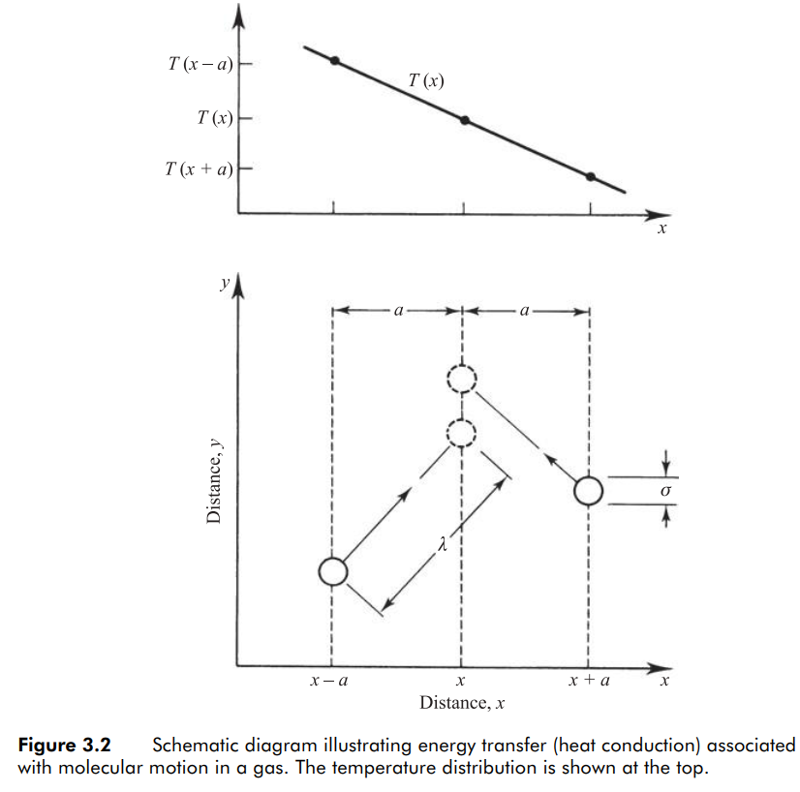
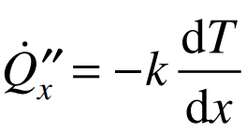
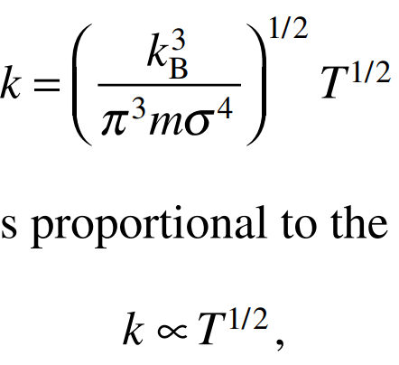
Heat Conduction (Fourier’s law of conduction)
Thermal conductivity
Solve this problem in Octave and OpenFOAM
Ref: Stephen R. Turns - An introduction to combustion - concepts and applications

Slide 6
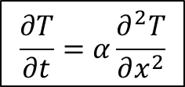
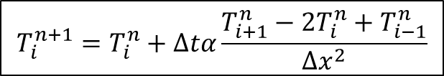
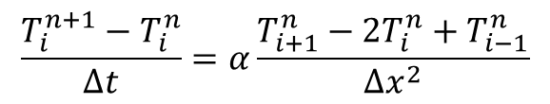

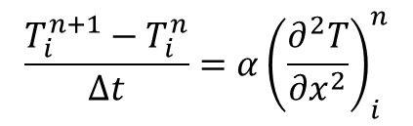

Numerical Solution to Diffusion Equation
$$\frac{∂T}{∂t}=α\frac{∂^{2}T}{∂x^{2}}$$
Time level: $n+1$
$$\frac{T_{i}^{n+1}−T_{i}^{n}}{Δt}=α{\left(\frac{∂^{2}T}{∂x^{2}}\right)}_{i}^{n}$$
$$x_{i−1}$$
$$x_{i}$$
$$x_{i+1}$$
$$x_{i+2}$$
$${\left(\frac{d^{2}T}{dx^{2}}\right)}_{i}=\frac{T\left(x_{i+1}\right)−2T\left(x_{i}\right)+T\left(x_{i−1}\right)}{Δx_{i}^{2}}+O\left(Δx_{i}^{2}\right)$$
Time level: $n$
$$x_{i+1}$$
$$x_{i+2}$$
$$x_{i−1}$$
$$x_{i}$$
$$\frac{T_{i}^{n+1}−T_{i}^{n}}{Δt}=α\frac{T_{i+1}^{n}−2T_{i}^{n}+T_{i−1}^{n}}{Δx^{2}}$$
Information is from both left and right end
$$T_{i}^{n+1}=T_{i}^{n}+Δtα\frac{T_{i+1}^{n}−2T_{i}^{n}+T_{i−1}^{n}}{Δx^{2}}$$

Slide 8



Numerical discretization (Grid layout)
$$u$$
$$e_{y}$$
$$e_{x}$$

Slide 9






Numerical discretization (Grid layout)
$$u$$
$$e_{y}$$
$$\left(i,j+1\right)$$
$$e_{x}$$
$$\left(i−1,j\right)$$
$$\left(i,j\right)$$
$$\left(i+1,j\right)$$
$$\left(i,j−1\right)$$
Flow properties are assigned at each grid locations.

Slide 10














Numerical discretization (Grid layout)
Cell centered representation
$$v$$
$$e_{y}$$
$$p$$
$$u, v, p$$
$$u$$
$$\left(i,j+1\right)$$
$$\left(i,j+1\right)$$
$$e_{x}$$
$$\left(i−1,j\right)$$
$$\left(i,j\right)$$
$$\left(i+1,j\right)$$
$$\left(i−1,j\right)$$
$$\left(i,j\right)$$
$$\left(i+1,j\right)$$
$$\left(i,j−1\right)$$
$$\left(i,j−1\right)$$
Staggered grid
Collocated grid

Slide 11
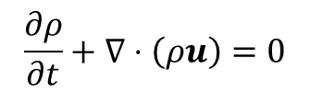
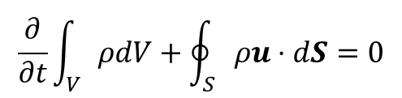










Finite Difference – Finite Volume
Differential form
Integral form
Notes:
This is where I want to introduce you to finite difference and finite volume approaches
Integral form: is in OpenFOAM
We will use differential form in Octave

Slide 13




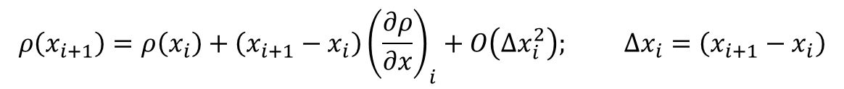
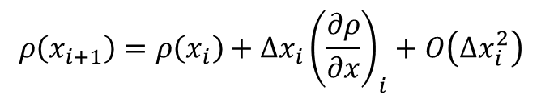
Taylor series expansion

Slide 14
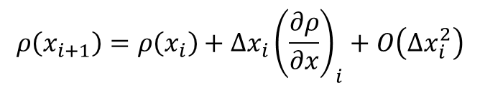
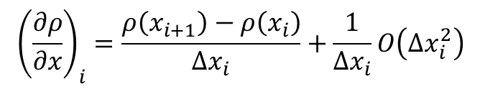
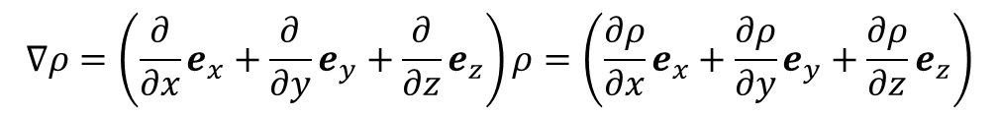
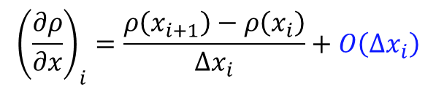
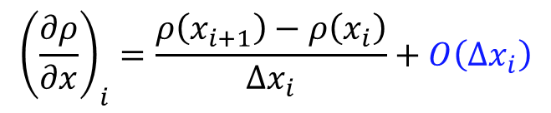
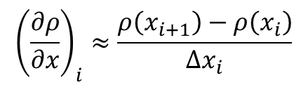
Taylor series (1st order) and FDM
Taylor series:
Finite difference
First order forward difference

Slide 15

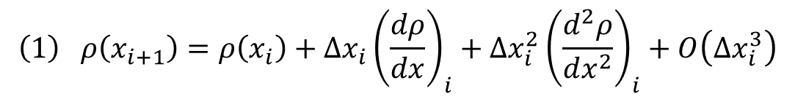



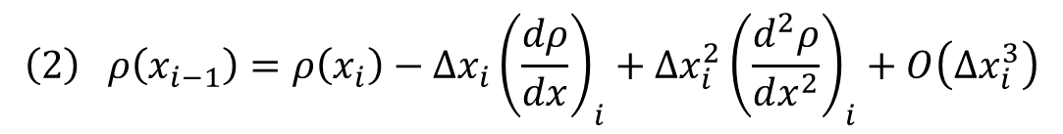
Taylor series (2nd order) – First Order Derivative
$$x_{i−1}$$
$$x_{i}$$
$$x_{i+1}$$
$$x_{i+2}$$
$$ρ\left(x_{i+1}\right)=ρ\left(x_{i}\right)+\left(x_{i+1}−x_{i}\right){\left(\frac{dρ}{dx}\right)}_{i}+{\left(x_{i+1}−x_{i}\right)}^{2}{\left(\frac{d^{2}ρ}{dx^{2}}\right)}_{i}+{\left(x_{i+1}−x_{i}\right)}^{3}{\left(\frac{d^{3}ρ}{dx^{3}}\right)}_{i}+…$$
$$\left(1\right) ρ\left(x_{i+1}\right)=ρ\left(x_{i}\right)+Δx_{i}{\left(\frac{dρ}{dx}\right)}_{i}+Δx_{i}^{2}{\left(\frac{d^{2}ρ}{dx^{2}}\right)}_{i}+O\left(Δx_{i}^{3}\right)$$
$$\left(2\right) ρ\left(x_{i−1}\right)=ρ\left(x_{i}\right)−Δx_{i}{\left(\frac{dρ}{dx}\right)}_{i}+Δx_{i}^{2}{\left(\frac{d^{2}ρ}{dx^{2}}\right)}_{i}+O\left(Δx_{i}^{3}\right)$$

Slide 16
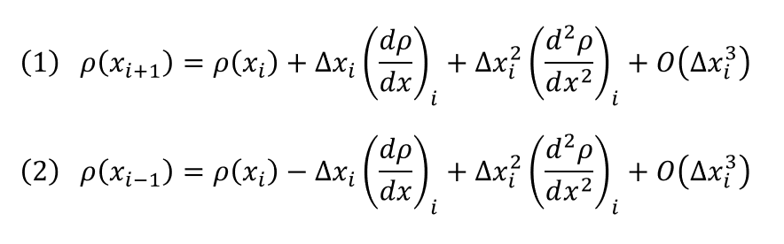
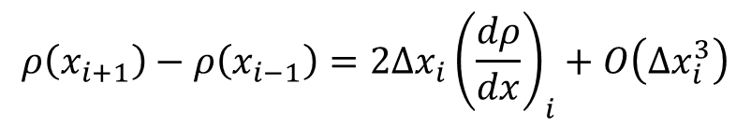
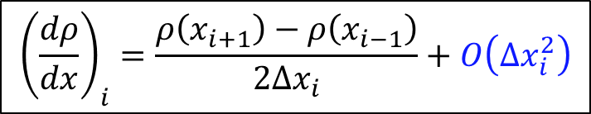
Taylor series (2nd order) – First Order Derivative
$$x_{i−1}$$
$$x_{i}$$
$$x_{i+1}$$
$$x_{i+2}$$
Subtract (2) from (1)
$$ρ\left(x_{i+1}\right)−ρ\left(x_{i−1}\right)=2Δx_{i}{\left(\frac{dρ}{dx}\right)}_{i}+O\left(Δx_{i}^{3}\right)$$
$${\left(\frac{dρ}{dx}\right)}_{i}=\frac{ρ\left(x_{i+1}\right)−ρ\left(x_{i−1}\right)}{2Δx_{i}}+O\left(Δx_{i}^{2}\right)$$
First Order Derivative
Second order central difference scheme

Slide 17
Taylor series (2nd order) – Second Order Derivative
$$x_{i−1}$$
$$x_{i}$$
$$x_{i+1}$$
$$x_{i+2}$$
$$ρ\left(x_{i+1}\right)=ρ\left(x_{i}\right)+\left(x_{i+1}−x_{i}\right){\left(\frac{dρ}{dx}\right)}_{i}+\frac{{\left(x_{i+1}−x_{i}\right)}^{2}}{2}{\left(\frac{d^{2}ρ}{dx^{2}}\right)}_{i}+\frac{{\left(x_{i+1}−x_{i}\right)}^{3}}{6}{\left(\frac{d^{3}ρ}{dx^{3}}\right)}_{i}+\frac{{\left(x_{i+1}−x_{i}\right)}^{4}}{24}{\left(\frac{d^{4}ρ}{dx^{4}}\right)}_{i}+…$$
$$\left(1\right) ρ\left(x_{i+1}\right)=ρ\left(x_{i}\right)+Δx_{i}{\left(\frac{dρ}{dx}\right)}_{i}+\frac{Δx_{i}^{2}}{2}{\left(\frac{d^{2}ρ}{dx^{2}}\right)}_{i}+\frac{Δx_{i}^{3}}{6}{\left(\frac{d^{3}ρ}{dx^{3}}\right)}_{i}+\frac{Δx_{i}^{4}}{24}{\left(\frac{d^{4}ρ}{dx^{4}}\right)}_{i}+O\left(Δx_{i}^{5}\right)$$
$$\left(2\right) ρ\left(x_{i−1}\right)=ρ\left(x_{i}\right)−Δx_{i}{\left(\frac{dρ}{dx}\right)}_{i}+\frac{Δx_{i}^{2}}{2}{\left(\frac{d^{2}ρ}{dx^{2}}\right)}_{i}−\frac{Δx_{i}^{3}}{6}{\left(\frac{d^{3}ρ}{dx^{3}}\right)}_{i}+\frac{Δx_{i}^{4}}{24}{\left(\frac{d^{4}ρ}{dx^{4}}\right)}_{i}+O\left(Δx_{i}^{5}\right)$$

Slide 18
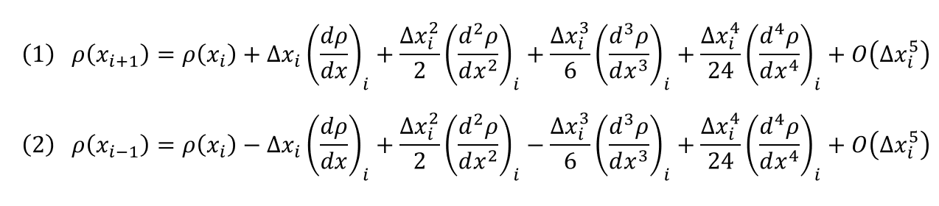
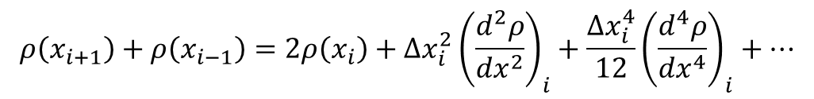
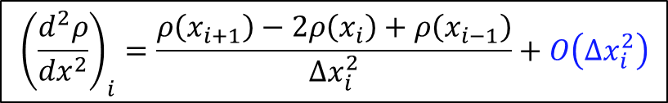
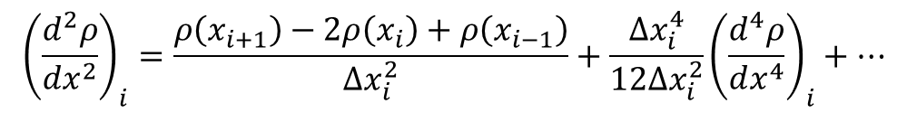
Taylor series (2nd order) – Second Order Derivative
$$x_{i−1}$$
$$x_{i}$$
$$x_{i+1}$$
$$x_{i+2}$$
Add (1) and (2)
$$ρ\left(x_{i+1}\right)+ρ\left(x_{i−1}\right)=2ρ\left(x_{i}\right)+Δx_{i}^{2}{\left(\frac{d^{2}ρ}{dx^{2}}\right)}_{i}+\frac{Δx_{i}^{4}}{12}{\left(\frac{d^{4}ρ}{dx^{4}}\right)}_{i}+…$$
$${\left(\frac{d^{2}ρ}{dx^{2}}\right)}_{i}=\frac{ρ\left(x_{i+1}\right)−2ρ\left(x_{i}\right)+ρ\left(x_{i−1}\right)}{Δx_{i}^{2}}+\frac{Δx_{i}^{4}}{12Δx_{i}^{2}}{\left(\frac{d^{4}ρ}{dx^{4}}\right)}_{i}+…$$
$${\left(\frac{d^{2}ρ}{dx^{2}}\right)}_{i}=\frac{ρ\left(x_{i+1}\right)−2ρ\left(x_{i}\right)+ρ\left(x_{i−1}\right)}{Δx_{i}^{2}}+O\left(Δx_{i}^{2}\right)$$
Second Order Derivative
Second order central difference scheme

Slide 19
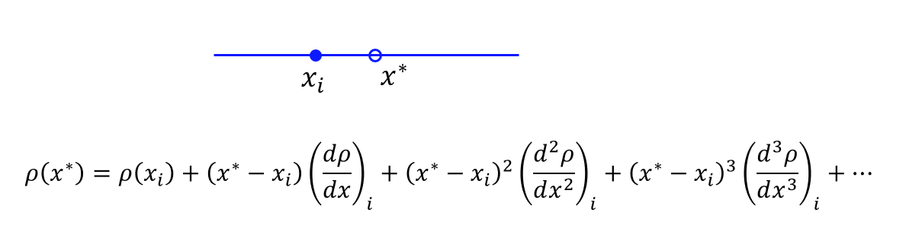
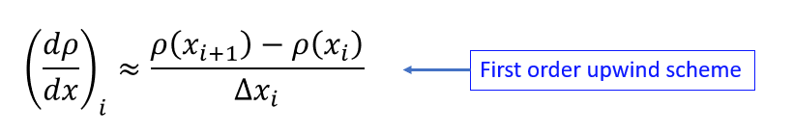
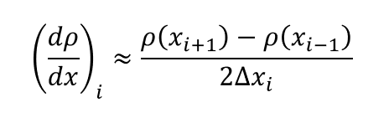
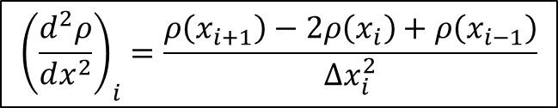
Taylor series – Summary
$$x_{i−1}$$
$$x_{i}$$
$$x_{i+1}$$
$$x_{i+2}$$
$${\left(\frac{d^{2}ρ}{dx^{2}}\right)}_{i}=\frac{ρ\left(x_{i+1}\right)−2ρ\left(x_{i}\right)+ρ\left(x_{i−1}\right)}{Δx_{i}^{2}}$$
First order forward difference
First Order Derivative
Second order central difference
Second Order Derivative
Second order central difference

Slide 21
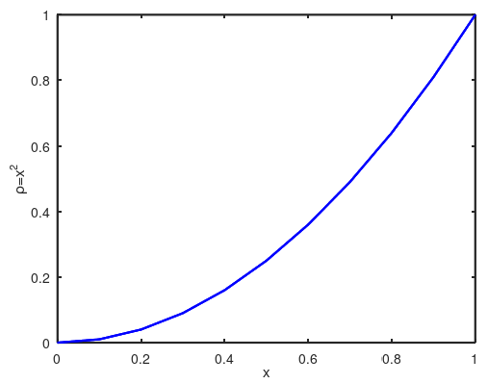
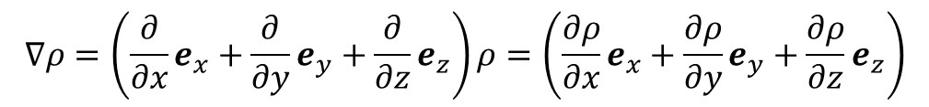
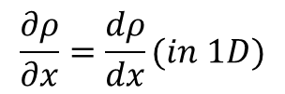
Mathematical operations
Gradient
e_{y}
e_{x}
e_{z}

Slide 22
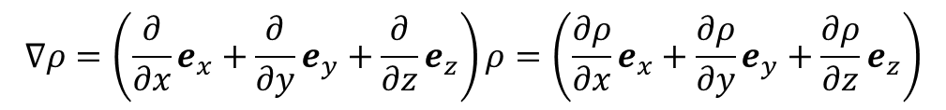

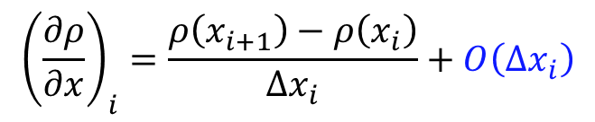




Mathematical operations
Notes:
https://www.youtube.com/watch?v=vWFjqgb-ylQ
The pressure gradient term in the Navier-Stokes equations is negative because the pressure force is acting in the opposite direction to the fluid flow. This term represents the force that drives the fluid in a particular direction. If the pressure is higher in one area of the fluid and lower in another, the fluid will flow from the high pressure area to the low pressure area

Slide 23
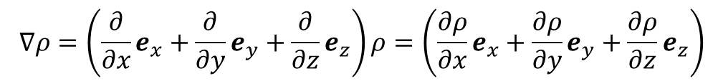
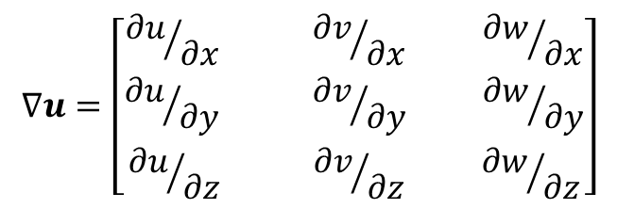
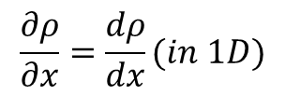
Mathematical operations
Gradient:
e_{y}
e_{x}
e_{z}

Slide 24
Mathematical operations
Divergence:
In vector calculus, divergence is a vector operator that operates on a vector field, producing a scalar field giving the quantity of the vector field's source at each point.
More technically, the divergence represents the volume density of the outward flux of a vector field from an infinitesimal volume around a given point.
As an example, consider air as it is heated or cooled. The velocity of the air at each point defines a vector field. While air is heated in a region, it expands in all directions, and thus the velocity field points outward from that region. The divergence of the velocity field in that region would thus have a positive value. While the air is cooled and thus contracting, the divergence of the velocity has a negative value.

Slide 25
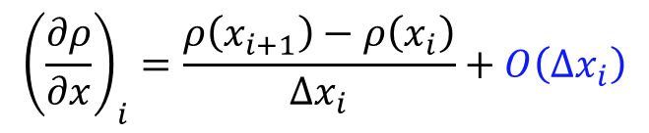




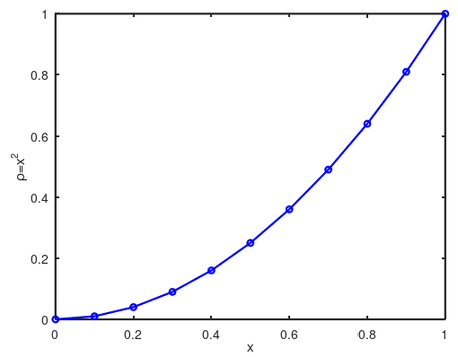
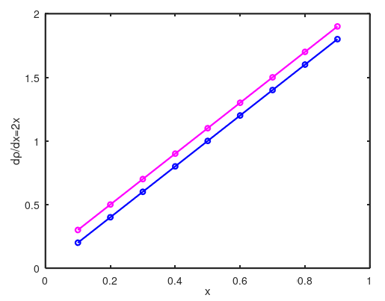
Analytical and Numerical solutions
Resolved in OCTAVE
Analytical | Numerical
An analytical solution involves framing the problem in a well-understood form and calculating the exact solution. | A numerical solution means making guesses at the solution and testing whether the problem is solved well enough to stop.
Numerical result
Analytical result

Slide 27
Governing Equations
The general equation can be written in the form as:
1
2
3
4
1
Unsteady/Transient term
3
Diffusion term
2
Advection/Convection term
4
Source term

Slide 28
Governing Equations
Continuity equation:
➔
Momentum equation:
➔
Energy equation:
➔
Species equation:
➔
Turbulence equation:
➔
Ideal Gas equation:

Slide 30
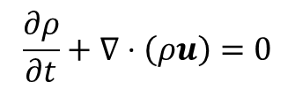
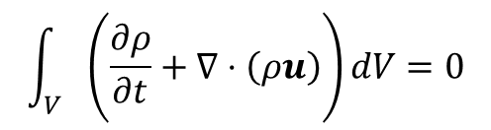
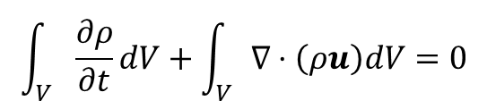
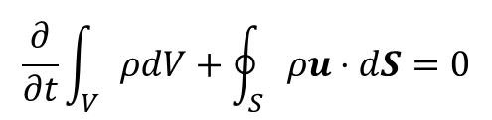
Integral Form – Differential Form
Conservation of mass
Integrate over a control volume
Gauss – divergence theorem

Slide 31





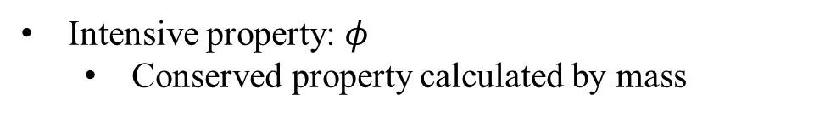

Gauss Divergence Theorem

Slide 32


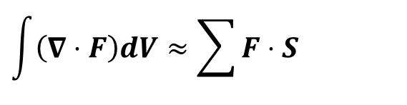

Gauss Divergence Theorem
Rate of change of a quantity over a control volume = Rate of flow through control surface.

Slide 33

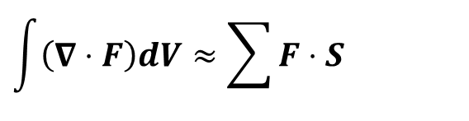



Gauss Divergence Theorem
e_{y}
e_{x}
e_{z}

Slide 34









Gauss Divergence Theorem

Slide 36

Fick's law describes the movement of particles from a region of high concentration to a region of lower concentration.
Diﬀusion generally represents the transport of a ﬂuid property (momentum) due to ﬂuctuating motions that are not captured by the bulk motion that is represented by the continuum velocity eqn.
Diffusion
Thermodynamic diffusers supply heated air with a downward jet, the difference in air density causes hot air to rise in the first minute after starting the system.

Slide 37
Numerical Solution to Diffusion Equation
$$\frac{∂T}{∂t}=α\frac{∂^{2}T}{∂x^{2}}$$
Time level: $n+1$
$$\frac{T_{i}^{n+1}−T_{i}^{n}}{Δt}=α{\left(\frac{∂^{2}T}{∂x^{2}}\right)}_{i}^{n}$$
$$x_{i−1}$$
$$x_{i}$$
$$x_{i+1}$$
$$x_{i+2}$$
$${\left(\frac{d^{2}T}{dx^{2}}\right)}_{i}=\frac{T\left(x_{i+1}\right)−2T\left(x_{i}\right)+T\left(x_{i−1}\right)}{Δx_{i}^{2}}+O\left(Δx_{i}^{2}\right)$$
Time level: $n$
$$x_{i+1}$$
$$x_{i+2}$$
$$x_{i−1}$$
$$x_{i}$$
$$\frac{T_{i}^{n+1}−T_{i}^{n}}{Δt}=α\frac{T_{i+1}^{n}−2T_{i}^{n}+T_{i−1}^{n}}{Δx^{2}}$$
Information is from both left and right end
$$T_{i}^{n+1}=T_{i}^{n}+Δtα\frac{T_{i+1}^{n}−2T_{i}^{n}+T_{i−1}^{n}}{Δx^{2}}$$

Slide 38


Exercise – 7 (Let’s solve the Diffusion Equation)
$$T_{i}^{n+1}=T_{i}^{n}+Δtα\frac{T_{i+1}^{n}−2T_{i}^{n}+T_{i−1}^{n}}{Δx^{2}}$$
a7_solve_diffusion.m
Resolve the diffusion equation with $α$ = 1, dt = 0.001, dx = 0.05, Dirichlet boundaries (T_left = 300K , T_right = 273K), and write the above numerical solution to extract the results.
Change the right boundary condition from Dirichlet to Neumann. Explain about it in few words.
Repeat Step 1: Analyze for different time steps (dt) 0.1, 0.01, and 0.001 and give your comments. Hint: Von Neumann stability analysis.
Repeat Step 1: Learning debug skills – fix breakpoints, run , and understand the codes. Explain about it in few words.
Notes:
https://ezgif.com/maker
Dirichlet boundary conditions assume the solution to the variable.
In Neumann boundary conditions, a solution is assumed for the derivative of the variable.
https://en.wikipedia.org/wiki/Von_Neumann_stability_analysis

Slide 40
Research Project Presentation
April 29 and next week:
Every individual should present the topic in the form of presentation for 15 minutes. This topic carries high marks. Please prepare and present it carefully.
Query session: 5 minutes.
Every individual should ask a single question during the presentation.

