Slide 1
Aerothermochemistry and Combustion
Introduction – DAY 2
Kumaresh

Slide 2
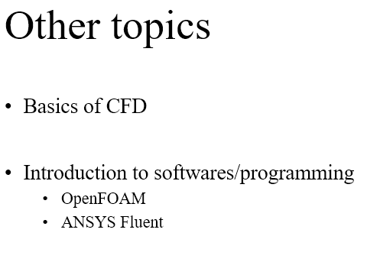
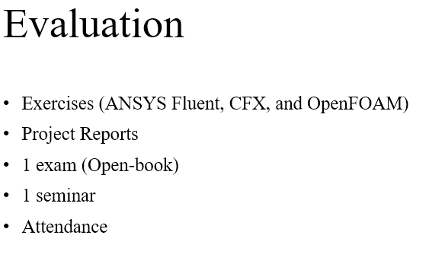
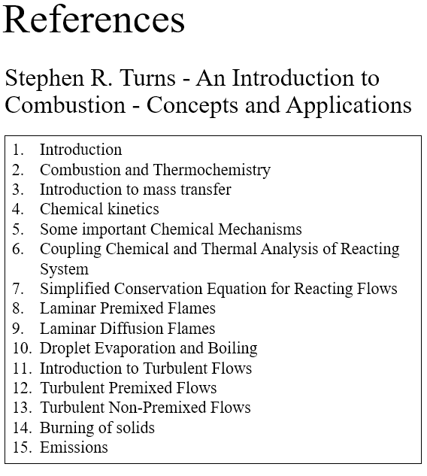
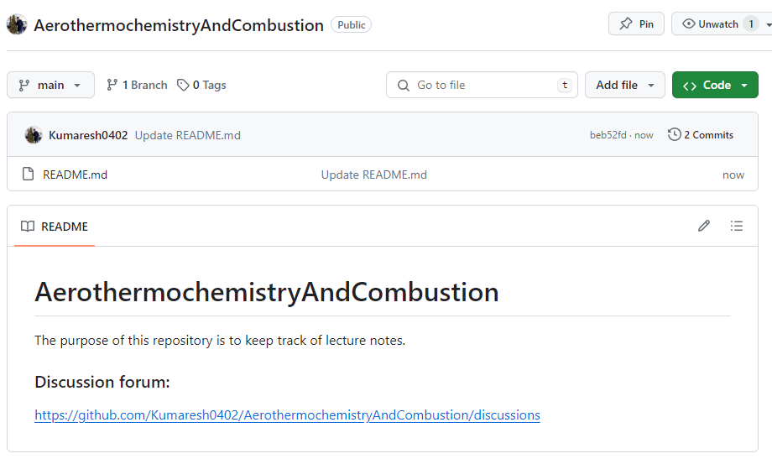
Quick Recap
GitHub repository
Notes:
https://ezgif.com/maker
Dirichlet boundary conditions assume the solution to the variable.
In Neumann boundary conditions, a solution is assumed for the derivative of the variable.
https://en.wikipedia.org/wiki/Von_Neumann_stability_analysis

Slide 3
Contents
Introduction to Combustion and Thermochemistry
Solve Exercises – 1, 2 and 3

Slide 4

Fluid
A substance whose molecular structure offers no resistance to external forces - Ferziger, Peric
Fluid parcel
Fluid molecules

Slide 5












Fluid
A substance whose molecular structure offers no resistance to external forces - Ferziger, Peric
Fluid parcel
Rotation
Expansion
Deformation

Slide 6





Fluid
A substance whose molecular structure offers no resistance to external forces - Ferziger, Peric
Fluid parcel
Molecular
physics
Continuum
Fluid molecules

Slide 7


https://en.wikipedia.org/wiki/Knudsen_number#References
Continuum
Knudsen number:
Kn < 0.01 | Continuum flow
0.01 < Kn < 0.1 | Slip flow
0.1 < Kn < 10 | Transitional flow
Kn > 10 | Free molecular flow
In physics, mean free path is the average distance over which a moving particle

Slide 8
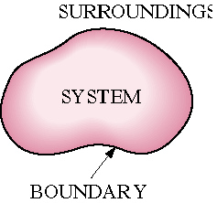
Closed, Open, and Isolated Systems
A thermodynamic system, or simply system, is defined as a quantity of matter or a region in space chosen for study.
The region outside the system is called the surroundings.
The real or imaginary surface that separates the system from its surroundings is called the boundary.
The boundary of a system may be fixed or movable.
Systems may be considered to be closed or open, depending on whether a fixed mass or a fixed volume in space is chosen for study.

Slide 9
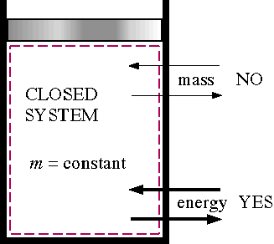
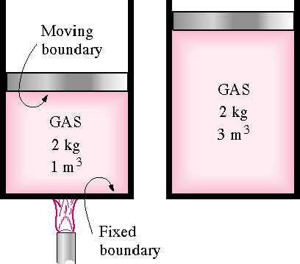
Closed System
A closed system consists of a fixed amount of mass and no mass may cross the system boundary. The closed system boundary may move.
Examples of closed systems are sealed tanks and piston cylinder devices (note the volume does not have to be fixed). However, energy in the form of heat and work may cross the boundaries of a closed system.

Slide 10
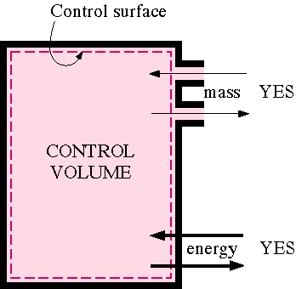
Open System
An open system, or control volume, has mass as well as energy crossing the boundary, called a control surface. Examples of open systems are pumps, compressors, turbines, valves, and heat exchangers.

Slide 11
Isolated System
An isolated system is a general system of fixed mass where no heat or work may cross the boundaries.
Exchanging mass and energy among themselves with no other system. Energy and Matter conservation and entropy increases as per 2nd law of thermodynamics.
Our Universe, Inflated Balloon, Thermos Flask, Air tight container
Isolated System Boundary
Heat = 0
Work = 0
Mass = 0
Across
Isolated
Boundary
Work
Surr 4
Mass
System
Surr 3
Surr 1
Heat
Mass
Surr 2

Slide 12
Properties of a System
Any characteristic of a system in equilibrium is called a property. The property is independent of the path used to arrive at the system condition.
Properties may be intensive or extensive.
Extensive property | Intensive property
Extensive properties are those that vary directly with size--or extent--of the system. | Intensive properties are those that are independent of size.
mass volume total energy mass dependent property | temperature pressure any mass independent properties like specific volume, specific internal energy, specific enthalpy

Slide 13

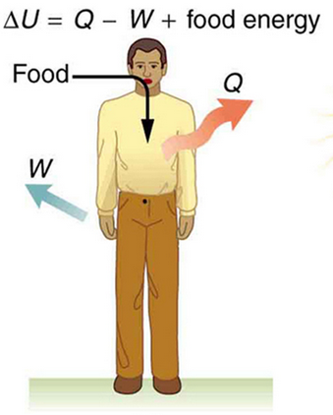


First Law of Thermodynamics
Energy can neither be created nor be destroyed but can be transformed from one form to another.
In a cyclic process,
Algebraic sum of work transfers= Algebraic sum of heat transfers
dE = dQ – dW
E₂ - E₁ = Q – W
Q = W + (E₂ - E₁)
Heat Transfer = Work Done + Change in Energy
Propulsion & Combustion Lab.

Slide 14



Specific Heat of Gases
Heat carrying capacity in a process.
Amount of heat required to raise the temperature of a unit mass of the gas by one degree.
Ratio of the specific heat : (important in compressible flow problems)
Specific heat at constant volume | Specific heat at constant pressure
Amount of heat required to raise the temperature of a unit mass of the gas by one degree at constant volume. | Amount of heat required to raise the temperature of a unit mass of the gas by one degree at constant pressure.
Propulsion & Combustion Lab.

Slide 15









Specific Terms
Internal Energy – Energy stored in it by the virtue of its molecular motion.
Enthalpy – Heat Supplied or rejected from the system at constant pressure. For Ideal gas,
Ideal Gas – Obeys Boyle’s and Charles’s law
Ideal gas
Substituting - in , &
Propulsion & Combustion Lab.

Slide 16




Specific Terms
Perfect gas – Specific heats remain constant at all temperatures – C_{v} , C_{p} = Specific heat at constant volume and pressure
Semi – Perfect gas - Specific heats vary with temperature.
Real gas – Doesn’t obey the equation of ideal gas states.
Propulsion & Combustion Lab.

Slide 17
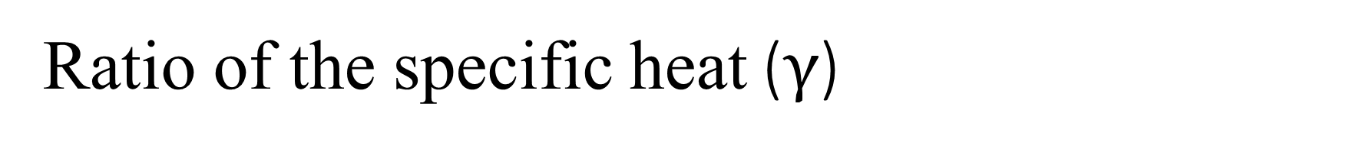

Ratio of the specific heat ($γ$)
$γ=\frac{C_{p}}{C_{v}}$- related to degree of freedom of the molecule.
$γ=\frac{n+2}{n}$
For monatomic gas, $γ=\frac{3+2}{3}$=$\frac{5}{3}$=1.667 (Translational motion =3)
For diatomic gas, $γ=\frac{5+2}{5}$=$\frac{7}{5}$=1.4 (Translational motion =3, Rotational motion =2)
At higher temperature, due to vibration, $γ=\frac{6+2}{6}$=$\frac{8}{6}$=1.33
At fully excited state, molecules might gain full energy due to excitation energy,
$γ=\frac{7+2}{7}$=$\frac{9}{7}≈$1.29

Slide 18


Types of Process
Reversible Process – System and surrounding can be restored to their initial states by reversing the process – occurs by the absence of friction heat transfer with finite temperature difference – in real all process are irreversible – it can be used as ideal reference (no change in entropy (dS = 0) ➔ Entropy is constant)
Irreversible Process – Is the one which doesn’t satisfy the above conditions of reversibility (change in entropy (dS > 0))
Adiabatic Process – No heat transfer between the system and the surroundings.
Isentropic Process – An adiabatic process in which the entropy remains constant is also known as reversible adiabatic.
Chonbuk National Univ.
Propulsion & Combustion Lab.

Slide 19

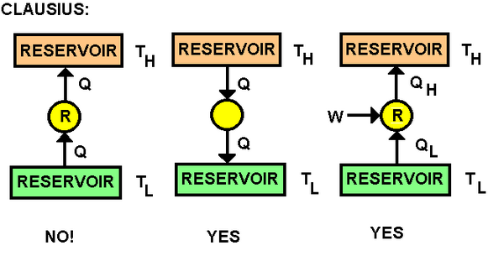





Second law of thermodynamics
Clausius statement – Heat can’t flow from lower temperature body to higher temperature body without any external work.
Kelvin – Planck’s Statement – Impossible to construct a heat engine which performs the complete cycle with 100% efficiency.
Definition of entropy:
Clausius inequality:
In any irreversible process:
In any irreversible adiabatic process:
In any reversible cycle:
Isentropic process :
Chonbuk National Univ.
Propulsion & Combustion Lab.

Slide 20
Zeroth Law of Thermodynamics
The Zeroth law of thermodynamics states that if two bodies are individually in equilibrium with a separate third body, then the first two bodies are also in thermal equilibrium with each other.
This means that if system A is in thermal equilibrium with system C and system B is also in equilibrium with system C, then system A and B are also in thermal equilibrium.

Slide 21
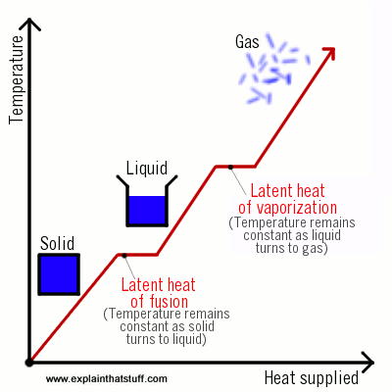
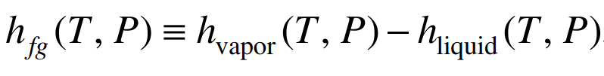
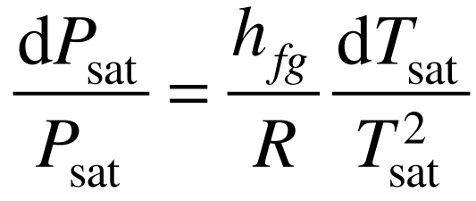
Latent heat
Latent heat vaporization (h_{fg}) as the heat required in a constant-pressure process to completely vaporize a unit mass of liquid at a given temperature.
The latent heat of vaporization at a given saturation temperature and pressure is frequently used with the Clausius–Clapeyron equation to estimate saturation pressure variation with temperature:
Assuming h_{fg} is constant, the above equation can be integrated from (P_{sat,1}, T_{sat,1}) to (P_{sat,2}, T_{sat,2}) in order to permit, for example, P_{sat,2} to be estimated from a knowledge of P_{sat,1}, T_{sat,1}, and T_{sat,2}.

Slide 22

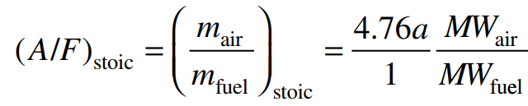
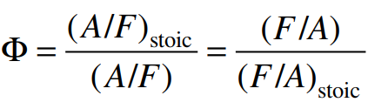
Stoichiometry
The stoichiometric quantity of oxidizer is just that amount needed to completely burn a quantity of fuel.
If more than a stoichiometric quantity of oxidizer is supplied, the mixture is said to be fuel lean and vice-versa.
The stoichiometric oxidizer– (or air–) fuel ratio (mass) is determined by writing simple atom balances, assuming that the fuel reacts to form an ideal set of products. For a hydrocarbon fuel given by CxHy, the stoichiometric relation can be expressed as
The equivalence ratio, Φ, is commonly used to indicate quantitatively whether a fuel–oxidizer mixture is rich, lean, or stoichiometric. From this definition, we see that for fuel-rich mixtures, Φ > 1, and for fuel-lean mixtures, Φ < 1.
where,

Slide 23
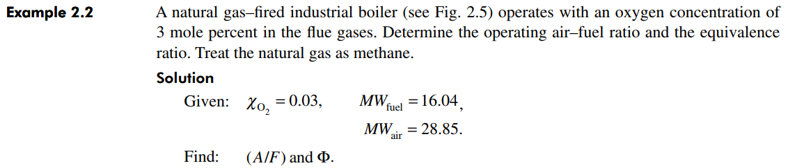
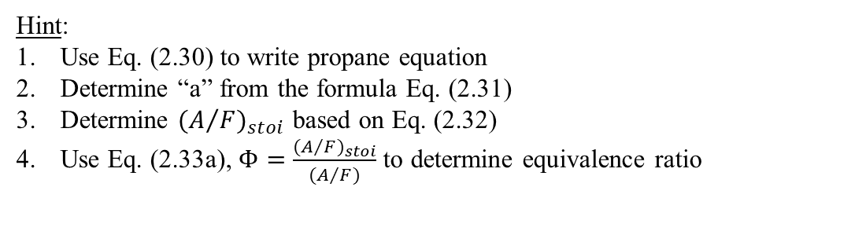
Problem 1
SAMPLE problem
Exercise – 1
Hint:
Use Eq. (2.30) to write propane equation
Determine “a” from the formula Eq. (2.31)
Determine ${(A/F)}_{stoi}$ based on Eq. (2.32)
Use Eq. (2.33a), $Φ=\frac{{(A/F)}_{stoi}}{(A/F)}$ to determine equivalence ratio

Slide 24
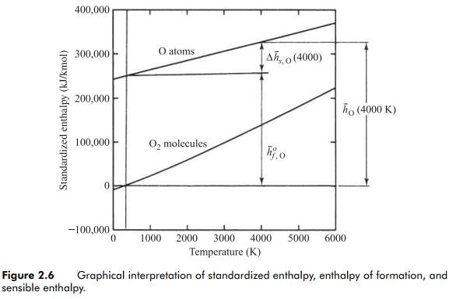
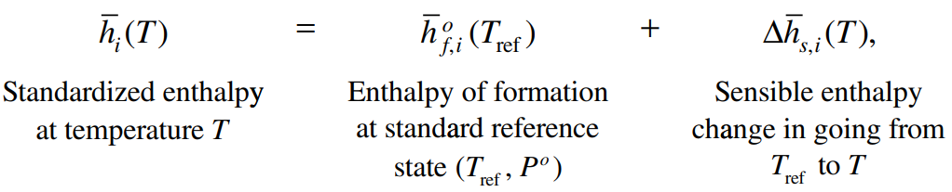
Standardized Enthalpy and Enthalpy of Formation
For any species, a standardized enthalpy is defined as the sum of an enthalpy that takes into account the energy associated with chemical bonds (enthalpy of formation), and an enthalpy that is associated only with the temperature, the sensible enthalpy change.
To form oxygen atoms at the standard state requires the breaking of a rather strong chemical bond. The bond dissociation energy for O2 at 298 K is 498,390 kJ/kmolO2. Breaking this bond creates two O atoms; thus, the enthalpy of formation for atomic oxygen is half the value of the O2 bond dissociation energy,

Slide 25
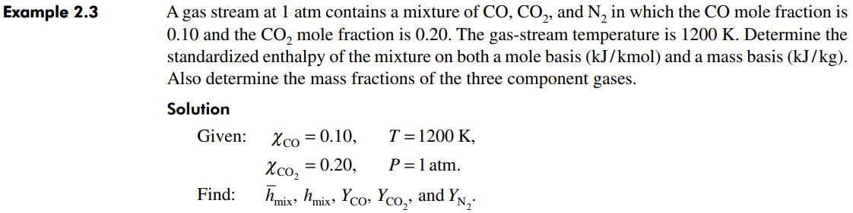
Problem 2
SAMPLE problem
Exercise – 1
Hint:
Use Table A-2 to determine enthalpy formation and sensible enthalpy for CO₂ and O₂ at 400K.
Use Eq. (2.15b), to determine the standardized enthalpy of mixture.

Slide 26
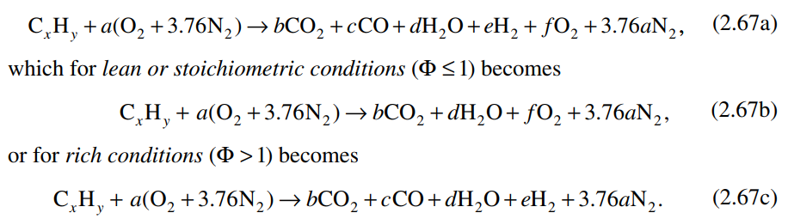
Ideal products of combustion
The calculation of the ideal products of combustion is considered for both lean and rich conditions dissociating minor species.
For rich combustion, however, we employ a single equilibrium reaction, CO + H₂O ⇔ CO₂ + H₂, called as water-gas shift reaction, to account for the simultaneous presence of the incomplete products of combustion, CO and H₂. This water-gas equilibrium is central to steam reforming of CO in the petroleum industry.

Slide 27
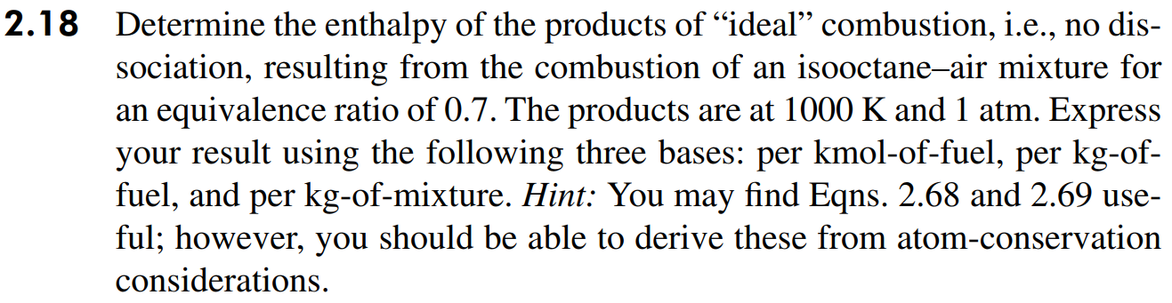
Problem 3
Exercise – 2
Hint:
Use Eq. (2.67b) to write isooctane-air mixture equation.
Solve the coefficients (a, b, d, f) using Eqs. 2.68, 2.69a, 2.69c, 2.69e
Use Table A-2 to determine enthalpy formation and sensible enthalpy for the mixture at 1000K.
Use Eq. (2.15b), to determine the standardized enthalpy of mixture in KJ/kmol-of-fuel and kg-of-fuel.
Molecular weight of the mixture = kg/kmol; (KJ/kmol) / (kg/kmol) = KJ / kg-of-mixture

Slide 28
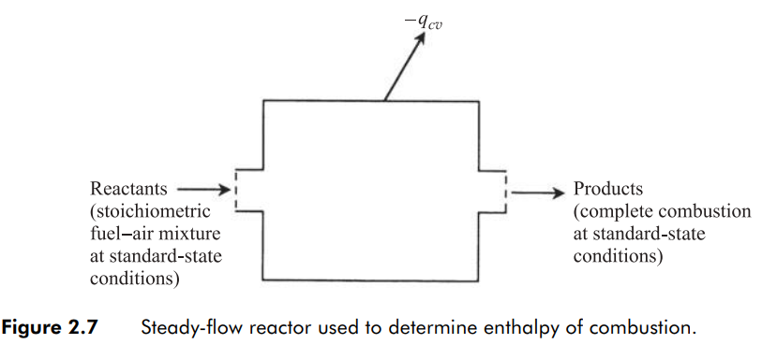
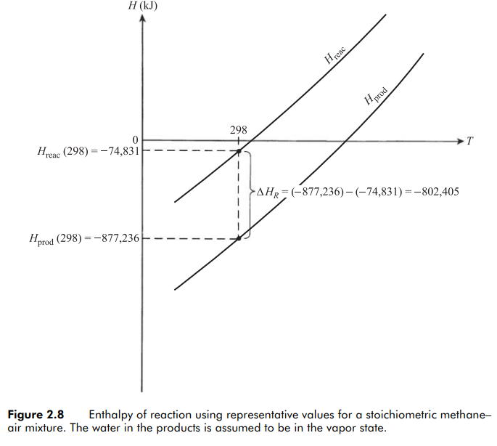

Enthalpy of Combustion and Heating values
Consider the steady flow reactor, shown in Fig. 2.7, in which a stoichiometric mixture of reactants enters and products exits, both at standard-state conditions (25°C, 1 atm).
The combustion process is assumed to be complete, i.e., all of the fuel carbon is converted to CO2 and all of the fuel hydrogen is converted to H2O.
For the products to exit at the same temperature as the entering reactants, heat must be removed from the reactor.
HHV (Higher Heating Value) is the heat of combustion calculated assuming that all of the water in the products has condensed to liquid. This scenario liberates the most energy, hence the designation “upper.”
LHV (Lower Heating Value) corresponds to the case where none of the water is assumed to condense.

Slide 29
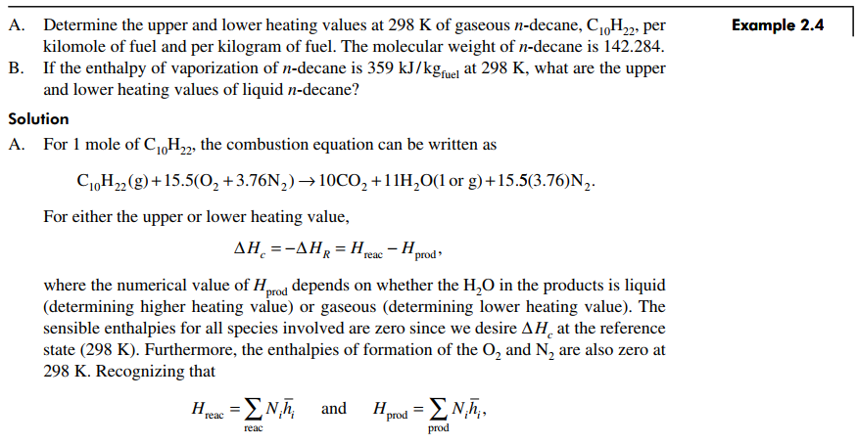
Problem 4
Check this problem and understand

Slide 30
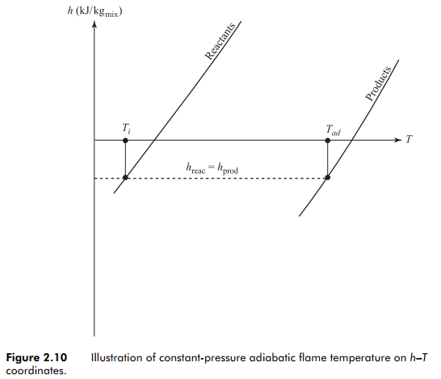
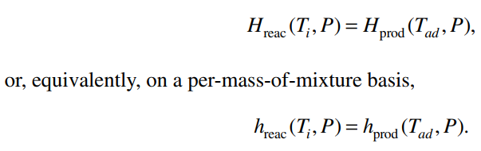
Adiabatic Flame Temperature
At the adiabatic flame temperature, the composition of the combustion products are obtained.
At typical flame temperatures, the products dissociate and the mixture comprises many species.

Slide 31
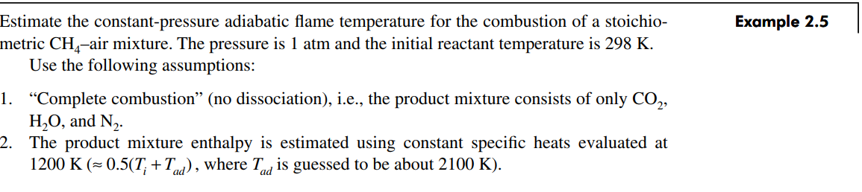

Problem 5
SAMPLE problem
Exercise – 2
Hint:
Write propane-air mixture equation
Derive enthalpy of reactant and product.
Equate it to evaluate the adiabatic flame temperature.

Slide 32


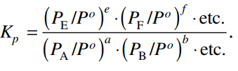





Gibbs Function
The Second Law of Thermodynamics states that a spontaneous process occurs when there is an increase in the entropy of the universe. Gibbs function defines the spontaneity of the process.
For a mixture of ideal gases, the Gibb’s function for the i^{th} species is given by,
Equilibrium constant (K_{p})
$$dS=\frac{dQ}{T}=\frac{dH}{T}$$
For spontaneous reaction
The argument of the natural logarithm is defined as the equilibrium constant K_{p} for the reaction expressed as,
$$dG= dH−TdS<0$$
P⁰ = standard pressure
P_{i} = partial pressure
In a generalized manner,
$$G= H−TS$$
$$dG=dH−TdS−SdT$$

Slide 33
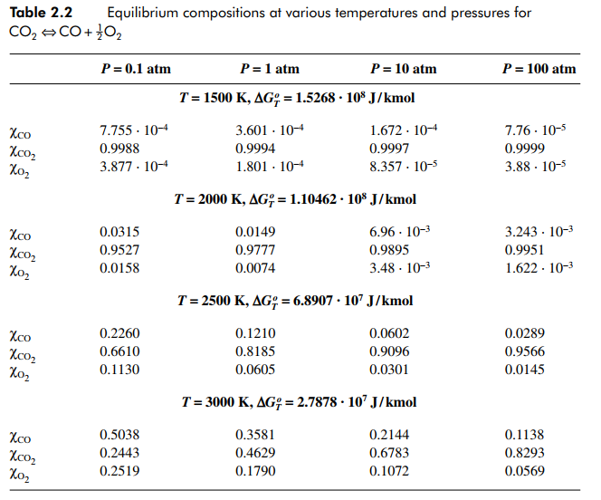
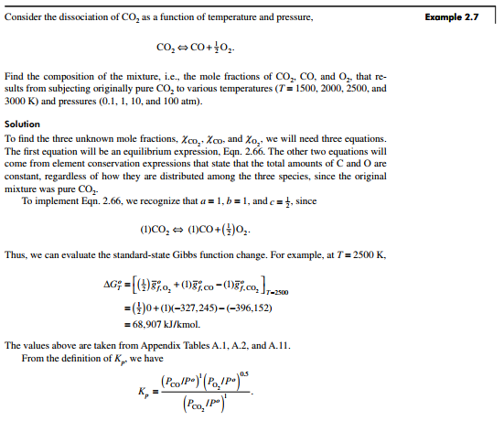
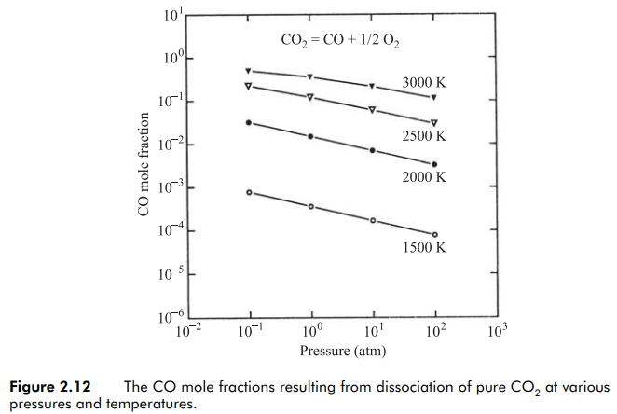
Equilibrium compositions of the CO₂ equation
SAMPLE problem

Slide 34
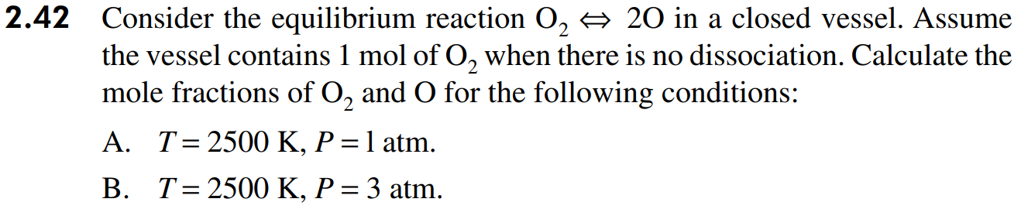
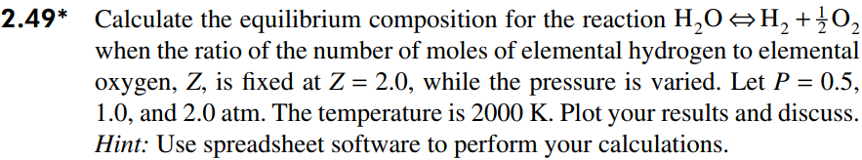
Problem 6
Exercise – 3
Hint:
Need to come up with 2 equations, because here we have 2 unknowns (mole fractions of O₂ and O).
Using Tables A.11 and A.12, calculate Gibbs function at standard state pressure.
Using Eqs. 2.65, 2.66a, and 2.66b, frame one equation.
Second equation: mole fraction of O2 + mole fraction of O = 1
With 2 equations, 2 unknowns are solved for 2500K. Calculate for 2 different pressure values.

Slide 35
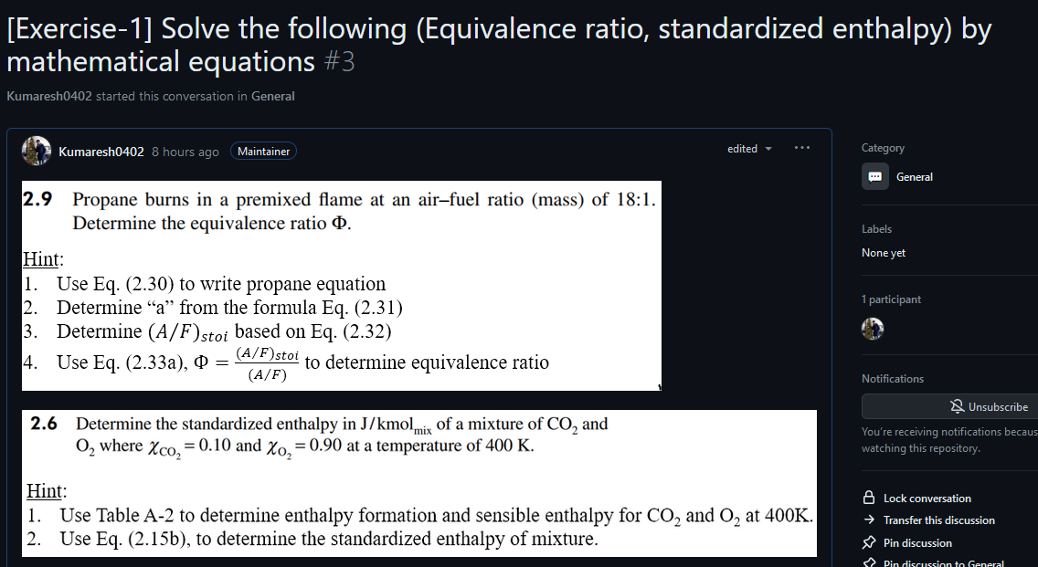
Exercise – 1 (Equivalence ratio and Standardized enthalpy)
https://github.com/Kumaresh0402/AerothermochemistryAndCombustion/discussions/3

Slide 36
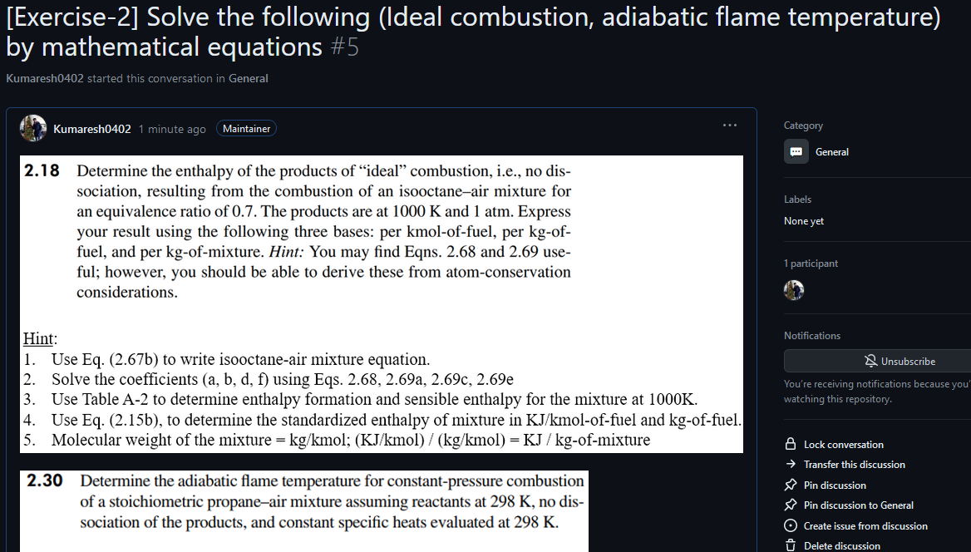
Exercise – 2 (Ideal combustion and flame temperature)
https://github.com/Kumaresh0402/AerothermochemistryAndCombustion/discussions/5

Slide 37
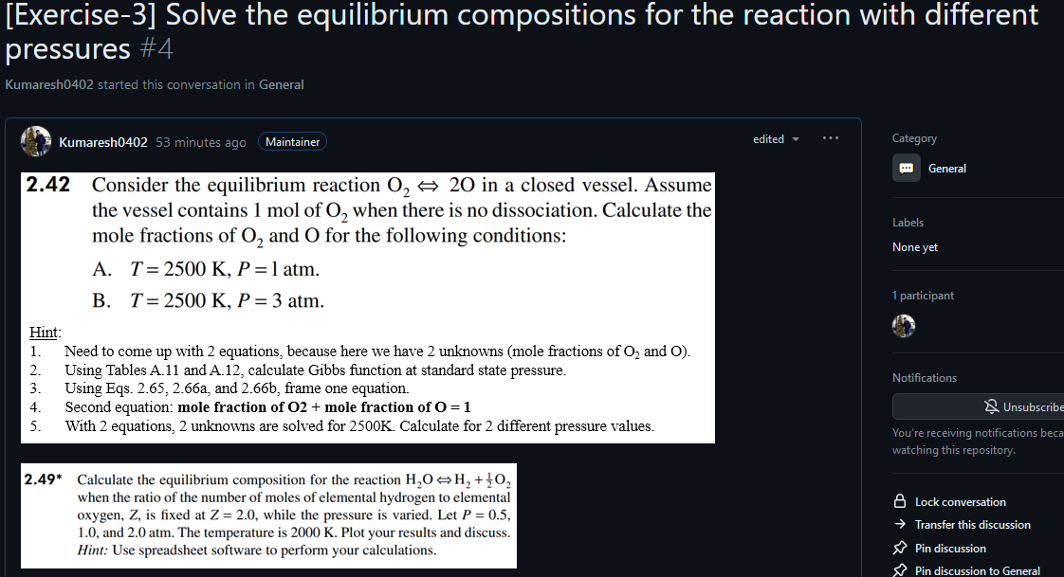
Exercise – 3 (Equilibrium Compositions)
https://github.com/Kumaresh0402/AerothermochemistryAndCombustion/discussions/4

