Slide 1
Aerothermochemistry and Combustion
Introduction – DAY 1
Kumaresh

Slide 2
Definition – Aerothermochemistry
Aero (Aerodynamics) + propulsive effects
Thermo (heat)
Chemistry (chemical changes)
The term Aerothermochemistry was coined by Theodore von Karman, in the 1950’s, to provide a scientific basis for the study of gases taking into account the effects of motion, heat, and chemical changes.
Notes:
Aero (Aerodynamics) + propulsive effects
Thermo (heat)
Chemistry (chemical changes)

Slide 3
Physics and Applications
In this subject, I will cover the topics related to the study of chemical kinetics, thermodynamics, and mechanisms.
Some important phenomena:
Combustion mechanisms
Surface reactions
Droplet evaporation and burning
Laminar diffusion and premixed flames
Turbulent non-premixed and premixed flames
Emission behavior
Detonation
Applications: Gas turbine combustor, catalytic combustor, SI engines, coal pyrolysis, supersonic/hypersonic jet engines, solid rocket motor

Slide 4
References
Stephen R. Turns - An Introduction to Combustion - Concepts and Applications
Stephen R. Turns - An Introduction to Combustion - Concepts and Applications
K. K. Kuo – Principles of Combustion
A. M. Kanury – Introduction to Combustion Phenomena
Introduction
Combustion and Thermochemistry
Introduction to mass transfer
Chemical kinetics
Some important Chemical Mechanisms
Coupling Chemical and Thermal Analysis of Reacting System
Simplified Conservation Equation for Reacting Flows
Laminar Premixed Flames
Laminar Diffusion Flames
Droplet Evaporation and Boiling
Introduction to Turbulent Flows
Turbulent Premixed Flows
Turbulent Non-Premixed Flows
Burning of solids
Emissions

Slide 5
Chapters 1, 2, 3 – Introduction
Motivation to study combustion
Combustion and Thermochemistry
Review of Property Relations
Laws of thermodynamics
Reactant and product mixtures
Adiabatic Flame temperature
Chemical equilibrium
Applications
Introduction to Mass transfer
Laws and species conservation
Some applications

Slide 6
Chapters 4, 5, 6 – Chemical kinetics, Mechanisms
Chemical Kinetics
Elementary reactions
Reaction rates for multistep mechanisms
Catalysis and Heterogeneous reactions (ANSYS Fluent)
5. Some Important Chemical Mechanisms
Methane combustion and oxides of Nitrogen (ANSYS Fluent and OpenFOAM)
6. Coupling Chemical and Thermal Analyses of Reacting Systems
Constant-Pressure, Fixed Mass
Reactors
Plug-Flow Reactor (CHEMKIN)
Applications to Combustion System

Slide 7
Chapters 7, 8, 9 – Equations, Laminar Flames
7. Simplified Conservation Equations for Reacting Flows
Continuity, Momentum, Energy, and Species Mass Conservation equations
Multicomponent Diffusion
8. Laminar Premixed Flames (ANSYS or OpenFOAM simulations)
Physical description
Simplified analysis
Structure of CH₄ – air flames
Flame velocity and thickness
Quenching, Flammability, and Ignition
Flame Stabilization
9. Laminar Diffusion Flames

Slide 8
Chapters 10, 11, 12, 13
10. Droplet Evaporation and Burning (ANSYS or OpenFOAM simulations)
Applications
Model of droplet evaporation
Droplet burning
11. Introduction: Turbulent flows
12. Turbulent Premixed Flames (ANSYS or OpenFOAM simulations)
Applications
Turbulent Flame Speed
Structure and flame stabilization
13. Turbulent Nonpremixed Flames

Slide 9
Chapters 14, 15, 16
14. Burning of Solids
Heterogeneous Reactions
Coal Combustion, Pyrolysis
15. Emissions
16. Detonations - Guest lecture

Slide 10
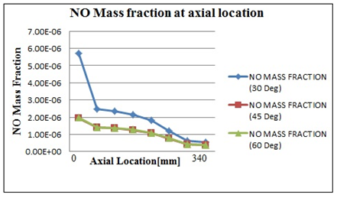
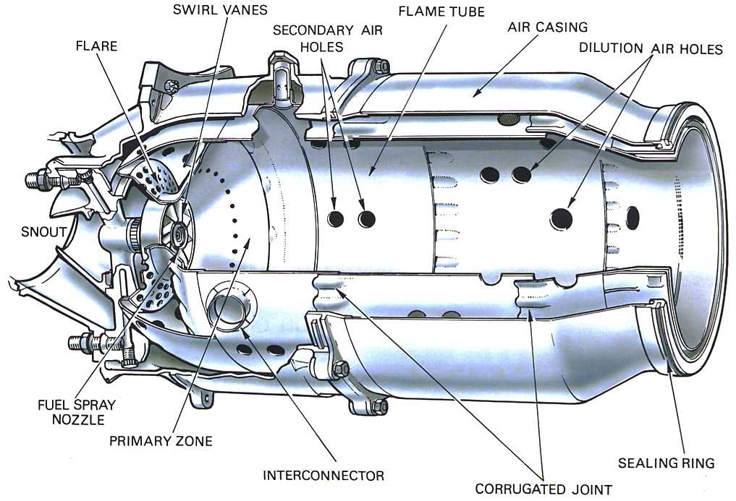
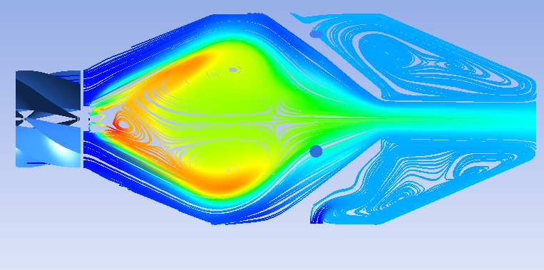
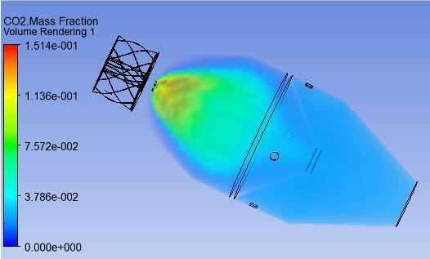
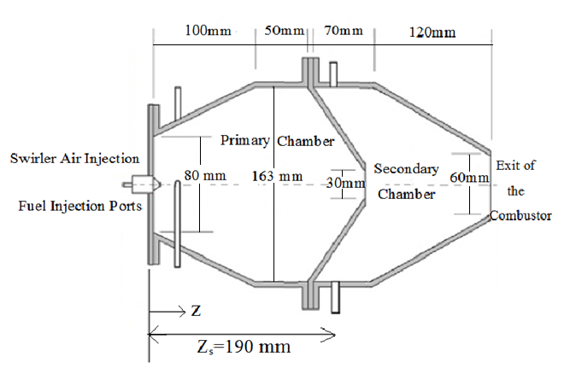
Gas Turbine Combustion
S. Kumaresh, M. Y. Kim, and G. W. Lee, Numerical Evaluation of the Flow and Emission Characteristics in a Can-Combustor with Excess-Air Ratios, Advanced Science and Technology Letters, 90, 2015, 39-43. https://www.researchgate.net/publication /315549992_Numerical_Evaluation_of_the_Flow_and_Emission_Characteristics_in_a_ Can_Combustor_with_Excess-Air_Ratios

Slide 11
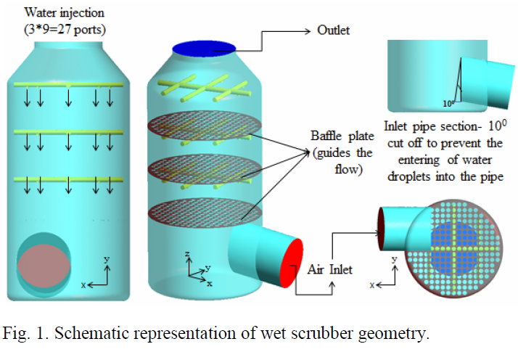
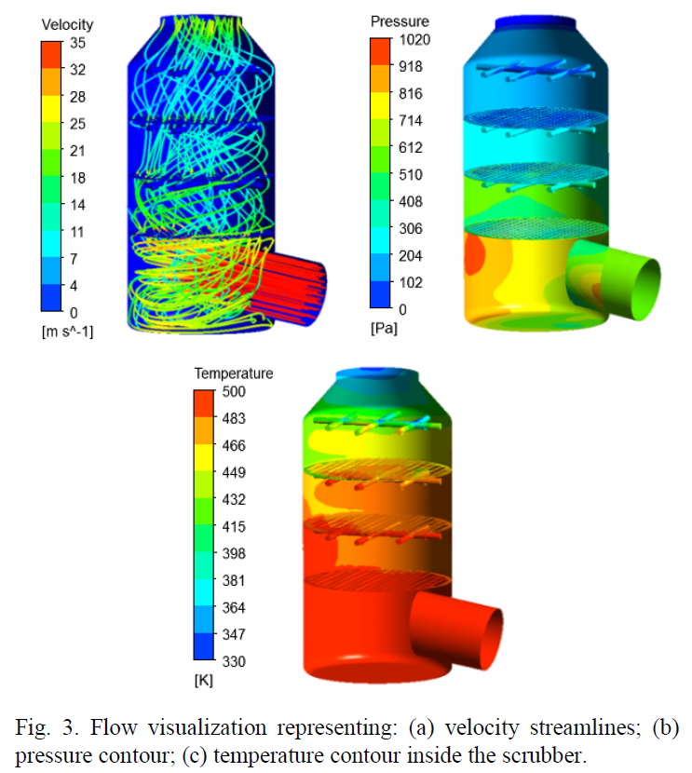
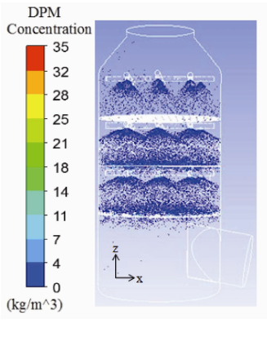
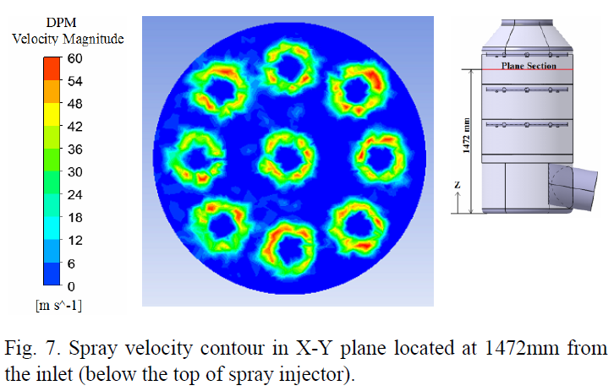
Droplet Evaporation and Burning
Scrubber model
S. Kumaresh and M. Y. Kim, A numerical study on the fluid flow and thermal characteristics inside the scrubber with water injection, Journal of Mechanical Science and Technology, 30(2), 2016, 915–923. https://doi.org/10.1007/s12206-016-0145-2

Slide 12
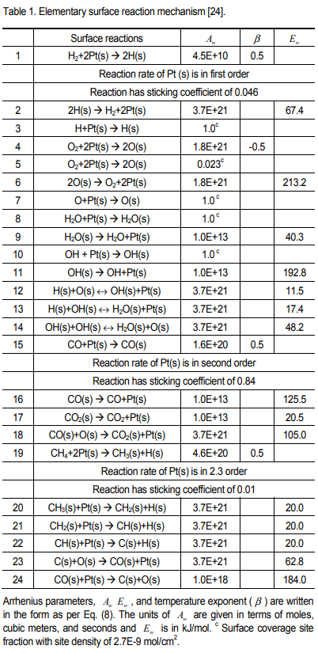
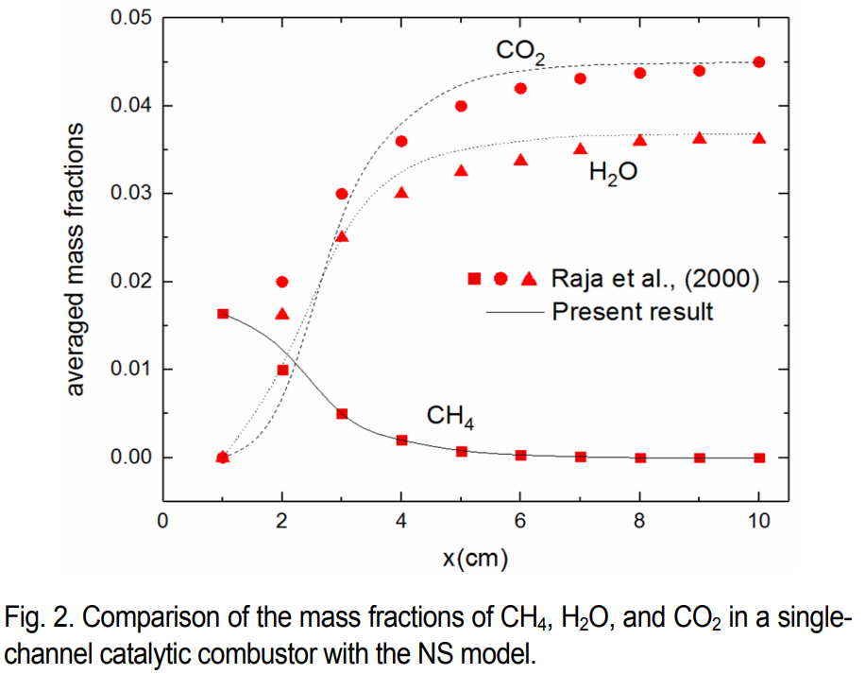
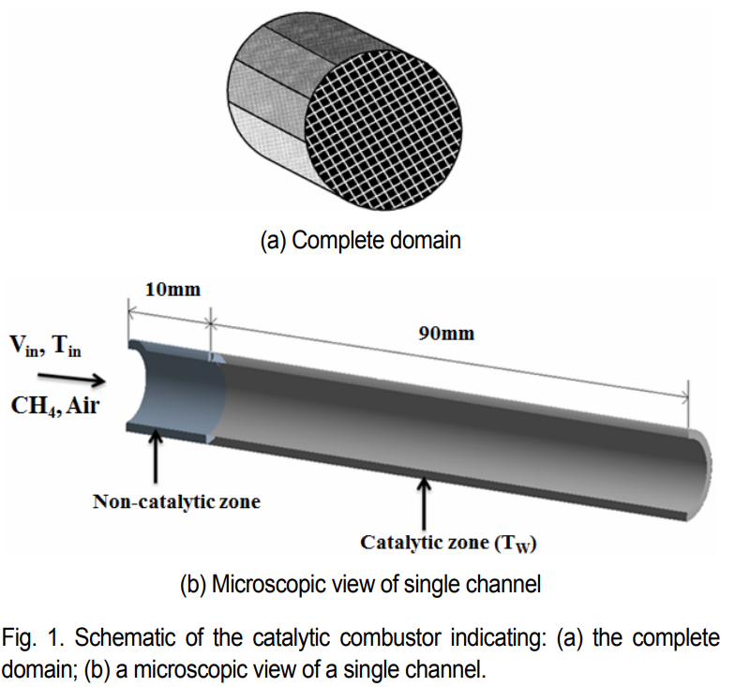
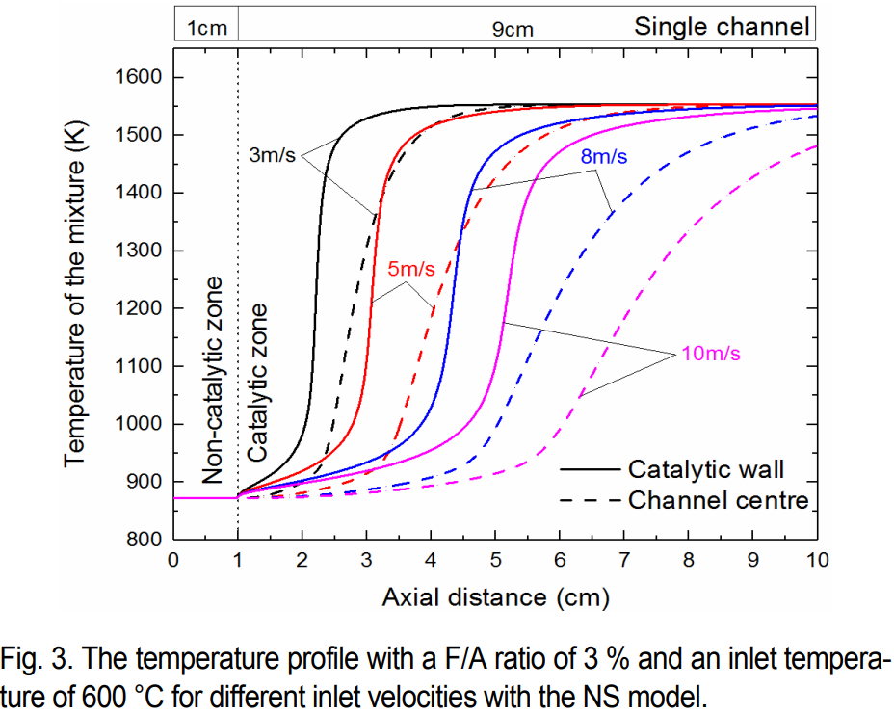
Catalytic Combustion
S. Kumaresh, G. W. Lee, and M. Y. Kim, On the catalytic combustion behavior of lean methane-air mixture over platinum catalyst with the navier-stokes and plug-flow models, Journal of Mechanical Science and Technology, 37(5), 2023, 2699-2707. https://doi.org/10.1007/s12206-023-0443-4

Slide 13
Other topics
Basics of CFD
Introduction to softwares/programming
OpenFOAM
ANSYS Fluent

Slide 14
Evaluation
Exercises (ANSYS Fluent, CFX, and OpenFOAM)
Project Reports
1 exam (Open-book)
1 seminar
Attendance

Slide 15
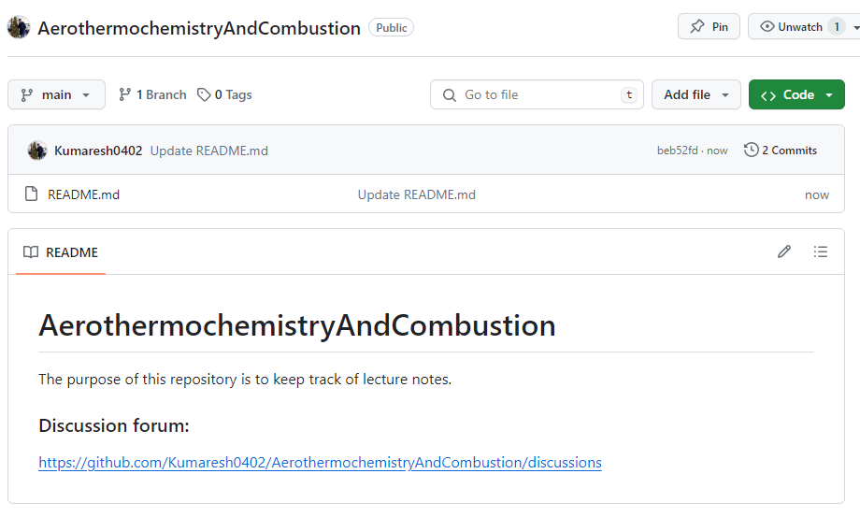
Presentation and Records – GitHub
https://github.com/Kumaresh0402/AerothermochemistryAndCombustion

Slide 16
Next week …
Please bring the laptop with ANSYS student version installed.
I will help you to install OpenFOAM in Ubuntu using Virtual Box in Windows.

Slide 17
Workflow …
Flow in the channel – Laminar and Turbulent flow behavior (comparing velocity profiles) in both ANSYS Fluent and OpenFOAM
Methane – air combustion with Laminar and Turbulent flow (ANSYS Fluent and OpenFOAM)
Introducing multi-step gaseous reaction
Introducing CH₄-air catalytic surface reactions
Modelling injection behavior in ANSYS Fluent

