Slide 1


Mid-term Presentation
CFD class
NGUYEN THANH PHUONG
20.11.2024

Slide 2
Outline
Introduction
Experiment setup
Numerical modeling
Results and Discussion
Conclusion

Slide 3
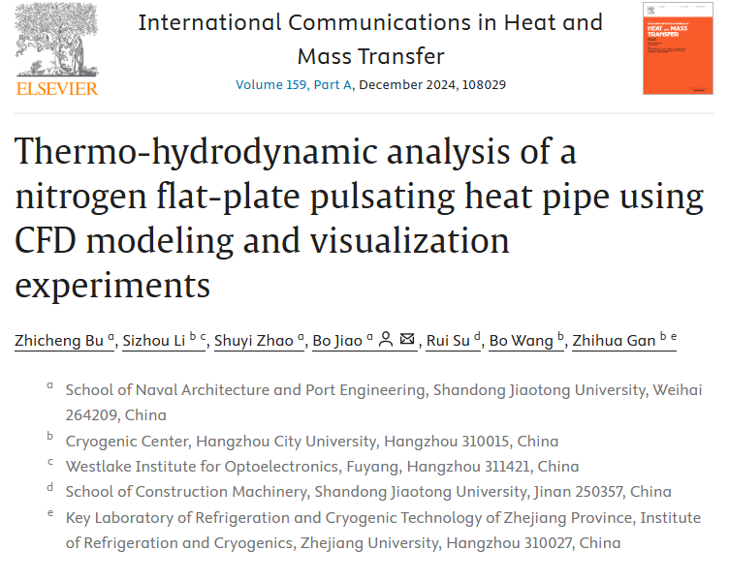

Slide 4
1. Introduction
A three-dimensional computational fluid dynamics (CFD) model of the PHP was developed using ANSYS Fluent.
The evaporation and condensation coefficients in Lee model were transformed into coefficient magnitude and coefficient ratio.
The model considers the impact of surface tension based on the continuum surface force model and integrates the gas-liquid phase change based on the Lee model
A correction factor related to filling ratio which determines the coefficient ratio through gas-liquid density ratio.
An analysis of the overall temperature and pressure fields was conducted.
Cryogenic PHPs nitrogen

Slide 5
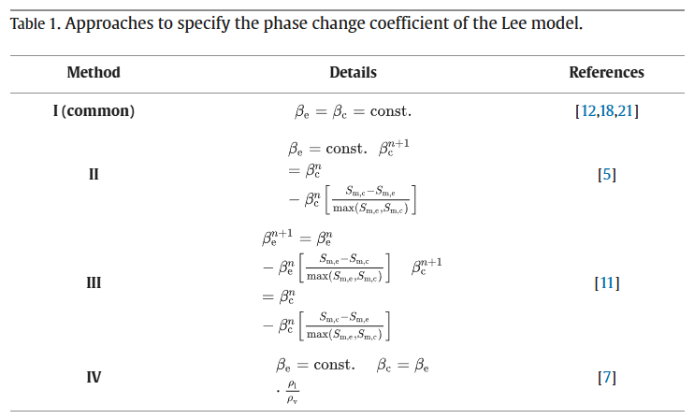
1. Introduction

Slide 6
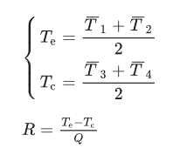
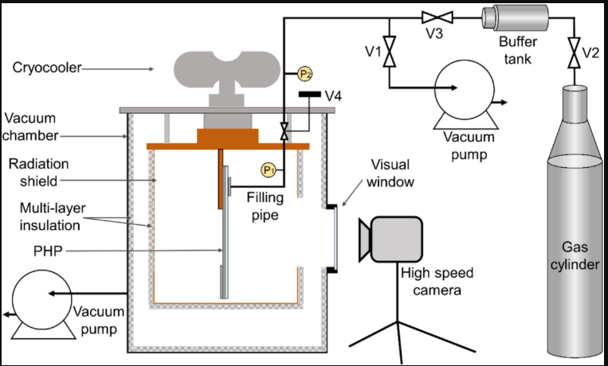
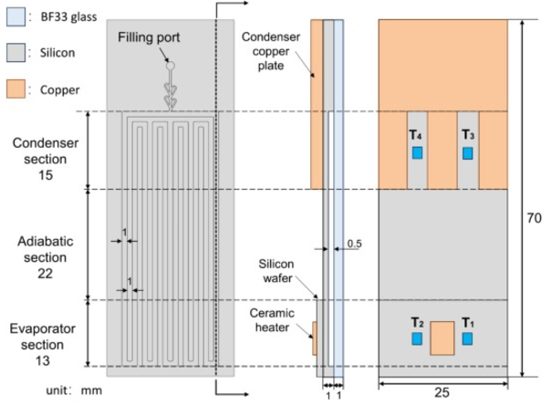
2. Experimental method
2.1. Experimental apparatus
Fig. 1. Schematic of the experimental apparatus.
Notes:
single-stage hybrid pulse-tube cryocooler

Slide 7
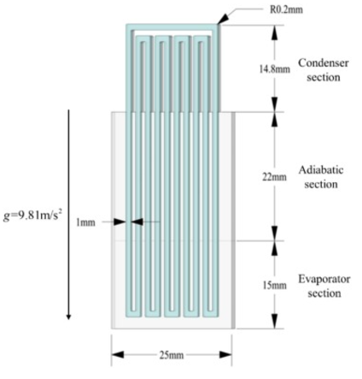
3. Numerical modeling
3.1. Geometry and boundary conditions
Nitrogen fluid domain (blue) and the silicon solid domain (gray)
Glass front cover is omitted
Solid domain behind the flow channel is retained in the condenser section.
Boundary condition:
At beginning:
Evaporator: T=const, after 1 s q’ = const
Condenser: Tcond = 80K
Fig. 3. Geometrical structure of the PHP

Slide 8

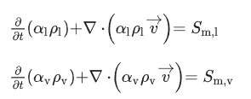
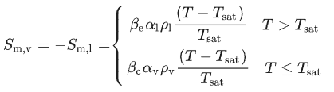



3. Numerical modeling
3.2. Governing equations
Volume of fluid (VOF) method
Volume fraction in each computational cell
The continuity equations for the volume fractions of each phase
The source of phase change for each phase using the Lee model
The momentum equation
Continuum surface force (CSF) model to calculate volume force
Notes:
S (source of phase change)
continuum surface force (CSF) model
K interfacial curvature

Slide 9


3. Numerical modeling
The energy equation
Vapor is treated as an ideal gas
Liquid is assumed to be incompressible
Thermophysical properties is fitted function of temperature
Tsat correlation with pressure
Ansys fluent 18.0
pressure-velocity coupling by PISO algorithm
PRESTO scheme for pressure interpolation
Second-order upwind scheme for discretizing the energy and momentum equations.
Geo-Reconstruct method is used for volume fraction solution to ensure sharp phase interface
Time step 10^-4 s
Convergence residuals for continuity and energy equas 5x10^-4 and 10^-7, for x velocity and y velocity 10^-4
Notes:
Sh energy source

Slide 10
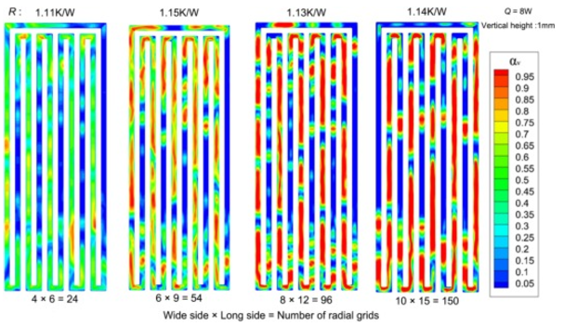
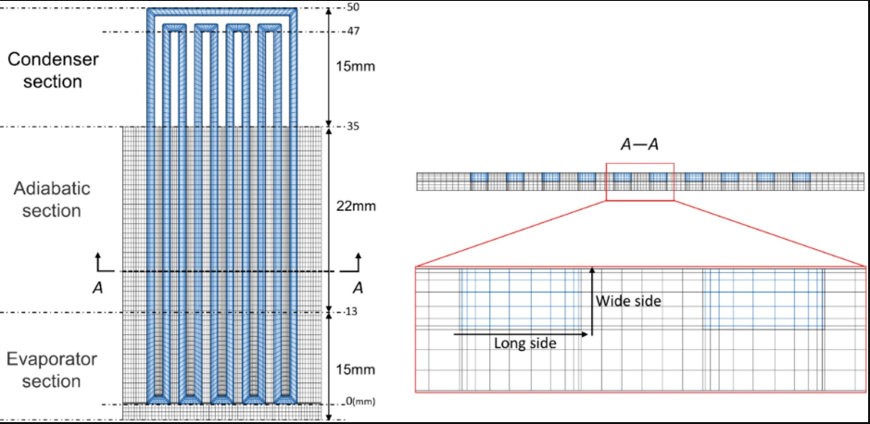
3. Numerical modeling
3.3. Grid independence
Comparison of liquid-vapor distribution comparison and therm resistance for different numbers of radial grids
Mesh fluid domain key parameters: height of first grid layer, number of radial grids and height of vertical grids

Slide 11
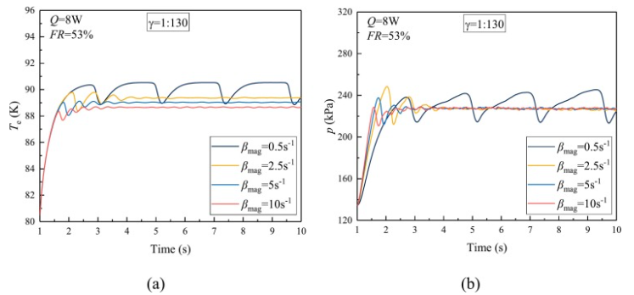

4. Results and discussions
4.1. Determination of phase change coefficients
Fig. 7. Effect of the coefficient magnitude on (a) evaporator temperature and (b) pressure.
Pressure remains constant while temperature decreases as coefficient increases
Higher β_{mag} values reach the quasi-steady state more rapidly.
Notes:
1:130 gas-liquid density ratio at T = 80 K

Slide 12
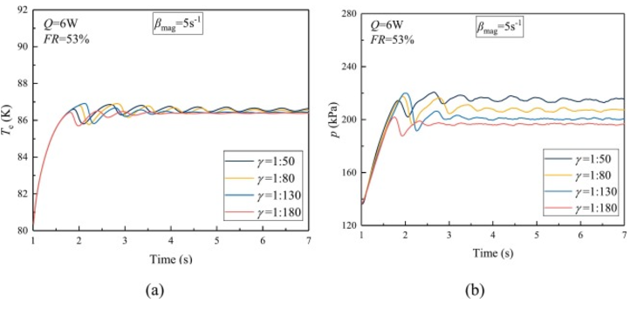
4. Results and discussions
Fig. 8. Effect of the coefficient ratio on (a) evaporator temperature and (b) pressure.
Increase in γ correlates with an increase in pressure, while there is no substantial change in average temperature
Cases with higher γ exhibit more pronounced amplitudes in both temperature and pressure.
β_{mag} influences evaporator temperature, while γ impacts pressure.

Slide 13
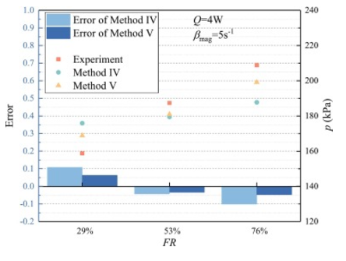

4. Results and discussions
Fig. 9. Comparison of pressure between experiment and simulation.
The pressure error for Method V is comparatively smaller.
Followed by selecting an appropriate β_{mag} within a reasonable range.

Slide 14
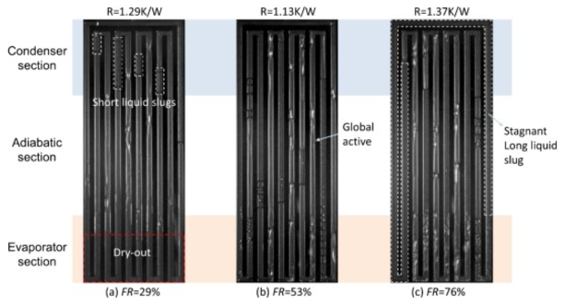
4. Results and discussions
4.2. Analysis of thermal resistance in experiments and simulations
Fig. 10. Gas-liquid interface distribution images at the quasi-steady state (Q = 6 W).
At FR = 29 %, dryout appeared.
At FR = 53 %, all flow channels are activated and a stable flow is formed.
At FR = 76 %, a stagnant long liquid slug obstructs global activation.
Notes:
CFD model is unable to predict the dry-out phenomenon, and the stagnant long liquid slug due to the absence of gasification nucleation points and turbulence phenomena

Slide 15
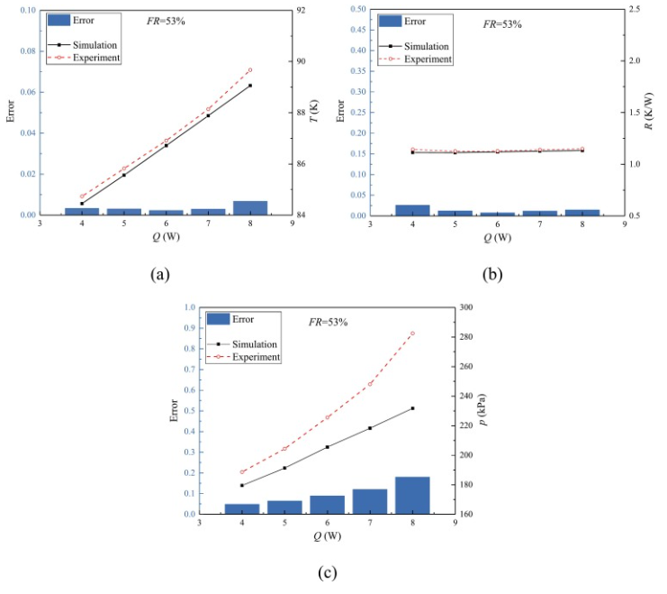
4. Results and discussions
Fig. 11. Comparison of experimental and numerical results under quasi-steady state.
The temperature error remains under 1 % and thermal resistance error is within 5 %.
The pressure error stays below 20 %.
Notes:
FR = 53 % are set to 5 s⁻¹ and 550 s⁻¹
disparity between ideal and actual gas density.

Slide 16
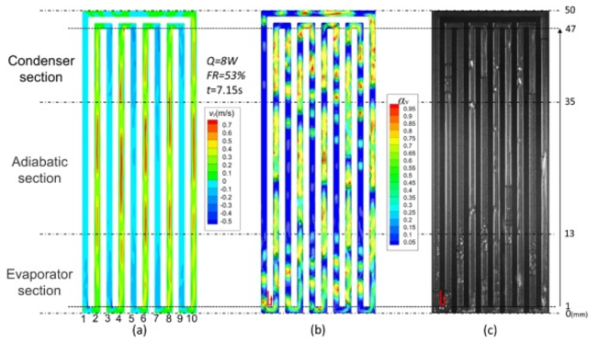
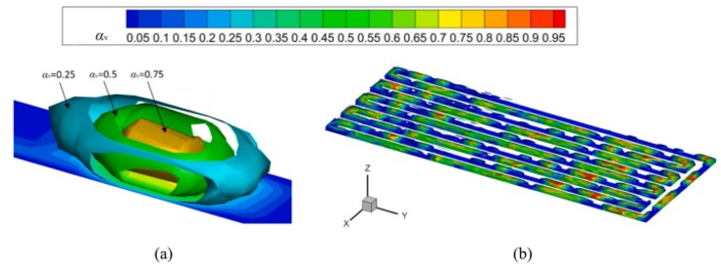
4. Results and discussions
4.3. The velocity and flow characteristics
Fig. 12. Construction stacked coutour of α_{v} isosurfaces (for example FR = 53 %, t = 8.00s, Q = 6 W): (a) a 3-layer stacked coutour of α_{v} isosurfaces representing a single bubble; (b) a 20-layer stacked coutour in the fluid domain.
Fig. 13. The velocity coutour at the center section(a), the 20-layer stacked coutour of α_{v} isosurfaces (b), and visualization experimental image(c).
The working fluid downward flows in the odd-number channels and upward in the even-number channels, represent counterclockwise circulation.
The flow patterns in the simulation results closely resemble those observed in the experimental results.

Slide 17
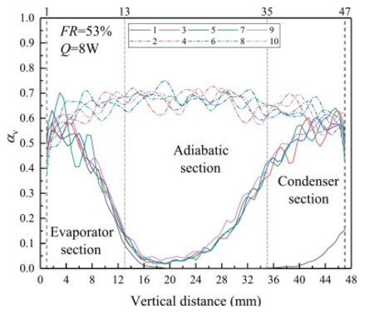
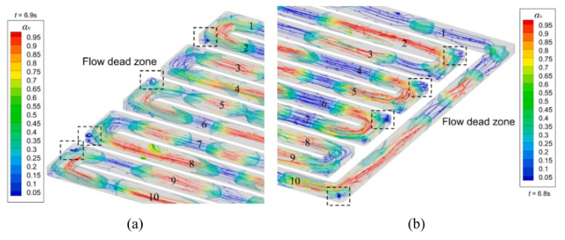
4. Results and discussions
Fig. 14. Gas proportion curves at the quasi-steady state.
Fig. 15. The flow dead zone during the quasi-steady state (FR = 53 %, Q = 8 W).
Gas proportion ranges between 50 % to 70 %, indicating the presence of liquid film throughout the quasi-steady state.
Longer liquid slug within tube 1 compared to other downward pipes.
Liquid accumulates at the bend, resulting in the formation of a vortex.

Slide 18
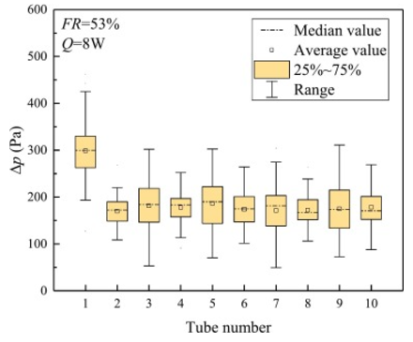
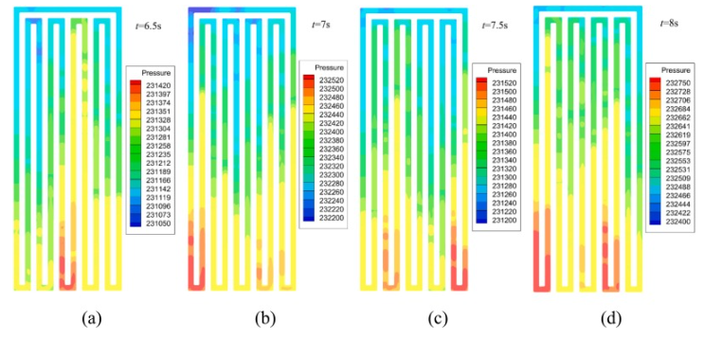
4. Results and discussions
4.4. The pressure difference characteristics
Fig. 16. Pressure difference distributions under the quasi-steady state.
Fig. 17. The pressure contours at a specific moment (FR = 53 %, Q = 8 W).
The average of pressure difference in the other tubes falls within the range of 150 Pa to 200 Pa.
Peak pressure at different bends provide the main driving force at different moments.
Notes:
At the quasi-steady state of 5–8 s with a total of 120 time points, the pressure difference distributions between 1 mm and 47 mm

Slide 19
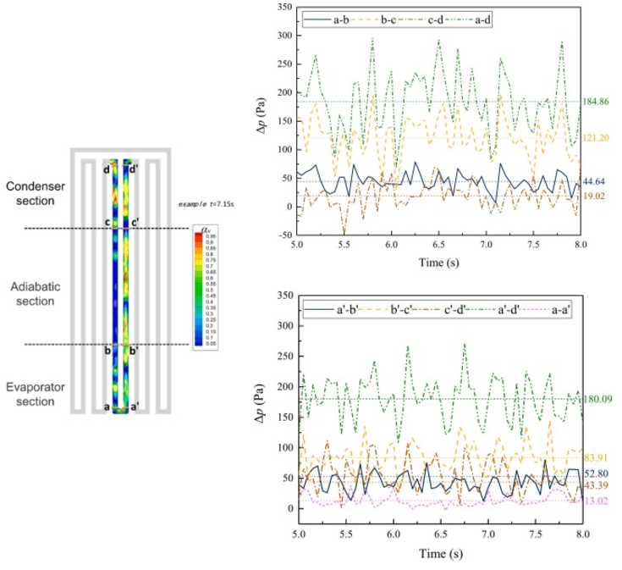
4. Results and discussions
Fig. 18. The pressure difference between the upward and downward pipes (FR = 53 %, Q = 8 W).
Pressure difference between the upward and downward pipes (a-d and a’-d’) are essentially equal, as well as are the pressure difference in the evaporator section (a-b and a’-b’).
There are variations in the pressure difference in the adiabatic section (b-c and b’-c’) and the condenser section (c-d and c’-d’).
(a-a’) causes a pressure difference of about 13 Pa
The balance of the pressure difference between the pipes allows the working fluid to circulate and flow efficiently to achieve heat transfer.

Slide 20
5. Conclusion
The β_{mag} influences temperature, while the γ impacts pressure. Moreover, the cases with higher β_{mag} values reach the quasi-steady state more rapidly, while the cases with higher γ exhibit larger temperature and pressure amplitudes.
To achieve more precise pressure values, the γ not only related to the density ratio, but also to the FR. Following this rule, the values of β_{e} and β_{c} are set to 5 s⁻¹ and 550 s⁻¹ at FR = 53 %. The temperature error remains below 5 %, while the pressure error stays within the range below 20 %.
The pressure difference remains consistent across each pipe. The working of the PHP at different moments is influenced by the pressure in different bends, which serves as the primary driving force. Furthermore, alternating peaks in pressure difference ensure the sustained flow of the PHP.

