Slide 1


Enhancing PV solar Panel efficiency through integration with a passive Multi-Layered PCMs cooling system: A numerical Study
DEPARTMENT OF MECHANICAL DESIGN ENGINEERING JEONBUK NATIONAL UNIVERSITY
HTRF (Heat Transfer and Reacting flow Lab)

Slide 2

Introduction To Solar Energy
Global issues
Fossil fuel-based energy sources are depleting and contribute to environmental pollution and climate change.
Renewable energy, particularly solar energy, is essential due to its wide availability and inexhaustibility.
Current Status of Solar Energy
Despite its potential, solar energy accounts for only about 3.6% of global electricity production.
Key challenge: Photovoltaic (PV) cells have low conversion efficiency, typically ranging from 5% to 20%.

Slide 3
PV Panel Efficiency and Heat Challenges
Heat Generation in PV Panel
Most incident solar radiation converts to heat, raising PV cell temperature and reducing efficiency and power output.
A temperature increase of 1°C can lead to a 0.65–0.85% drop in power output.
Impact of Ambient Temperature
Increased temperatures decrease power output, open-circuit voltage, and maximum power, although short-circuit current rises.
Efficiency losses can reach 7.5–22.5% in high temperatures (up to 70°C in summer).

Slide 4
Cooling Methods for PV Panel
Types of Cooling System
Active Cooling: Uses fans or pumps; suitable when power output surpasses cooling system power requirements.
Passive Cooling: Relies on natural convection, air ventilation, or liquid immersion; no additional power is required.
Emerging Interest in Phase Change Materials (PCMs)
PCMs absorb and release thermal energy within a narrow temperature range, providing passive cooling.
Various studies demonstrate PCM's cooling benefits on PV panels with different materials and configurations.
Metal fins and nano-material additions (e.g., CuO, TiO₂) improve PCM thermal conductivity, providing enhanced cooling for PV panels.

Slide 5
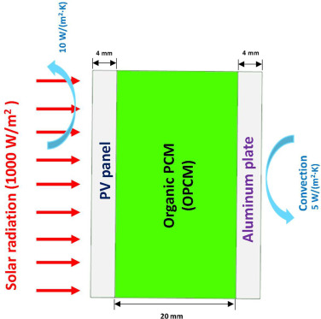
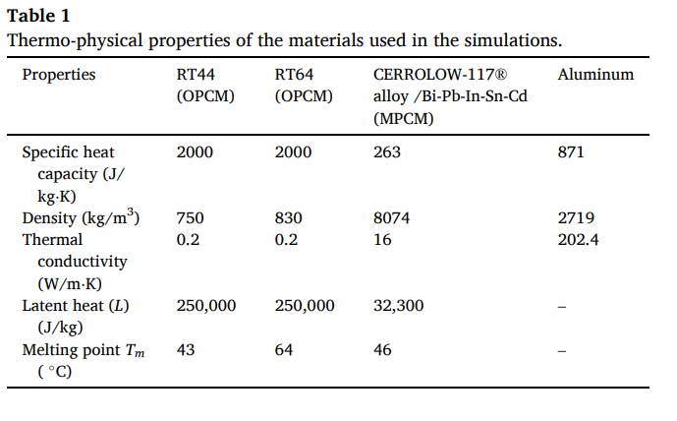
Methodology
Geometrical Model
Multi-Layered
Working Fluids RT44 & RT64
constant heat flux 1000 w/m^2

Slide 6
Methodology
Model assumptions
Thermo-physical properties, including density and thermal conductivity of the materials, are treated as constant and independent of temperature across the materials.
Radiation heat losses are assumed to be negligible, and the convection coefficients are assumed to be constant.
Adiabatic boundary condition is applied at the top and bottom walls
Uniform heat flux of 1000 W/m2 , initial temperature of 20 ◦C, and constant ambient temperature of 20 ◦C are assumed.
The PV-PCM system’s contact resistances are assumed to be negligible.
The flow is considered laminar, incompressible, unsteady, and two-dimensional.

Slide 7
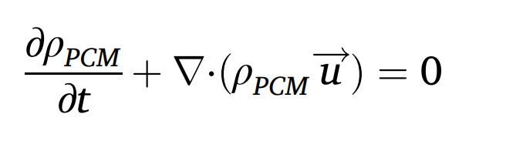
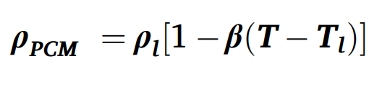
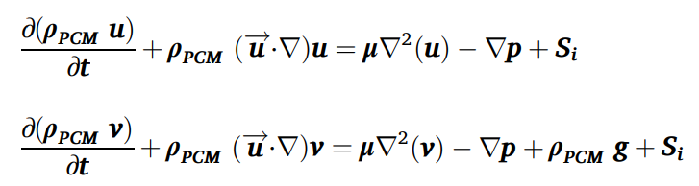
Methodology
Governing Equations
Continuity Equation (Mass conservation)
Boussinesq Approximation (Density Variation)
Momentum Equations (x, y Components)

Slide 8
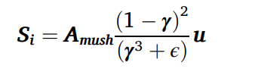
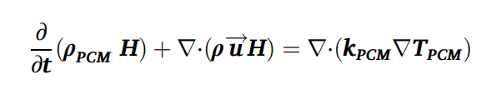
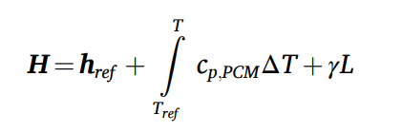
Methodology
Governing Equations
Resistance Term (Mushy Zone)
Energy Equation (PCM)

Slide 9
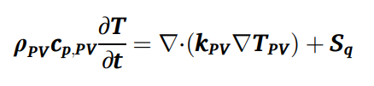
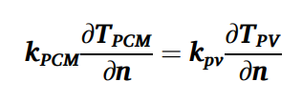
Methodology
Governing Equations
PV Panel Energy Equation
Heat Transfer at PV-PCM Interface (Fourier’s Law)

Slide 10
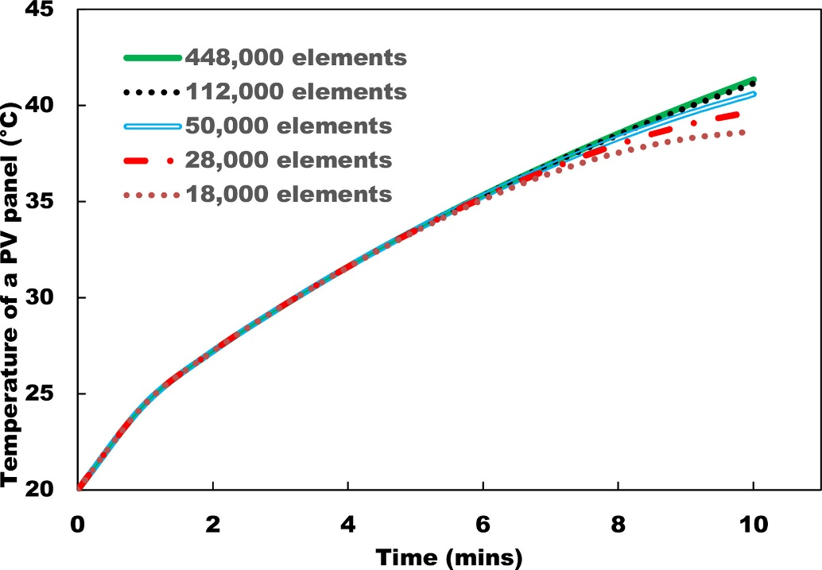
Methodology
Grid Independence test
The results become independent of mesh size after 112,000 elements, as there is no significant alteration in the PV panel temperature profile beyond this number over time

Slide 11
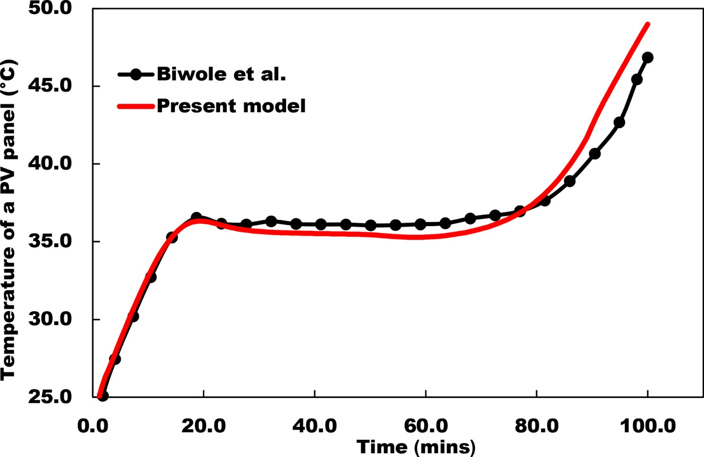
Results and Discussion
Validation

Slide 12
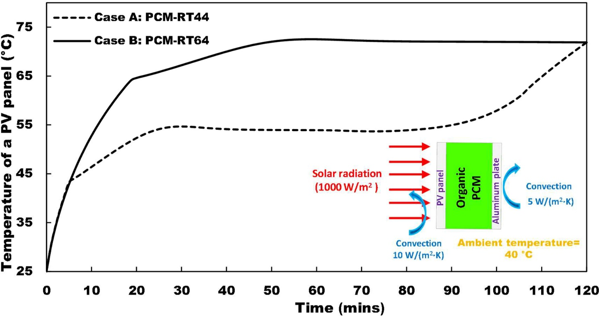
Results and Discussion
Effect of different OPCMs

Slide 13
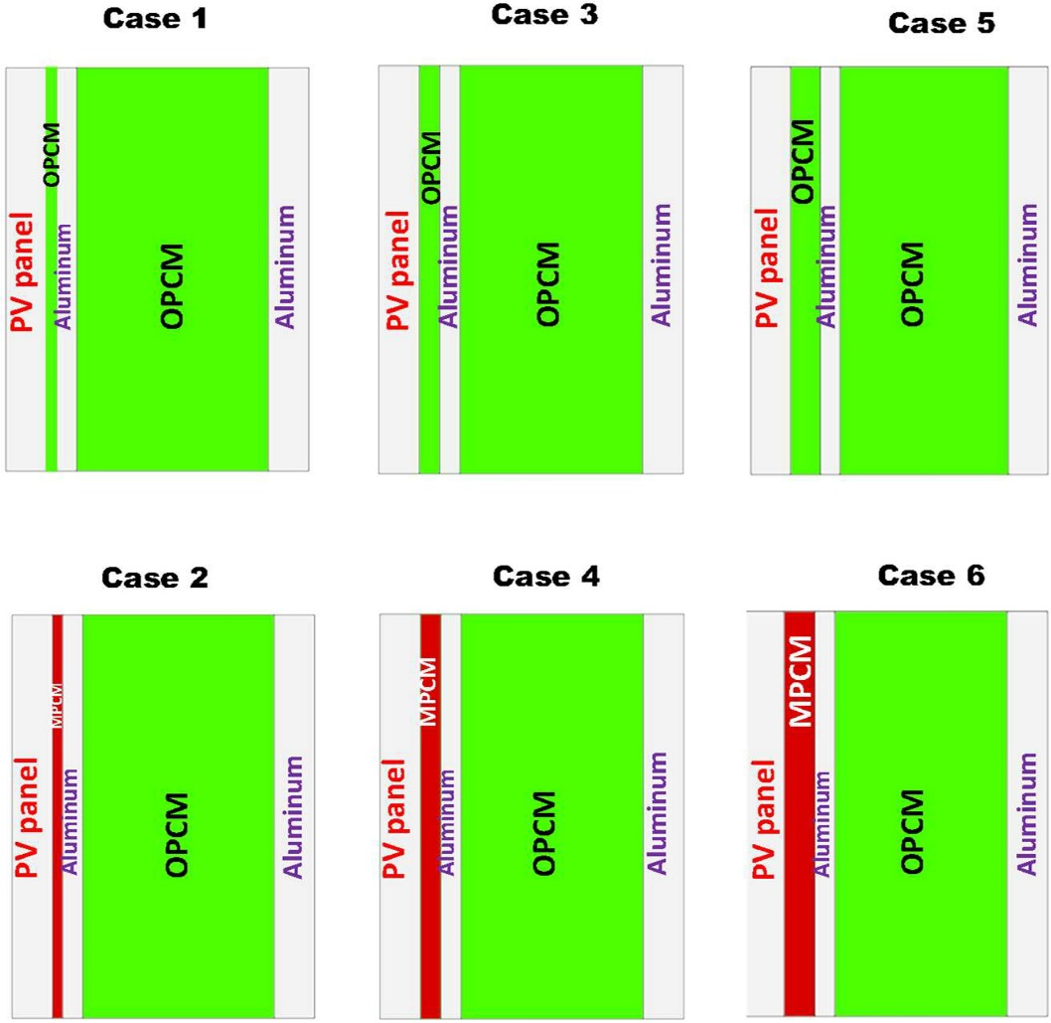
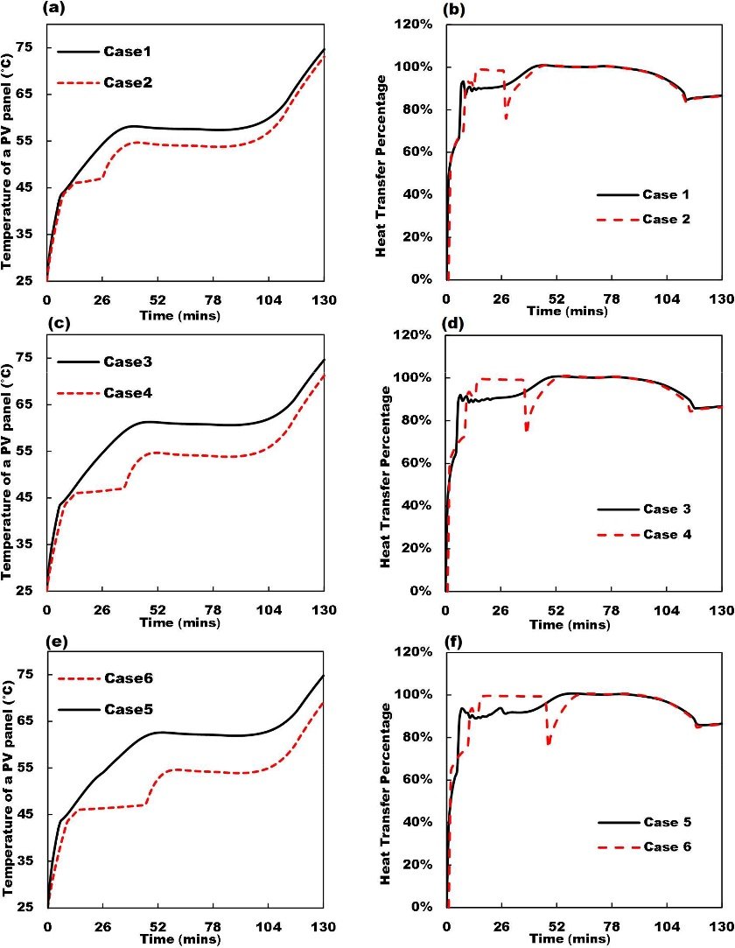
Results and Discussion
Effect of multi-layered PV/PCMs system

Slide 14
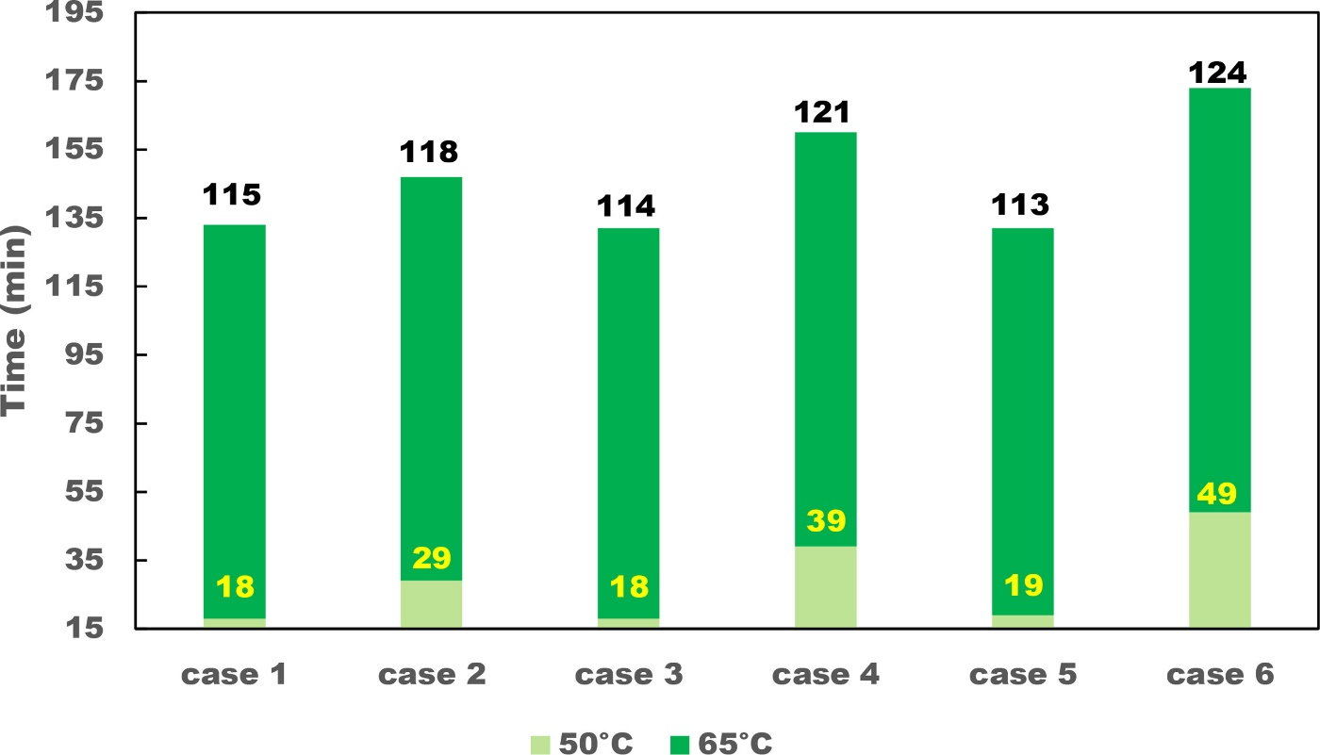
Results and Discussion
Time taken for a PV panel to reach certain temperatures at a heat flux of 1000 W/m^2

Slide 15
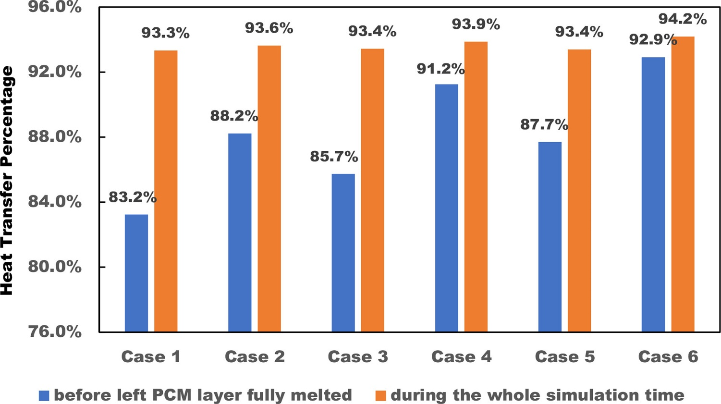
Results and Discussion
Average percentages of heat removed from PV panels by multi-layered PCMs-based heat sinks before the left PCM layer fully melted and during the whole simulation period.

Slide 16
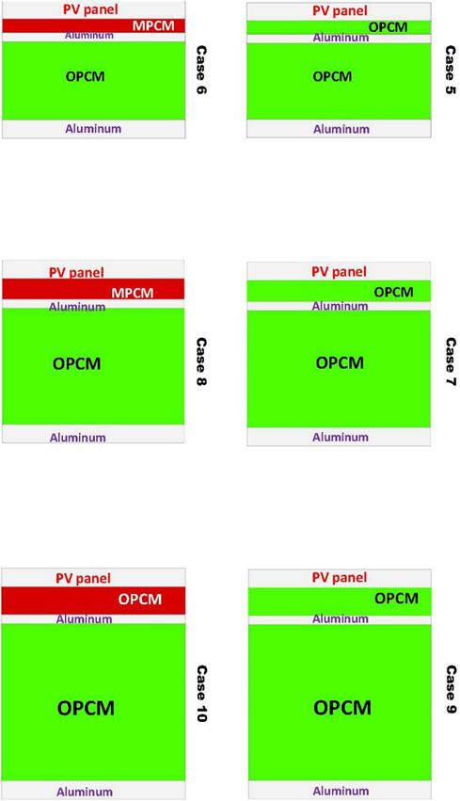
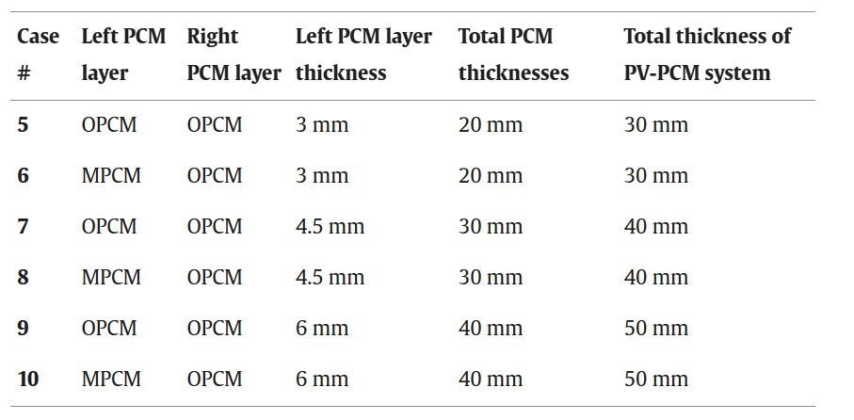
Results and Discussion
The effect of different total PCMs thicknesses on the temperature of a pv panel

Slide 17
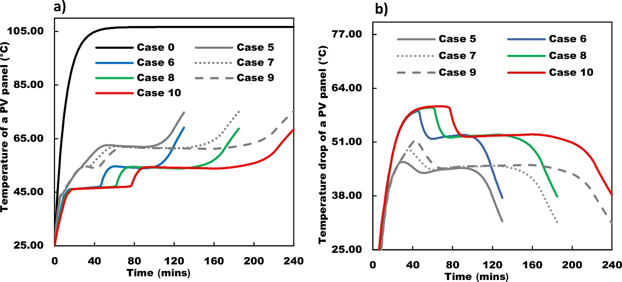
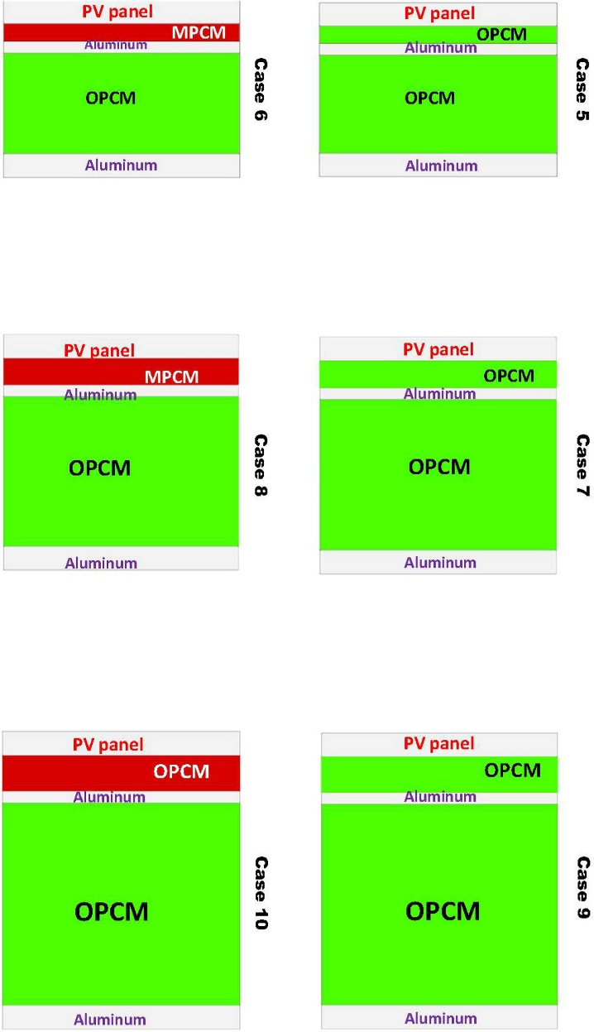
Results and Discussion
a) temperature profiles and b) temperature drop profiles of a PV panel integrated with various multi-PCMs-based cooling systems at a fixed MPCM-OPCM thickness ratio of 15:85, comparing Cases 5–10 with Case 0 (standalone PV panel).

Slide 18
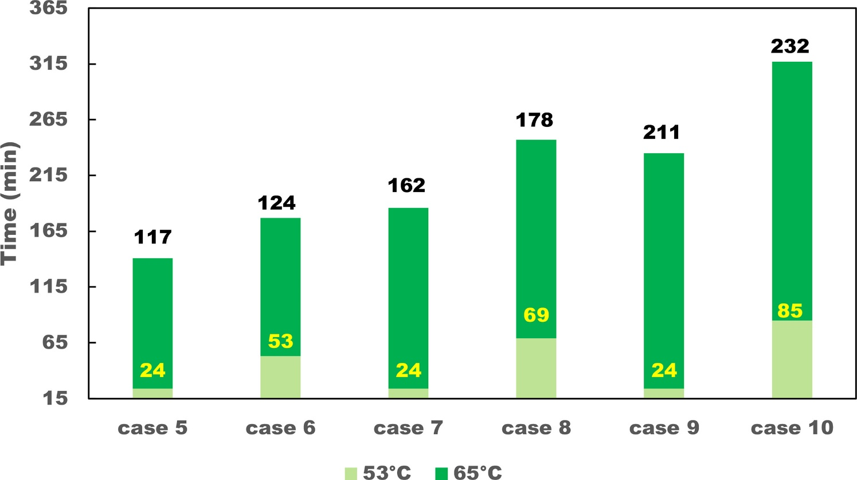
Results and Discussion
Time taken for a PV panel integrated with various Multi-PCMs-based cooling system to reach certain temperatures at a heat flux of 1000 W/m^2

Slide 19
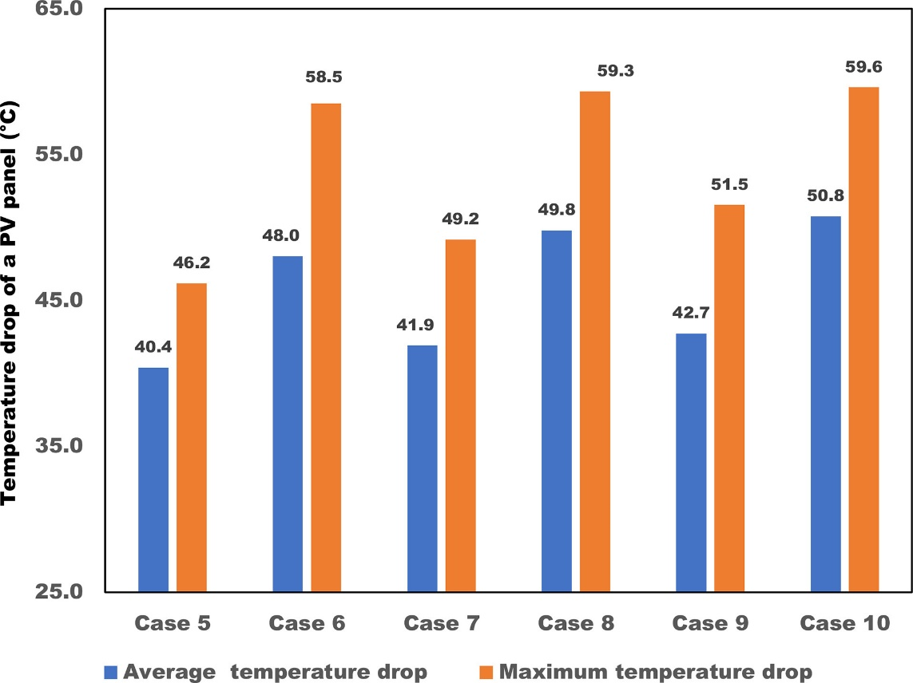
Results and Discussion
The average and maximum temperature drop of a PV panel integrated with PCMs, with case 0 as the reference.

Slide 20
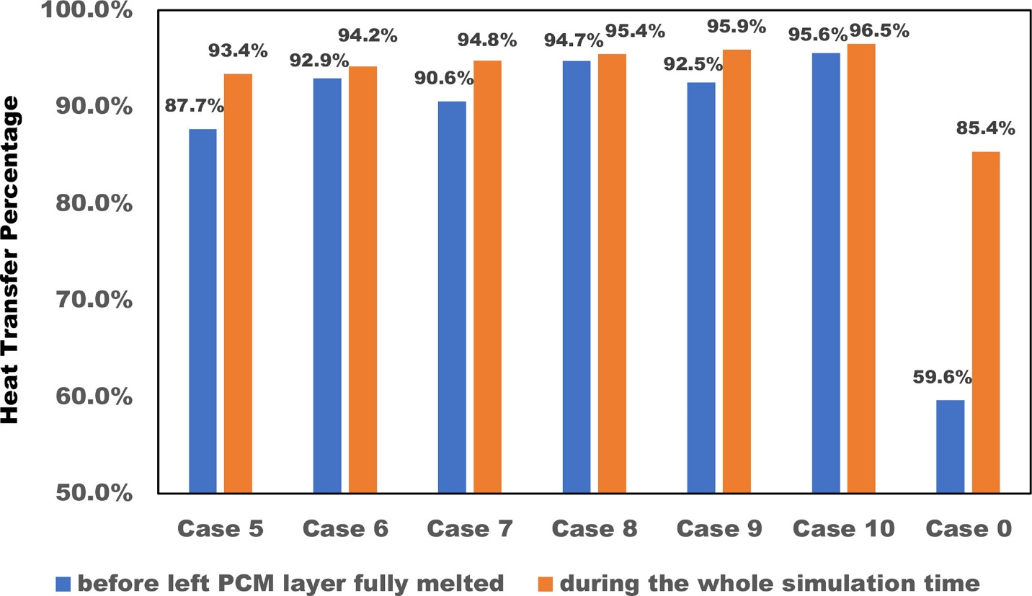
Results and Discussion
Average percentages of heat removed from PV panels by multi PCMs based heat sinks before the left PCM layer fully melted and during the whole simulation period, with Case 0 as the reference.

Slide 21
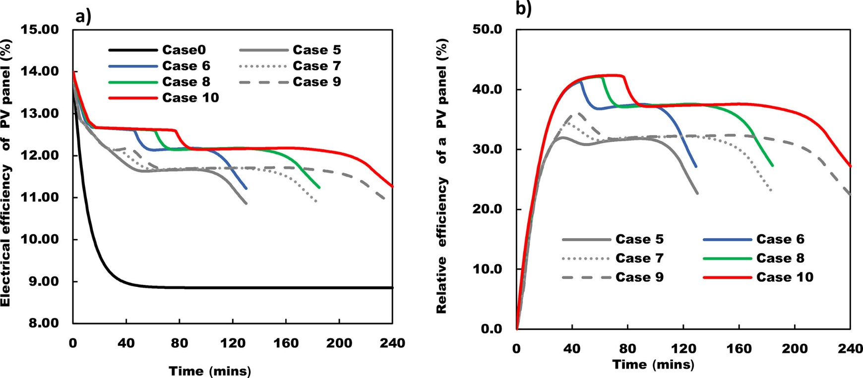
Results and Discussion
The PV panel’s a) electrical efficiency and b) relative electrical efficiency variations over time, integrated with various multi-PCMs-based cooling systems at a fixed MPCM-OPCM thickness ratio of 15:85.

Slide 22
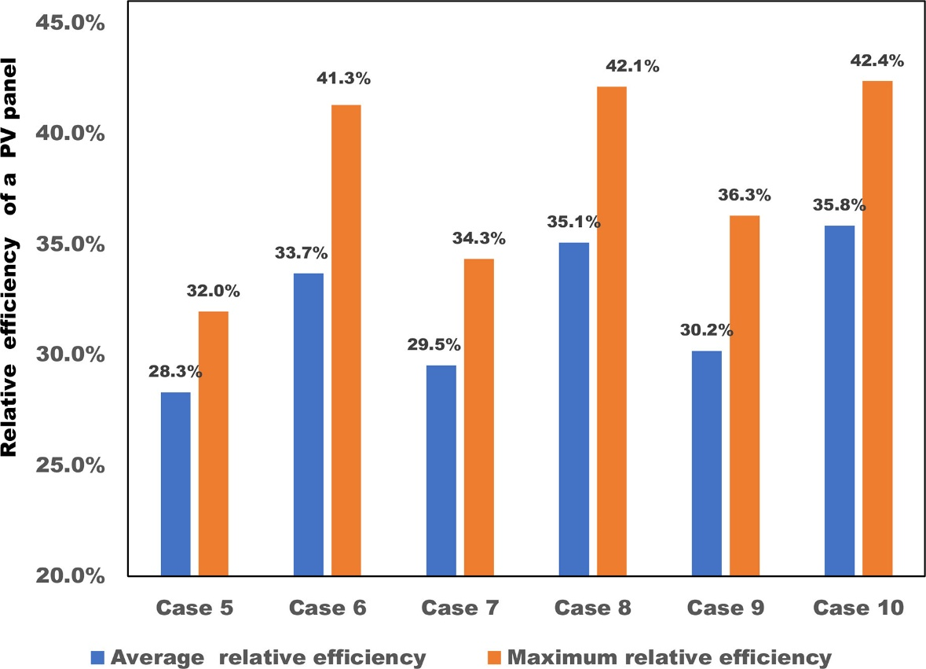
Results and Discussion
The average and maximum relative efficiency of a PV panel integrated with multi PCMs with case 0 as the reference.

Slide 23
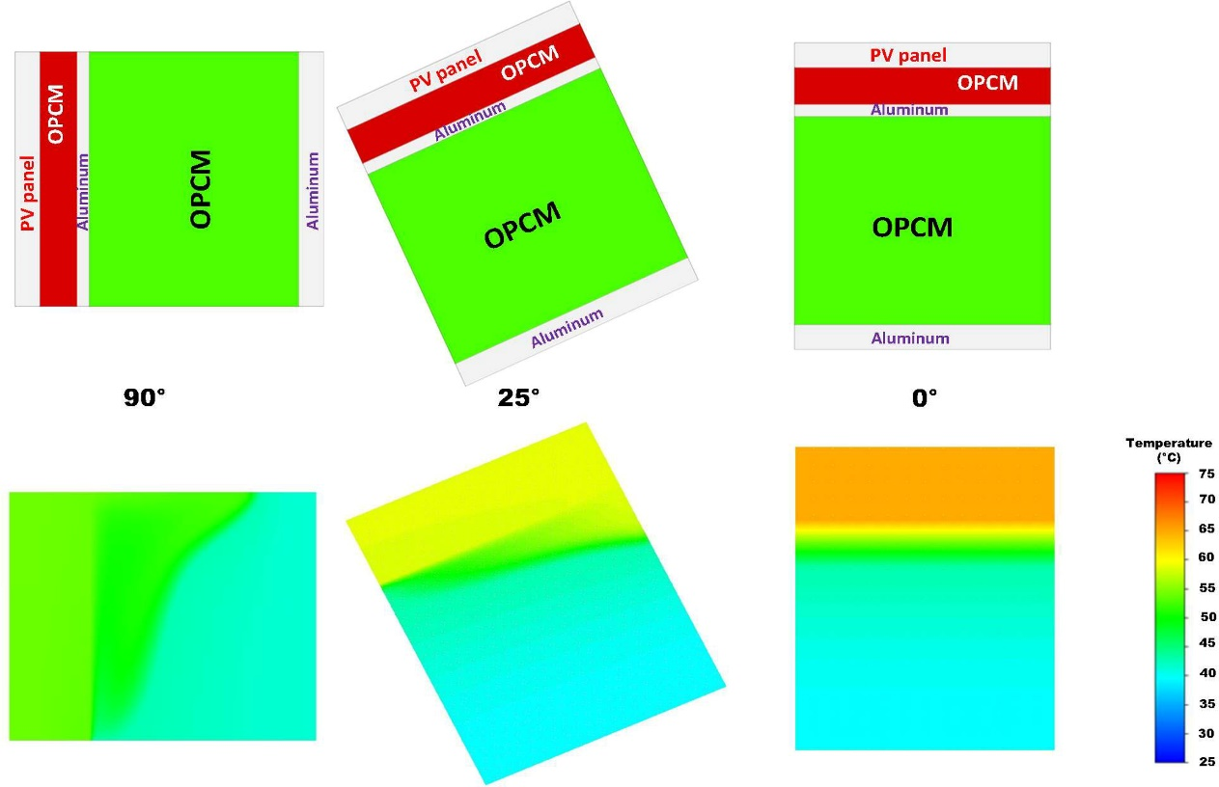
Results and Discussion
Cross-sections and temperature contours of PV solar panels integrated with multi PCMs based cooling systems (Case 10) at different tilt angles at 100 min.

Slide 24
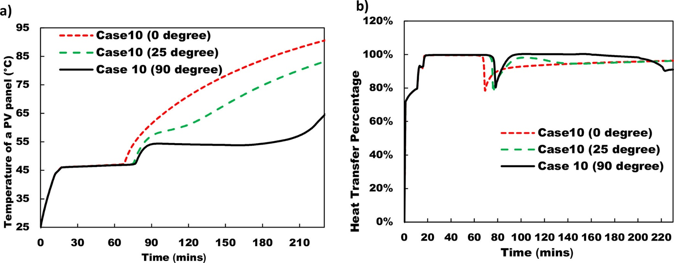
Results and Discussion
Temperature profiles of PV panels integrated with multi-based cooling systems (Case 10) with various tilt angles (a) and percentages of thermal energy absorbed by Case 10 at different tilt angles over time (b).

Slide 25
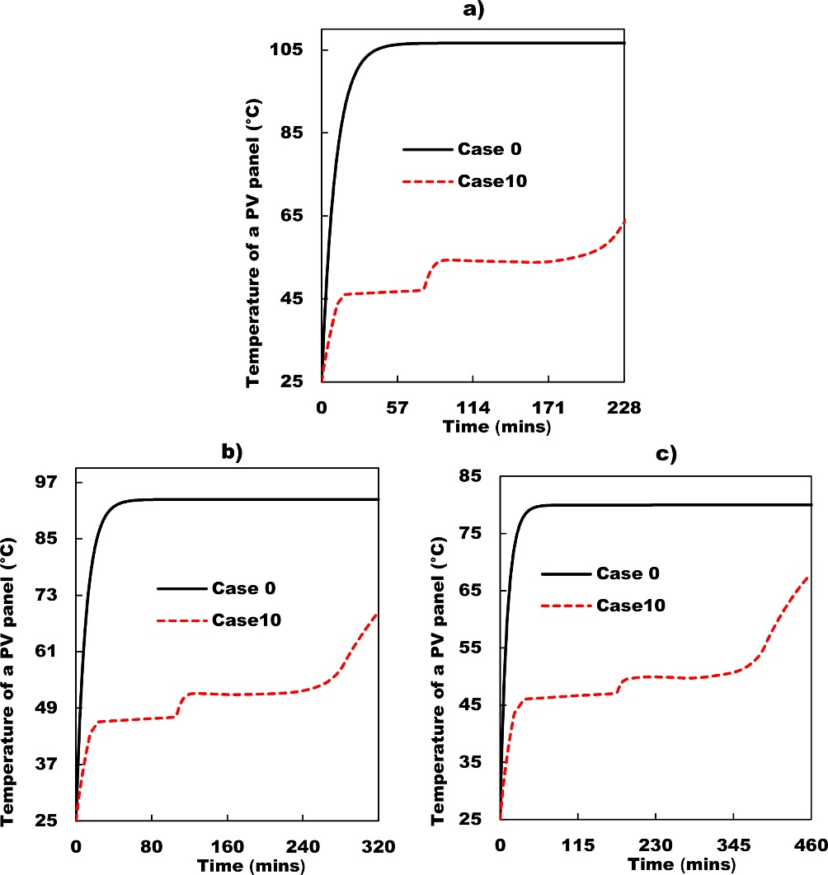
Results and Discussion
Temperature profiles of PV panels without cooling system (Case 0), and with multi PCMs based cooling systems (Case 10) with various heat fluxes (a) 1000 W/m2 , (b) 800 W/m2 and (c) 600 W/m2 .

Slide 26
Conclusion
Efficiency Improvement
Multi-PCM cooling boosts PV efficiency by 35.8% during peak hours.
Temperature drop: up to 59.6°C with multi-PCMs.
MPCM-OPCM setups yield 5% higher efficiency than OPCM alone.
Thermal energy transfer: 95.6% (pre-melting), 96.5% (overall).
Efficient cooling prevents overheating.
Tilt angle comparison:
90° optimal for vertical bifacial and BIPV systems.
Outperforms 0° and 25° setups.

Slide 27
Thank You!

