Slide 1
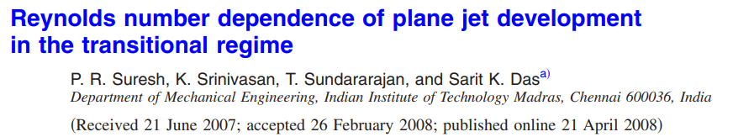


Slide 2
Introduction
The transitional characteristics of plane turbulent jets have been investigated.
It focuses attention on the features of mean flow and turbulent fluctuations with axial distance.
Hot wire measurements have been performed for a jet issuing from a rectangular nozzle of aspect ratio 20, for Reynolds number varying in the range 250 ≤ Re ≤ 6250.

Slide 3
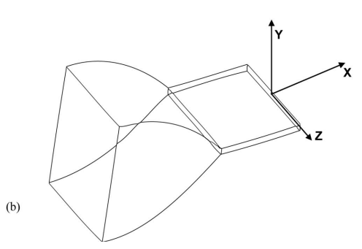
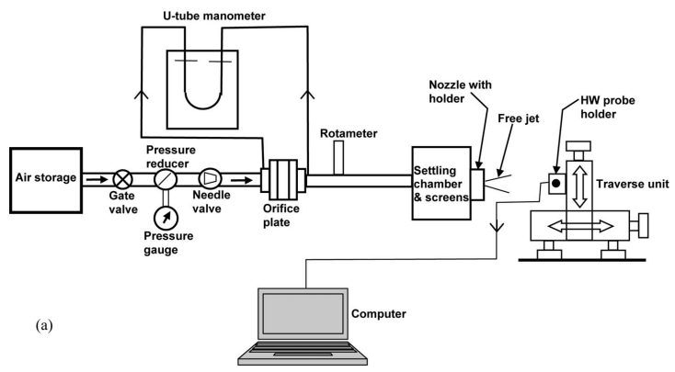

Experimental details
Compressed air stored in a vessel is admitted through a pressure regulator into a settling chamber of 300 x 300 mm² cross section and 600 mm length.
A calibrated orifice meter is used to measure the air flow rate, based on which the average nozzle exit velocity is calculated.
A honeycomb structure made of straws and two layers of very fine mesh is employed in the settling chamber to reduce the turbulence level of the incoming flow.
This turbulence management system effectively brings down the turbulence intensity to a low value of 0.5% at the nozzle exit for the range of average jet inlet velocities 2.1– 51.9 m/s i.e., Re ranging from 250 to 6250.

Slide 4
Experimental details
a convergent nozzle of contraction ratio 20 with a fifth order polynomial profile has been used to generate a smooth attached flow. A parallel channel of length adjustable up to 150 mm is attached to the nozzle to achieve the desired laminar inlet velocity profile for the jet (When an adequate straight lip is not provided following the contraction, the boundary layer can deviate from the Blasius profile even in the laminar regime).
The final slot dimensions of the nozzle are 40 mm width (W) and 2 mm height (d), providing an aspect ratio of 20.
Mean and fluctuating velocities have been measured using DANTEC 90N10 hot wire anemometer, using a 5 μm diameter, 1.5 mm long wire made of platinum coated tungsten.
The hot wire anemometer is calibrated using a pitot tube and a micromanometer (Furness Control-FCO12 ) with an accuracy of 1% of the reading and linearity better than 1% of the reading.

Slide 5
Experimental details
The voltage-velocity calibration graph is fitted with a power law form E=A + BU^{n} , where A and B are constants.
The wire probe is cleaned in acetone solution after every 3 h exposure to air flow for removing any possible contamination and then recalibrated.
Correction is applied to the calibration curve to account for any variations in the ambient temperature.
The mean and rms values are sampled at the rate of 1 kSa/s (kilo samples per second) for a sampling time of 30 s.
For the measurement of power spectra of velocity fluctuations, the maximum sampling frequency used was 50 kHz at the highest Reynolds number
To fully understand the evolution of the jet flow features, it is necessary to measure the mean velocity profile and its characteristic length scales such as displacement and momentum thicknesses and the shape factor of the boundary layer at the jet inlet.

Slide 6
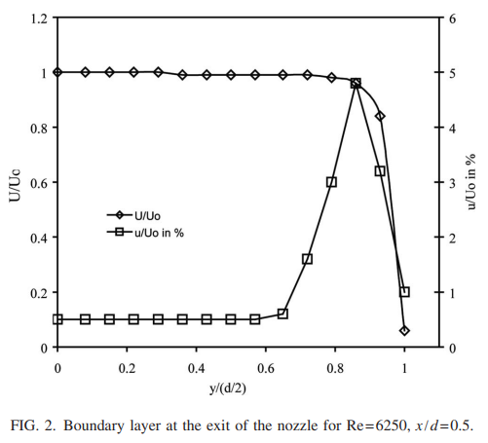
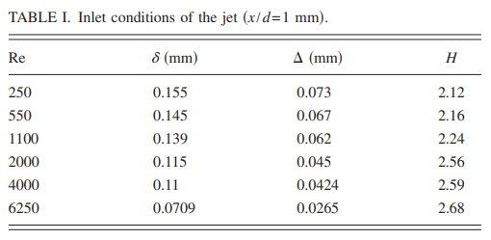
Experimental details
Mean and fluctuating velocity components U and u have been measured at an axial distance of 1 mm from the nozzle exit at different Reynolds numbers and the jet inlet profile for Re= 6250 is plotted in Fig. 2. For this case, the displacement thickness obtained by numerical integration is 0.0709 mm and momentum thickness is 0.0265 mm.
The ratio of the displacement to momentum thickness, known as the “shape factor,” is found to have a value of 2.68. This is close to the value of 2.5 obtained for the Blasius velocity profile in laminar boundary layer flow over a flat plate.

Slide 7
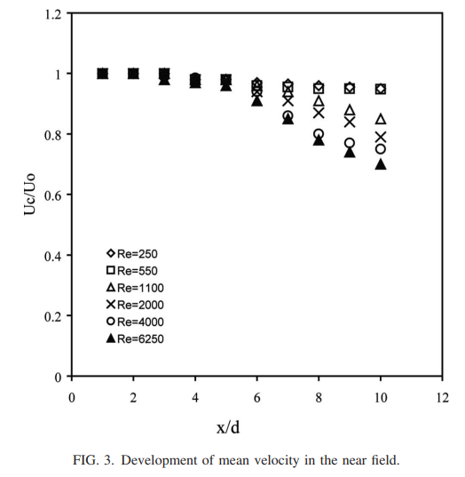
Experimental results
A. Near field and far field flow features
At low Reynolds number Re= 250 and 550, the mean centerline velocity decay is relatively slower than at higher Reynolds numbers.
The potential core length is also observed to slightly decrease with Reynolds number.

Slide 8
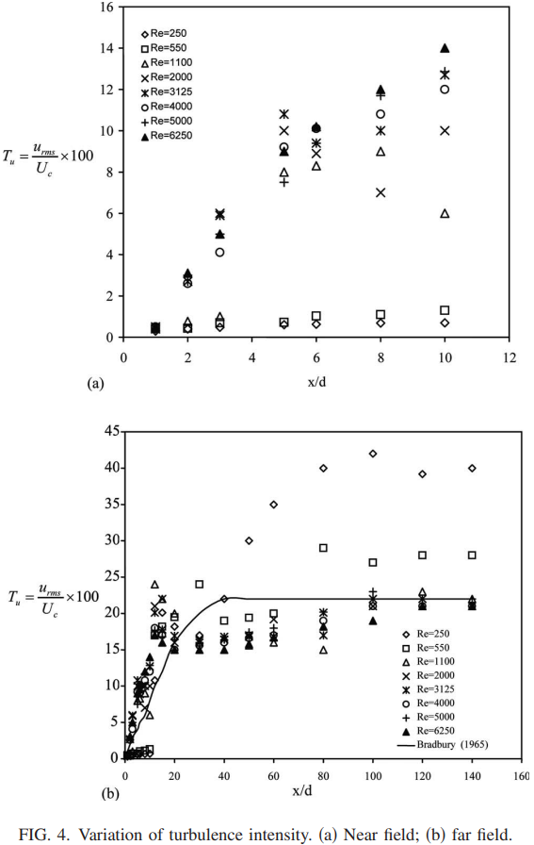
Experimental results
A. Near field and far field flow features
Slow increase of turbulence intensity (T_{u}) in the low Re cases is the existence of an initial “laminar length,” because of the flow field essentially remains laminar.
The turbulence intensity shows an initial linear growth up to a value of 6% [Fig. 4a] for Reynolds numbers greater than or equal to 2000.
The observed peak and dip in the turbulence intensity values (T_{u}) between x/d= 6 and 10 arise due to shear layer interactions after the potential core.
Far field turbulence intensity values are higher for Re values of 250 and 550 and these do not approach self-similar behavior even at large axial distances of x/d ≈ 140.
For higher Re values, the turbulence intensity approaches an asymptotic fully developed state which is independent of Re or axial distance.

Slide 9
Experimental results
A. Near field and far field flow features
The fluctuations of high amplitude noted at low Re are contributed by large sized vortices lying in a narrow frequency band, which do not correspond to a fully developed turbulent state. They rather give rise to an essentially laminar flow with a high level of intermittency.
It is seen that the turbulence intensity peaks in the range 5˂x/d ˂ 20 for high Re cases. This is possibly due to the interaction between the two mixing layers growing from the opposite sides.
The high velocity fluctuations can be attributed to large scale double roller structures rather than Kelvin–Helmholtz vortices which usually occur only in the near field.
The peak intensity value in the interaction region is seen to decrease with the increase in Reynolds number.
Beyond x/d= 80, the turbulence intensity attains an asymptotic value of 22%

Slide 10
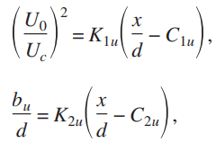

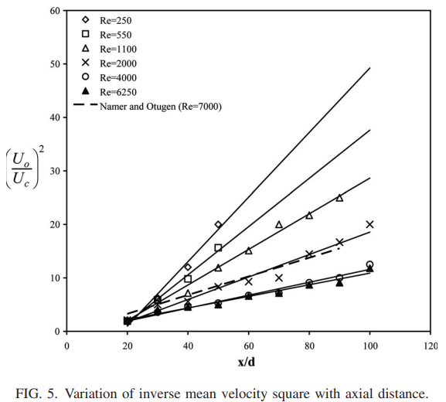
Experimental results
B. Jet spread rate and flow visualization
The conventional measures of jet spreading, and velocity decay give the following relations in the fully developed region:
where b_{u} is the jet half-width, U_{c} is the local centerline velocity, U₀ is the mean nozzle exit velocity, and K_{2u} is the jet spread rate. Also, C_{1u} and C_{2u} are the locations of virtual origin for the mean velocity decay and jet half-width, respectively.
For Re ˂ 1100 and x/d ˃ 40, the mean velocity decay is very fast.
For such low Re situations, fluctuations become comparable to the mean velocities in the far field and the entrained mass flow rate is significant compared to the jet inlet flow rate, even at moderate values of x/d.
These trends can be attributed to the dominance of large sized vortices in the far field of a low Re jet.

Slide 11
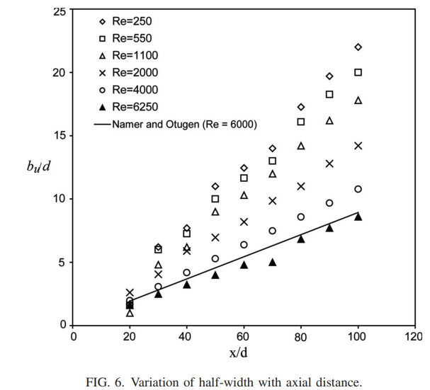
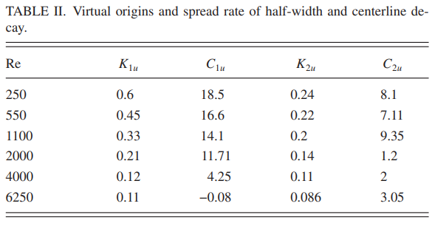
Experimental results
B. Jet spread rate and flow visualization
The slope of half-width K2u (=db_{u} /dx) is 0.086 for this study at Re= 6250 which is quite close to the value of 0.10 obtained by Thomas and Goldschmidt using a long approach channel nozzle at Re= 6000.
The mean velocity decay constant (K_{1u}) obtained in the present study is 0.11.
Both the slopes K_{1u} and K_{2u} show a decreasing trend with Re in general and attain asymptotic values of around 0.1 at higher Reynolds numbers.

Slide 12
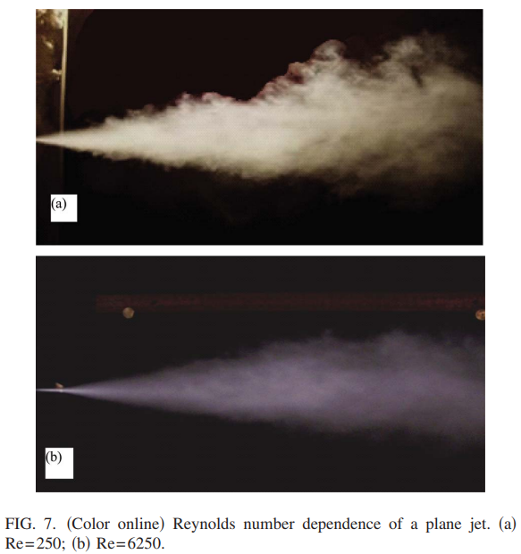
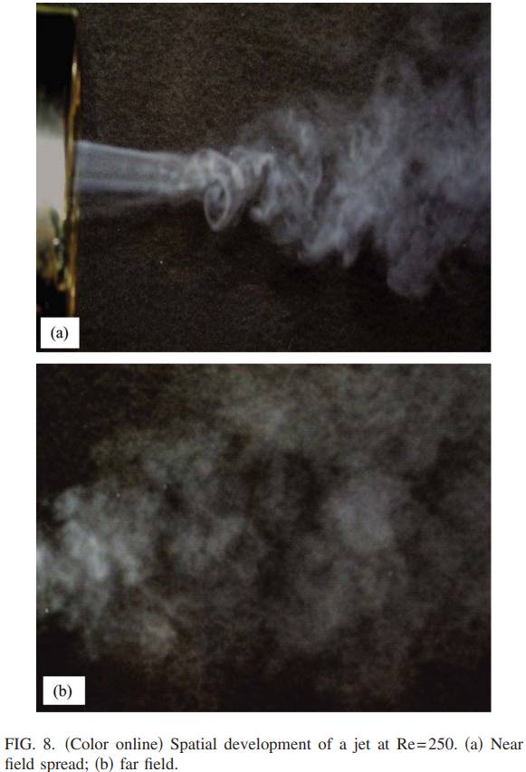
Experimental results
B. Jet spread rate and flow visualization
At low Reynolds number, the photographs show dominance of large scales in the outer shear layer zone [Fig. 7(a)].
at Re= 6250 [Fig. 7(b)], it is observed that large scales are absent in the outer shear layer. Consequently, ambient air entrainment decreases, leading to reduction in the jet spread rate with increasing Re.
Fig. 8. The near field development shows shear layer stretching, resulting in the formation of vortices.
For far field, it shows adjoining regions of smoke and ambient air throughout the jet cross section, implying that intermittent excursion of ambient fluid occurs right up to the jet centerline. In other words, large levels of flow intermittency prevail in the far region of a low Re jet.

Slide 13
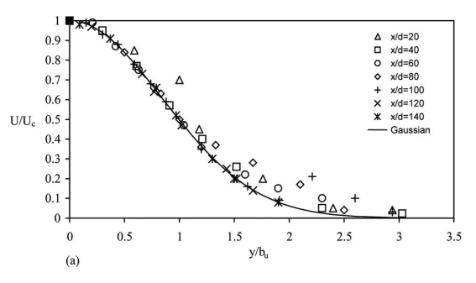
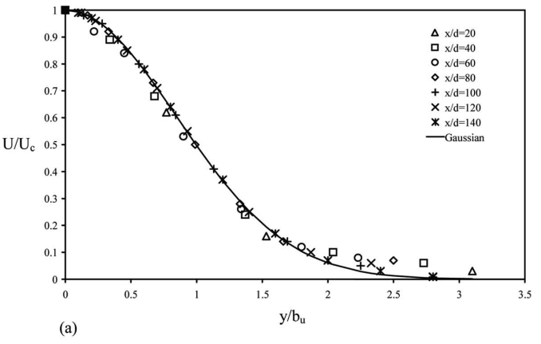
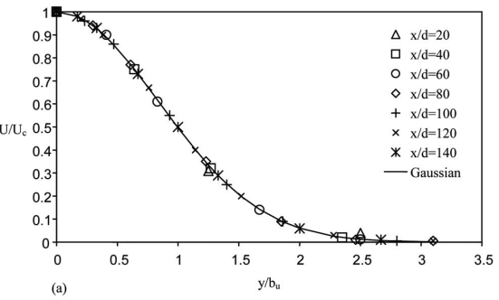


Experimental results
C. Self-similarity of mean and fluctuating quantities
The Gaussian curve
The mean velocities are self-similar in lower Re cases for x/d ˃ 20, particularly close to the jet midplane Fig. 9a
At the jet periphery, for y/b_{u} ˃ 1.5, similarity is poor probably because of the shear layer instability mechanisms at play and the plane to axisymmetric jet transition.
At the higher Reynolds numbers of 2000 and 6250 [Figs. 10a and 11a], attainment of self similarity for the mean velocity occurs earlier than in the case of low Re jets.

Slide 14
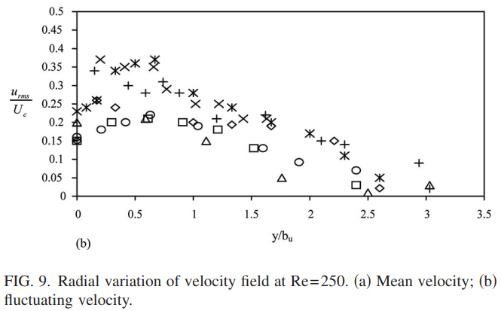
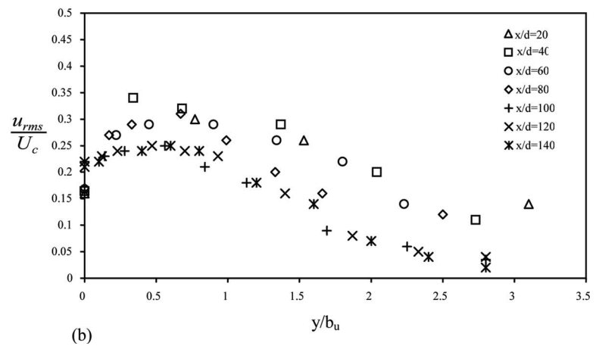
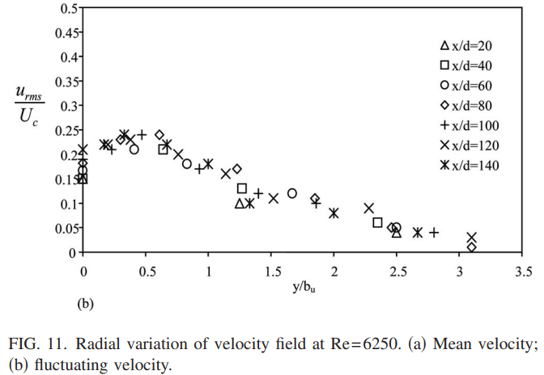

Experimental results
C. Self-similarity of mean and fluctuating quantities
At Reynolds numbers between 250 and 2000, turbulence intensity values are very much scattered and do not show any trend toward self preservation [Figs. 9(b)and 10(b)].
Moreover, turbulence intensities attain relatively higher values in the central part of the jet with u/U_{c} ~ 0.35.
It is clear that mean quantities attain self-similarity earlier than fluctuating quantities.

Slide 15
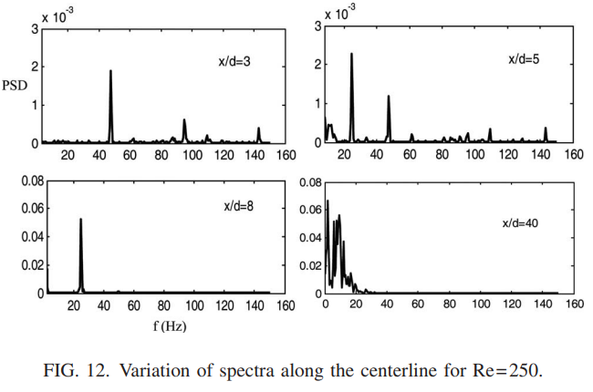
Experimental results
D. Spectral analysis
The power spectrum exhibits a fundamental vortex formation frequency of 48 Hz at x/d= 3.
The subharmonic with f = 24 Hz is observed at x/d= 5 which then grows in amplitude and finally develops into several subharmonic components at larger axial distances.

Slide 16
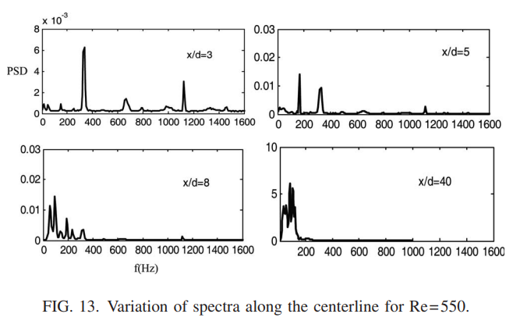
Experimental results
D. Spectral analysis
Similarly, for Re= 550, the fundamental frequency is 342 Hz at x/d= 3
At the end of the potential core x/d= 5, the subharmonic of 171 Hz dominates over the fundamental component.

Slide 17
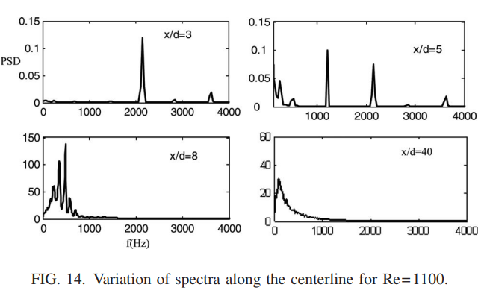
Experimental results
D. Spectral analysis
Similar features are observed for Re= 1100, also with a fundamental frequency of f 2000 Hz.

Slide 18
Experimental results
D. Spectral analysis
vortex breakup processes, which produce finer scales, seem to be absent in the low Re jets, even in the far field.

Slide 19
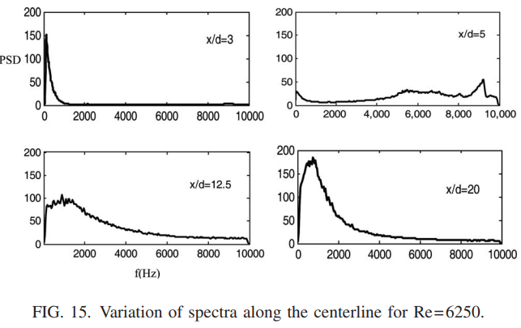
Experimental results
D. Spectral analysis
At a high Re such as 6250, no discrete peaks are seen in the near field.
Finer scales appear at small axial distances and a fully developed spectrum is also attained at an earlier axial distance x/d= 20.

Slide 20
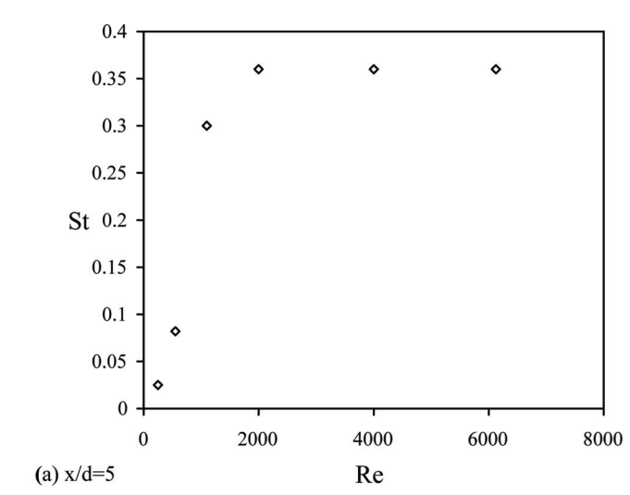
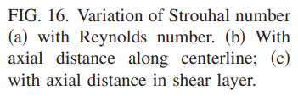
Experimental results
D. Spectral analysis
The dominant frequency is taken from the power spectra plots at x/d= 5
St = f d/U0.
The values of St for Re= 250, 550, and 1100 turn out to be 0.025, 0.082, and 0.3, respectively. For Reynolds numbers of 2000 and higher, the asymptotic value of Strouhal number approaches 0.36
At high Reynolds numbers, i.e., Re2000, Strouhal number tends to become independent of Reynolds number

Slide 21
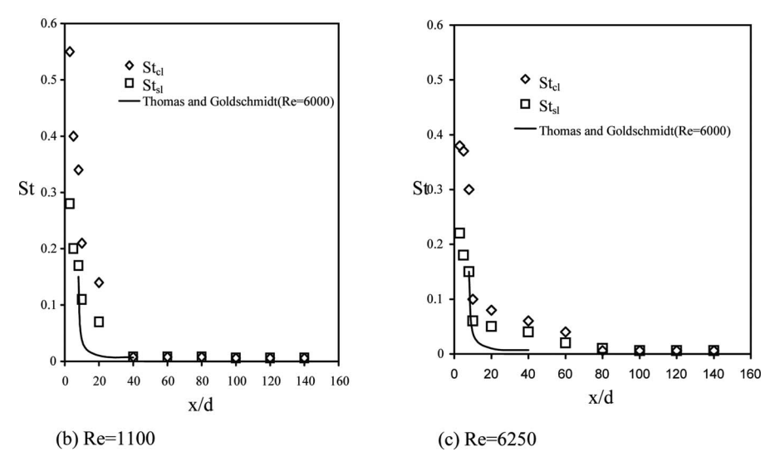
Experimental results
D. Spectral analysis
The centerline Strouhal number St_{cl} is higher than the shear layer Strouhal number St_{sl} near the nozzle; however, beyond a certain axial distance, the two Strouhal numbers approach a single value.
For lower Re jet, convergence of the two Strouhal number values is observed at x/d= 40, while at Re= 6250, convergence occurs at around x/d= 80.
The earlier collapse of St_{cl} and St_{sl} in the low Re jet flow of the present study can be explained in terms of the faster shear layer growth at lower Re.

Slide 22
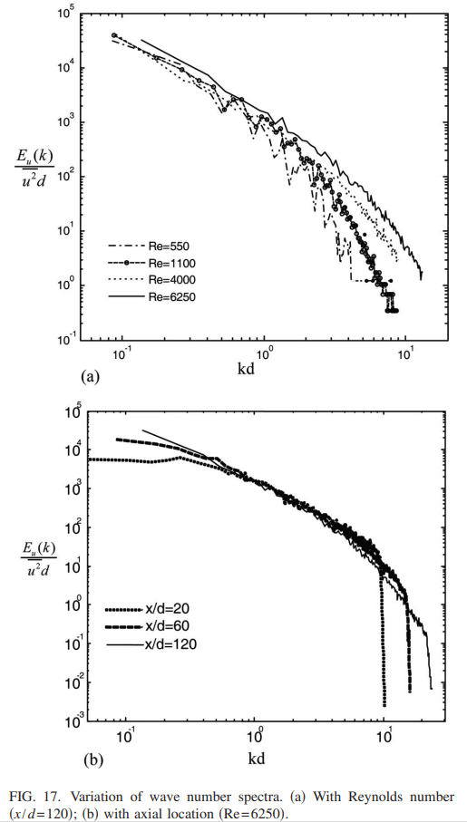
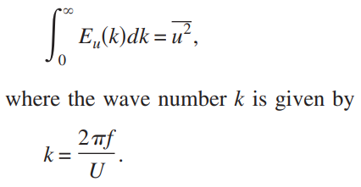
Experimental results
D. Spectral analysis
The power spectrum, 𝐸_{𝑢}(𝑘), represents how the kinetic energy is distributed across different scales (or wavenumbers 𝑘) of the flow.
Energy cascading process (Eu) is defined
The power spectrum broadens with the increase in Re toward higher wave numbers. As a result of this, smaller scales start to appear in the flow at higher Re.
Location dependence is observed only at lower and higher wave numbers, corresponding to very large or very small eddies.
As distance increases, the spectrum broadens, indicating the appearance of finer scales.

Slide 23



Experimental results
D. Spectral analysis
Autocorrelation Function: The autocorrelation function 𝑅_{𝑢𝑢}(𝜏) describes how the velocity at a given point is correlated with itself over time:
The integral time scale 𝜏 represents the average time over which the turbulent fluctuations remain correlated.
The integral length scale L represents the typical size of energy containing turbulent eddies.

Slide 24
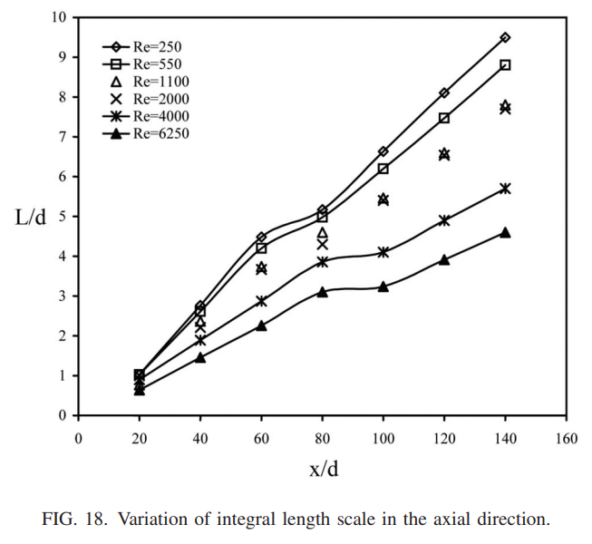
Experimental results
D. Spectral analysis
The integral length scale is observed to increase with respect to axial distance for all the Reynolds numbers of the present study.
Length scale decreases with the increase in Reynolds number at a given axial location. This implies that turbulent scales become finer at higher Re values, although a broad range of eddy sizes will coexist at any location.
The slower spread rate and centerline decay rate of high Re jets are associated with the reduction of size and strength of the energy containing eddies which are primarily responsible for turbulent mixing in jets.
The larger sizes of the integral length scales seen for low Re jets can be attributed to the shear layer instability and the associated large vortices

Slide 25
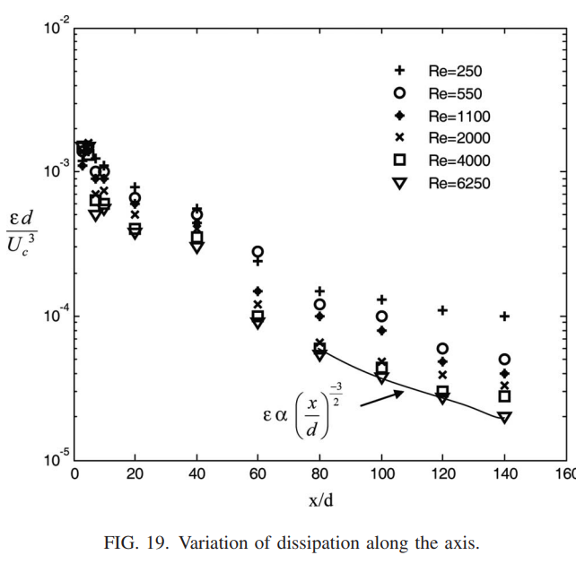
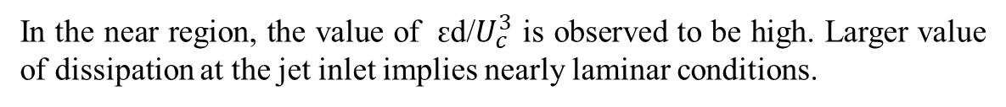
Experimental results
D. Spectral analysis
As the axial distance increases, the local Re increases, implying that the relative significance of viscosity reduces especially for high Re jets in the far field. Consequently, the value of dissipation tends to decrease.
In the near region, the value of ԑd/$U_{c}^{3}$ is observed to be high. Larger value of dissipation at the jet inlet implies nearly laminar conditions.
Away from the nozzle exit, the dimensionless turbulence dissipation rate decreases at higher Re.
The dissipation decreases with an increase in distance.
The far region at high Re obeys the well-known trend of ԑ α (x/d)^{−3/2}

Slide 26
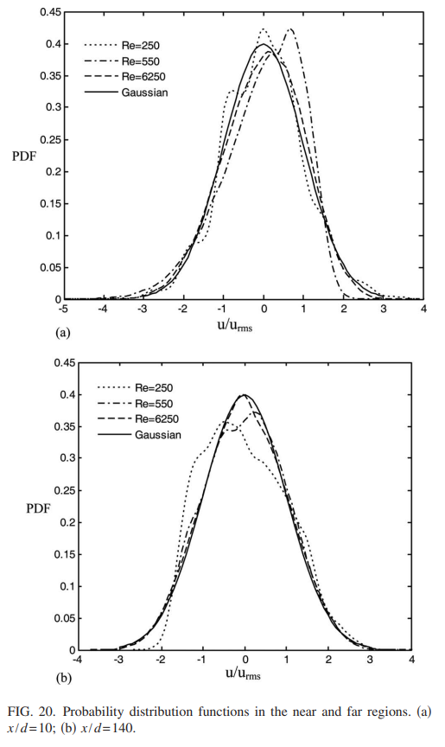
Experimental results
E. Attainment of homogeneous turbulence
The PDF of velocity fluctuations can be used to assess the attainment of homogeneous turbulence and the existence of nonequilibrium and anisotropic features.
The PDF has definite peaks and lengths of the exponential tails are also high for low Re cases Re= 250 and 550. This shows the existence of large coherent structures in the flow.
At a high Re of 6250, the PDF is skewed but closer to Gaussian. Therefore, it can be concluded that in the initial region of a rectangular jet, anisotropy exists due to the dominance of large-scale structures.

Slide 27
Experimental results
E. Attainment of homogeneous turbulence
The PDF is still skewed for low Re jets (Re= 250 and 1100) implying that low Re jets never attain equilibrium turbulence due to the inherent large-scale vortices present in the flow.
For a high Re jet (Re= 6250) at x/d= 140, the PDF coincides with Gaussian profile indicating that isotropic turbulence has been attained.

Slide 28
Conclusions
The evolution of mean and fluctuating velocity components in the transition Reynolds number regime of 250 ≤ Re ≤ 6250 has been characterized in detail, for plane free jets
It is found that at lower Reynolds numbers, self similarity of mean velocity profile is achieved at a smaller axial distance than for the turbulence intensity profile.
The near field region of a low Re jet is dominated by discrete frequency peaks due to the vortex shedding associated with shear layer instability.
The subsequent vortex pairing processes lead to halving of the fundamental frequency and appearance of other subharmonic components, resulting in the dominance of large size vortices.
The flow intermittency associated with large scale vortices persists for a long distance and the flow does not approach an isotropic turbulence condition even in the far field.
The spread rate of a low Re jet is high because of the dominance of large size eddies which cause vigorous mixing as well as decay of the jet flow.

Slide 29
Conclusions
At higher Reynolds numbers, finer vortex structures dominate the flow. These give rise to slower jet spread rate as well as slower growth of shear layers.
At higher Reynolds numbers, the mean velocity and turbulent fluctuations achieve self-similarity almost simultaneously at smaller axial distances.
The approach to isotropic turbulence also occurs earlier in a high Re jet.
It is observed that for low Reynolds numbers Re ˂ 2000, characteristics such as velocity profiles, turbulence intensities, centerline decay rates, and length scales are strong functions of Reynolds number and axial distance.
At high Reynolds numbers, the state of turbulence becomes independent of inlet Reynolds number and axial distance, in the far field.

Slide 30


Slide 31
The Biot–Savart induction (or law) originates from electromagnetism
in electromagnetism, where moving charges create a magnetic field, here the moving fluid elements (with vorticity) induce motion in the surrounding fluid, drawing it in or pushing it away.
Taylor’s Frozen Turbulence Hypothesis assumes that turbulent structures (eddies) are "frozen" as they are advected by the mean flow velocity . This assumption is valid for flows where the turbulent velocity fluctuations are much smaller than the mean flow velocity.
Thus, the integral length scale can be interpreted as the distance over which the turbulent fluctuations remain correlated, or equivalently, the size of the largest turbulent eddies that contain the most energy.
Dissipation Rate (ϵ):The dissipation rate represents the rate at which turbulent kinetic energy is converted into thermal energy due to viscous effects. It is often expressed in terms of the kinematic viscosity (𝜈) and velocity gradients.

