Slide 1
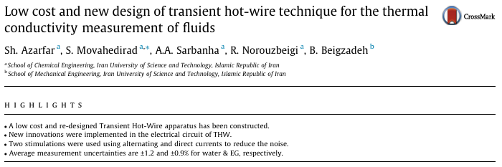

JEONBUK NATIONAL UNIVERSITY – 202451013 - LEECHANMIN
Notes:
ㅁㄴㅇㄻㄴㅇㄻㄴㅇㄹ

Slide 2
Introduction
- Thermal Conductivity Measurements
Crucial in fields like energy systems, material science, and fluid dynamics.
Vital for designing heat transfer equipment.
Accuracy and efficiency.
Notes:
123123123123

Slide 3
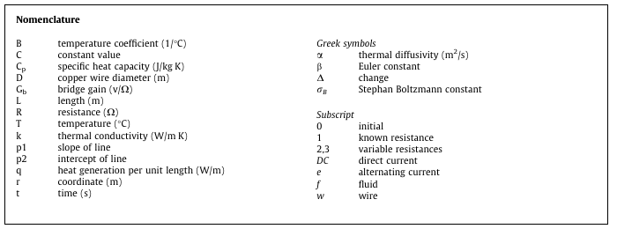
Introduction
- Objectives of the Study
Develop a low-cost THW apparatus using copper wire instead of platinum.

Slide 4
Introduction
- Key goals
Maintain measurement precision and accuracy.
Innovate the electrical circuitry to minimize noise.
Evaluate the system using DI water)and ethylene glycol.

Slide 5
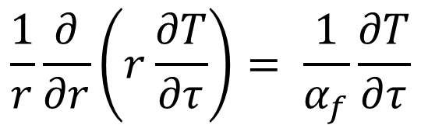

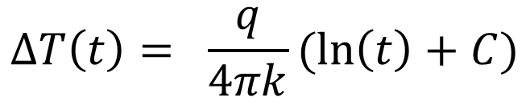
Theoretical Background
- Principles of Transient Hot-Wire
uses a metal wire as both a heat source and a temperature sensor.
$$R\left(T\right)= R_{0}(1+BT)$$
$$\frac{1}{r}\frac{∂}{∂r}\left(r\frac{∂T}{∂τ}\right)= \frac{1}{α_{f}}\frac{∂T}{∂τ}$$
$$∆T\left(t\right)= \frac{q}{4πk}(\ln\left(t\right)+C)$$

Slide 6
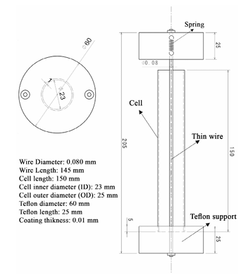
Experimental Design
- Apparatus
Borosilicate glass cell
Cost-effectiveness and sufficient sensitivity.
Copper wire - Diameter : 80 µm
Length : 145 mm.

Slide 7

Experimental Design
- Copper Wire
Coefficient of resistance variation against temperature must be large.
Resistance should be high
Melting temperature
Corrosion
Repeatability
Continuous

Slide 8
Experimental Design
- Electrical Circuit
Two types of current AC and DC were used to minimize noise.
The heating current was isolated from the Wheatstone bridge circuit to prevent resistance heating errors.
A high-precision 2.5V DC supply powered the setup.

Slide 9
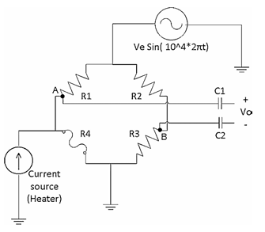
Experimental Design
- Data Acquisition
The Wheatstone bridge was balanced before heating.
Voltage changes were recorded with a frequency of 2000 data points per second.
Software processed the data to calculate temperature changes and thermal conductivity.

Slide 10
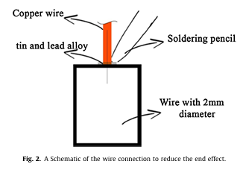
Experimental Design
- Addressing Systematic Errors
Radiation effects: Calculated using the Stefan-Boltzmann law.
Wire heat capacity: Found to be negligible for the chosen conditions.
A 10 µm polyester insulating layer prevented electrical leakage from the copper wire to the fluid.

Slide 11
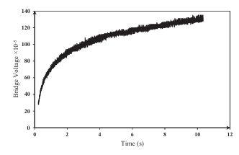
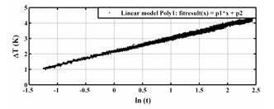
Results and Analysis
- Procedure and Key Findings
Fluids: DI water and EG, tested from 5°C to 50°C.
Each test was repeated four times to ensure consistency.
The linear relationship between ΔT and ln(𝑡) confirmed no convection effects.
The average measurement uncertainties were:
±1.2% for DI water.
±0.9% for EG.

Slide 12
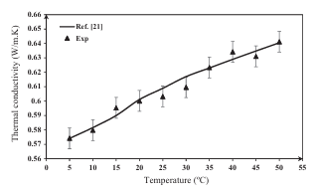
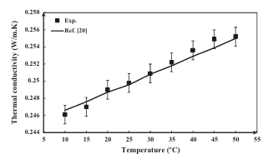
Results and Analysis
- Comparison with Literature
The results agreed well with established data, validating the apparatus.
Despite using a copper wire, the precision matched or exceeded conventional platinum setups.

Slide 13
Conclusions
- Summary
The study successfully developed a low-cost THW apparatus.
Key innovations in circuitry and material selection reduced costs while maintaining accuracy.
The device is suitable for various fluids, including nanofluids.

Slide 14
Conclusions
- Future Applications
Further testing on a broader range of fluids and higher temperatures could enhance applicability.
Potential for commercial use in industries requiring rapid thermal conductivity measurements.

