Slide 1
Computational Fluid Dynamics (CFD)
DAY 9
Kumaresh

Slide 2
Research Presentation
Yousef, Phuong, Saleem, and Baral (teach Python) → Nov. 20
Others and Phuc (run ANSYS simulation and explain) → Nov. 27
Please spend more time on explaining the introduction part
(your research topic clearly)
+ numerical methodology + results + conclusion
12 minutes each presentation + 5 minutes Query session
Every individual should post a question

Slide 3
Group Project – 1
Create a surface file “Sphere”
Create a case setup file for the problem, “Flow over a sphere”
Modify the case setup file
Run your new case file
Upload your new solver, case files, and results in GITHUB

Slide 4
1. Create a surface file “Sphere”
1) Use any modelling software (AutoCAD, CATIA, FreeCAD or any tool) to model sphere
2) Sphere dimensions are as follows:
Radius = 0.1mm
Location of the sphere = (0.5mm, 0.5mm, 0.5mm)
3) Export the sphere file with the file name, “sphere.obj”

Slide 5
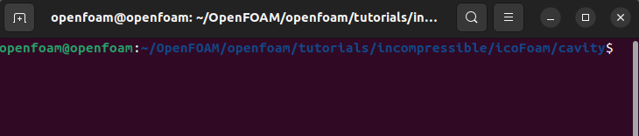
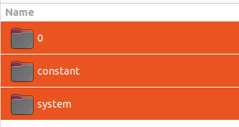
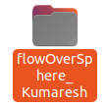
2. Create a case setup file for the problem, “Flow over a sphere”
Use icoFoam solver
From the location:
Copy 0, constant, and system files in the new file name
“flowOverSphere_YourNAME”

Slide 6
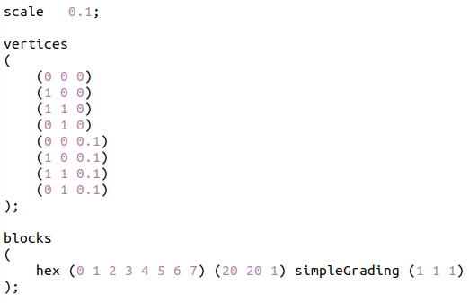
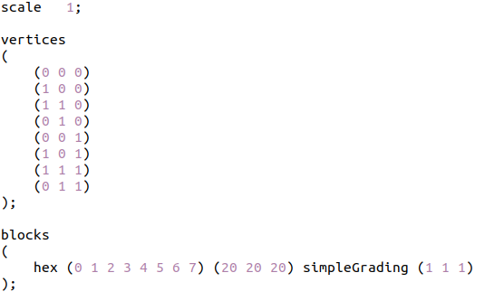
3a. Modify the case setup file
Changes in system/blockMesh file
icoFoam file
flowOverSphere

Slide 7
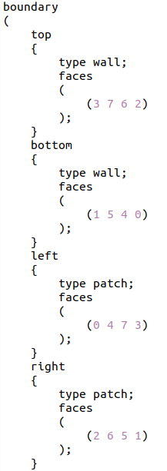
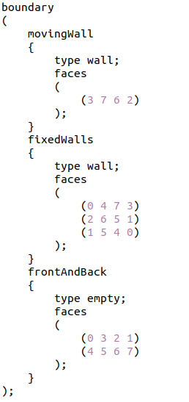
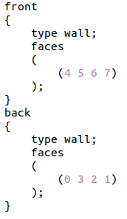
3a. Modify the case setup file
Changes in system/blockMesh file
icoFoam file
flowOverSphere

Slide 8
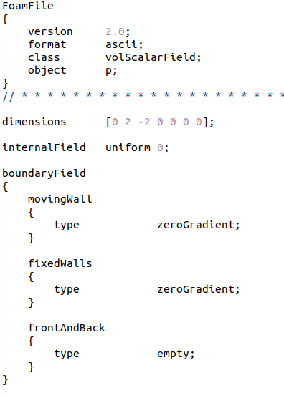
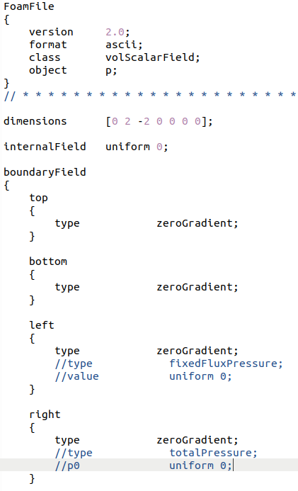
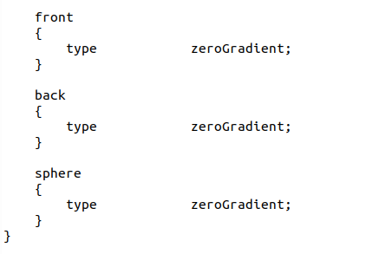
3b. Modify the case setup file
Changes in 0/p boundary file
icoFoam file
flowOverSphere

Slide 9
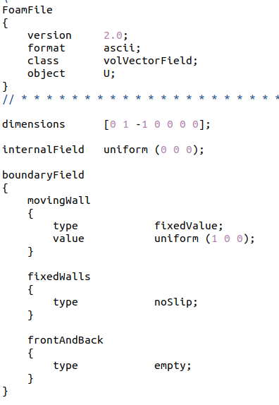
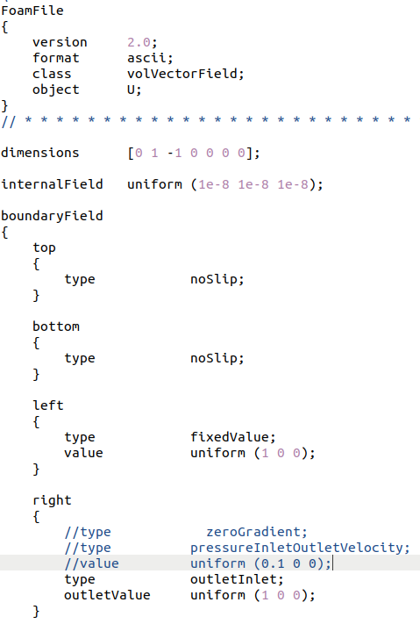
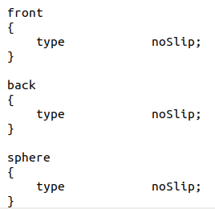
3b. Modify the case setup file
Changes in 0/U boundary file
icoFoam file
flowOverSphere

Slide 10

3c. Modify the case setup file
Changes in constant file
1) Create a triSurface file by the following command:
mkdir –p triSurface
2) Inside the triSurface file, copy the surface file named “sphere.obj” (Carried out in step 1)

Slide 11
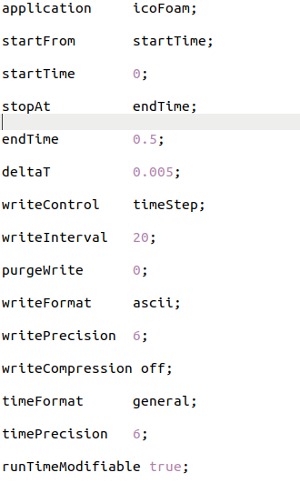
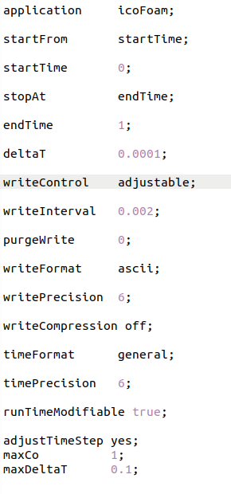
3d. Modify the case setup file
Changes in system/controlDict file
icoFoam file
flowOverSphere

Slide 12
3d. Modify the case setup file
Changes in system file
1) Keep the remaining files, fvSchemes, fvSolution, and decomposeParDict as such.
2) Download the following files from GitHub and copy inside system file:
> meshQualityDict
> snappyHexMeshDict
> surfaceFeatureExtractDict

Slide 13
4. Run your new case file
blockMesh
surfaceFeatureExtract
snappyHexMesh -overwrite
icoFoam

Slide 14
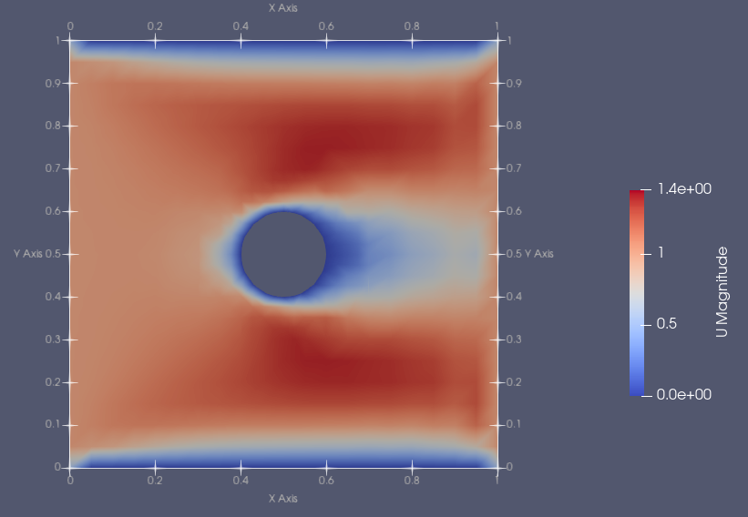
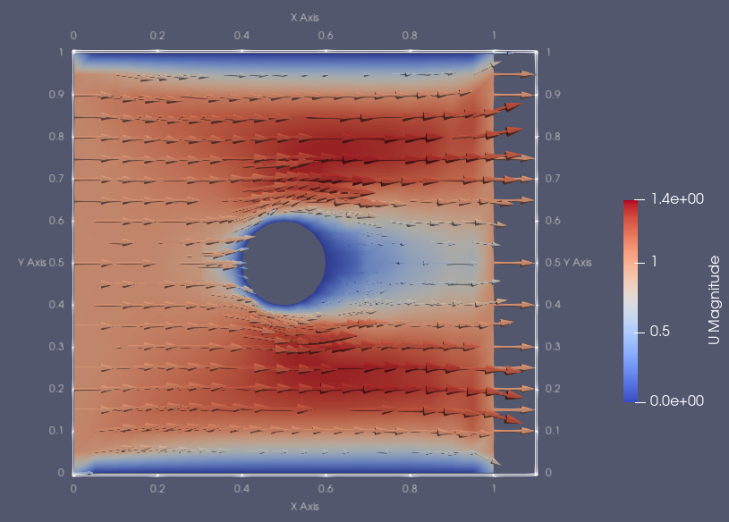
5. Upload your new solver, case files, and results in GITHUB
GROUP PROJECT – 1

