Slide 1
Computational Fluid Dynamics (CFD)
DAY 5
Kumaresh

Slide 2
Contents
Numerical Solution to Diffusion Equation
Exercise – 5 → Diffusion equation

Slide 3
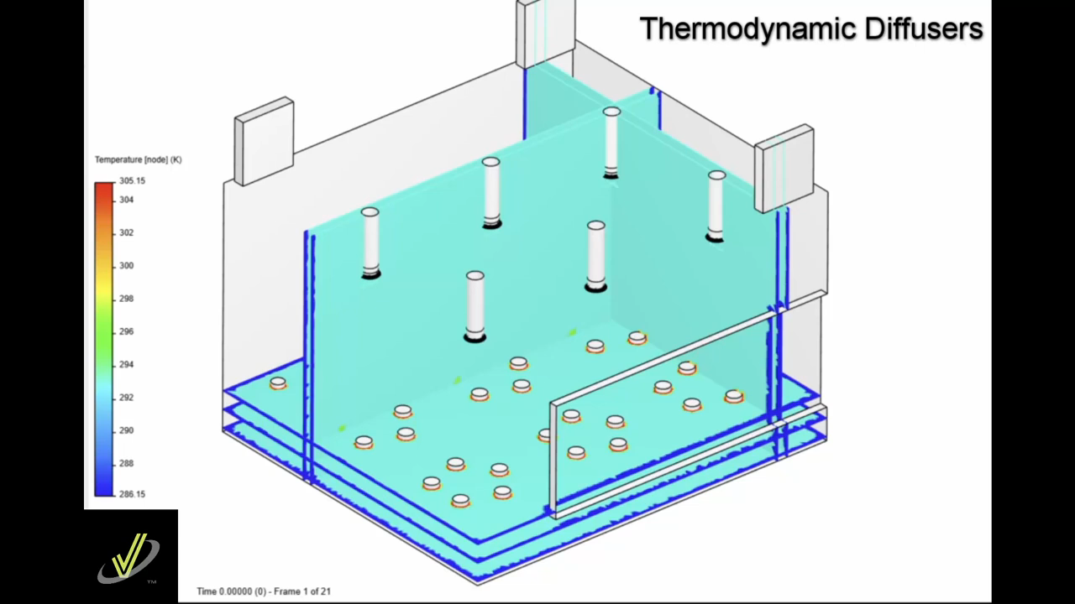
Fick's law describes the movement of particles from a region of high concentration to a region of lower concentration.
Diﬀusion generally represents the transport of a ﬂuid property (momentum) due to ﬂuctuating motions that are not captured by the bulk motion that is represented by the continuum velocity eqn.
Diffusion
Thermodynamic diffusers supply heated air with a downward jet, the difference in air density causes hot air to rise in the first minute after starting the system.

Slide 4

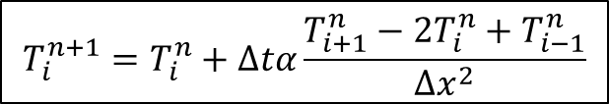
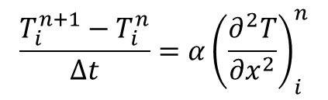
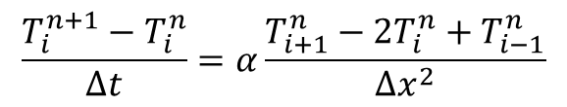
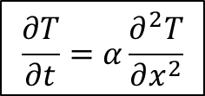

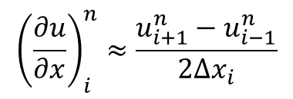
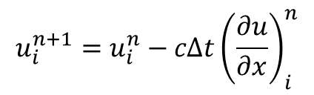
Numerical Solution to Diffusion Equation
$$\frac{∂T}{∂t}=α\frac{∂^{2}T}{∂x^{2}}$$
Time level: $n+1$
$$x_{i−1}$$
$$x_{i}$$
$$x_{i+1}$$
$$x_{i+2}$$
$$\frac{T_{i}^{n+1}−T_{i}^{n}}{Δt}=α{\left(\frac{∂^{2}T}{∂x^{2}}\right)}_{i}^{n}$$
Time level: $n$
$$x_{i+1}$$
$$x_{i+2}$$
$$x_{i−1}$$
$$x_{i}$$
$${\left(\frac{d^{2}T}{dx^{2}}\right)}_{i}=\frac{T\left(x_{i+1}\right)−2T\left(x_{i}\right)+T\left(x_{i−1}\right)}{Δx_{i}^{2}}+O\left(Δx_{i}^{2}\right)$$
Information is from both left and right end
$$\frac{T_{i}^{n+1}−T_{i}^{n}}{Δt}=α\frac{T_{i+1}^{n}−2T_{i}^{n}+T_{i−1}^{n}}{Δx^{2}}$$
$$u_{i}^{n+1}=u_{i}^{n}−cΔt{\left(\frac{∂u}{∂x}\right)}_{i}^{n}$$
$${\left(\frac{∂u}{∂x}\right)}_{i}^{n}≈\frac{u_{i+1}^{n}−u_{i−1}^{n}}{2Δx_{i}}$$
$$T_{i}^{n+1}=T_{i}^{n}+Δtα\frac{T_{i+1}^{n}−2T_{i}^{n}+T_{i−1}^{n}}{Δx^{2}}$$
Central difference

Slide 5
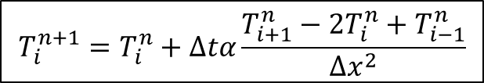
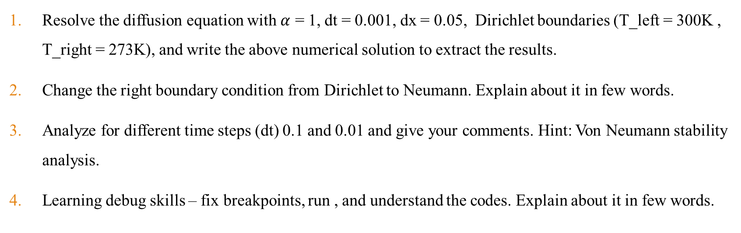
Exercise – 5 (Let’s solve the Diffusion Equation)
$$T_{i}^{n+1}=T_{i}^{n}+Δtα\frac{T_{i+1}^{n}−2T_{i}^{n}+T_{i−1}^{n}}{Δx^{2}}$$
a7_solve_diffusion.m
Resolve the diffusion equation with $α$ = 1, dt = 0.001, dx = 0.05, Dirichlet boundaries (T_left = 300K , T_right = 273K), and write the above numerical solution to extract the results.
Change the right boundary condition from Dirichlet to Neumann. Explain about it in few words.
Analyze for different time steps (dt) 0.1 and 0.01 and give your comments. Hint: Von Neumann stability analysis.
Learning debug skills – fix breakpoints, run , and understand the codes. Explain about it in few words.
Notes:
https://ezgif.com/maker
Dirichlet boundary conditions assume the solution to the variable.
In Neumann boundary conditions, a solution is assumed for the derivative of the variable.
https://en.wikipedia.org/wiki/Von_Neumann_stability_analysis

Slide 6
Research Project Presentation
(30th October, 2024)
- Every individual should take a presentation for 15 minutes. This topic carries high marks. Please prepare and present it carefully.
- Query session: 5 minutes.
- Every individual should ask a single question during the presentation.

