Slide 1
Computational Fluid Dynamics (CFD)
DAY 8
Kumaresh

Slide 2
Contents
Creating a new OpenFOAM solver based on icoFoam
Exercise – 6

Slide 3
Following things to do:
Copy default icoFoam solver
Adding the temperature field in the icoFoam solver
Copy default cavity tutorial based from icoFoam
Add a new file for initial and boundary conditions
Add respective files in fvSchemes and fvSolution
Run your new case file
Upload your new solver, case files, and results in GITHUB

Slide 4
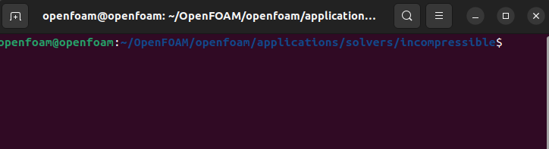
Copy default icoFoam solver
From the location:
To make your own solver, firstly do the following:
Change the default icoFoam name into myIcoFoam.
Change the source file name from icoFoam.C into myIcoFoam.C
Open Files, and do the following:
myIcoFoam.C
EXE = $(FOAM_USER_APPBIN)/myIcoFoam

Slide 5
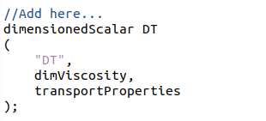
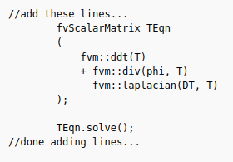
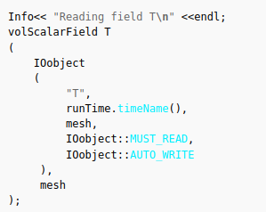
2. Adding the temperature field in the icoFoam solver
Under createFields.H
Under myIcoFoam.C

Slide 6
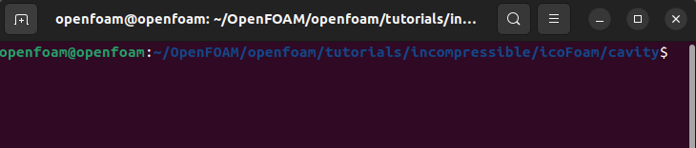
3. Copy default cavity tutorial based from icoFoam
From the location:
Modify your solver name as myCavityCaseFile

Slide 7
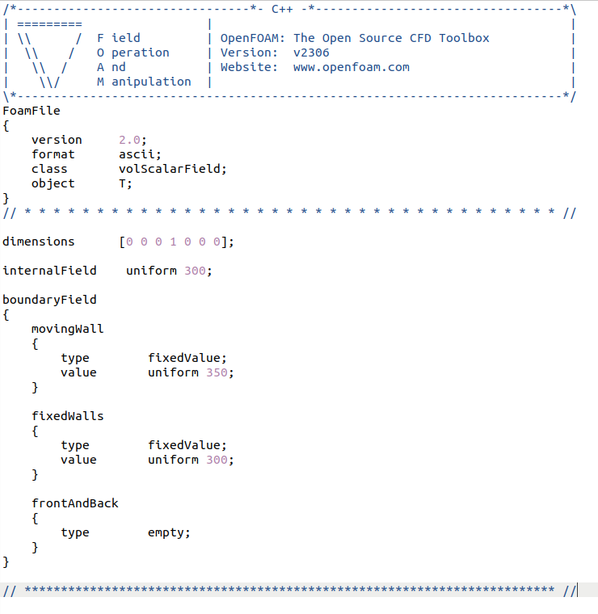
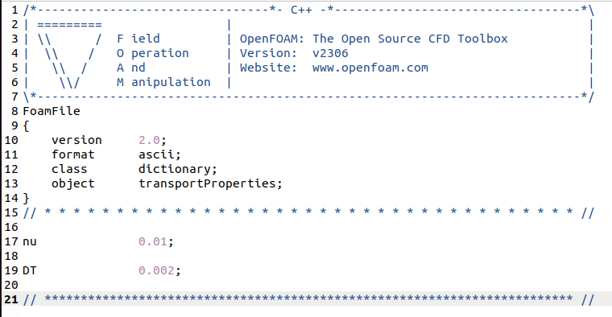
4. Add a new file for initial and boundary conditions
Under constant/transportProperties
Add DT (new variable created)
Add “T” field in “0” file

Slide 8
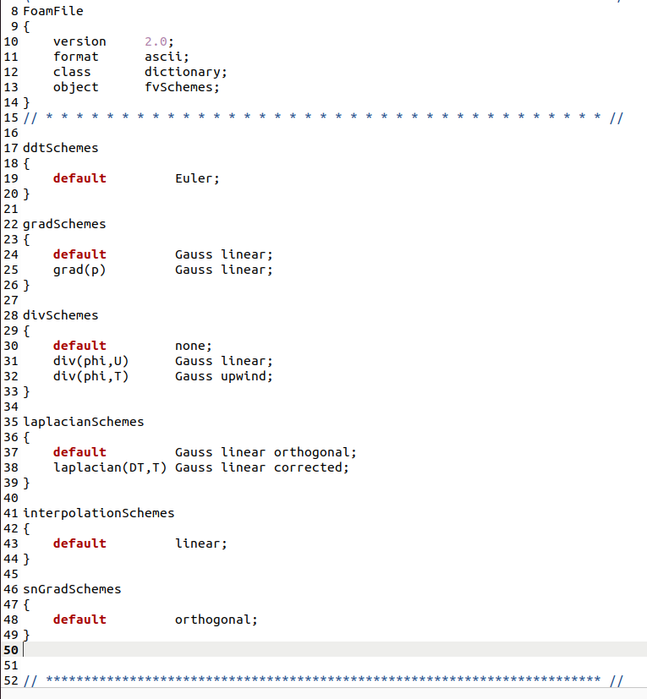
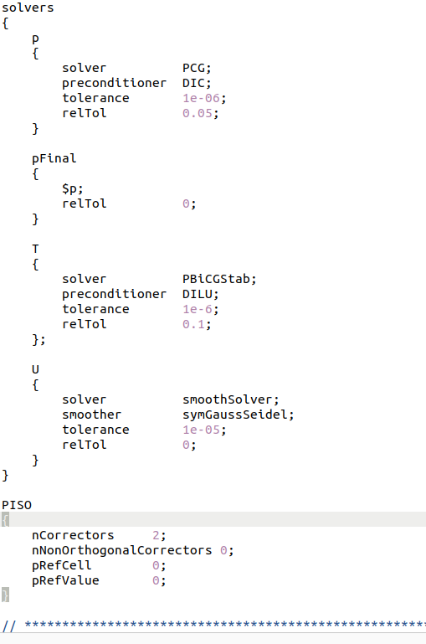
5. Add respective files in fvSchemes and fvSolution
Under system/fvSchemes
Under system/fvSolution

Slide 9
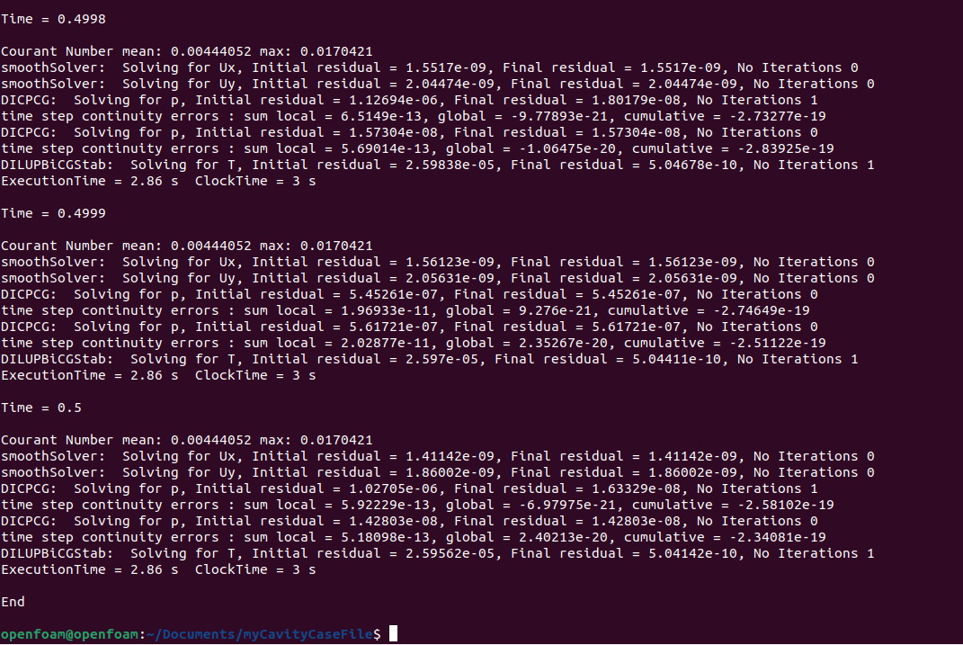
6. Run your new case file

Slide 10
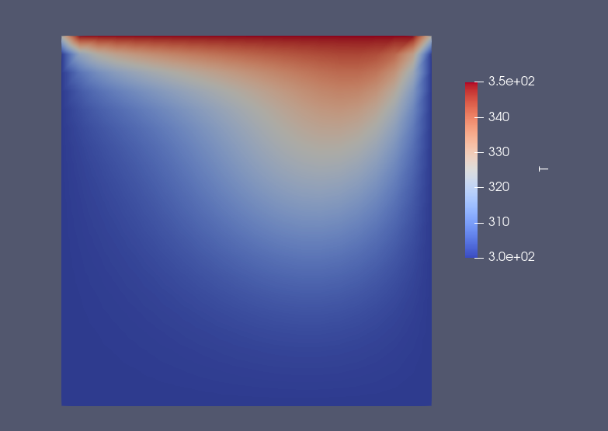
7. Upload your new solver, case files, and results in GITHUB

Slide 11
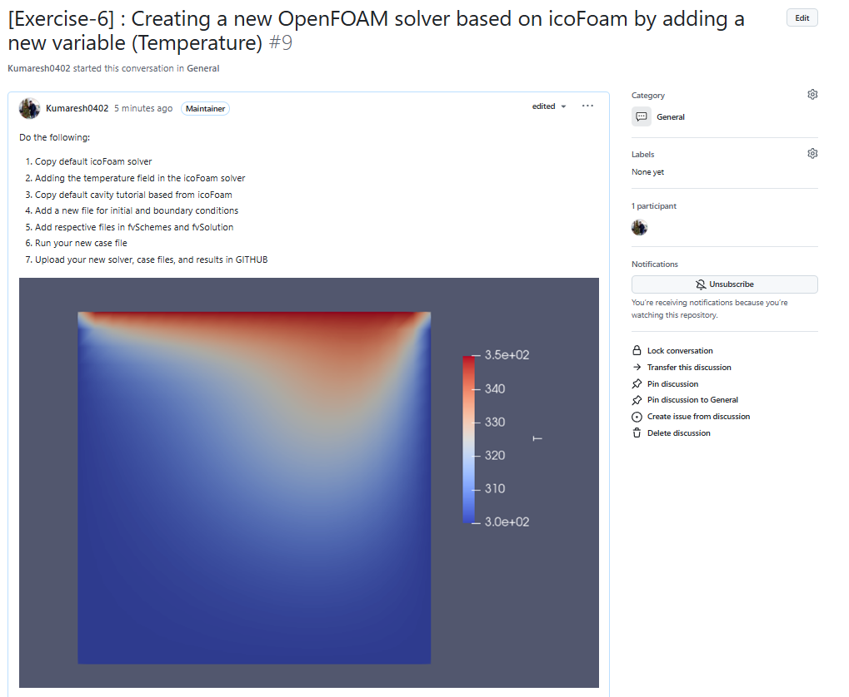
Exercise – 6

Slide 12
Research Presentation
Yousef, Phuong, Saleem, and Baral (teach Python) → Nov. 20
Others and Phuc (run ANSYS simulation and explain) → Nov. 27
Please spend more time on explaining the introduction part
(your research topic clearly)
+ numerical methodology + results + conclusion
12 minutes each presentation + 5 minutes Query session
Every individual should post a question

