Slide 1
Computational Fluid Dynamics (CFD)
DAY 3
Kumaresh

Slide 2
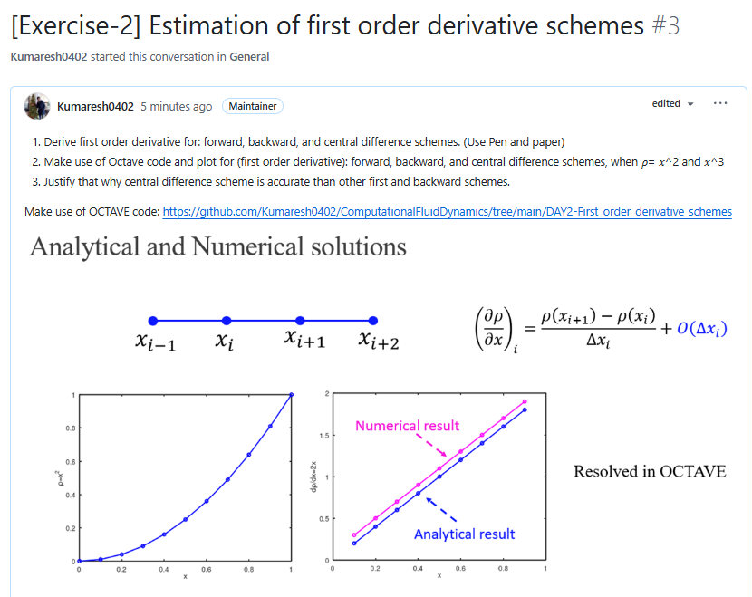
Quick Recap

Slide 3
Contents
Taylor series
Numerical discretization
Gauss-Divergence theorem
Reynolds Transport Theorem
Solve Exercise – 3 in Octave

Slide 4
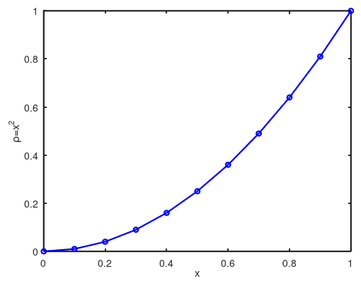


Taylor series: Discrete Operations
$$x_{i}$$
$$x^{∗}$$
$$ρ\left(x^{∗}\right)=ρ\left(x_{i}\right)+\left(x^{∗}−x_{i}\right){\left(\frac{dρ}{dx}\right)}_{i}+{\left(x^{∗}−x_{i}\right)}^{2}{\left(\frac{d^{2}ρ}{dx^{2}}\right)}_{i}+{\left(x^{∗}−x_{i}\right)}^{3}{\left(\frac{d^{3}ρ}{dx^{3}}\right)}_{i}+…$$

Slide 5




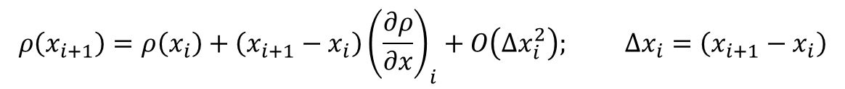
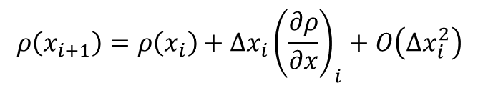
Taylor series expansion

Slide 6
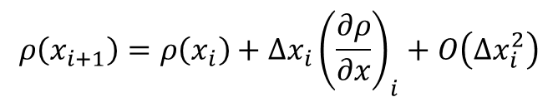
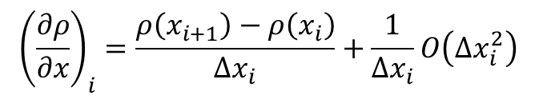
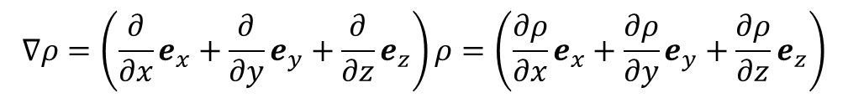
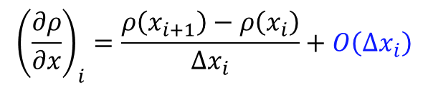
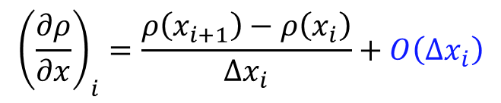
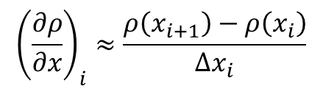
Taylor series and FDM
Taylor series:
Finite difference
First order derivative – forward difference method

Slide 7

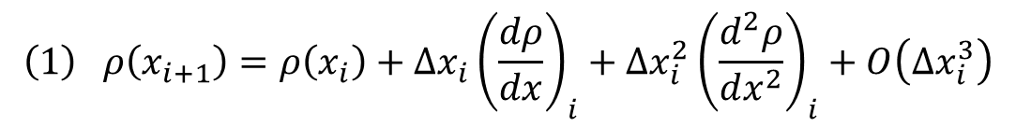



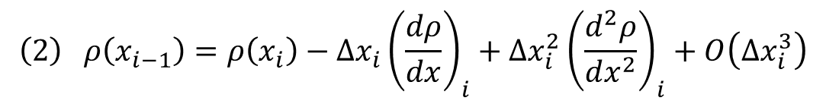
Taylor series: Central Difference Scheme (2nd order)
$$x_{i−1}$$
$$x_{i}$$
$$x_{i+1}$$
$$x_{i+2}$$
$$ρ\left(x_{i+1}\right)=ρ\left(x_{i}\right)+\left(x_{i+1}−x_{i}\right){\left(\frac{dρ}{dx}\right)}_{i}+{\left(x_{i+1}−x_{i}\right)}^{2}{\left(\frac{d^{2}ρ}{dx^{2}}\right)}_{i}+{\left(x_{i+1}−x_{i}\right)}^{3}{\left(\frac{d^{3}ρ}{dx^{3}}\right)}_{i}+…$$
$$\left(1\right) ρ\left(x_{i+1}\right)=ρ\left(x_{i}\right)+Δx_{i}{\left(\frac{dρ}{dx}\right)}_{i}+Δx_{i}^{2}{\left(\frac{d^{2}ρ}{dx^{2}}\right)}_{i}+O\left(Δx_{i}^{3}\right)$$
$$\left(2\right) ρ\left(x_{i−1}\right)=ρ\left(x_{i}\right)−Δx_{i}{\left(\frac{dρ}{dx}\right)}_{i}+Δx_{i}^{2}{\left(\frac{d^{2}ρ}{dx^{2}}\right)}_{i}+O\left(Δx_{i}^{3}\right)$$

Slide 8
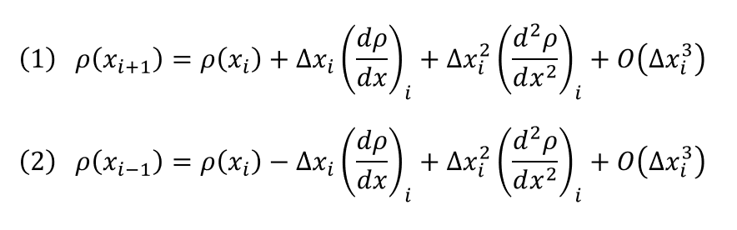
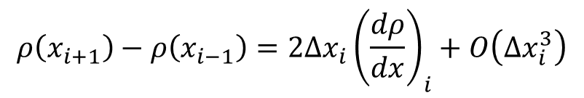
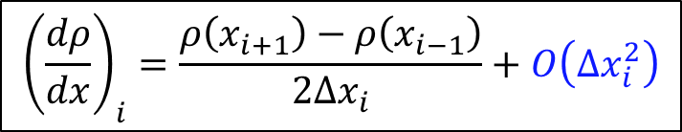
Taylor series: Central Difference Scheme (2nd order)
$$x_{i−1}$$
$$x_{i}$$
$$x_{i+1}$$
$$x_{i+2}$$
Subtract (2) from (1)
$$ρ\left(x_{i+1}\right)−ρ\left(x_{i−1}\right)=2Δx_{i}{\left(\frac{dρ}{dx}\right)}_{i}+O\left(Δx_{i}^{3}\right)$$
$${\left(\frac{dρ}{dx}\right)}_{i}=\frac{ρ\left(x_{i+1}\right)−ρ\left(x_{i−1}\right)}{2Δx_{i}}+O\left(Δx_{i}^{2}\right)$$
First order derivative –
Second order central difference scheme

Slide 9
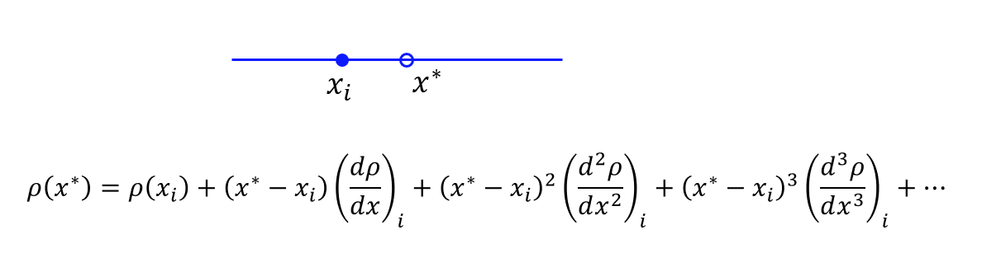
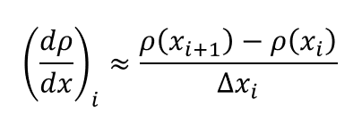
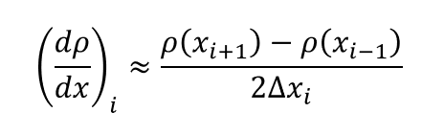




Taylor series: Summary (first order derivative)
$$x_{i−1}$$
$$x_{i}$$
$$x_{i+1}$$
$$x_{i+2}$$
First order forward difference
Second order central difference

Slide 11



Numerical discretization (Grid layout)
$$u$$
$$e_{y}$$
$$e_{x}$$

Slide 12






Numerical discretization (Grid layout)
$$u$$
$$e_{y}$$
$$\left(i,j+1\right)$$
$$e_{x}$$
$$\left(i−1,j\right)$$
$$\left(i,j\right)$$
$$\left(i+1,j\right)$$
$$\left(i,j−1\right)$$
Flow properties are assigned at each grid locations.

Slide 13
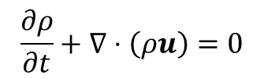
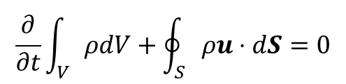










Finite Difference – Finite Volume
Differential form
Integral form
Notes:
This is where I want to introduce you to finite difference and finite volume approaches
Integral form: is in OpenFOAM
We will use differential form in Octave

Slide 14














Numerical discretization (Grid layout)
Cell centered representation
$$v$$
$$e_{y}$$
$$p$$
$$u, v, p$$
$$u$$
$$\left(i,j+1\right)$$
$$\left(i,j+1\right)$$
$$e_{x}$$
$$\left(i−1,j\right)$$
$$\left(i,j\right)$$
$$\left(i+1,j\right)$$
$$\left(i−1,j\right)$$
$$\left(i,j\right)$$
$$\left(i+1,j\right)$$
$$\left(i,j−1\right)$$
$$\left(i,j−1\right)$$
Staggered grid
Collocated grid

Slide 16
Eulerian frame
Conservation laws are applied around a fixed “control volume” in space
Flux of quantities through the boundary is used to estimate the flow variables
Useful to take observations at fixed locations
Notes:
'gca' sets the current axes for the current figure which is created before.
a = linspace(0,10,150);

Slide 17
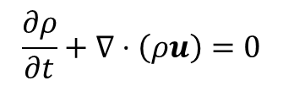
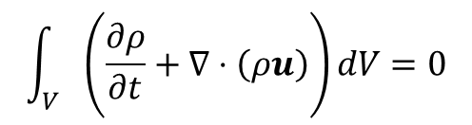
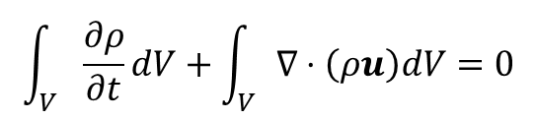
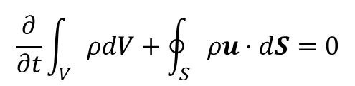
Integral Form – Differential Form
Conservation of mass
Integrate over a control volume
Gauss – divergence theorem

Slide 18





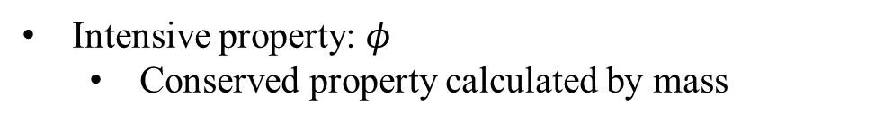

Gauss Divergence Theorem

Slide 19


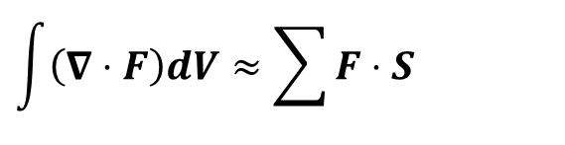

Gauss Divergence Theorem
Rate of change of a quantity over a control volume = Rate of flow through control surface.

Slide 20

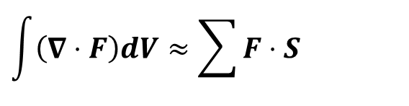


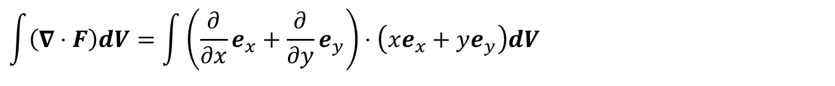
Gauss Divergence Theorem
e_{y}
e_{x}
e_{z}

Slide 22

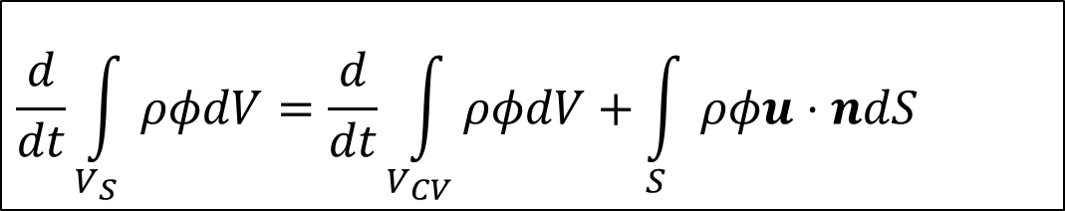

Reynolds Transport Theorem

Slide 23
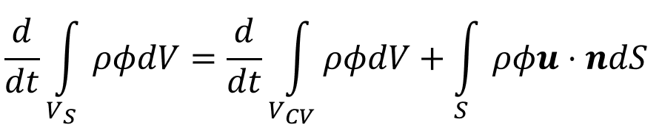








Reynolds Transport Theorem
Control volume
System

Slide 24

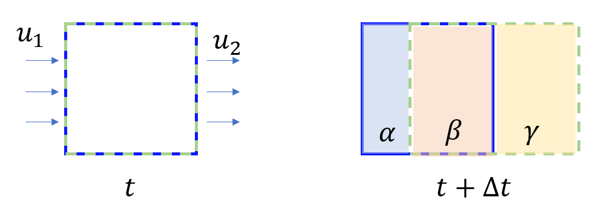
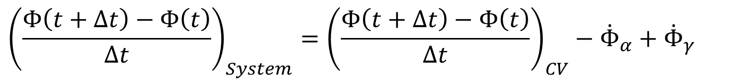
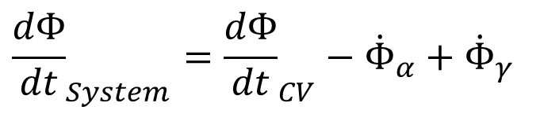
Reynolds Transport Theorem
Subtract (1) from (2)

Slide 25
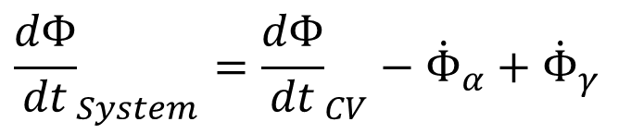

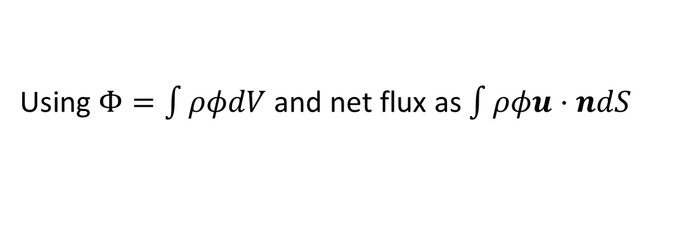
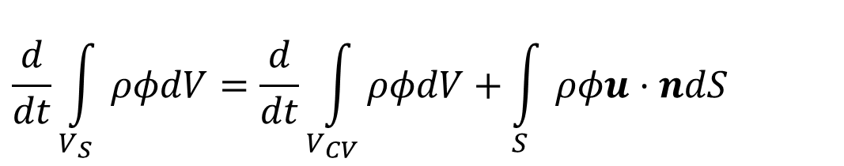
Reynolds Transport Theorem

Slide 26
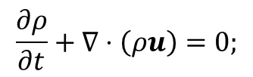
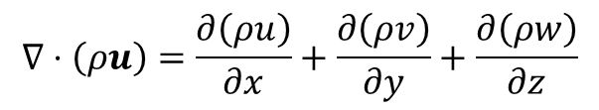
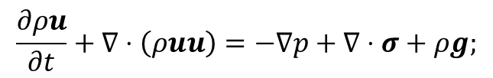
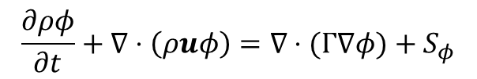
Conservation Laws
Conservation of mass
Conservation of momentum
Scalar conservation law

Slide 28
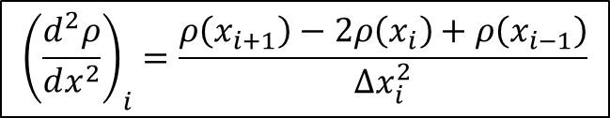
Taylor series
$$x_{i−1}$$
$$x_{i}$$
$$x_{i+1}$$
$$x_{i+2}$$
$${\left(\frac{d^{2}ρ}{dx^{2}}\right)}_{i}=\frac{ρ\left(x_{i+1}\right)−2ρ\left(x_{i}\right)+ρ\left(x_{i−1}\right)}{Δx_{i}^{2}}$$
First Order Derivative
forward difference
First Order Derivative
Second order central difference
Second Order Derivative
Second order central difference

Slide 29

Exercise – 3 ➔ Octave
Derive second order derivative for central difference scheme. (Use Pen and paper)
$$x_{i−1}$$
$$x_{i}$$
$$x_{i+1}$$
$$x_{i+2}$$
$$ρ\left(x_{i+1}\right)=ρ\left(x_{i}\right)+\left(x_{i+1}−x_{i}\right){\left(\frac{dρ}{dx}\right)}_{i}+\frac{{\left(x_{i+1}−x_{i}\right)}^{2}}{2}{\left(\frac{d^{2}ρ}{dx^{2}}\right)}_{i}+\frac{{\left(x_{i+1}−x_{i}\right)}^{3}}{6}{\left(\frac{d^{3}ρ}{dx^{3}}\right)}_{i}+\frac{{\left(x_{i+1}−x_{i}\right)}^{4}}{24}{\left(\frac{d^{4}ρ}{dx^{4}}\right)}_{i}+…$$
$$\left(1\right) ρ\left(x_{i+1}\right)=ρ\left(x_{i}\right)+Δx_{i}{\left(\frac{dρ}{dx}\right)}_{i}+\frac{Δx_{i}^{2}}{2}{\left(\frac{d^{2}ρ}{dx^{2}}\right)}_{i}+\frac{Δx_{i}^{3}}{6}{\left(\frac{d^{3}ρ}{dx^{3}}\right)}_{i}+\frac{Δx_{i}^{4}}{24}{\left(\frac{d^{4}ρ}{dx^{4}}\right)}_{i}+O\left(Δx_{i}^{5}\right)$$
$$\left(2\right) ρ\left(x_{i−1}\right)=ρ\left(x_{i}\right)−Δx_{i}{\left(\frac{dρ}{dx}\right)}_{i}+\frac{Δx_{i}^{2}}{2}{\left(\frac{d^{2}ρ}{dx^{2}}\right)}_{i}−\frac{Δx_{i}^{3}}{6}{\left(\frac{d^{3}ρ}{dx^{3}}\right)}_{i}+\frac{Δx_{i}^{4}}{24}{\left(\frac{d^{4}ρ}{dx^{4}}\right)}_{i}+O\left(Δx_{i}^{5}\right)$$
Add (1) and (2) and derive ${\left(\frac{d^{2}ρ}{dx^{2}}\right)}_{i}$

Slide 30
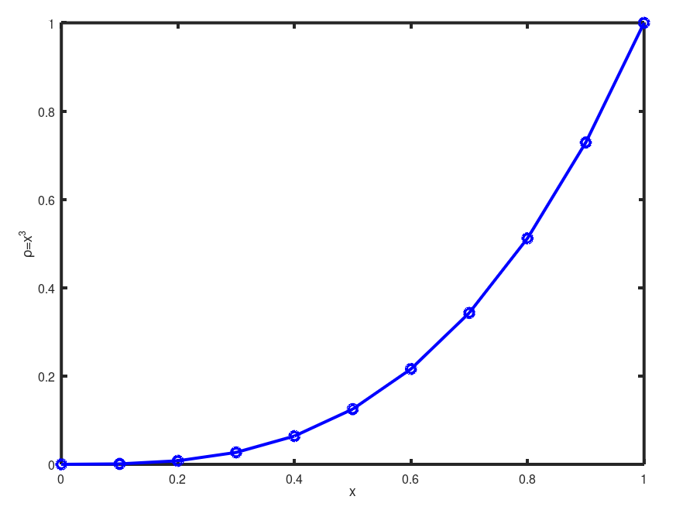
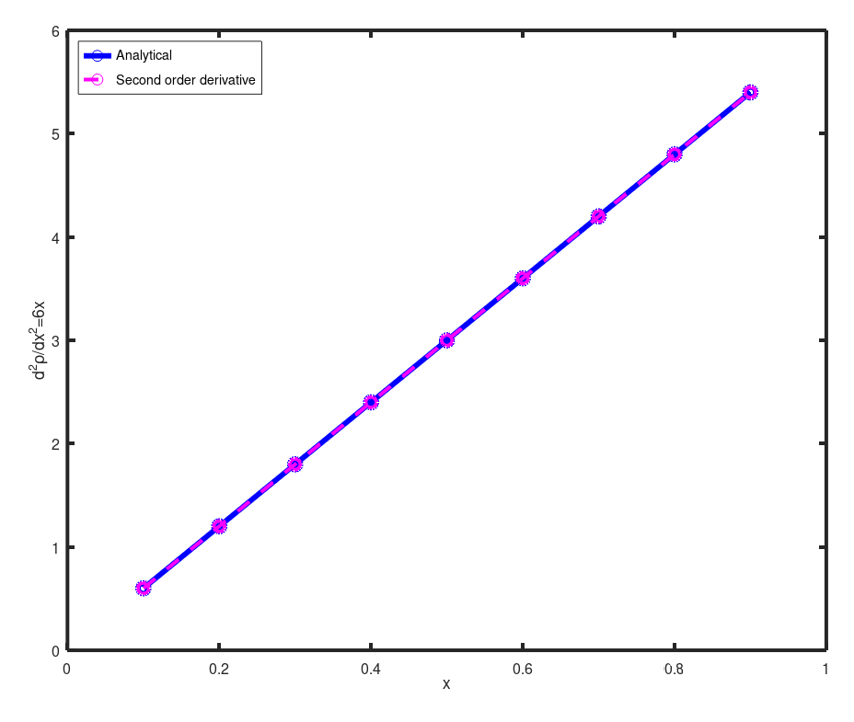
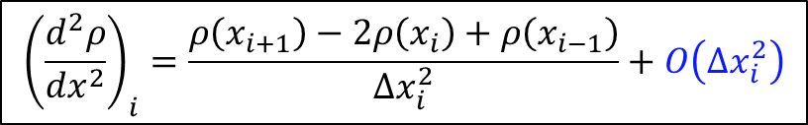
Approximating Second Order Derivative
$${\left(\frac{d^{2}ρ}{dx^{2}}\right)}_{i}=\frac{ρ\left(x_{i+1}\right)−2ρ\left(x_{i}\right)+ρ\left(x_{i−1}\right)}{Δx_{i}^{2}}+O\left(Δx_{i}^{2}\right)$$

Slide 31
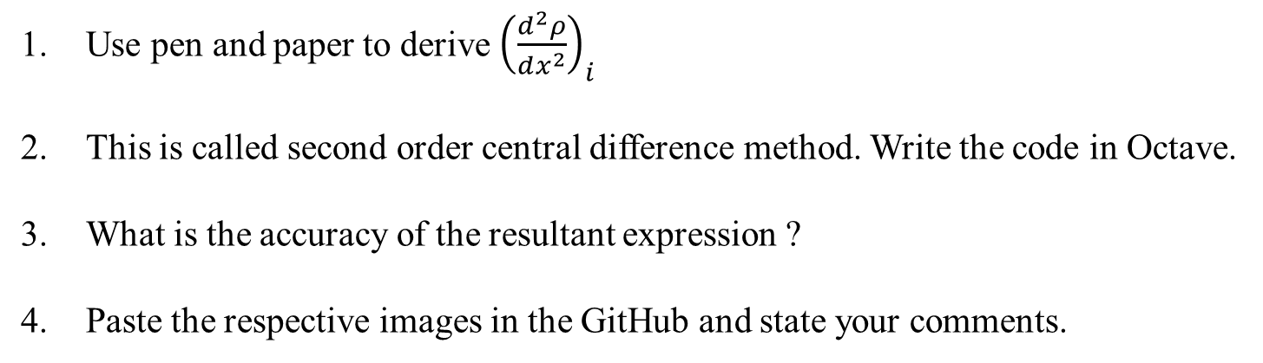
Exercise – 3
https://github.com/Kumaresh0402/ComputationalFluidDynamics/discussions/4
$$x_{i−1}$$
$$x_{i}$$
$$x_{i+1}$$
$$x_{i+2}$$
Use pen and paper to derive ${\left(\frac{d^{2}ρ}{dx^{2}}\right)}_{i}$
This is called second order central difference method. Write the code in Octave.
What is the accuracy of the resultant expression ?
Paste the respective images in the GitHub and state your comments.

