Slide 1

WEATHER PREDICTION

Slide 2
Weather Prediction
Team MEMBERS :
KARTHIKEYAN K
KUMARESH V
MANIKANDAN S
PONVIGNESH C

Slide 3
CONTEXT
Basically what we are going to do is predict the temperature based on the following factors:
HUMIDITY
WIND SPEED
VISBILITY
PRESSURE

Slide 4
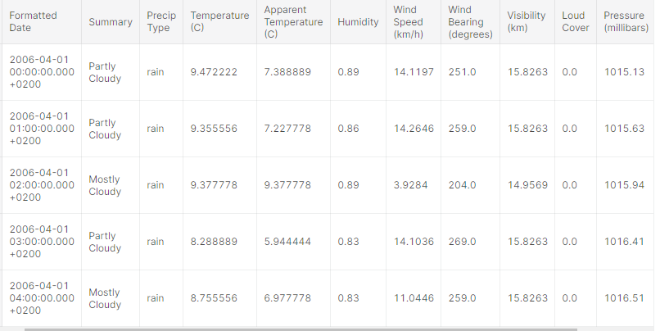
DATASET

Slide 5
METHODOLOGIES USED:
We are going to try these different methodologies and analyse which performs the best.
RandomForest Regresssion
Support Vector Regression
Decision Tree Regression
Kneighbor Regression
Gradient Boosting Regression

Slide 6
RANDOM FOREST REGRESSION
Random Forest Regression is a supervised learning algorithm that uses ensemble learning method for regression. Ensemble learning method is a technique that combines predictions from multiple machine learning algorithms to make a more accurate prediction than a single model.

Slide 7
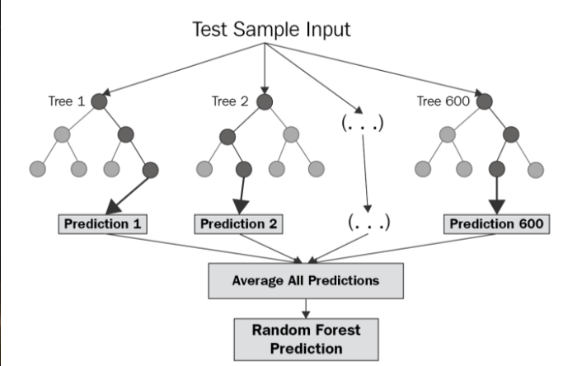

Slide 8
Decision tree regression:
It is a tree-structured classifier with three types of nodes. The Root Node is the initial node which represents the entire sample and may get split further into further nodes. The Interior Nodes represent the features of a data set and the branches represent the decision rules. Finally, the Leaf Nodes represent the outcome. This algorithm is very useful for solving decision-related problems.

Slide 9
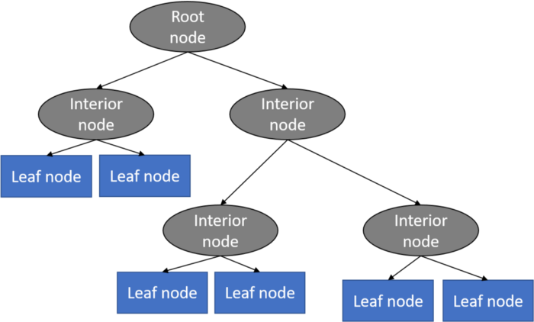

Slide 10
KNN algorithm:
The KNN algorithm assumes that similar things exist in close proximity. In other words, similar things are near to each other

Slide 11
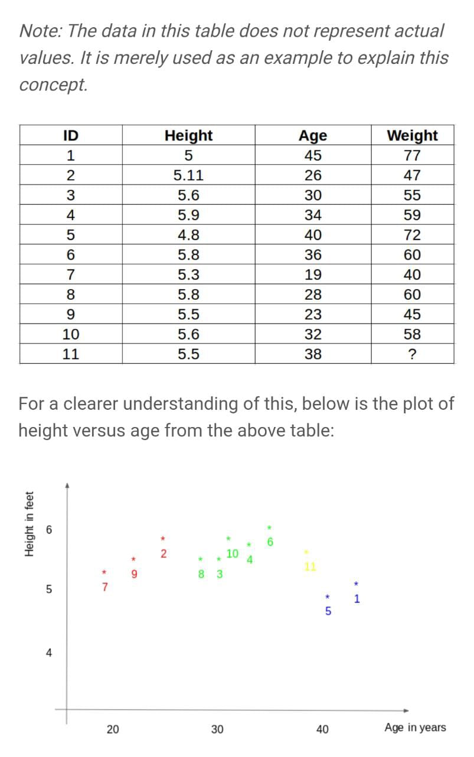
KNN

Slide 12
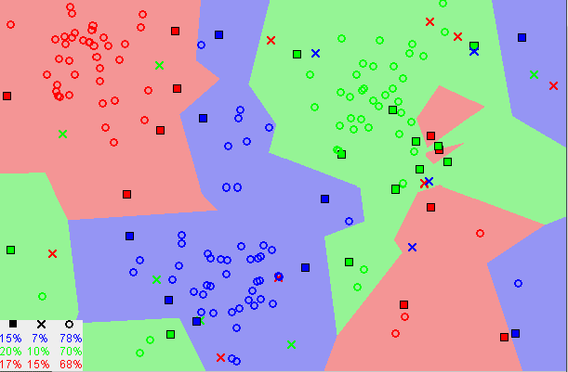

Slide 13
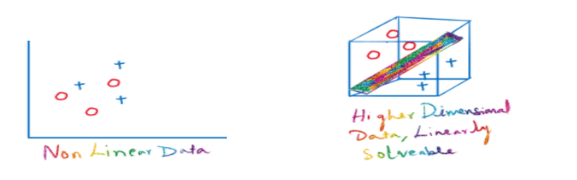
Support vector regression:
The Support Vector Regression (SVR) uses the same principles as the SVM for classification, with only a few minor differences.
SVMs can handle highly non-linear data using an amazing technique called kernel trick. It implicitly maps the input vectors to higher dimensional (adds more dimensions) feature spaces by the transformation which rearranges the dataset in such a way that it is linearly solvable.

Slide 14
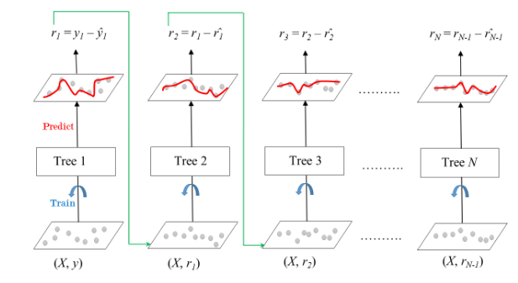
Gradient Boosting algorithm:
Gradient Boosting is a popular boosting algorithm. In gradient boosting, each predictor corrects its predecessor’s error.Each predictor is trained using the residual errors of predecessor as labels.There is a technique called the Gradient Boosted Trees.

Slide 15
RMSE
Root Mean Square Error (RMSE) is the standard deviation of the residuals (prediction errors). Residuals are a measure of how far from the regression line data points are; RMSE is a measure of how spread out these residuals are. In other words, it tells you how concentrated the data is around the line of best fit.

Slide 16

THE END

