Slide 2
Preparing the environment
Hands-on Lab using Pivotal Big Data Suite

Slide 3



Labs we’re going to do
GEMFIRE
PIVOTAL HD + HAWQ
SPRING XD
Access data in-memory
Scale-out
Query data
High Availability
Monitoring
Accessing HDFS
Creating Tables
Massive parallel load of data
Leveraging SQL on HDFS
Create data streams easily – no coding
Easily connect to external tools
Built-in transformation and processors

Slide 4


What you’re going to build
Groovy
JSON
CSV
Ingestion
Data Lake
Ingest
Split
Filter
Transform
Sink
HDFS
JSON / HTTP
SpringXD
Tap
Advanced Analytics
Fast
Extensible
Open-Source
Fault-Tolerant
Horizontally Scalable
GemFire
HAWQ
JSON / Rest
SQL
Transactional App
Analytics App

Slide 5



Roadshow Labs environment choices
8Gb memory local VM
VmWare Player / Fusion
VM running on Cloud
Remote Desktop Client

Slide 6
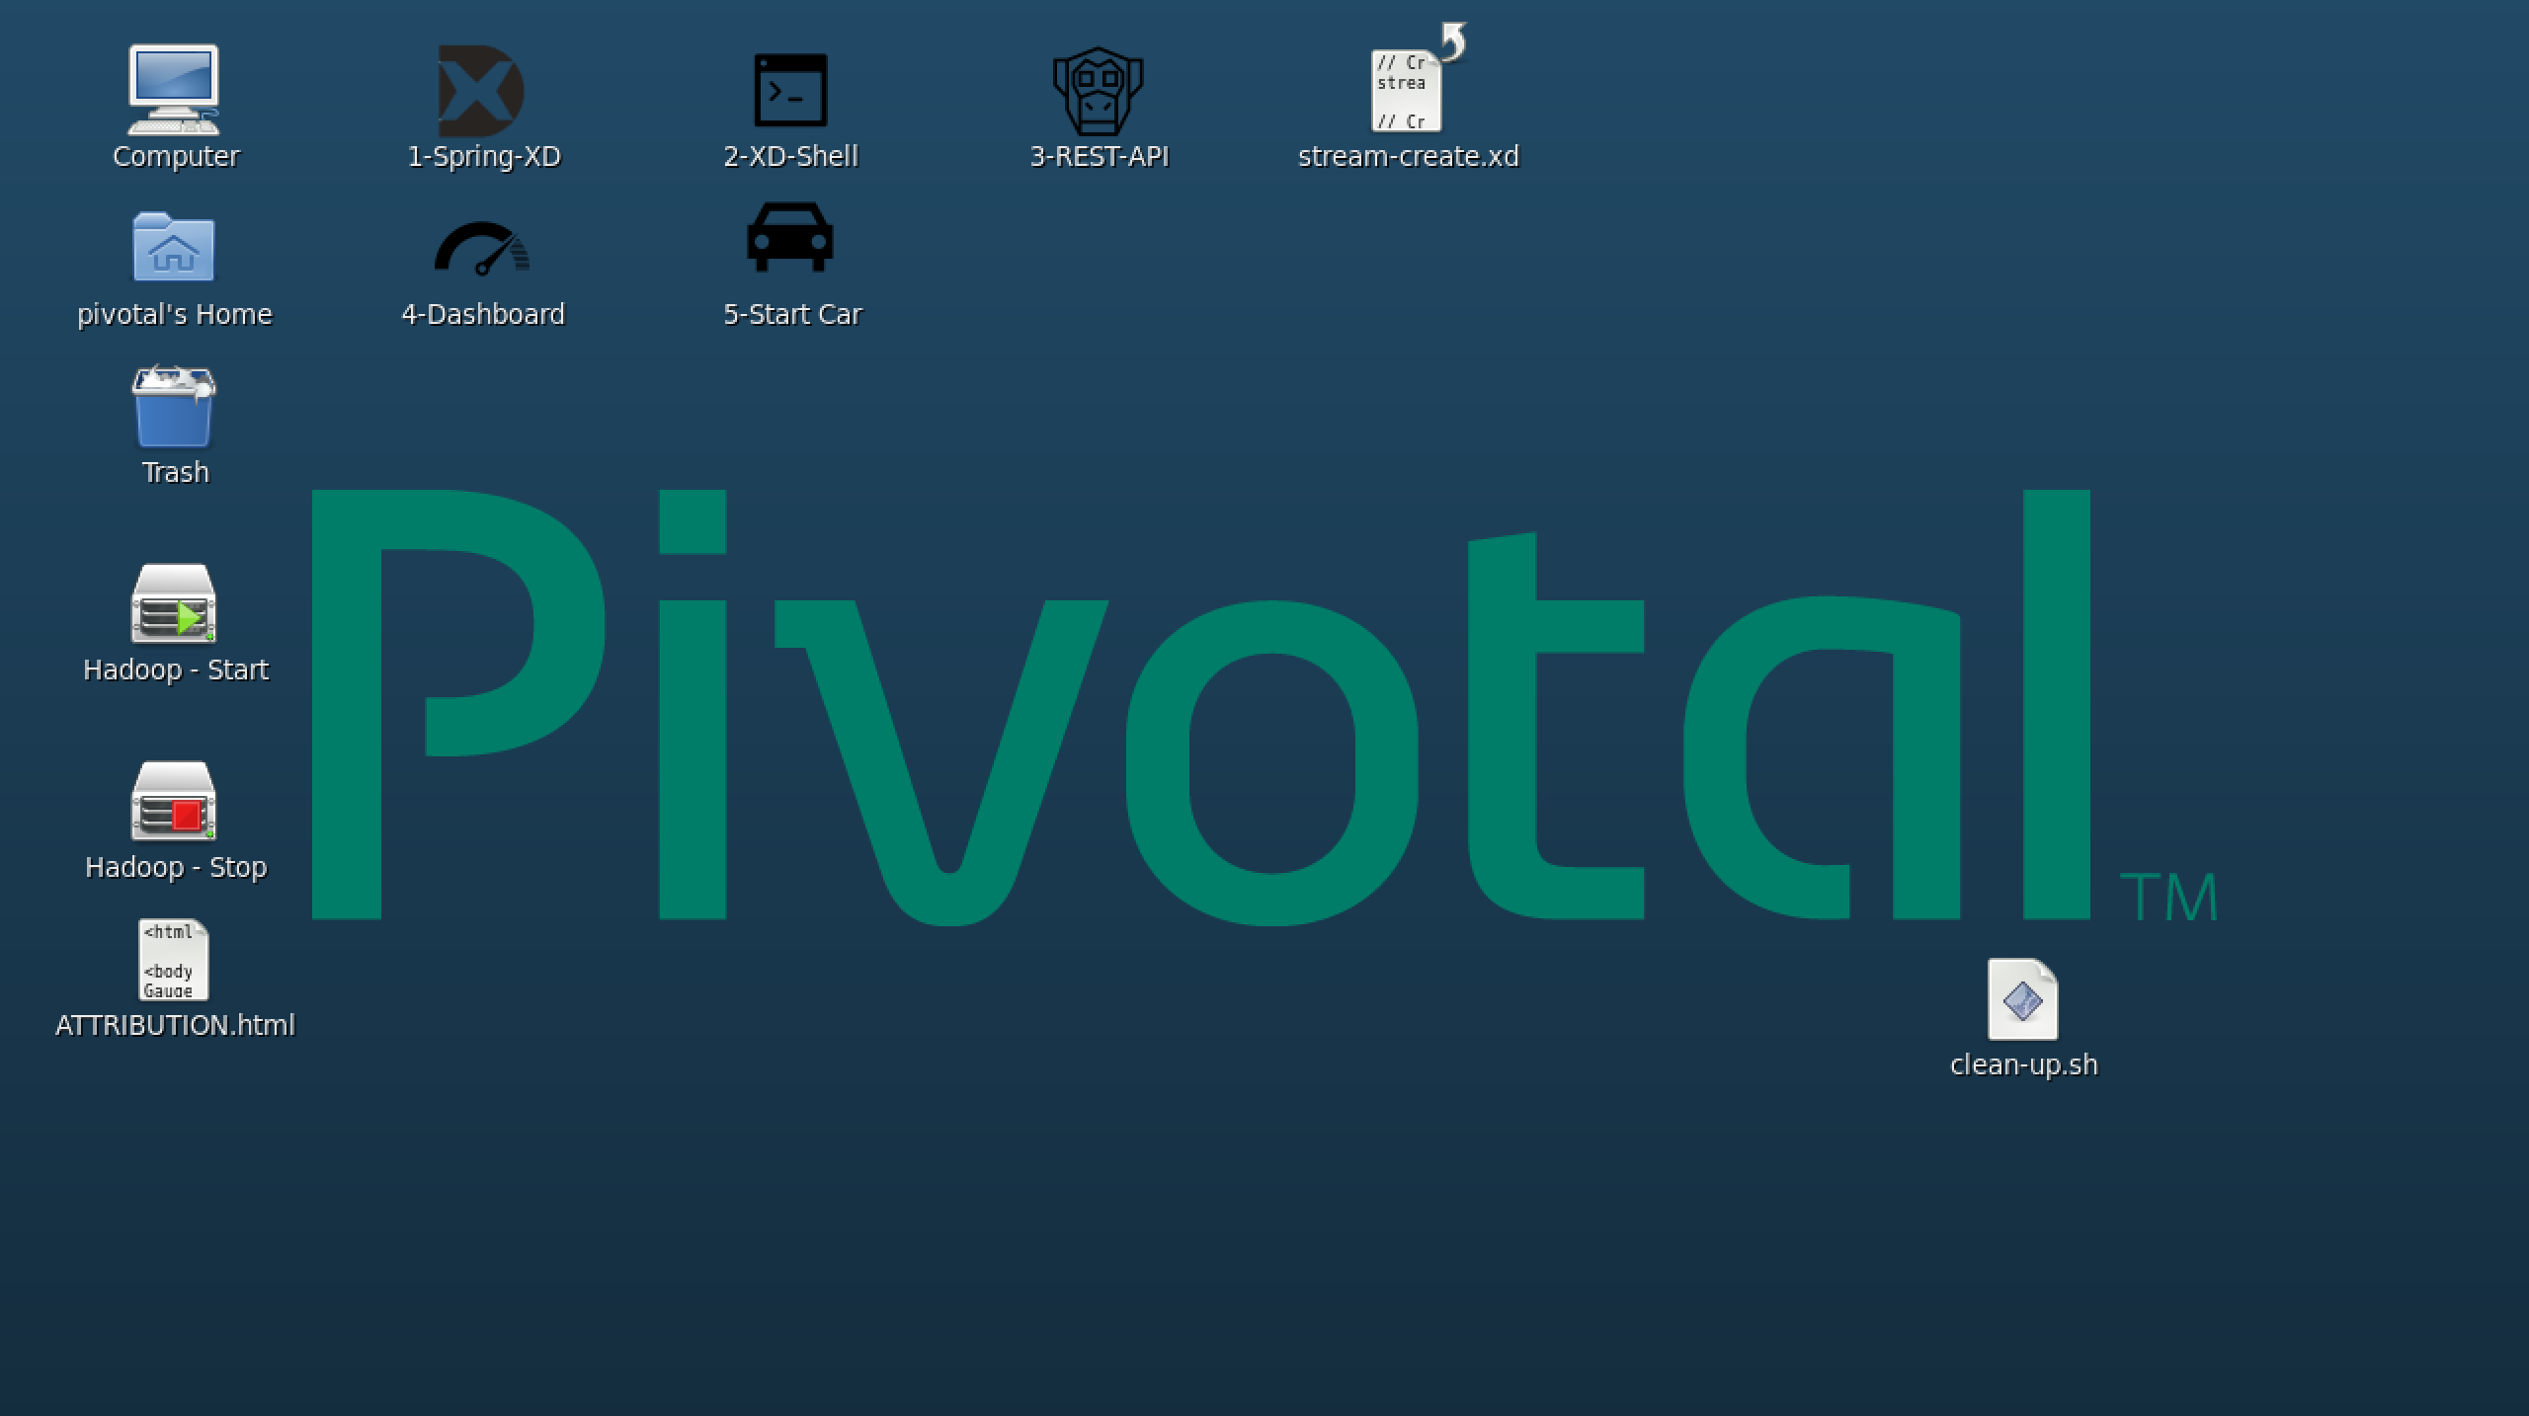

Roadshow Labs environment credentials
Username: gpadmin
Password: bebold

Slide 7
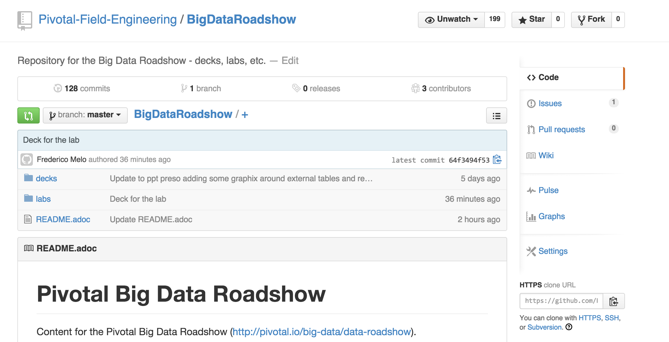
Once you have access to an environment….
Access: http://tinyurl.com/pivotal-big-data-roadshow

Slide 8
Coming Up
Break (60’) – Lunch!!
GemFire Lab (40')
First steps with Pivotal GemFire
Data load, query, scale-out, HA, monitoring
Pivotal HD + Hawq Lab (40')
First steps with Pivotal HD and Hawq
Accessing HDFS, loading data, performing SQL queries
Data Streaming with Spring XD Lab (+ GemFire and Pivotal HD / Hawq) – 40'
First steps with Spring XD
Building a Data Stream Pipeline. Using transformations, sinking to HDFS and GemFire.

