Slide 1
Pivotal Gemfire
Pivotal Big Data Road Show 2015

Slide 2
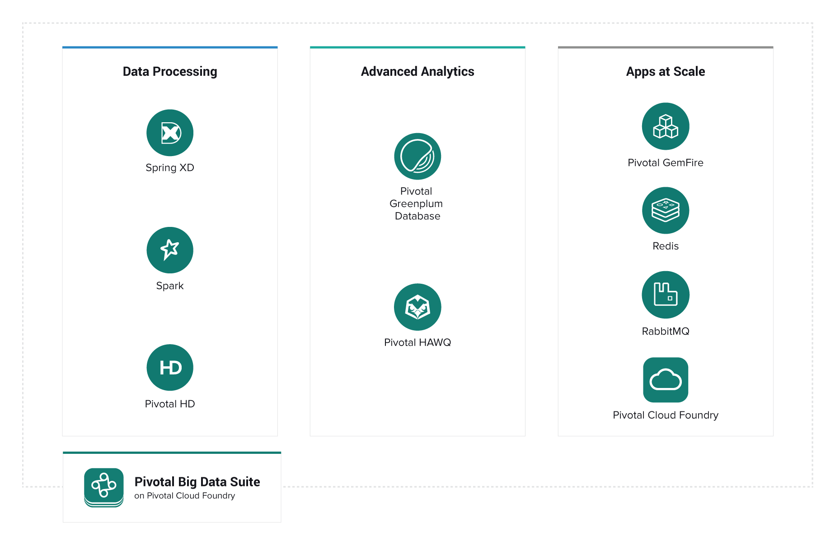
Notes:
With the Pivotal Big Data Suite we are enabling you to build your “Business Data Lake” with ease along side current existing investments to support the different use cases of data during it’s lifecycle – whether it be real-time with GemFire or GemFire XD, near-time with Greenplum and HAWQ or batch with Pivotal HD.
GemFire and GemFire XD are the transactional data store of the Big Data Suite, serving to “operationalize big data” so that it can be leveraged by applications, scale up and down to meet application demand, and protect tenured back end systems from peaky demand.

Slide 3
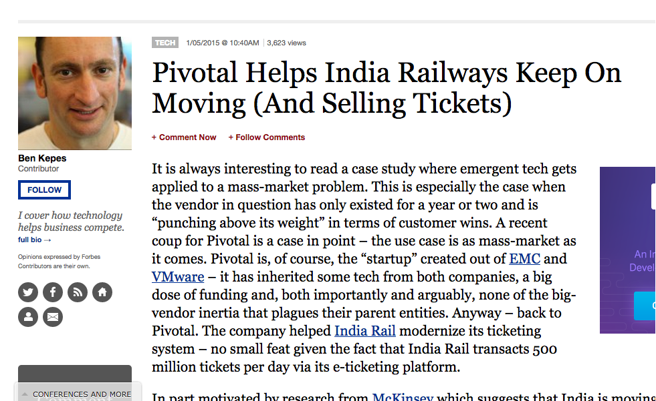

Who Is Using Gemfire?
“This isn’t the online mass-scale case study that Pivotal has for GemFire – GE Research is using GemFire to handle 17 billion individual records in-memory. Another railway organization, China Railways, has 3TB of operational data in-memory and a further 400 TB archived. China Rail’s size challenges even India Rail’s – they process 4.6 million transactions per day and up to 40,000 per second. Finally GIRE, a payment processing organization is running 19 million payment transactions a month with over 4000 concurrent clients connecting via intermittent internet connections.”
http://www.forbes.com/sites/benkepes/2015/01/05/pivotal-helps-india-railways-keep-on-moving-and-selling-tickets/

Slide 4
Big Data Apps at Scale Have Unique Needs
Pivotal GemFire is the distributed, in-memory NoSQL database for big data apps for that need:
Scale-out performance
Consistent database operations across globally distributed nodes
High availability, resilience, and global scale
Powerful & Standards-based developer features
Easy administration of distributed nodes
Notes:
For an enterprise perspective on real time data: https://www.gesoftware.com/blog/can-memory-storage-solve-one-datas-greatest-challenges
First, let’s talk about consumer driven applications. Applications today are really about serving this market. Historically, enterprise applications were truly the focus, where the interactions were expected to be that… interactive. With consumer driven applications, you are really pushing the limits of instantaneous information to users, even going so far as to be predictive with what may be useful or appealing to them, to provide “value” to that consumer. What makes you different than your competitors in driving consumers to you is more about what extras you provide than the base service.
Consumer driven applications until recently were not so data driven. Data flowed through them, but they didn’t provide information back, except in a pull fashion.
GemFire is the distributed NoSQL, in memory database for big data apps that need:
Scale out performance – as demand goes up and down, due to seasonal demand, flash types of events, or increasing data pipes, GemFire can scale up and down with commodity hardware, providing predictable, linear scalability, without downtime.
Consistent database operations across globally distributed nodes: GemFire focuses on data being consistent. This has been our bent from the beginning. The only thing we will sacrifice performance for is consistency. This is key to our customers that sell things like train tickets and stocks.
High availability, resilience, and global scale – GemFire is intended for mission critical data and applications. Through a series of innovations, GemFire can provide continuous availability of data at a global scale, through code changes, model changes, hardware changes, major version upgrades and smoking hole disasters
Powerful developer features – Developers here are concerned about one of two things – first they want powerful capabilities for quickly adding innovative features in their applications. In the case of structured data, they are often concerned about standards support so they can take advantage of the mature ecosystem of SQL-compliant tools for developing, reporting, as well as often support other legacy applications. Even though GemFire is pure Java, it is accessible through many APIs. It also provides a rich event framework, allowing applications to subscribe to individual data events in GemFire. GemFire XD through its JDBC and ODBC support allows SQL app developers to leverage many tools, support queries from other applications, and work with reporting and visualization such as Tableau.
Easy administration of distributed nodes: Easy administration of distributed nodes: GemFire relies on you to say how to evenly distribute your data from a statistical perspective and takes care of the runtime implementation. GemFire manages partitions of data between nodes in a dynamic fashion, removing the chore of mapping partitions to specific nodes, slaves, and masters in a cluster. GemFire manages that for you, along with recovery of nodes. Additionally, GemFire provides tools to help you manage and understand the behavior of the system.

Slide 5


1. Scale-Out Performance
In-Memory Storage
China Railway Corporation
“The system is operating with solid performance and uptime. Now, we have a reliable, economically sound production system that supports record volumes and has room to grow”
Dr. Jiansheng Zhu, Vice Director of China Academy of Railway Sciences
4.5 million ticket purchases & 20 million users per day.
Spikes of 15,000 tickets sold per minute, 40,000 visits per second.
Elastic, linear scalability
Ops / Sec
Nodes
Optimized data
distribution
Notes:
Please see the case study here. Talk about what they did first. Then go over the key points in this slide. Note that this is a GemFire customer story.
http://blog.pivotal.io/pivotal/case-studies-2/china-railway-corp-for-chinese-new-year-chunyun
Key stats:
Query time reduced from 15 seconds to .2 sec – a 75x improvement (other customers have seen up to 100x)
Queries went from 3500 per second to 10s of 1000s per second
Train tickets to major cities sold out in 20 seconds
Growth is about 20% per year
Emphasize “room to grow” in this quote.
Why was this so successful? A few things:
CRC used a partitioned data set in memory. What this gave them was:
In memory performance. Data is “persisted” to at least 2 nodes in memory, rather than to disk, saving IO cost
Ability to scale up and down as needed, maximizing infrastructure usage. They don’t have to keep expensive dedicated hardware in place to accommodate peak usage
Optimized data distribution – CRC defines how the data should be partitioned. GemFire takes care of the physical implementation of this actively, optimizing the distribution of data as machines are added and removed.
GemFire and GemFire XD have a shared nothing, in memory architecture. Data can be persisted to disk or another system, but it is out of band with the transaction, using the network to “persist” the data. This allows them to perform at maximum speeds with consistency. As more nodes are added, Gem and Gem XD can be notified to take advantage of these new nodes based on current resource usage. This gives us predictable linear performance as we scale up and down to meet peaky demands, while keeping data absolutely consistent – we can’t sell the same train ticket twice!
Colocation of related data sets allows us to scale transactions to hundreds of thousands of concurrent transactions running in a single cluster
As we distribute this data, our ability to operate on it is also scaled out. Queries, events, and functions that the grid operates on are all done in a distributed, parallel fashion.

Slide 6

2. Consistent Database Operations Across Distributed Nodes
Performance-optimized
persistence
Configurable
consistency
“Our global deployment of Pivotal GemFire’s distributed cache gives me a single version of the trade – resolving hard-to-test-for synchronization issues that exist within any globally distributed business application architecture”
Michael Benillouche, Global Head of Data Management
Partitioned
Replicated
Disabled
Distributed queries
& function execution
Indexing, triggers, event notification
Notes:
Read case study here (note: this is a GemFire customer story):
http://www.pivotal.io/sites/default/files/Pivotal_vFabric_CS_Newedge_061213__0.pdf
Quote:
Group CIO, Alain Courbebaisse, says, “We have successfully implemented the most advanced post-trading platform of the clearing industry.”
As well as the strategic alignment, the NVision program resulted in a number of further, more tangible objectives being met:
Support for higher clearing volumes and create a platform that is horizontally scalable as more markets are connected to it
Reduced time to market for new market adapters
Global cache provides single version of the truth and removes synchronization issues created by latency sensitive global flows
Creation of a globally consistent trade flow across regions and exchanges, serving the derivative and equity business seamlessly
SIGNIFICANT IMPROVEMENT IN CLIENT ON-BOARDING TIME AND CLIENT SERVICE
Faster resolution window (investigate, resolve and re-submit)
Able to resolve reference data issues once and propagate out
Replay capability removes manual re-keying
Thikn about this – a trading platform. Operating in markets all over the world. A few things:
These have to be FAST to minimize risk – trades need to be executed as much as they can be in real time in order to make sure that the actual price was as close to the agreed to price as possible. The longer the delay, the more the possibility of drift between these prices, and the more risk is introduced.
The data must be consistent.
GemFire and GemFire XD provides
Performance optimized persistence – “first line persistence” can be to other nodes in memory, making the speed of persistence as fast as the network will allow it to be. Disk can still be used for long term storage, but your transaction in GemFire is ACID compliant in memory. This takes disk i/o out of the critical path of the transaction, but still allows it to take place.
Consistency can be configured to meet your performance and data requirements. If you care less about accuracy and more about response time, you can configure data sets to those characteristics.
Distributed queries and regional functions – as queries and function calls are sent to the grid, their path is optimized as much as possible. What this means is that when queries or functions are sent to the grid, they are sent in parallel, and they are optimized to route directly to nodes that hold the data. When you query the grid or execute functions on it, you can be assured that your client will get a consistent overall view of the data. Queries and logic are distributed for optimal performance, but always lean towards consistency.
Indexing, triggers and event notifications are provided to react in real time to data as it is coming into the system
Data can also be configured to propagate to other geographically dispersed clusters, to allow you to operate on the data as close to the “action as possible” – minimize the distance data has to travel.
---------
We support persistence and make sure updates are consistent. We use replication for higher performance GemFire uses the concept of having redundant copies in memory to make the data more available. What this means, is that instead of writing the data to disk to persist it, I will write it to one or more other nodes. If I am doing this on a reasonably fast network, I can “persist” the data in less than 1 ms. Data can be configured to write to local attached disk (shared nothing) or some other data source at the appropriate time via a rich event framework
Data can also be configured to propagate to other geographically dispersed clusters, to allow you to operate on the data as close to the “action as possible” – minimize the distance data has to travel.

Slide 7

3. High Availability, Resilience, and Global Scale
Cluster resilience
& failover
“We can track and collect money at our 4,000+ kiosks and branches – even without a reliable Internet connection. GemFire provides the core data grid and a significant amount of related functionality to help us handle this unreliable network problem”
Gustavo Valdez, Chief of Architecture and Development
19 million payment transactions per month
4000+ points of sale with intermittent Internet connectivity
Cluster to cluster
WAN connectivity
WAN
Notes:
Read case study here (Note this is a GemFire customer story):
http://blog.pivotal.io/pivotal/case-studies-2/how-argentina-pays-its-bills-19-million-cash-transactions-a-month-on-unreliable-networks-with-pivotal-gemfire-and-spring
(Rapipago is their most well known brand)
With over 2,600 branches, 4,000 kiosk-based points of sale, and a huge call center, Rapipago is part of GIRE’s business of providing billing, collection, payment, and transaction processing services.
To put it simply, consumers visit our locations to pay their bills. Rapipago supports payments between 1200+ companies and their consumers—around 19 million transactions per month. Rapipago’s card, check, and cash-based transactions ultimately collect money on behalf of cell phone companies, automotive, banking, energy, gas, water, insurance, cable, credit cards, schools, municipalities, tourism operators, and more.
The biggest problem GemFire has helped us solve has to do with unreliable network connectivity. This limited our ability to report on the business operations and take certain actions. In our network, we collect money from 6 AM until 9 PM, depending on the region. Before GemFire, we had to wait until the next day to have visibility into how our network is collecting money. The previous system would process batch files each night. Our management team could only see transactions after a day’s time passed. In addition, many locations have unreliable network connections that make it harder to get a current view of the information.
With GemFire, we can see the information in real-time, even if there is an unreliable network. The data is synced 24 x 7 as the network allows. Now, we have a much more accurate view of the cash at each location. From an operations perspective, having a better picture of each payment point throughout the day means we can now decide to do things like send an armed vehicle to take cash off the street when large sums of money start to accumulate.
In each Kiosk, transactions are captured in a local GemFire instance. GemFire also places the transactions in a shared branch region. This way, we can share information between kiosks within a branch.
In each branch, we have a GemFire peer-to-peer topology set up—a branch’s kiosks are part of a distributed system. Before GemFire, business rules were on the server side, and the system had to be online for the rules to run. With GemFire’s P2P topology, we have those rules running in each kiosk, and they can be executed when the server is offline.
The kiosks also place information on the GemFire WAN gateway to synchronize information to the central data center. With the WAN gateway, a returning network connection allows us to synchronize with the data center’s master database. When we don’t have internet connection to our central datacenter, we store all the transactions in the gateway’s queue. This is how we get a near real-time view of the entire network in a central place.
Can you explain more about how GemFire handles the WAN synchronization?
Yes. This is the key function that allows us to have up to date information and deal with lost network connections. We use the WAN gateway to synchronize transactions between kiosks and our data center. GemFire’s WAN gateway allows us to loosely couple multiple, independent GemFire systems. So, each of our kiosks has it’s own GemFire instance and region data is shared with the central GemFire instance via the WAN gateway. If communications between sites fail or become slow, the systems still run independently, and persistent queues operate for messaging between sites.
Within a cluster, data can be made resilient to failures. This means that nodes can come and go without data loss. Additionally, data can be persisted to local disk as an added measure. If servers fail within a cluster, it is transparent to the client. Data is kept consistent, and the connection is automatically routed to an available node.
Cluster to cluster connectivity gives the data a way to survive smoking hole failures as well. The data is queued up to write asynchronously to other clusters. These queues can also be written to local disk to avoid data loss of queues in memory, in case a data center loses connectivity. The data is saved in the local cluster safely until network connectivity is restored. Gire specifically uses this to handle their unreliable network issues.

Slide 8

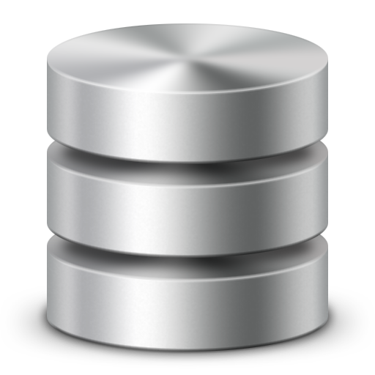



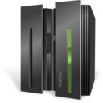
Client and Server Architecture
Cluster
Optional
Back End
Clients
Cache
Cache
TCP/IP
Cache
Clients connect directly to data servers
Locators
Read Through, Write Through, Persistence
Apps contains GF Caches and Regions
Servers
Notes:
Describe how a client server architecture usually looks. The next slide goes into detail on that.

Slide 9

Topologies – Client-Server
Application
Application
Application
Region
Region
Region
Region
Region
Region
Region
Region
Region
Cache
Cache
Cache
Notes:
Introducing concept of Cache, Regions and Clients and putting them together.

Slide 10





Locators and Group Membership
gemfire.properties
mcast-port= 0
locators=ServerA[40404],ServerB[40404]
40404
40404
ServerA
ServerB
Membership
UDP Unicast
UDP Unicast
UDP Unicast
UDP Unicast
Coordinator
Ack
Ack
Ack
Ack
Nack
Nack
Nack
TCP/IP
TCP/IP
Server
Server
Server
TCP/IP
Notes:
This explains how a cluster membership and introduces the locator

Slide 11
Connecting a Client to the Cluster
Application
clientCache.xml
<client-cache>
<pool name=“client” min-connections=“2” max-connections=“3”>
<locator host=“ServerA” port=“40404” />
<locator host=“ServerB” port=“40404” />
</pool>
</client-cache>
Pool
40404
40404
ServerA
ServerB
Server
Server
Server
Notes:
This shows how a client connects

Slide 12
Replicated Regions Overview
Products
Products
Products
Notes:
Replicated Region Overview

Slide 13
Partitioned Regions Overview
Customers
Customers
Customers
Customers
Products
Products
Products
Notes:
Partitioned Regions

Slide 14
Continuous Queries Overview
Application
onEvent(CqEvent event)
String query = “SELECT * FROM /Customers WHERE balance < 0”;
Region
Pool
Cache Server
Update
Region
cOQL
Server
Notes:
Continous Query

Slide 15
CQ Driven Dashboard Demo

Slide 16
Lab

Slide 17
QUESTIONS

