Slide 2
Data Streaming
Hands-on Lab using Pivotal Big Data Suite

Slide 3


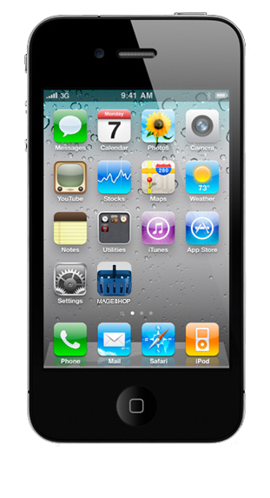






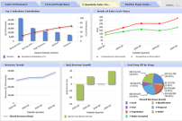









Data Streaming Reference Architecture
Data Feeds
Transactional Apps
Analytic Apps
Data Stream Pipeline
Distributed Computing
Real-Time Data
Expert Systems & Machine Learning
Advanced Analytics
Data Lake
HDFS

Slide 4








Data Streaming Reference Architecture
Data Feeds
Transactional Apps
Analytic Apps
Ingest
Filter
Enrich
Sink
SpringXD
GemFire
HAWQ
GPDB
Data Lake
HDFS

Slide 5


Spring XD Scale-Out and HA Architecture
XD admin
Ingest
Split
Filter
Transform
Sink
SpringXD
Stream Deployment
XD Containers
XD Containers
XD Containers
XD Containers
XD Containers
Ingest
Split
Filter
Transform
Sink
RabbitMQ

Slide 6
What you’ll build with no source code required
Groovy
JSON
CSV
Ingestion
Data Lake
Ingest
Split
Filter
Transform
Sink
HDFS
JSON / HTTP
SpringXD
Tap
Advanced Analytics
Fast
Extensible
Open-Source
Fault-Tolerant
Horizontally Scalable
GemFire
HAWQ
JSON / Rest
SQL
Transactional App
Analytics App

