Slide 2



Slide 3






















What is Hadoop?

Slide 4
What is Hadoop
Hadoop – “The Apache Hadoop software library is a framework that allows for the distributed processing of large data sets across clusters of computers using simple programming models”
Core Hadoop components: HDFS, Map Reduce (M/R) and YARN.
HDFS is a read-only file system that is massively scalable and reliable. HDFS can store various file types regardless if they are structured or unstructured – SCHEMA ON READ
M/R is a distributed processing framework built for very large batch processing.
YARN is a distributed application framework with job scheduling and resource management components.
*initial ODP charter to standardize these among participants

Slide 5
What is the Hadoop Ecosystem
Hadoop Ecosystem – Components in and out of the Apache software foundation that either run on top of or have the ability to interact with Hadoop
Examples
HBase - A scalable, distributed database that supports structured data storage for large tables
Pig - A high-level data-flow language and execution framework for parallel computation.
Spark - A fast and general compute engine for Hadoop data. Spark supports a wide range of applications, including ETL, machine learning, stream processing, and graph computation
Zookeeper - A high-performance coordination service for distributed applications

Slide 6


Slide 7
HDFS Basic Architecture
Client
Standby
NameNode
Ingest Files
NameNode
Egress Files
Metadata
Ethernet
DataNode
DataNode
DataNode
Local Data Stores
Local Data Stores
Local Data Stores
HDFS
3 x Replication (default)

Slide 8
How do I access Hadoop (HDFS)?
Open a terminal
Execute the following:
hdfs dfs –ls / (List what directories are on HDFS)
hdfs dfs –mkdir /user/sample (Create a directory for our demo)
hdfs dfs –ls /user/ (Verify the directory was successfully created)
Now let’s load some data!
cd /home/gpadmin/Labs/PHDHAWQ/ (You should see a .csv)
hdfs dfs –put sample.csv /user/sample/
Let’s check to see what was loaded
hdfs dfs –ls /user/sample
hdfs dfs –tail /user/sample/sample.csv

Slide 9
What are the key things I need to know about Hadoop (HDFS)?
HDFS stores files as blocks and each block is replicated 3 times (1 GB file = 3 GB file on Hadoop)
The base architecture of Hadoop revolves around the namenode (brain) and the datanodes (workers)
HDFS is best at handling very big files (1 TB file vs 1000 1 GB files)
Horizontally scalable…just add datanodes
Hadoop was originally designed for large batch processing. Without massive scale, quick results are not always attainable.

Slide 11
What is HAWQ?
HAWQ is a Massively Parallel Processing RDBMS that sits on top of HADOOP
SQL on Hadoop or more importantly ANSI SQL on Hadoop
What about Hive?
HAWQ stores all data directly on HDFS
Open Terminal
Execute the following
hdfs dfs -ls –R /hawq_data
Notes:
Keeping it simple – HAWQ is the answer to SQL on HADOOP
Hive is great except for 2 things, SQL compliance and speed (uses M/R)
HAWQ is not only ANSI compliant but an MPP for performance
Show them that data is physically stored on HDFS

Slide 12
Basic HAWQ Architecture
HAWQ Master
Parser
Query Optimizer
HAWQ Standby Master
NameNode
Secondary NameNode
Local TM
Dispatch
Query Executor
PXF
HDFS
HDFS
Local Storage
Interconnect
DataNode
DataNode
Segment Host
Segment Host
Query Executor
Query Executor
PXF
PXF
Segment
Segment
…
[Segment …]
[Segment …]
Local Temp Storage
Local Temp Storage
HDFS
HDFS
Notes:
The basic HAWQ architecture representing the minimal nodes required are represented in the graphic. These include the HAWQ Master, HAWQ standby master, Namenode, Secondary Namenode, and DataNodes where the HAWQ segment hosts and HAWQ segments reside. However, in a production environment there may be a multitude of other nodes for example, Pivotal admin node and YARN Resource Manager node.

Slide 13
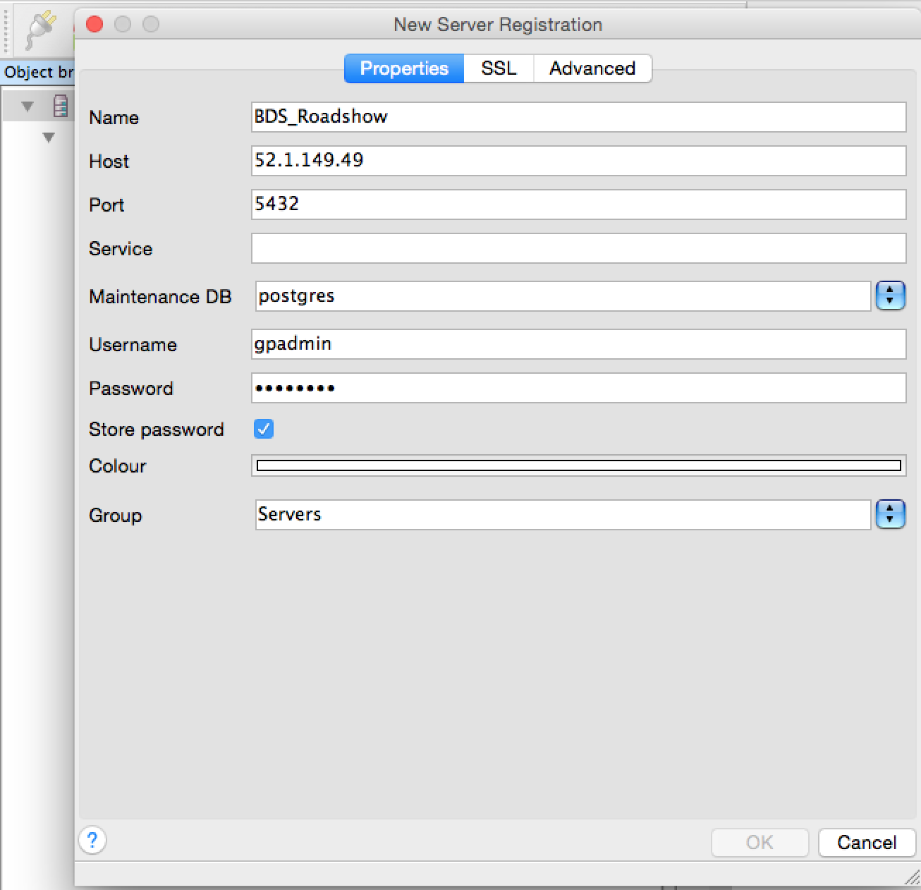
How do I access HAWQ
HAWQ can be accessed via PSQL command line client or pgadminIII. We’re going to use pgadminIII
Under Applications, click on pgadminIII
Click the plug in the upper right hand corner
Now that we’re connected we’re going to:
Create an external table
Create a table in HAWQ
Load data into HAWQ

Slide 14

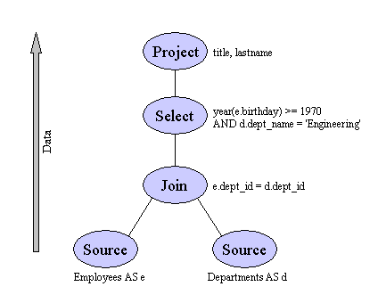


What do I need to know about external tables?
External tables are the most efficient way to load data into HAWQ
Loading speed is achieved by taking advantage of parallelization. A distributed protocol (PXF or GPFDIST) is used to load the data in parallel.
External tables are a logical view of the file on HDFS.
External tables are simple, use SQL and can be used to transform the data in flight
SQL
Master
...
Network
Interconnect
Segment Servers
...
External Sources
ETL
File Systems

Slide 15
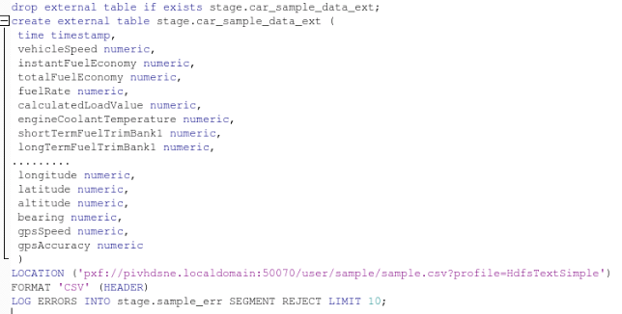
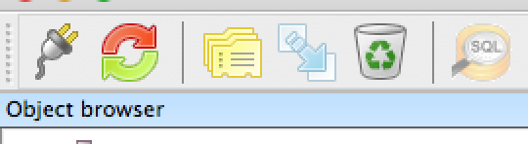

Create an external table
First thing we need to do is identify the exact location of the file we wish to load
hdfs dfs -ls /user/sample/ ( /user/sample/sample.csv )
This will be used by our location
In pgadminIII, click on the
the SQL glass
Open the following file from the lab
1_create_ext_table.sql
Click the play button to execute

Slide 16
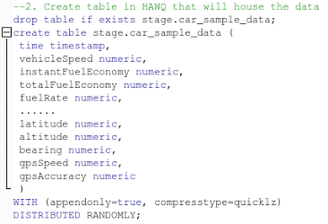
Create an HAWQ table
We created the external table to read the data from hdfs, now we need to create a place to send the data
Open up another SQL window
Open the following file from your desktop
2_create_hawq_table.sql
Click the play button to execute

Slide 17

Load data into HAWQ
We created the external table to read the data from hdfs, we created the HAWQ table to load it in to, now we need to load the data.
Open another SQL window
Open the following file from your desktop
3_load_hawq_table.sql
Click the play button to execute

Slide 18
What are the key things I need to know about HAWQ?
Distribution, Distribution and Distribution
No Updates and Deletes
Parallelism is defined by the number of segments

Slide 19
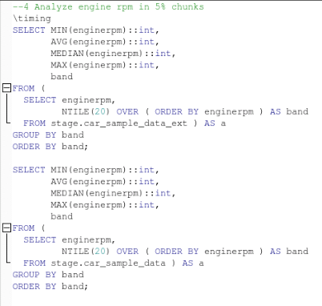
Query data in HAWQ
We’ll now run a SQL query on the data we have in CSV in HDFS and additionally in HAWQ binary format
Open another SQL window
Open the following file from your desktop
4_rpm_bands.sql
Click the play button to execute

Slide 20
Summary
What have we done?
We loaded a file onto hdfs
We navigated through the hdfs file system
We created an external table
We created a table in HAWQ
We loaded data into HAWQ
We queried HAWQ

Slide 21
