Slide 2
Preparing the environment
Hands-on Lab using Pivotal Big Data Suite

Slide 3



Labs we’re going to do
GEMFIRE
PIVOTAL HD + HAWQ
SPRING XD
Access data in-memory
Scale-out
Distribute data automatically
HA / Fail-over
Massive parallel load of data
Scale-out
SQL on HDFS
Create data streams easily – no coding
Scale-out
Built-in processors
Easily connect to external tools

Slide 4



Roadshow Labs environment choices
8Gb memory local VM
VmWare Player / Fusion
VM running on Cloud
Remote Desktop Client

Slide 5
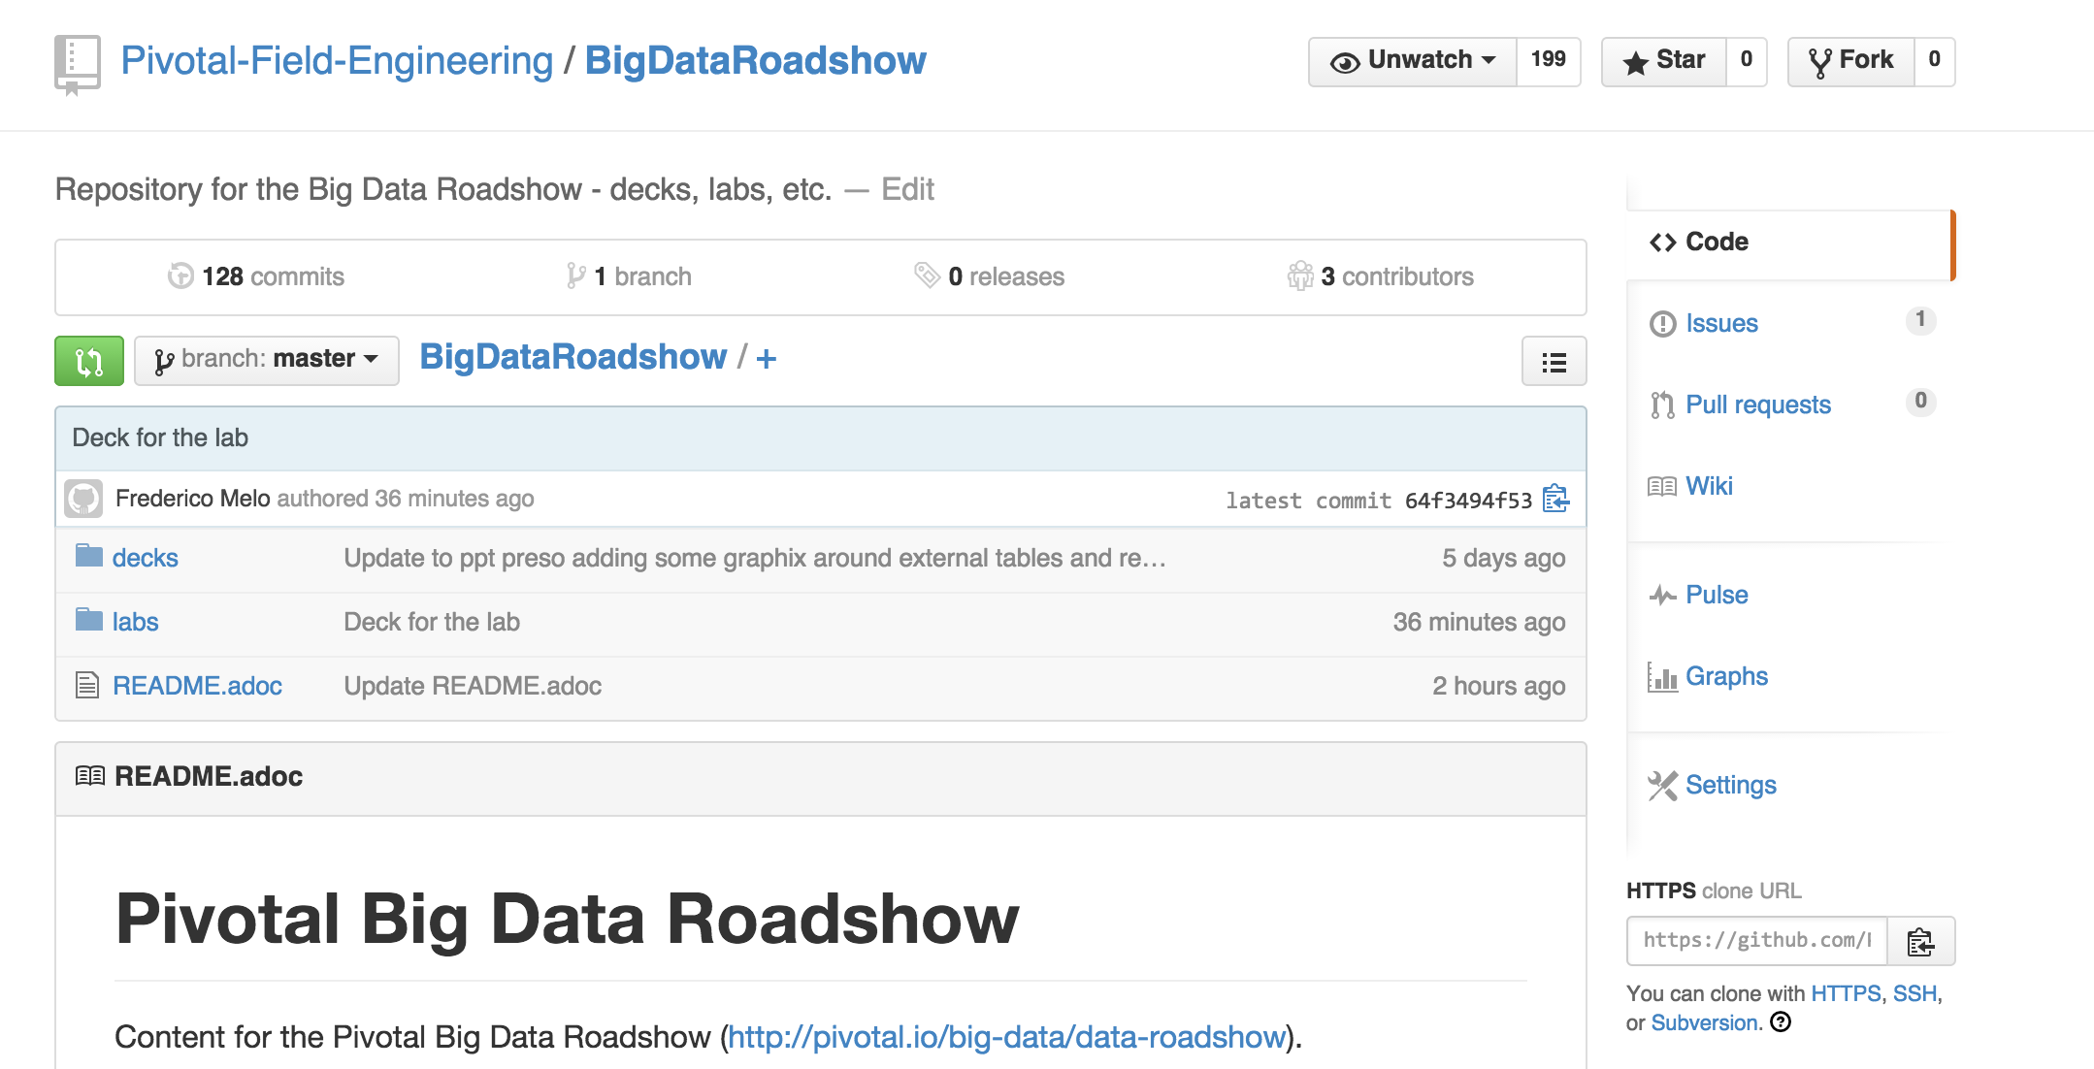
Once you have access to an environment….
$ git clone http://tinyurl.com/pivotal-big-data-roadshow

