Slide 1

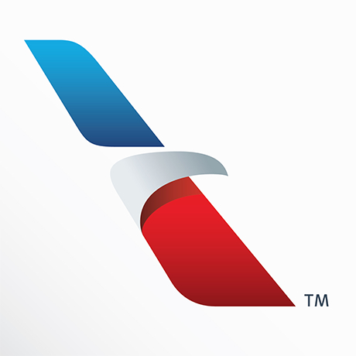

Cloud Native Applications
Introductions, Agenda, and Pivotal Cloud Foundry at American Airlines
Notes:
Resting slide on screen before you begin presenting.

Slide 2
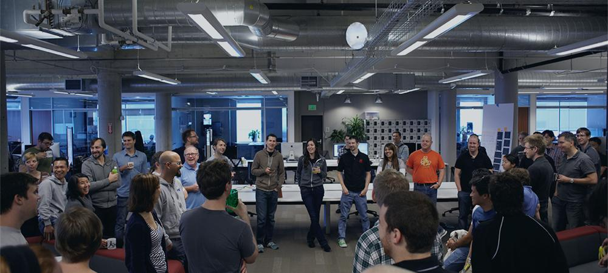

Introductions
Name, Team, Apps

Slide 3
Workshop Agenda
11:30 AM - 12:00 PM Pivotal Cloud Foundry at American Airlines
Cloud Native Applications
12:00 PM - 1:30 PM Introducing Spring Boot (and working lunch)
Lab 1: Building A Spring Boot Application
Polyglot Persistence with Spring Data REST
Lab 2: Adding Persistence to Boot Application
Advancing Spring Boot with Actuator and Profiles
Lab 3: Enhancing Boot Application with Metrics

Slide 4
Important Links
Workshop Git Repo
https://github.com/Pivotal-Field-Engineering/CN-Workshop-AA
Pivotal Web Services
https://run.pivotal.io

Slide 5

Be Interactive!

