Slide 1


Cloud Native Applications
Introductions, Agenda, and Pivotal Cloud Foundry at Boeing
Notes:
Resting slide on screen before you begin presenting.

Slide 2
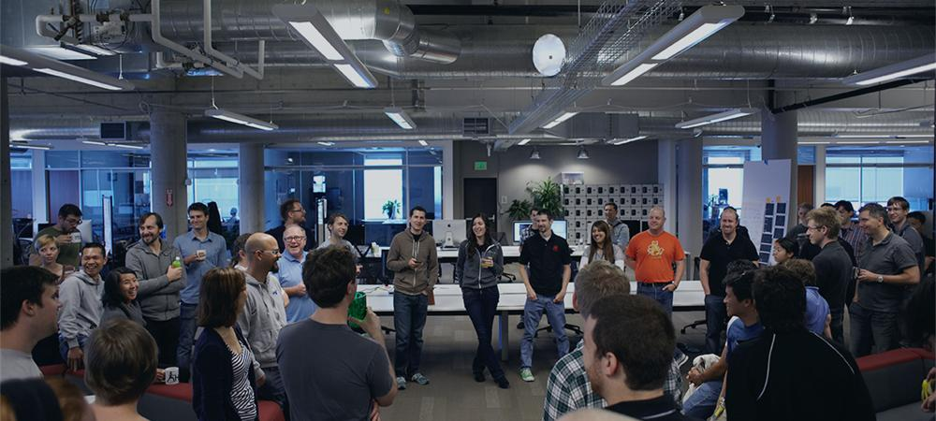

Introductions
Name, Team, Apps

Slide 3
Workshop Agenda
09:00 – 9:30 Welcome
09:30 - 10:30 Cloud Native & DD Design, Microservices
10:30 - 10:45 Break
10:45 - 12:00 Introducing Spring Boot
Lab 1: Building A Spring Boot Application
Polyglot Persistence with Spring Data REST
Lab 2: Adding Persistence to Boot Application
12:00 - 12:45 Lunch
12:45 - 13:30 Advancing Spring Boot with Actuator and Profiles
Lab 3: Enhancing Boot Application with Metrics

Slide 4
Workshop Agenda
13:30 - 14:45 Introducing Spring Cloud Netflix
Spring Cloud Config
Lab 4: Introducing Spring Cloud into Boot Application
14:45 - 15:00 Break
15:00 - 15:45 Spring Cloud Netflix - Service Discovery & Load Balancing
Lab 5: Microservice Service Discovery and Load Balancing
15:45 - 16:30 Spring Cloud Netflix - Circuit Breakers
Lab 6: Microservice Fault Tolerance with Circuit Breakers
16:30 Wrap-Up and Closing

Slide 5
Important Links
Workshop Git Repo
https://github.com/Pivotal-Field-Engineering/CN-Workshop-Boeing
Cloud Foundry API
https://api.run.pivotal.io
Cloud Foundry Apps Manager
https://console.run.pivotal.io

Slide 6

Be Interactive!

