Slide 1



Cloud Native Applications
Introductions, Agenda, and Pivotal Cloud Foundry at Duke Energy
Notes:
Resting slide on screen before you begin presenting.

Slide 2
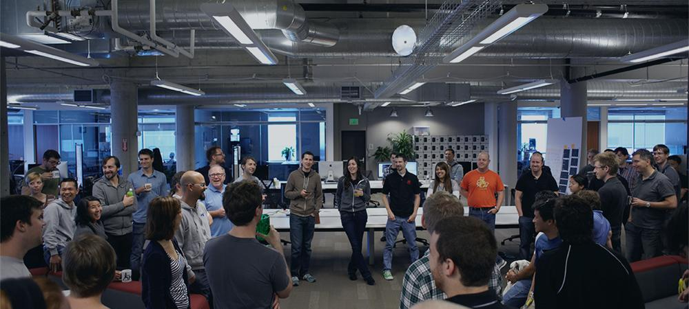

Introductions
Name, Team, Apps

Slide 3
Workshop Agenda
1:00 PM – 1:30 PM Cloud Native & DD Design, Microservices
1:30 PM – 2:00 PM Introducing Spring Boot
Lab 1: Building A Spring Boot Application
2:00 PM – 2:15 PM Break

Slide 4
Workshop Agenda
2:15 PM – 3:00 PM Introducing Spring Cloud Netflix
Spring Cloud Config
Lab 4: Introducing Spring Cloud into Boot Application
3:00 PM – 4:00 PM Spring Cloud Netflix - Service Discovery & Load Balancing
Lab 5: Microservice Service Discovery and Load Balancing
4:00 PM – 5:00 PM Spring Cloud Netflix - Circuit Breakers
Lab 6: Microservice Fault Tolerance with Circuit Breakers

Slide 5
Important Links
Workshop Git Repo
https://github.com/vrusso-pivotal/CN-Workshop-SA
Cloudfoundry API
https://api.cfpoc2.internal.t-mobile.com
Cloudfoundry Apps Manager
https://apps.cfpoc2.internal.t-mobile.com

Slide 6

Be Interactive!

Slide 7

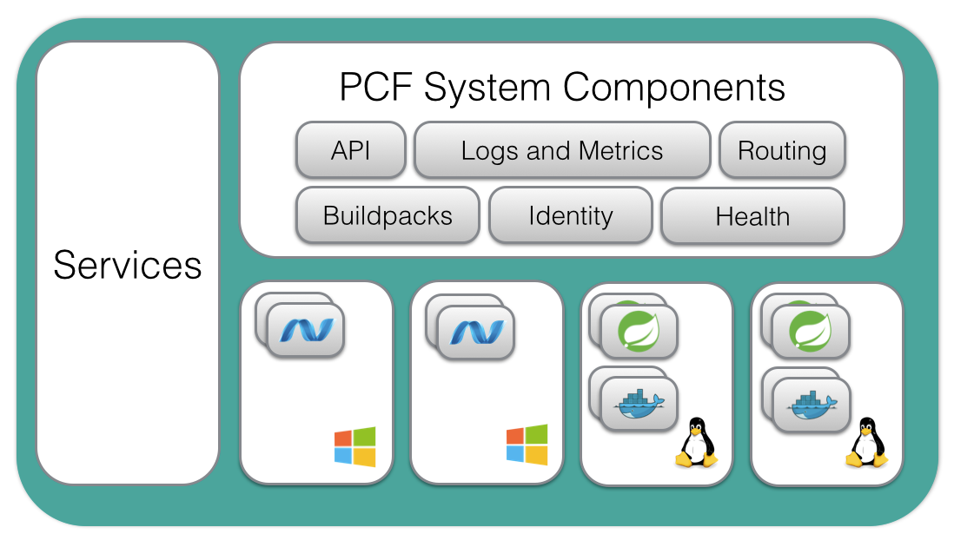




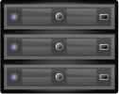
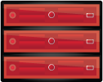


TMUS’ Cloud Foundry
Location
Independent
Polaris* Availability Zones x 3
*.px1.cfapps.internal.t-mobile.com
*.px2.cfapps.internal.t-mobile.com
*.px3.cfapps.internal.t-mobile.com
*.px1.cf.internal.t-mobile.com
*.px2.cf.internal.t-mobile.com
*.px3.cf.internal.t-mobile.com
ORACLE
vCenter
Network A
PCF /22 Net B
BOSH Net A, B
Cassandra Net TBD
TIBCO
Apigee
SQL
Ports: 80/443
DataStax /
Cassandra
BOSH
DC Going Away
Legacy
[ 6 x Nutanix ]
[ Dedicated ]
* Availability Zone arch same for Titan data center

