Slide 1



Cloud Native Applications
Advancing Spring Boot with Actuator and Profiles
Notes:
Resting slide on screen before you begin presenting.

Slide 2



Key Themes
Speed
Scale
Security
Stability
Notes:
all really apply to using Spring Boot

Slide 3

Getting Started
Actuator
Production grade features exposed as endpoints
Metrics
Health
Configuration
Errors
Info
Notes:
Actuators enable production-ready features to a Spring Boot application – without having to actually implement them yourself
They’re mainly used to expose different types of information about the running application – health, metrics, info, dump, env etc.. And while these are no replacement for production-grade monitoring solution –they’re a very good starting point

Slide 4
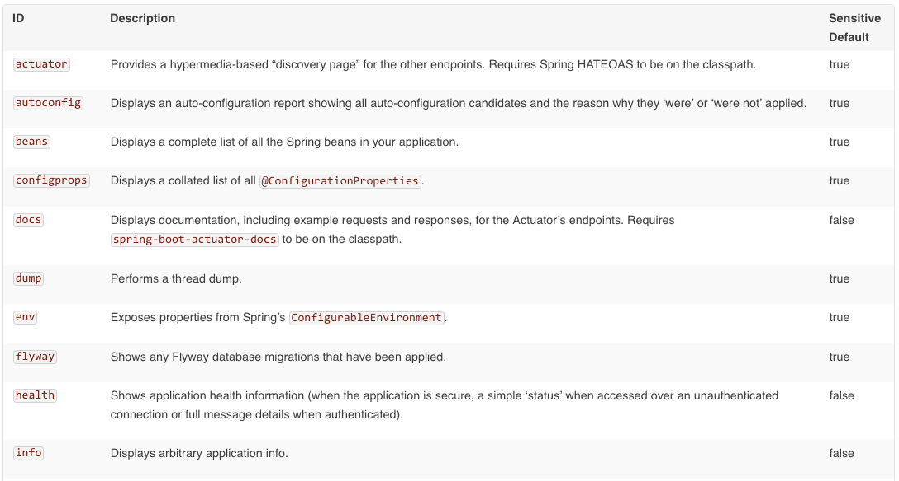
Endpoints
Notes:
Actuator endpoints allow you to monitor and interact with your application. Spring Boot includes a number of built-in endpoints and you can also add your own. For example the health endpoint provides basic application health information.
The way that endpoints are exposed will depend on the type of technology that you choose. Most applications choose HTTP monitoring, where the ID of the endpoint is mapped to a URL. For example, by default, the health endpoint will be mapped to /health
By default most endpoints are disabled on unsecured HTTP requests. For testing purposes you can sent “management.security.enabled” to false to allow access to all endpoints.

Slide 5
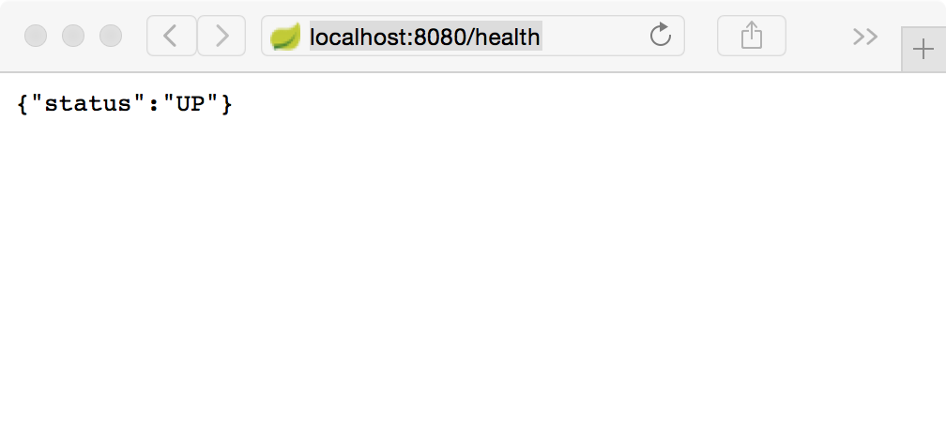
Health Endpoint
Notes:
Here we provide the example of the “/health” endpoint as noted in the URL location bar
There are a number of endpoints exposed by the Actuator, during lab please explore each one

Slide 6
Health Indicators
Health Indicator | Performed Checks
DiskSpaceHealthIndicator | Checks for low Disk space
DataSourceHealthIndicator | Check DataSource connection
ElasticsearchHealthIndicator | Checks ElasticSearch cluster is up
JmsHealthIndicator | Checks that a JMS broker is up
MailHealthIndicator | Checks that a mail server is up
MongoHealthIndicator | Cheks that a Mongo database is up
RabbitHealthIndicator | Checks that a Rabbit server is up
RedisHealthIndicator | Checks that a Redis server is up
SolrHealthIndicator | Checks that a Solr server is up
Notes:
Additionally these health indicators, some for backing services, are auto-configured by Spring Boot when appropriate
Information returned by HealthIndicators is often somewhat sensitive in nature. For example, you probably don’t want to publish details of your database server to the world. For this reason, by default, only the health status is exposed over an unauthenticated HTTP connection. If you are happy for complete health information to always be exposed you can set endpoints.health.sensitive to false.
Health responses are also cached to prevent “denial of service” attacks. Use the endpoints.health.time-to-live property if you want to change the default cache period of 1000 milliseconds.

Slide 7
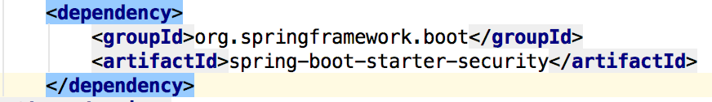
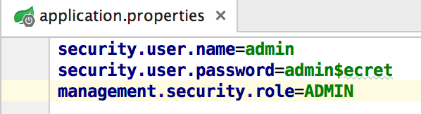
HTTP Access
Importing Spring Security Dependency
Setting required Authentication & Authorization Roles
Notes:
The management endpoints are secure even if the application endpoints are insecure.
Security events are transformed into AuditEvents and published to the AuditService.
The default user will have the ADMIN role as well as the USER role.

Slide 8
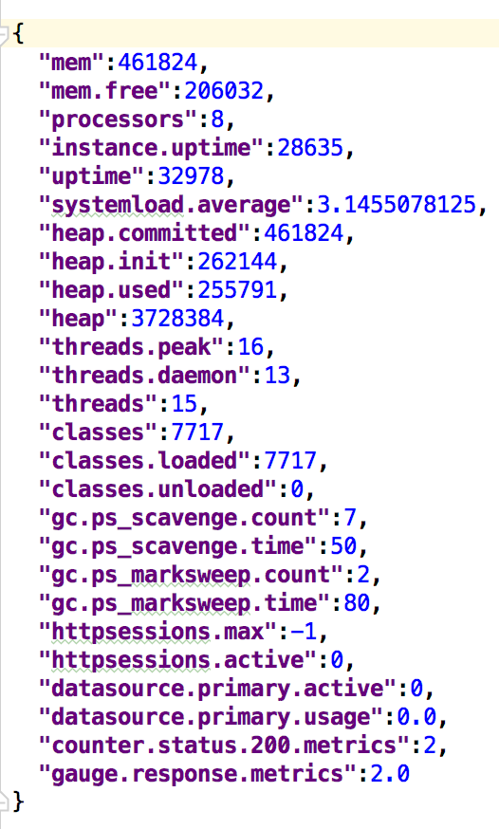
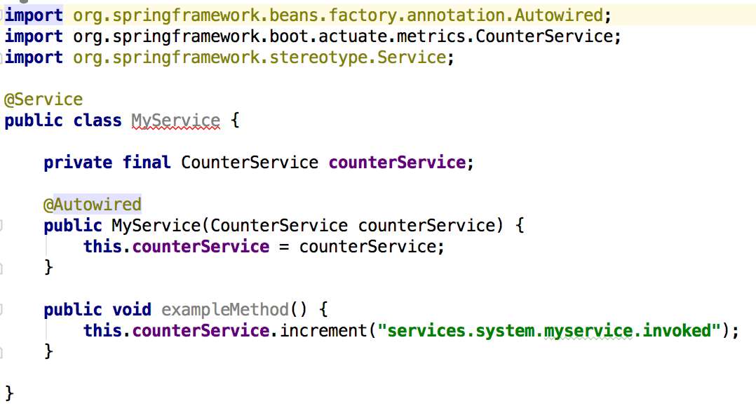
Metrics
Spring Boot Actuator includes a metrics service with ‘gauge’ and ‘counter support
Record your own metrics, inject CounterService and/or GaugeService into your bean
Notes:
A ‘gauge’ records a single value; and a ‘counter’ records a delta (an increment or decrement). Spring Boot Actuator also provides a PublicMetrics interface that you can implement to expose metrics that you cannot record via one of those two mechanisms. Look at SystemPublicMetrics for an example.
Metrics for all HTTP requests are automatically recorded, so if you hit the metrics endpoint you should see a response similar to this:

Slide 9
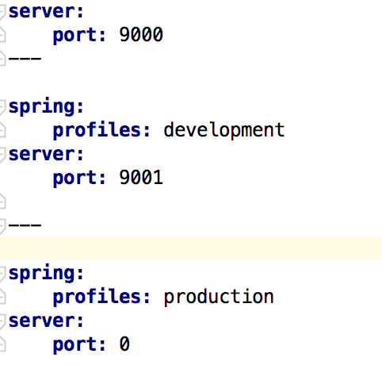


Profiles
YAML file can contain for several documents
Convenient to specify alternate configurations in the same file
Set the active profile
SPRING_PROFILES_ACTIVE=production
or
spring.profiles.active=production
Development profile
Production profile
Notes:
If one wants to set the active Spring profiles
The Spring Environment has an API for this, but normally one would set either a System.property, or an OS environment variable or it can be set in the application.properties (or application.yml) file
The YAML documents are merged in the order they are encountered (so later values override earlier ones)

Slide 10

Demo

