Slide 1
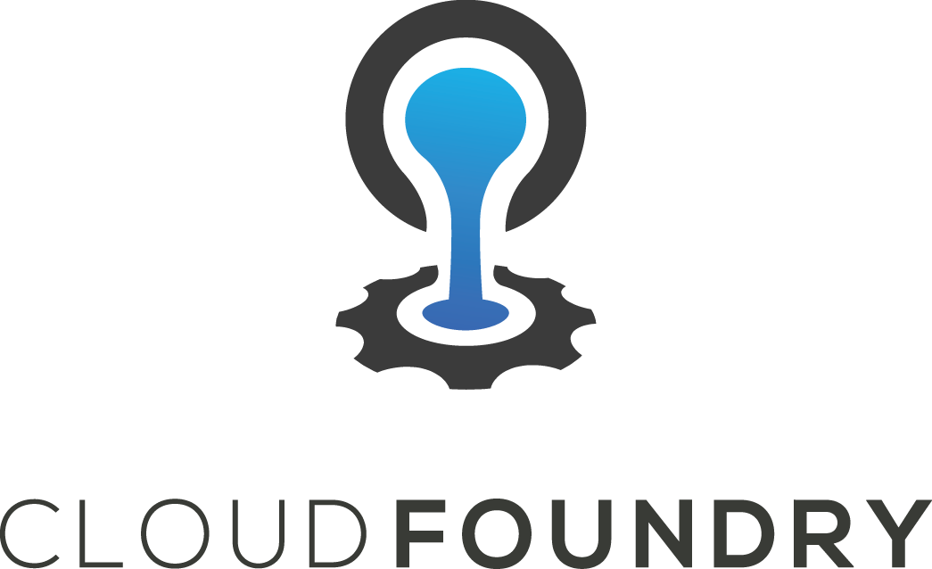
CLOUD FOUNDRY Basic

Slide 2

Part 1 – What is Cloud Foundry Agenda
Overview
CF Foundation
Distributions

Slide 3
Cloud Foundry Overview
Initial release in 2011
An open Cloud Native Platform (PaaS)
Fast and easy to build, test, deploy & scale apps
Works with any language or framework
Available as open source, commercial distributions or hosted offerings

Slide 4
What’s PaaS?
Platform as a Service
Cloud Computing taxonomy: IaaS, PaaS, and SaaS
PaaS aims to improve developer productivity
Reduces undifferentiated ‘plumbing’ aka ‘yak shaving’
Heroku blazed a trail for PaaS and 12 Factor apps
Applications are the Cloud Native unit of currency

Slide 5
Why a Cloud Native Platform?
What characterises Cloud Native?
12 Factor architectural style
Embracing low cost of change in cloud
Fast feedback and small batch sizes
Don’t waste time on plumbing infrastructure
Deliver business value more often
Learn about your customers more quickly

Slide 6
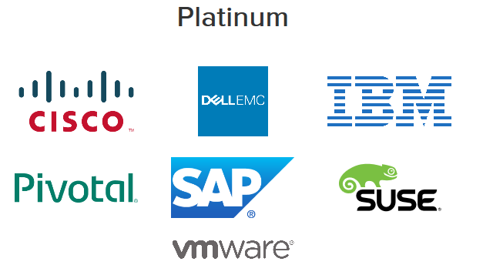
Cloud Foundry Foundation
60+ industry leading member companies!

Slide 7
Open Source Distribution
Where can you get Open Source Cloud Foundry?
github.com/cloudfoundry
cf-release requires BOSH knowledge
bosh-lite for a local CF deployment

Slide 8
Part 2 – Interacting with Cloud Foundry Agenda
Interacting with the CLI
Orgs, spaces, quotas and apps

Slide 9
Command Line Interface cf CLI
How do I interact with CF?
Command Line Interface (cli): from terminal / command prompt
IDE plugins
Vendor specific consoles
CI tool integration (e.g Concourse.ci)

Slide 10
APPS & SERVICES IN CF Spaces
Every application and service is scoped to a space
$ cf spaces
$ cf space <some-space> # for details

Slide 11
MULTITENANCY IN CF Orgs
Organisations segregate tenants in a Cloud Foundry installation.
$ cf orgs
$ cf org pcfdev-org

Slide 12
LIMITING RESOURCES Quotas
Quotas provide resource limits to orgs and spaces
$ cf quotas

Slide 13
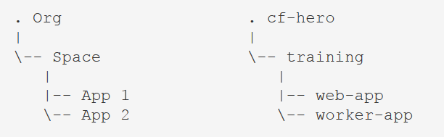
Bringing it altogether Orgs, Spaces and Apps
What is the relationship between orgs, spaces & apps?
Run cf target to confirm your org and current space.
$ cf target

Slide 14
Part 3 –Pushing Your First App Agenda
cf push basics
Staging
Running

Slide 15
Deploying Apps
What happens when I cf push?
1. Upload: App files sent to CF
2. Staging: Executable artifact is created (droplet)
3. Running: App starts on an app host
App receives web requests (if it binds to TCP port)

Slide 16
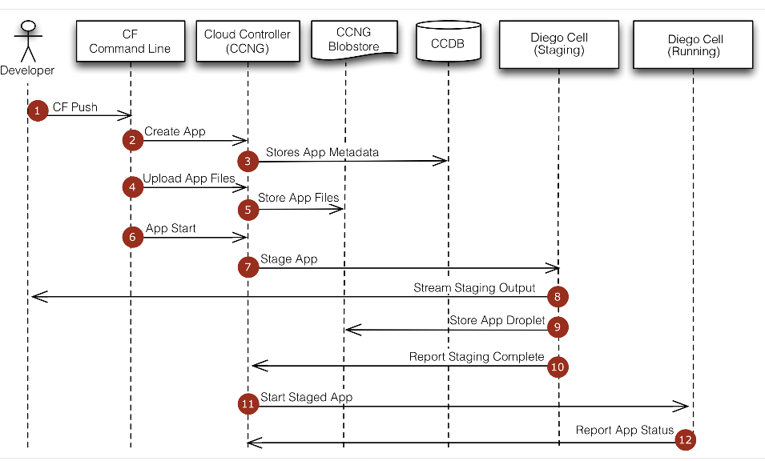

Slide 17

Staging
Buildpacks create a runnable artifact called a droplet
App Files + Runtime Dependencies = App Artifact (droplet)

Slide 18
Running
Apps are started on specialized VMs called cells
If it’s a web process, it binds to a TCP port
Instances are distributed across multiple cells
Router distributes traffic across instances

Slide 19

Separating Build And Run Stages 12 Factor
V. Build, release, run
Strictly separate build and run stages
http://12factor.net/build-release-run

Slide 20
Part 4 – Buildpacks Agenda
Why Buildpacks?
How they work
Types of Buildpacks

Slide 21
Runtime Dependencies in Cloud Foundry - Buildpacks
Buildpack: A Cloud Foundry component that resolves your app’s runtime dependencies

Slide 22
Standardizing runtime and deployment Why Buildpacks?
Simplify app deployment -> focus on your code
Fewer files, quicker app deploys
Produce self-contained, runnable and cacheable app artifacts

Slide 23
Standardizing runtime and deployment How do they work?
Given: An Application
Execute: A set of script endpoints against the app
bin/detect: Can I handle this? (introspection)
bin/compile: If yes, make the droplet
bin/release: Build the metadata (env variables, start command, etc)

Slide 24
Types of Buildpacks
Default buildpacks (included in the platform)
Community buildpacks: Leverage the community
Custom buildpacks: Build your own

Slide 25
Online/Offline
Online: Downloads dependencies as needed
Offline: All possible dependencies included (behind the firewall)

Slide 26
Part 5 –Resilience and Availability Agenda
Resilience
Health Management

Slide 27
Online/Offline
Online: Downloads dependencies as needed
Offline: All possible dependencies included (behind the firewall)

Slide 28
How do you configure an app deployment for resilience?
Embrace failure & run many instances of the same app
$ cf scale imperfect-app -i 3
$ cf apps

Slide 29
What happens when instances fail?
They are automatically recreated by comparing desired state to actual state
https://docs.cloudfoundry.org/concepts/architecture/#nsync-converger

Slide 30
Health Management Components:
nsync: gets message from CC (after cf scale). Writes the DesiredLRP value in BBS.
Cell Rep Monitors containers to get the ActualLRP value
BBS: Monitors DesiredLRP vs ActualLRP and kills/launches instances.

Slide 31
Part 6 –Debugging Agenda
Debugging basics & info sources
3rd party instrumentation

Slide 32
Debugging Basics
How do I debug my app?
cf logs App logs
cf events App events
App instrumentation via 3rd party tools
cf ssh SSH access to the app container

Slide 33
3rd Party Integration Instrumentation
CF contains hooks to enable 3rd party integrations
AppDynamics
New Relic
PWS console (built in)
AppDynamics and New Relic agents are included in Java buildpack

Slide 34
Part 7 –Dealing with State Agenda
Handling State in Applications
Marketplace & Brokers
Binding to apps

Slide 35
Where should my app store state?
In an external service.
Horizontal scale (adding instances)
Eliminate costly routing overhead (sticky sessions are supported)
Leverage services in the marketplace

Slide 36
What is a Service Broker?
Brokers access to resources of a specific type
Implements a rest API advertising a catalog of service offerings and plans

Slide 37
How do I see all available service offerings?
$ cf marketplace

Slide 38
How are service credentials exposed to applications?
$ cf env stateful-app
III. Config: Store config in the environment
IV. Backing services: Treat backing services as attached resources

Slide 39
Part 8 –Domains and Routes Agenda
Custom Domains
Routes
Blue/Green Deployments

Slide 40
Domains: provide a namespace from which to create routes
Shared domain: for all of CF
Private domain: scoped to an Org
Requires DNS to be configured

Slide 41
Route: A URL on which an application can be accessed.
Many to Many Relationship between apps & routes.

Slide 42
Blue/Green Deployments
Deploy a new version (GREEN) of your app.
Map the route to it
Validate
Unmap from the old version (BLUE)

Slide 43
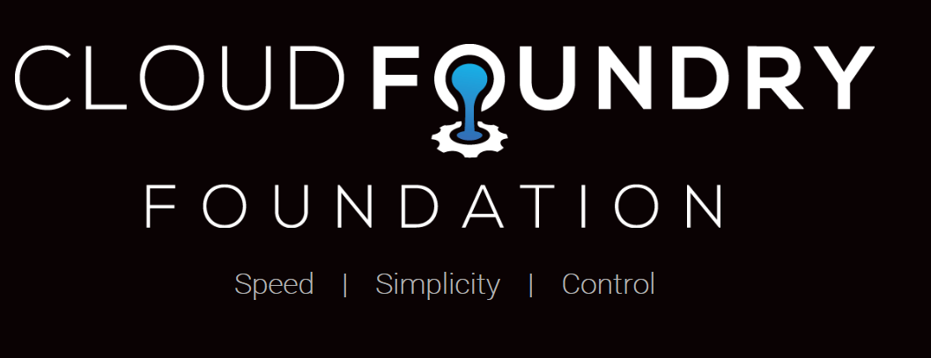

Slide 44
Resources
Cloud Foundry
Main Site: cloudfoundry.org
Mailing lists - lists.cloudfoundry.org
github.com/cloudfoundry
github.com/cloudfoundry-incubator
Bosh
Main Site: bosh.io
stemcells: bosh.io/stemcells
releases: bosh.io/releases
manifest: bosh.io/docs/deployment-manifest.html

