Slide 1
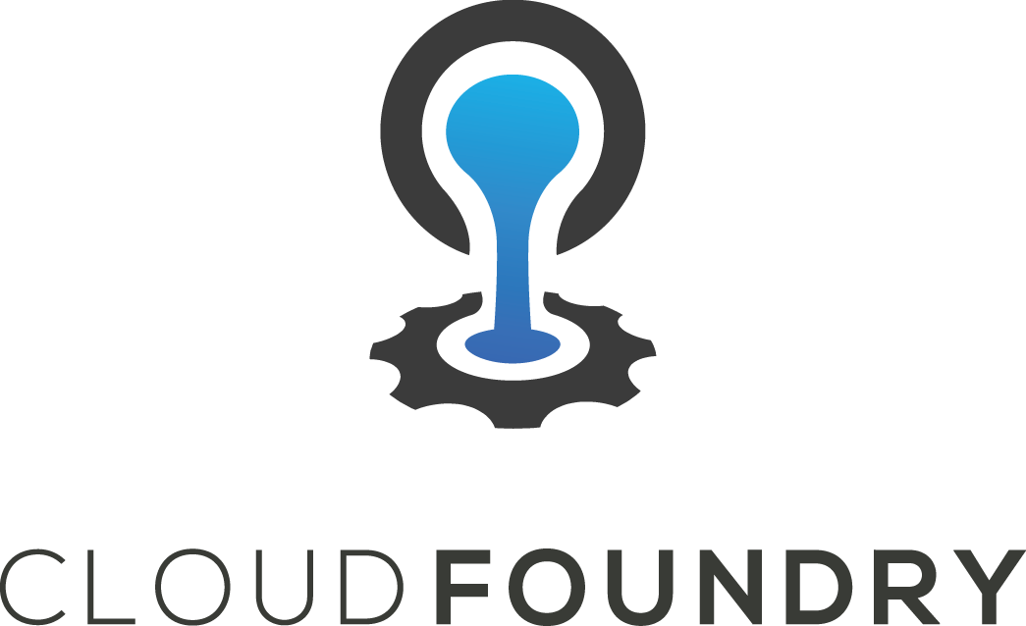
Microservices on the Cloud Foundry

Slide 2

Cloud Native Evolution Agenda
Monolithic Applications
Challenges
Going Cloud Native

Slide 3
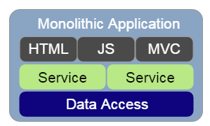
What is a Monolith?
Typically…
Tightly coupled
Multi-responsibility/mixed concerns
Large deployable unit(s)

Slide 4
Challenges on Monolithic
Scaling
Release Cycles
Onboarding
Feedback Loop

Slide 5
What if we could...
What characterises Cloud Native?
Develop quickly with fast feedback
Deploy quickly and confidently every time
Scale our teams and applications
Fail gracefully and recover quickly
Build the Right Thing

Slide 6
We can…
Cloud Native
Confidence

Slide 7
Microservices and 12 factor apps
Microservices defined as...
"A loosely-coupled, service-oriented architecture with bounded context.“
"It allows updates without needing to understand how everything else works.“
ADRIAN COCKCROFT
Source: http://thenewstack.io/dockercon-europe-adrian-cockcroft-on-the-state-of-microservices/
single responsibility
separation of concerns

Slide 8
Impact of Microservices
Decoupled change cycles -> frequent deploys
Small codebase -> fast onboarding
Efficient scale -> technology & organizations

Slide 9
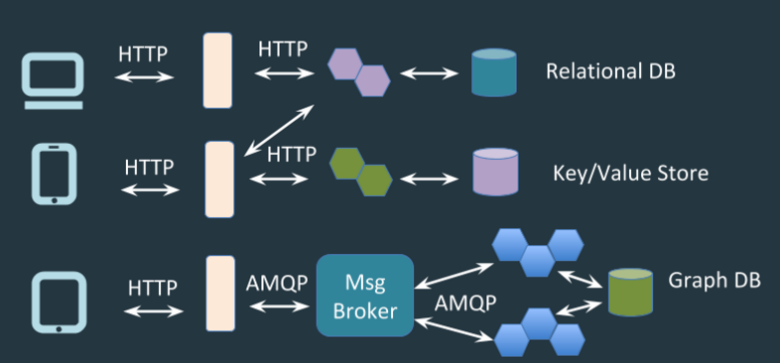
Data Microservices

Slide 10
Microservices architectures have significant...
Ops Overhead
Mitigated by CF

Slide 11
So what is 12 factor?
Coping mechanism for complexity in distributed systems.

Slide 12
12 Factor Review
V. Build, release, run
VII. Port binding
X. Dev/prod parity
VI. Processes
III. Config
IV. Backing services
VIII. Concurrency
IX. Disposability

Slide 13
12 Factor I. – Codebase
Git
Git is a free and open source distributed version control system designed to handle everything from small to very large projects with speed and efficiency.
SVN
Subversion exists to be universally recognized and adopted as an open-source, centralized version control system characterized by its reliability as a safe haven for valuable data; the simplicity of its model and usage; and its ability to support the needs of a wide variety of users and projects, from individuals to large-scale enterprise operations.

Slide 14
Service Discovery
Services need to be...
Discoverable
Accessible
Stateless services are constantly...
scaling
failing
recovering

Slide 15
In distributed systems...
Application dependencies cease to be a method call away
Configuring each client is error prone and brittle

Slide 16
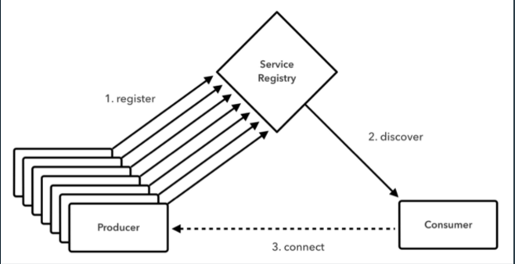
Service Discovery
Client Side load-balancing

Slide 17
Client side load-balancing is...
Simple - no need for another load-balancer
Efficient - minimize components between calls
Flexible - URIs change

Slide 18
Circuit Breaking
Interactions between services need to be...
Reliable
Fault Tolerant

Slide 19
Cascading Failure
GIVEN: app that relies on 30 services
each service: 99.99% uptime
99.7% uptime
0.3% of 1 billion requests = 3,000,000 failures
Reality is generally worse

Slide 20
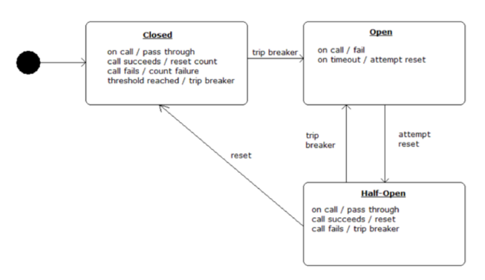
Circuit Breaking

Slide 21
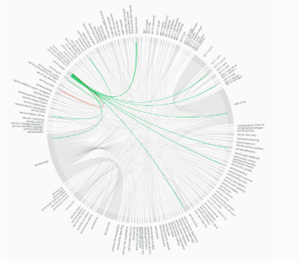
Distributed Tracing
When something goes bang…
how do we find the problem?
source: https://sudo.hailoapp.com/services/2015/03/09/journey-into-a-microservice-world-part-3/

Slide 22
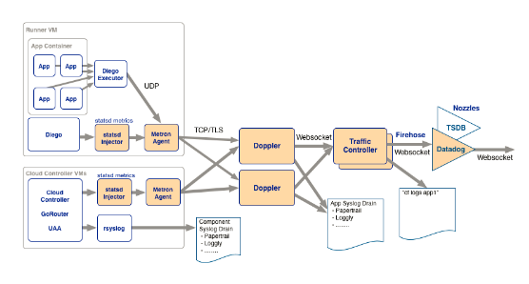
XI. Logs - Treat logs as event streams

Slide 23
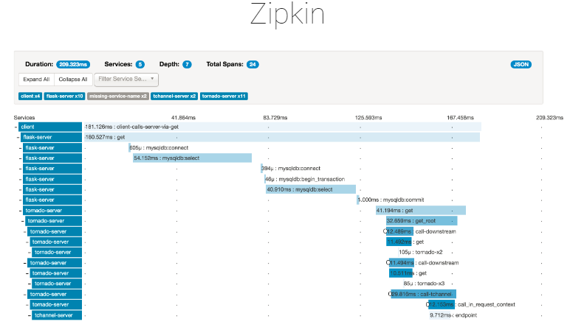
Tracing Solutions
Based on concepts in Google Dapper

Slide 24
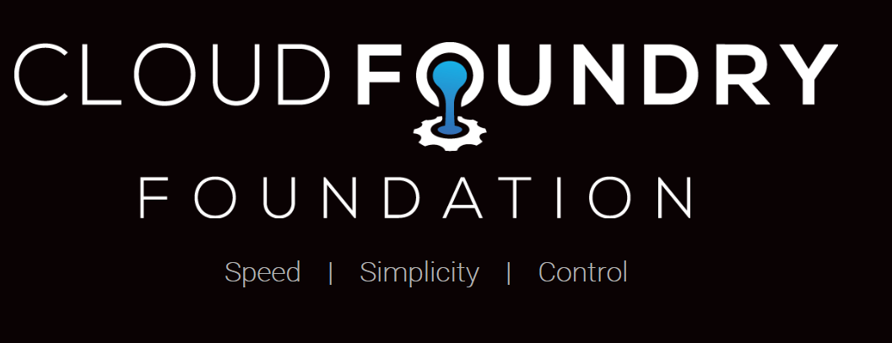

Slide 25
Resources
Cloud Foundry
Main Site: cloudfoundry.org
Mailing lists - lists.cloudfoundry.org
github.com/cloudfoundry
github.com/cloudfoundry-incubator
Bosh
Main Site: bosh.io
stemcells: bosh.io/stemcells
releases: bosh.io/releases
manifest: bosh.io/docs/deployment-manifest.html

