Slide 1
Auto-Scaling in Cloudfoundry
Team
Niket - 1PI13CS100
Parag - 1PI13CS103
Parikshit - 1PI13CS104
Rathan - 1PI13CS121

Slide 2
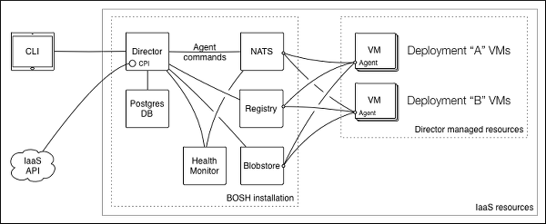
BOSH Architecture

Slide 3
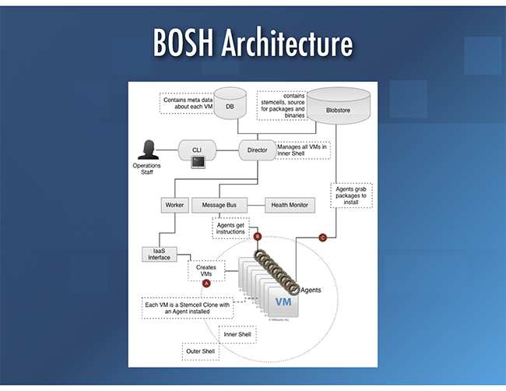

Slide 4
Cloudfoundry Application
Sample Application
Consists of Files
hello.py : Application Code
manifest.yml : Application Resources
Memory
No. of instances
Procfile : Command to execute

Slide 5
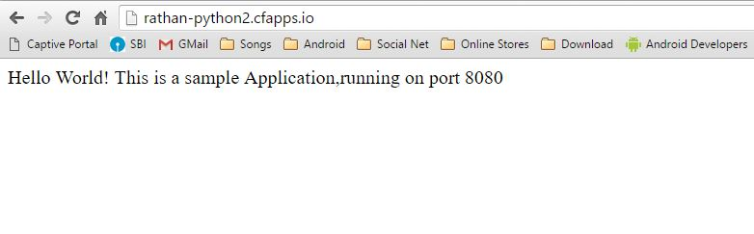
Application Launch
cf login
cf push app-name
URL : http://rathan-python2.cfapps.io for our sample application

Slide 6
Design
Scaling Tool
NO
Monitor Health
Reached Threshold ?
Termination ?
YES
Create New Instance
NO
YES
Reduce Instances
EXIT

Slide 7
Scaling-Tool Code
if __name__=='__main__':
signal.signal(signal.SIGINT, k)
p1 = Process(target = scaler)
p1.start()
p1.join()
Creates the process scaler
Scaler Process is the one which main functionalities

Slide 8
scaler Module
with open('log.hmonitor', 'w') as outfile: subprocess.call(['cf app rathan-python'], stdout=outfile,shell=True)
Creates a file log.hmonitor
Cf app rathan-python
gets details about the app health
cpu is a list which holds cpu% of all the Vms of the current application

Slide 9
checkHealth Module
Checks if health of all the apps is below 60%
If one of the Vm cpu% is below 60%, then we will assume we are in a safe zone.
If all cpu% are above 60% then we need to scale. So this module returns false, saying health is not good.
if(len(cpu)< totalInstances):
This condition is put inorder to accommodate for the time involved in starting the new VM
Call createInstance Module if we need to create a new Instance

Slide 10
createInstance Module
This is the module which creates the new Instance
cf scale app-name -i numberOfInstances
app-name is the name of the application. In our case it is rathan-python2
Command to create new Vms for the application.
numberOfInstances is the total number of instances, including current number of instances.

Slide 11
Termination
Termination must be explicity done by the user, whenever he needs to stop the Scaling.
Press Ctrl+c for termination
When Ctrl+c is pressed
We handle SIGINT signal and call reduceInstances module inorder to reduce the number of modules back to 2

Slide 12
reduceInstances Module
Reduces the number of instances back to 2
Uses
cf scale app-name -i numberOfInstances
EXIT

Slide 13
THANK YOU

