Slide 1


BOSH 1-Day Workshop
Matt Gunter
Sr Platform Architect
Mike Wright
Southeast PA Manager

Slide 2
Building a Pivotal Cloud Foundry Tile

Slide 3
Goals
Understand the difference between a Tile and a BOSH release
Understand the basics of the Tile Generator
Demonstration of Tile Generator

Slide 4
What’s the difference between a Tile vs BOSH deployment?
A BOSH deployment requires BOSH commandline access and handcrafting manifest files in order to deploy
Tile is a package that gets imported into Pivotal Ops Manager and installed via a Web GUI
Installing tiles via Ops Manager simplifies the install or upgrade process and does not need deep BOSH knowledge
Tile install uses BOSH to deploy

Slide 5
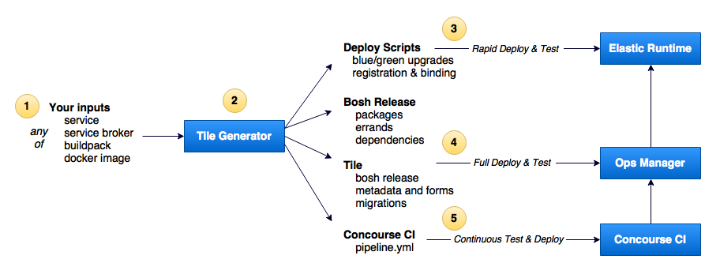

PCF Tile Generator

Slide 6
Resources
https://github.com/cf-platform-eng/tile-generator

