Slide 1


LAB 5:
Create a Service Broker With SpringBoot

Slide 2

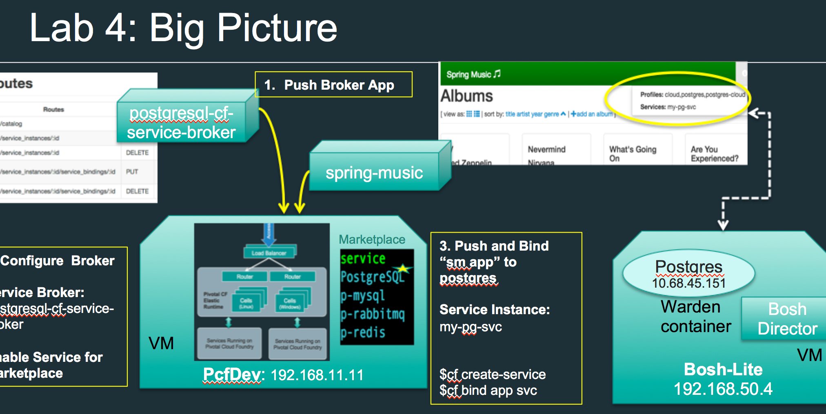




Lab 5: Big Picture
2. Modify
and Build
1. Copy an Example

Slide 3
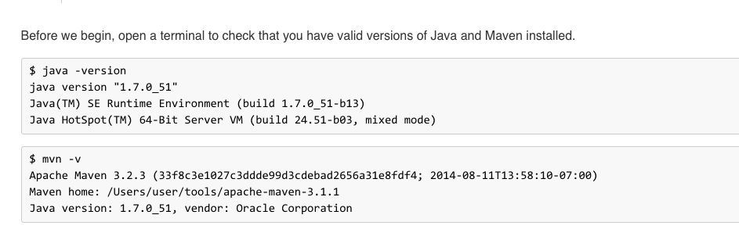
Pre-Requisites

Slide 4
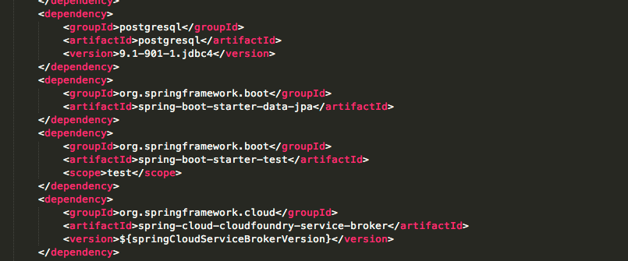
Maven POM

Slide 5
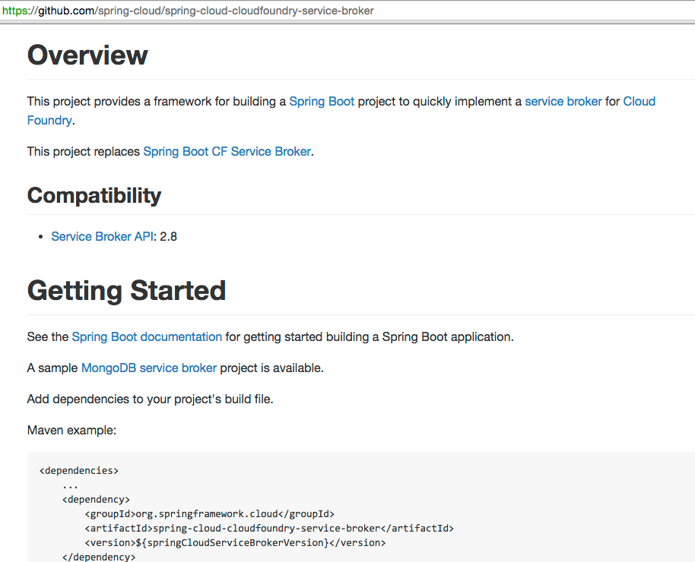
Git Project for the Spring Service Broker

Slide 6
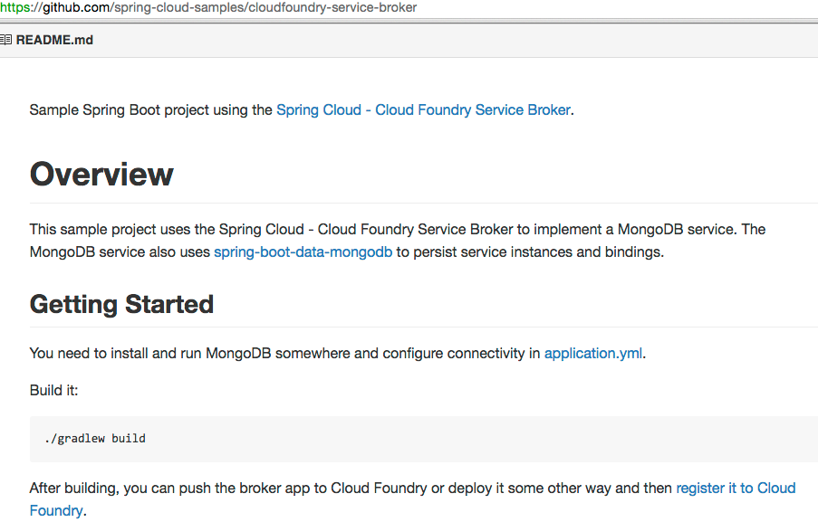
Git Project for the Spring Service Broker - MongoDB Sample -

Slide 7
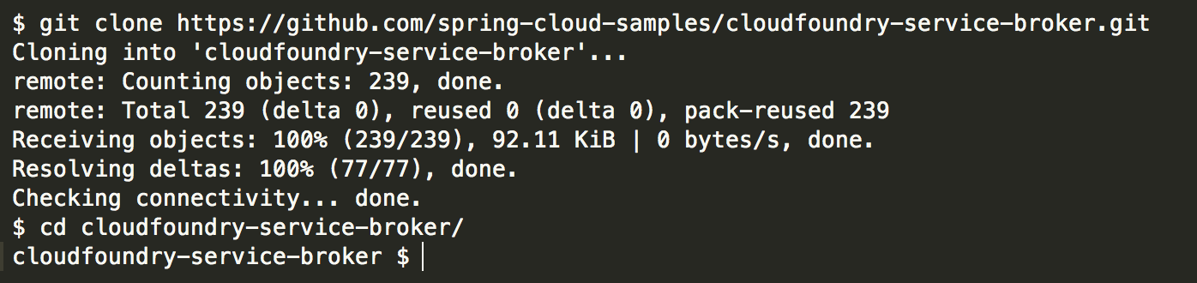
Use Git Clone (or Fork) from Github.

Slide 8
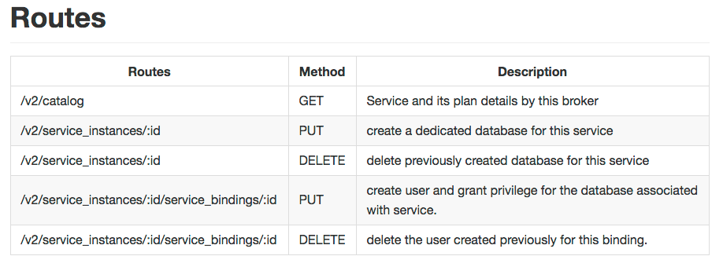
Simple API to implement:

Slide 9
Wash, rinse, repeat
Make whatever changes in the java src.
Use “ $mvn package” to build jar
Refer to Lab 04 instructions for adding broker to CloudFoundry & the Marketplace.

