Slide 2
Pivotal CF
Building Cloud ready apps
Questions about this deck: fmelo@pivotal.io

Slide 3
Limitations of traditional apps

Slide 4
The limitations of traditional apps
Scalability
Inter-Dependency
Platform Specificity
Location Specificity
Resiliency
Traceability / Logging

Slide 5
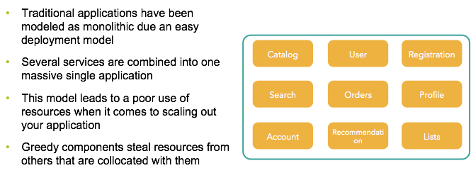
Scalability

Slide 6
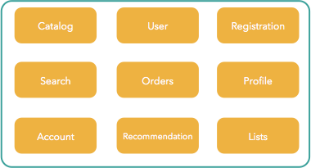
Scaling monolithic apps

Slide 7
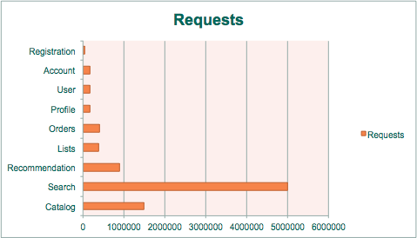
How you should scale

Slide 8
How you should scale
Slow/Expensive
Fast/Cheap
￼

Slide 9
The limitations of traditional apps
Scalability
Inter-Dependency
Platform Specificity
Location Specificity
Resiliency
Traceability / Logging

Slide 10
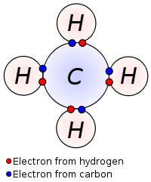
Inter dependency
Monolithic applications: component dependency as strong bindings at the code level
Hard / impossible to get independent scalable model
External dependencies are often also strongly bound

Slide 11
Inter dependency
Change to a single component impacts many others
Integration testing is much harder and often breaks
Slows down the development process as a whole
Imposes big development teams: can’t really have separate teams owning different pieces)

Slide 12
The limitations of traditional apps
Scalability
Inter-Dependency
Platform Specificity
Location Specificity
Resiliency
Traceability / Logging

Slide 13


Platform specificity
Hard dependencies on the runtime environment make applications not portable
At code level with runtime dependencies
At OS level (i.e. relying on cron as a scheduler)
At a business level, introduces vendor lock-in
import javax.servlet.http.HttpServlet;
import com.ibm.servlet.engine.webapp.*;

Slide 14
The limitations of traditional apps
Scalability
Inter-Dependency
Platform Specificity
Location Specificity
Resiliency
Traceability / Logging

Slide 15
Location Specificity : Writing to disk
Applications often need to write to disk, this includes form uploads with binary data, or content in most CMS systems
Containers are short lived and not guaranteed to be executed on the same hardware every time they are needed to restart. Depending on a local file system is a big lock dependency some applications impose on the runtime
This is one of the first issues to question or address when starting a conversation around new applications or selecting candidates to execute in PCF
Some CMS vendors support usage of a service such as S3 to be the persistent mechanism of choice

Slide 16
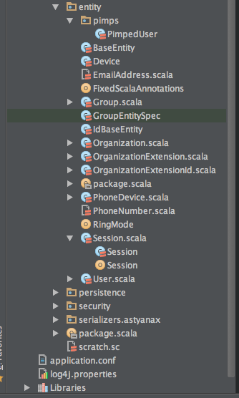
Location Specificity : service locations
Cache.hosts=10.68.27.41,10.68.27.42
#naming does not help either
Cache.hosts=cacheserver1, cacheserver2
Properties file deployed
With application

Slide 17
Location Specificity : Sticky sessions
Applications that rely on session stickiness are subject to lead to unexpected behavior in case of failure of the node that contains that data
Most web applications that use sessions do not have a replication strategy in place
Your application availability is subject to a single node (even if you LB the load over other nodes)
Some app servers use P2P session replication which can be very costly on large deployments
Dynamic Router
jsessionId
DEA
DEA

Slide 18
The limitations of traditional apps
Scalability
Inter-Dependency
Platform Specificity
Location Specificity
Resiliency
Traceability / Logging

Slide 19
Resilience
No graceful shutdown in case of catastrophic events
No recovery when the process executing the application dies
No horizontal and automatic scale under heavy load
No fallback mechanisms when dependent services are broken

Slide 20
The limitations of traditional apps
Scalability
Inter-Dependency
Platform Specificity
Location Specificity
Resiliency
Traceability / Logging

Slide 21
Traceability / Logging
Traditional apps usually write logs to files on disk
When you have a cluster composed of several instances, it becomes really hard to trace log files spread across different locations

Slide 22
12 factor apps

Slide 23

12 Factor Apps
I. Codebase
II. Dependencies
III. Configuration
IV. Backing services
V. Build, release, run
VI. Process
VII. Port binding
VIII. Concurrency
X. Dev/Prod parity
XII. Admin Process
IX. Disposability
XI. Logs

Slide 24
12 Factor Apps
I. Codebase
App = Single codebase.
Multiple codebases = distributed system
Each codebase tracked in version control
Single codebase, multiple deployments (dev, test, prod, vSphere, OpenStack, linux, Windows, etc)

Slide 25
12 Factor Apps
Easily and individually packaged - Jar (Java), gems (Ruby), CPAN (Perl), etc
Declared on a manifest for ultimate separation of concerns and abstraction. (i.e. Maven .pom file)
No reliance on system specific tools (i.e. Linux tool not runnable on Windows)
II. Dependencies

Slide 26
12 Factor Apps
III. Configuration
Config varies across deployments - source code does not.
Any external dependency config and credential should be part of environment, not code.
Stored as environment variables.
Internal wiring which doesn’t change between deployments is code(i.e. Spring config)

Slide 27
12 Factor Apps
IV. Backing Services
Consumed by application as normal operations: DBs, messaging queues, SMTP servers, etc.
May be locally or 3rd party managed
Connected via URL / config, independent from source code.
Should be swappable (i.e. change from local DB to 3rd party provided DB)

Slide 28
12 Factor Apps
V. Build, Release, Run
Lifecycle Stages:
Strictly separated build and run stages.
Build: convert codebase into build, including dependencies
Release: build + specific config (i.e. dev release). Ready to run
Run: Runs apps processes into the target execution environment, using the right release.

Slide 29
12 Factor Apps
VI. Process
App is built of one of more discrete running processes
Stateless, should rely on a shared nothing architecture
Data needed to be shared between processes should be persisted:
Memory / Local storage considered volatile
Processes should communicate through messaging or shared external storage / Db.

Slide 30
12 Factor Apps
VII. Port Binding
App should not need a “container". They are completely self-contained
Web App exports HTTP as a service by binding to a port and listening requests
One app can become the backing service to other app as providing the URL as resource to the config for consuming app.

Slide 31
12 Factor Apps
VIII. Concurrency
Scale-out via process model
Processes are first class citizens
Adding more concurrency is simple and reliable.
Must be horizontally scalable
Should rely on platform or OS process manager to manage output streams, respond to crashes and restart/shutdowns.

Slide 32
12 Factor Apps
IX - Disposability
Processes and instances should be disposable
Only achieved as being stateless, location agnostic.
Quick to start and stop.
Exit gracefully, finish current requests or idempotent / reentrant
Return current job to working queue
Enhanced scalability and fault-tolerance
Designed crash-only software

Slide 33
12 Factor Apps
X - Dev/Prod Parity
Designed for Continuous Deployment, minimizing gaps.
Time gap: build/release/deploy cycles short
Personnel gap: devs are closely involved on deployment and watching production.
Tools gap: keep dev and prod as similar as possible.
Keep save services - even though code might make it irrelevant.

Slide 34
12 Factor Apps
XI - Logs
Logs: streams of time-ordered, aggregated events
Apps should not be concerned about storing or routing logging: like write to sysout.
Platform should take care of logging depending on the environment. Diff environments have diff needs.
External log management specialized tools should handle indexing and analysis (i.e. Splunk)

Slide 35
12 Factor Apps
XII - Admin Process
Admin / Management processes run as One-Off processes
Db provisioning, maintenance. (e.g. Service Broker registration in CF)
Use same environment / platform as the applications.
Same dependency isolation and other characteristics apply.

Slide 36
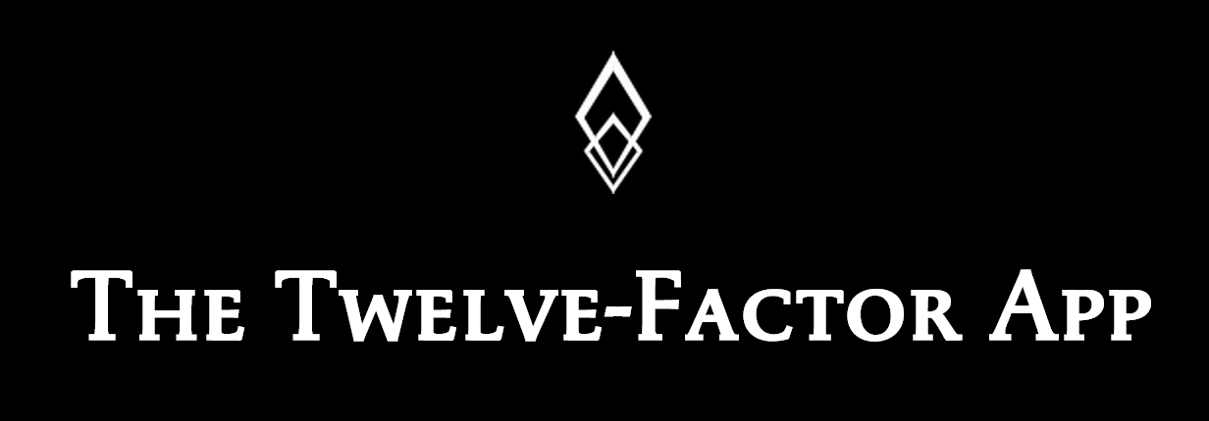
Twelve Factors
One Codebase/Many Deploys
Explicit Isolated Dependencies
Config via Environment
Attached Backing Services
Separate Build/Release/Run
Stateless Processes
Export Services via Port Bindings
Scale Out via Processes
Disposable Instances
Dev/Prod Parity
Logs == Event Streams
Admin Tasks == Processes
http://12factor.net

Slide 37


Made for each other
Pivotal CF
Microservices
Notes:
So I came to this conclusion that there’s a symbiotic relationship between Cloud Foundry and microservices.
Wikipedia defines symbiosis as a close and often long-term interaction between two or more different biological species, with mutualism adding the idea that both individuals benefit. <TRANSITION>

Slide 38

Continuous Delivery
Software Factories
Feedback Rapid Iteration
Horizontal Scale
Diversity of Clients
Physical/Virtual
Pivotal CF
Infrastructure
Applications
Monoliths
Microservices
Notes:
These factors have contributed to drive a change in how we approach infrastructure - Infrastructure has taken the lead in adapting to meet these needs with the move to the cloud, and Cloud Foundry has raised the level of abstraction to a focus on an ecosystem of applications and services. However, most applications are still developed as if we're living in the previous generation of both business and infrastructure: the monolithic application. <TRANSITION>

Slide 39



Monolithic Architecture
HTML
JavaScript
MVC
Service
Service
Data Access
Browser
Monolithic Application
Relational Database
Notes:
a large, monolithic enterprise relational DB — often preexisting
a layered, monolithic architecture:
Data access objects (JPA, Hibernate)
Service Beans (Spring Service Beans, EJB Session Beans)
Server-side MVC and templating (Spring MVC, Struts, JSF); Perhaps a smattering of JavaScript/AJAX
Delivered to the browser

Slide 40



Microservice Architecture
Relational
DB
HTTP
HTTP
Key/Value
Store
HTTP
HTTP
HTTP
…
AMQP
AMQP
HTTP
Graph
DB
Notes:
REST and message-driven services
Polyglot persistence, services encapsulate data store semantics
Diversity of clients acknowledged
API Gateway for service aggregation, reduce chattiness, protocol translation, reduce latency/round-trips, deal with mobile device fragmentation, build use case/device specific API’s

Slide 41
Organize Around Business Capabilities
Siloed
Functional
Teams
UI Specialists
Middleware Specialists
DBAs
Business Capability
Business Capability
Business Capability
Cross-
functional
Teams
HTML
JavaScript
MVC
Siloed
Application
Architectures
Microservice
Architectures
Service
Service
Data Access
http://martinfowler.com/articles/microservices.html#OrganizedAroundBusinessCapabilities
Notes:
Business Capability Organization:
- broad-stack implementation of software for that area
- includes UI, persistence, external collaborations
- cross-functional teams: UX, DB, PM, QA, etc.
- Cross functional teams are responsible for building and operating each product and each product is split out into a number of individual services communicating via a message bus. <TRANSITION>

Slide 42
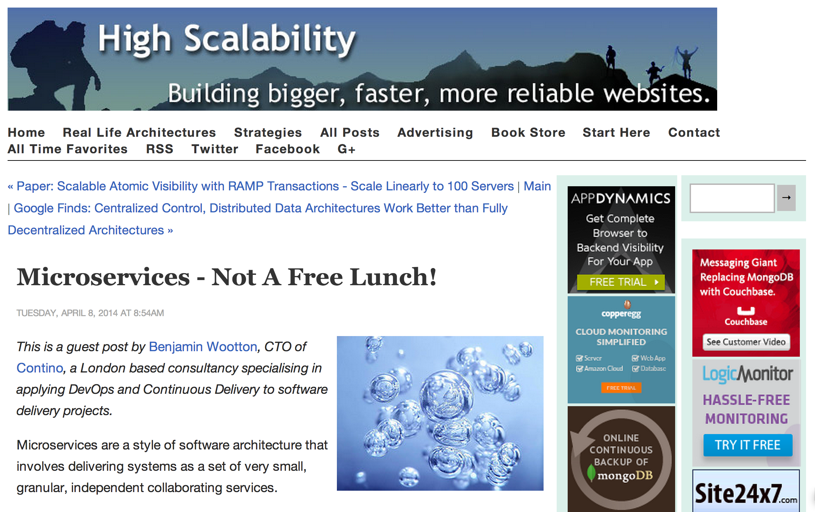
http://highscalability.com/blog/2014/4/8/microservices-not-a-free-lunch.html
Notes:
So to finish up, I’d like to take a look at the challenges associated with developing a microservices architecture.
Benjamin Wootton published an excellent article a couple of months ago at High Scalability entitled “Microservices - Not a Free Lunch!” In it he does an excellent job summarizing many of the challenges that you’ll encounter as you travel down the microservices road.

Slide 43
Paying for your lunch…
Significant Operations Overhead
Substantial DevOps Skills Required
Implicit Interfaces
Duplication of Effort
Distributed System Complexity
Asynchronicity is Difficult!
Testability Challenges
Notes:
He enumerated the costs of microservices at these seven bullet points…

Slide 44

You must be this tall
to use Microservices…
RAPID PROVISIONING
BASIC MONITORING
RAPID APPLICATION DEPLOYMENT
DEVOPS CULTURE
https://www.flickr.com/photos/gusset/3723961589
http://martinfowler.com/bliki/MicroservicePrerequisites.html
Notes:
While this is true…

Slide 45

It’s gonna take a platform…
Pivotal CF
Spring Cloud
Notes:
We want to encapsulate as much of the technology

Slide 46
Platform Features
Environment Provisioning
On-Demand/Automatic Scaling
Failover/Resilience
Routing/Load Balancing
Data Service Operations
Monitoring
Distributed/Versioned Config
Service Registration/Discovery
Routing/Load Balancing
Service Integration
Fault Tolerance
Asynchronous Messaging

Slide 47
Refactoring strategies

Slide 48
Some refactoring strategies
Use an storage gateway service instead of relying on plain old file system access
Abstracts the need of a local file system while giving your application a flexible mechanism to rely depending on it’s runtime (local on your dev, S3 or swift on prod)
Local Disk Storage
Embedded Services
Session Replication
Storage
Gateway
Service
Logging
S3
Swift

Slide 49
Some refactoring strategies
Let the runtime inject any service reference through environment variables
Reduces location specificity of the application
Allows disposability of containers
Runtime should inject any variable into the container
Local Disk Storage
Embedded Services
Session Replication
Logging

Slide 50
Some refactoring strategies
Local Disk Storage
Service Broker Node(s)
Service Broker Node(s)
Embedded Services
${VCAP_SERVICES}
DEA
Session Replication
Logging
Env

Slide 51
Some refactoring strategies
When necessary, leverage an external service such as Redis or GemFire.
Pivotal CF already provides session stickness
Local Disk Storage
Embedded Services
Session Replication
Logging

Slide 52
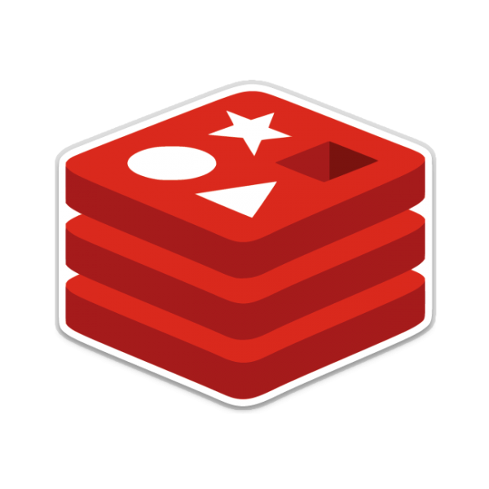
Some refactoring strategies
Local Disk Storage
Dynamic Router
Embedded Services
Session Replication
DEA
DEA
Logging
jsessionId

Slide 53
Some refactoring strategies
Do not write to log files
Output logs to console and use a syslog drain to collect all logs
Local Disk Storage
Embedded Services
Session Replication
Logging

Slide 54
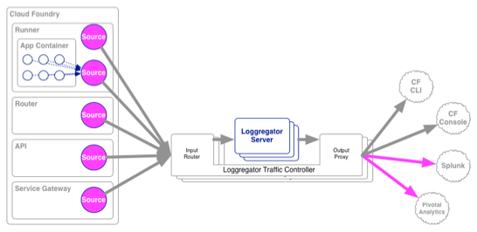
Some refactoring strategies
Local Disk Storage
Embedded Services
Session Replication
Logging

Slide 55
J2EE/JEE Specifics

Slide 56
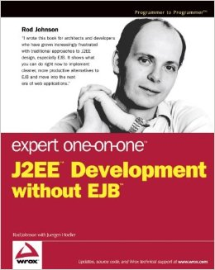
The J2EE story
Java enterprise beans has always been seen as a mammoth.
It inspired Rod Johnson to create Spring Framework, and the rest is history
The cumbersome model, coupled to fat application servers, and excessive plumbing code, led the market to embrace spring as the top application framework in the world
EJB 3 tried to fight back by adopting a lot of spring framework’s core concepts. Unfortunately by the time it was released, AWS was already a reality.

Slide 57
Can I run my JEE app on PCF?
JEE is a vast spec, people usually take for granted that JEE = EJB. EJBs are not a good match for running inside cloud foundry we will cover that later
For the majority of the spec, we actually support it inside tomcat. The main concerns are mostly around the application architecture and not the specs it uses
There are just a few specs are really not supported, be careful when bumping on those

Slide 58
JEE 7 and CloudFoundry (Most common JSRs)
JSR | Description | Supported | Notes
JSR 338 | Java Persistence API 2.1 | yes | Spring data JPA has better support than this JSR
JSR 340 | Java Servlets 3.1 | yes | Tomcat 8 support servlets 3.1
JSR 339 | JAX-RS 2.0 Restfull web services | yes | Jersey and resteasy can be used instead of SpringMVC
JSR 344 | JSF 2.2 Java server faces | yes | Supported on tomcat containers
JSR 349 | Bean Validation 1.1 | yes | Spring has support for bean validation
JSR 245 | Java server pages 2.3 | yes | Supported on tomcat containers
JSR 919 | Java mail 1.5 | yes | Spring has extensive support for java mail senders
JSR 343 | JMS 2.0 | partial | No support for MDBs, but JMS client is fully supported
JSR 345 | Enterprise Java Beans 2.0 | No
JSR 322 | Java Connector Architecture 1.7 | No
JNDI | Java Naming Directory Interface | No | Actually part of JSE, but its used by most containers

Slide 59
JNDI
JNDI is not JEE it’s actually part of JSE, but it’s quite often used by containers to store objects such as datasources or remote clients to EJBs
JNDI was never truly portable, across different vendors naming is different for same type of objects, stress that with your customer
Tomcat offers a read-only JNDI, so although possible to run applications that rely on datasource JNDI objects, its really not recommended, sometimes its not that simple to port them.
Educate your customers on how the service broker model and the environment variable system can offer the same functionality as a JNDI to store objects.

Slide 60
EJB: Stateless Session Beans
SLSB could potentially be executed on a supported container on PCF, but if the application only use them as a service bridge between the local web application (WAR) and business code, spring is a much lighter weight approach for that.
The problem on running SLSBs on PCF its really the fact that EJBs are located using JNDI on a remote port (1099 for example) and RPC are made towards another port (4445 for example). Warden only exposes one port for your application
So although an application using a web front end and a SLSB packaged on a single WAR could potentially be executed on PCF, there could never be an external route to the EJBs

Slide 61
EJB: Stateful Session Beans
SFSBs on the other hand are not really supported. The main issue is how replication works, and this is usually locked by vendor, and it requires multiple ports opened, which Warden would not allow. It could also be implemented using multicast (Jboss) and most cloud providers ban multicasting from their networks
SFSB makes code testing really hard. They allow state on the class level, and wrap calls on proxies to prevent racing conditions. This also makes the code practically impossible to be ported

Slide 62
EJB: Message Driven Beans
MDBs could be supported if running a JEE container inside PCF. MDBs are just message listeners to JMS that runs inside a transactional container.
Spring Messaging offers a very similar model (including transaction support) without the coupling of the container.
If message driven architecture is a requirement for the application, show how simple it is to implement a message driven pojo with spring as opposed to a message driven bean

Slide 63
JTA and distributed trasactions
If an application relies on distributed transactions across several EJB containers, that is a good indication that is really not a good fit for cloud applications.
Distributed transactions should be avoided, they bring a lot of complexity to the architecture, with very rarely any benefit
Spring supports 2PC using an external transaction provider (atomikos) but when talking about microservices, transactions should be a good boundary to start a conversation around the responsibility of the service

