Slide 1
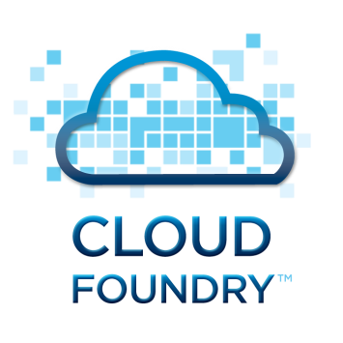
Pivotal CF
Containers and PaaS
Jemish Patel
Community Engineer
jpatel@pivotal.io
@jemish_p
November 2014

Slide 2
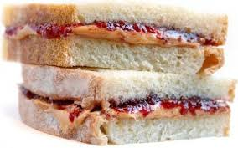
Containers and PaaS: Made for Each Other
Why containers matter for the enterprise
Container basics, limitations
Containers are building block of PaaS
Warden containers on Pivotal CF
Docker on Pivotal CF
Garden containers on Pivotal CF
Differences at a glance
Notes:
You might have heard some of the hype lately. Docker has gotten certainly got it’s share of it in the last few months.
So we’ll take this training session to discuss how containers are a core component of Pivtoal CF and Cloud Foundry.
How Docker and PCF work together. And importantly if your customer mentions containers, that is a great qualifier for their interest and readiness in PaaS.

Slide 3
Containers Pre-date the Docker Hype
Google started Linux container effort “Control Groups”
Added to the Linux Kernel in 2007
Cloud Foundry uses Linux container technology - “Warden containers” early 2012
Docker is like github for container images
Docker joins Cloud Foundry Foundation
Google, MSFT, IBM working on orchestration of multiple Docker containers
2006
2012
2014
Cloud Foundry has been using container technology pre-Docker
Notes:
Important to note, as you talk to customers or they ask about Docker is to recall that container technology has been around for years. And in fact, Cloud Foundry has been using container technology since 2012. The timeline could have gone back to BSD Jails and Solaris Zones but we wanted to keep the picture simple.
If you look at this timeline, you can see that the core container capability was added to the Linux Kernel in 2007. Since then many features have been added and containers have evolved. Since early 2012, Cloud Foundry has been using Linux container technology known as “Warden Containers” that provides a simple API to manage isolated applications as part of the platform.
Significantly, Docker recently Docker joined the Cloud Foundry Foundation. Also recently Docker bought Fig from Orchard labs to help with orchestration of multiple Docker containers. We’ll talk about the need for this in just a moment.
An now, throughout the industry, the likes of Google, Microsoft and IBM are contributing and are about orchestration or management of containers.
This need for orchestration and health management is key to what a Platform as a Service and Pivotal CF adds and is critical for container management. So lets dig a little deeper into that.

Slide 4
Anatomy of a Container
A simple analogy
You may not put up all the walls
The mechanism to put up all the walls is control groups and namespaces
Comes from the Linux kernel
It is the same mechanism across all container technology (Warden, Garden, Docker)
Notes:
A simple analogy (A box)
-- You may not put up all the walls to compelete it
-- However the mechanism you put up walls with in containers is via Control Groups and Namespaces

Slide 5
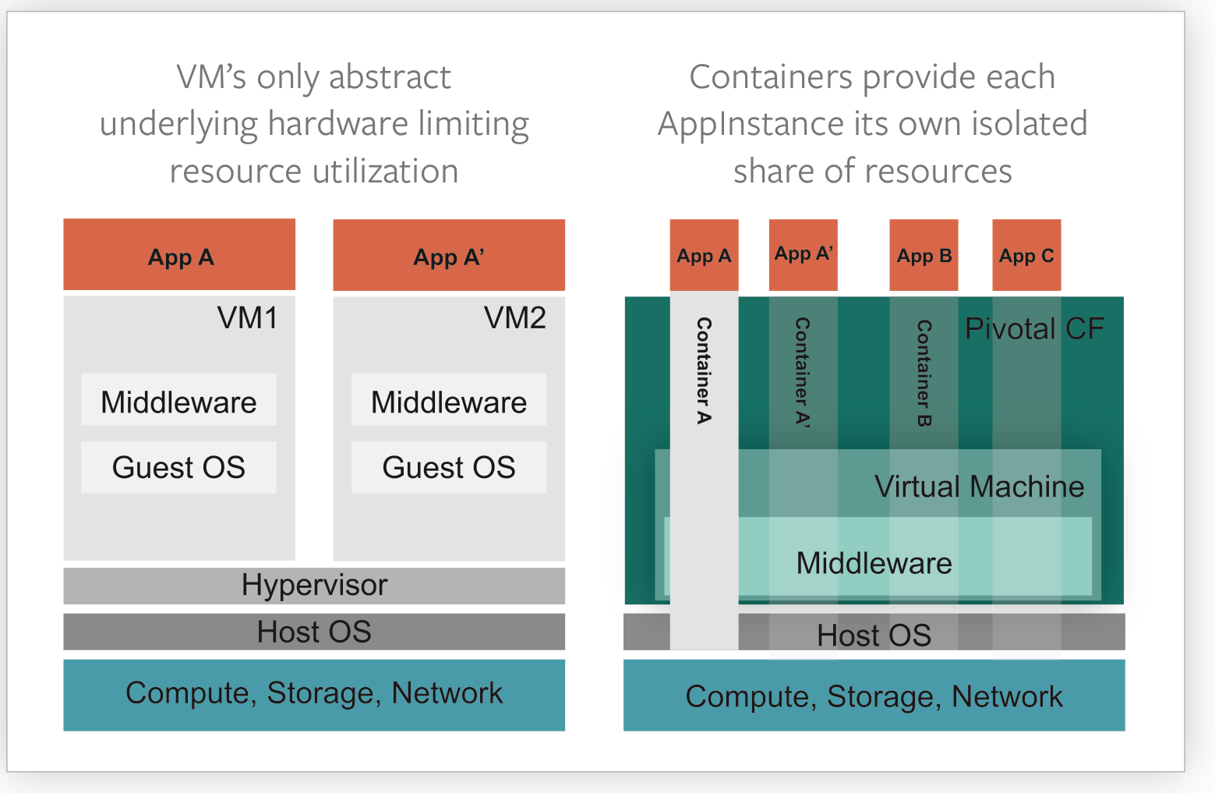
Containers Isolate and Abstract Resources
App Instances (AI’s) run in a container
Containers allow multiple AI’s to run on a single VM
Maximizes utilization without OS overhead
Notes:
So lets start with Container technology basics. Docker is container technology. Cloud Foundry and Pivotal CF also use container technology as the basic unit of how we run applications.
Lets take a look at this more closely. A good way to look at this is how containers contrast with Virtual Machines. VMs, as many of you know, have been the core technology component for running apps. Well with containers this shifts the unit of the app. Virtualized infrastructure is key to optimizing and managing applications, and containers makes this even more efficient.
Because containers, as you can see from this comparison graphic allows multiple app instances to run on a single VM. The benefit being that containers maximize utilization because they don’t require a copy of the OS, like the VM does.
We have a good description of this, and how this relates to our app instance pricing unit of measure that you can give to your customers. You can find that on Inside PCF. It has this drawing and a bit more description.
Net Net
Spinning up VMs = minutes and has a lot of overhead
Spinning up containers = seconds and a lot less overhead
Gain operational efficiency as we deploy multiple containers/ Ais on a single VM

Slide 6
Containers Are Essential for Speed
Portability
Packages any Linux application or service that can run across clouds
CF Push an application artifact (.WAR, Docker image, etc.)
Speed
Start up time in seconds vs. VM minutes
Seconds to deploy, scale, network config, health
Consistency
Captures exact configuration of an application
Layers are kept separate and can be rebuilt
Notes:
So why so interesting to developers and IT Operations managers alike? Containers bring some important benefits to running applications:
Portability: Containers package any Linux application or service. It’s an image package that is created and tested on a developer’s laptop using any language or framework which can run unmodified on any public cloud, any private cloud or a bare-metal server. This is a similar benefit to the Java “write once, run anywhere” idea but is more robust and is generalized to “build anything once, run anywhere”.
An instance of an image is called container. You have an image, which is a set of layers as you described it by yourself. If you start this image, you have a running container of this image. You can have many running containers of the same image.
Speed: Start-up time for a container is around a second. As you may know, with Pivotal CF you can see app instances starting up in 30 seconds and this is because it uses container technology. To contrast, public cloud virtual machines (VMs) take from tens of seconds to several minutes because they boot a full operating system every time, and booting a VM on a laptop can take minutes.
Consistency: The container captures the exact configuration of a version of an application. To upgrade the application in production, the container is usually replaced with a new version, which takes a few seconds. The layers of components that go into the configuration are kept separate and can be inspected and rebuilt easily. This changes configuration management to be largely a build- time activity, so for example a Chef recipe might be used to build a Docker container, but at runtime there is no need to use the Chef services to create many identical copies of a Docker container. Used in this way, Docker removes much of the need to use tools like Puppet, Chef, Ansible or Saltstack. And btw we’ll have another training session this month that gives more background on those.

Slide 7
Warden

Slide 8
What is Warden?
PivotalCF’s container technology
Service for managing a collection of containers
Protocol for clients to send/receive messages from the server
Each DEA host runs the Warden service
Notes:
Each DEA host in a Cloud Foundry deployment runs the Warden service, which manages cgroups, namespaces, process life cycle, and provides telemetry about the state of the host and each container. The Warden protocol is defined using Google protocol buffer definitions. Warden creates a root process, called “wshd” for Warden shell daemon, in each container. This root process is responsible for managing the container, launching application processes, and streaming the standard output and standard error back to the client.

Slide 9
Warden is part of Application Execution
Droplet Execution Agent (Review)
Manage app instances
Track app state
Broadcast app state messages
Should have > 1 DEAs for redundancy
Warden
Pivotal CF’s container technology
App Instances (AI) live inside Warden containers
AIs run in isolation
AIs get fair share of resources
AIs get protection from noisy neighbors
Notes:
Trying to say warden fits in the app execution components of PivotalCF and highlight its main functionality.
AIs get fair share of resources (cpu, mem, disk, net)

Slide 10
Warden
Manages environments that AIs run in
Isolated
Ephemeral
Resource controlled (limit CPU, mem and disk usage; network access)
Simple API for mgmt
Core components
Warden: server daemon
Warden-client: client (Ruby)
Warden-Protocol: used by server & client
Em-warden-client: EventMachine (Ruby)

Slide 11
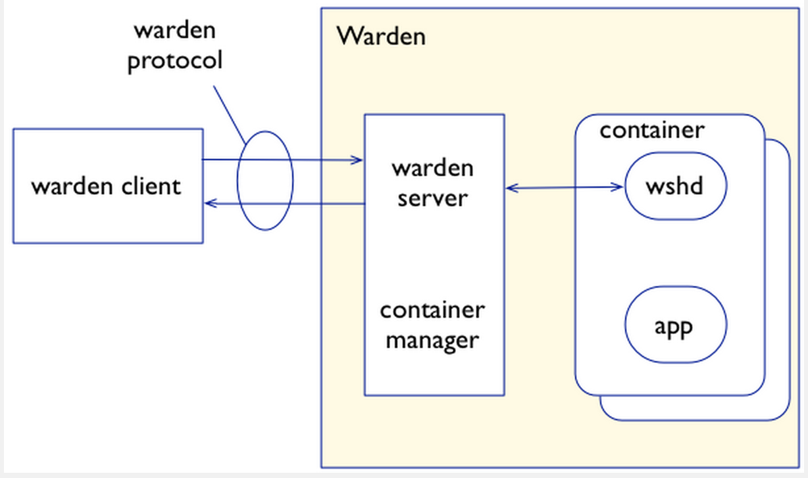
Warden – Architecture
Notes:
1 warden server and multiple wshd
ps -ef | grep wshd
root 799 1 0 Oct15 ? 00:00:00 wshd: 185d6755fct
root 913 1 0 Oct15 ? 00:00:00 wshd: 185d6755fcr
root 1130 1 0 Oct15 ? 00:00:00 wshd: 185d6755fd0
root 2285 1500 0 Oct15 ? 00:00:00 /var/vcap/data/warden/depot/185d6755fcr/bin/iomux-spawn /var/vcap/data/warden/depot/185d6755fcr/jobs/48 /var/vcap/data/warden/depot/185d6755fcr/bin/wsh --socket /var/vcap/data/warden/depot/185d6755fcr/run/wshd.sock --user vcap /bin/bash
root 2286 2285 0 Oct15 ? 00:00:00 /var/vcap/data/warden/depot/185d6755fcr/bin/wsh --socket /var/vcap/data/warden/depot/185d6755fcr/run/wshd.sock --user vcap /bin/bash
root 2461 1500 0 Oct15 ? 00:00:00 /var/vcap/data/warden/depot/185d6755fd0/bin/iomux-spawn /var/vcap/data/warden/depot/185d6755fd0/jobs/49 /var/vcap/data/warden/depot/185d6755fd0/bin/wsh --socket /var/vcap/data/warden/depot/185d6755fd0/run/wshd.sock --user vcap /bin/bash
root 2463 2461 0 Oct15 ? 00:00:00 /var/vcap/data/warden/depot/185d6755fd0/bin/wsh --socket /var/vcap/data/warden/depot/185d6755fd0/run/wshd.sock --user vcap /bin/bash
root 2470 1500 0 Oct15 ? 00:00:00 /var/vcap/data/warden/depot/185d6755fct/bin/iomux-spawn /var/vcap/data/warden/depot/185d6755fct/jobs/50 /var/vcap/data/warden/depot/185d6755fct/bin/wsh --socket /var/vcap/data/warden/depot/185d6755fct/run/wshd.sock --user vcap /bin/bash
root 2476 2470 0 Oct15 ? 00:00:00 /var/vcap/data/warden/depot/185d6755fct/bin/wsh --socket /var/vcap/data/warden/depot/185d6755fct/run/wshd.sock --user vcap /bin/bash

Slide 12
Warden – How does it do it?
Control groups
Provide Isolation
Resource control
Containers
Network
NAT
Iptables (filter network traffic)
Filesystem
Read-only root filesystem (OS & warden specific mods)
Read-Write filesystem (override container specific settings when necessary)
Large sparse file
Fixed size

Slide 13
Warden – LXC Differences
Isolation and Resource control are common goals
Use the same kernel primitives
LXC is tied to Linux
Warden backends can be implemented on any OS
OS must have a way of isolating environments
Warden no longer uses LXC (relied on a very small subset of LXC functionality)
We wrote a tool in under 1K LOC C code
Preconfigured hooks for container start process
Allows resource configuration without concurrency issues
Makes the start process more transparent
Notes:
Warden aids fast initial deployment

Slide 14
Warden – API
Create container
Handle/ID: Hex representation of container IP regardless of network config
Configure container (HASH configuration options)
Bind_mounts
Grace_time
Disk_size_mb
Use container
Run scripts
Copy files in/out
Modify firewall rules or resource limits
Destroy container
User Request
Automatically after being idle
Notes:
Container ID: Hex representation of container IP regardless of network config
Once the container is created, it is immediately ready for use. All resources will be allocated, required processes will be started and firewall rules will have been updated.
If warden is configured to clean up idle containers, it uses the number of connections as the metric. If that drops to 0, after a pre-configured time container is destroyed. If connections start referencing that container again, timer gets canceled. First the processes running in the container get terminated/killed. Then the root of the container process tree gets killed and once resources have been released, the files of the container get removed.

Slide 15
Demo -- Warden Containers in Action
Demo Video
Identify the running containers
Logging into a Warden container
Network , FileSystem, processes

Slide 16
Docker

Slide 17
Anatomy of a Container (revisited)
A simple analogy
You may not put up all the walls
The mechanism to put up all the walls is control groups and namespaces
Comes from the Linux kernel
It is the same mechanism across all container technology (Warden, Garden, Docker)
Notes:
A simple analogy (A box)
-- You may not put up all the walls to complete it
-- However the mechanism you put up walls with in containers is via Control Groups and Namespaces

Slide 18
Packaging has been improved
Docker File (Creation of a container with specifics like process x,y,z port a, etc.)
Docker Image (running app instance in a container)
Diego is going to leverage the packaging benefits of Docker
Chose not to leverage libcontainer project but only re-use some Go packages like netlink
Notes:
Docker File ex.
-- Download installable package
-- Install it in a specific path
-- Map specific network ports for traffic
-- start service/process
Docker image
A running instance of a container with the above package running in it

Slide 19
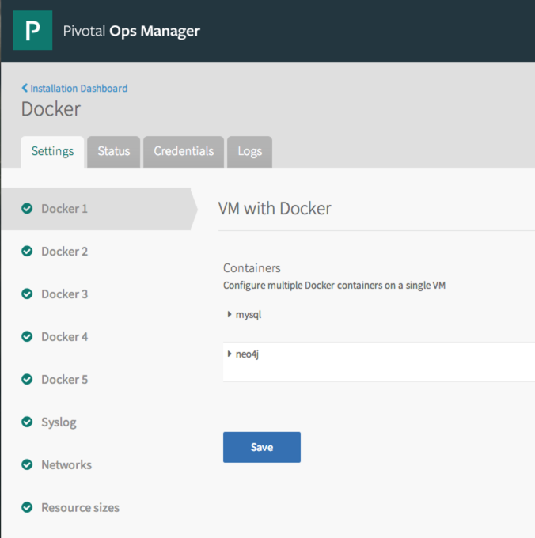
Docker Containers + Pivotal CF
Deploy, manage and scale apps that run multiple Docker containers, on IaaS of choice.
Health Management
VMs automatically recreated in case of failure
Containers automatically restarted in case of failure
Container dependencies maintained on restart
Video highlighting these capabilities
Notes:
Even more exciting is what you can demo today with PCF Operations Manager and Docker. We showed this demo at VMWorld – thanks to Jemish who is on this call who built out this demo. This is released experimental support for Docker containers (so a running instance of a Docker image) with Ops Manager to provide the ability to run multiple Docker images on a single VM.
You can show this video and demonstrate how we work together today, to deploy, manage and scale apps that run multiple Docker containers on IaaS of choice.
This is a service broker approach for now (Jemish to chime in):
Multiple Docker containers can be orchestrated into multiple virtual machines.
Containers can be deployed to a choice of IaaS (AWS, OpenStack, VSphere, VCHS, CloudStack or Google Compute Engine).
Containers are monitored automatically and restarted in case of failures.
If a container fails, when it is restarted then all of the dependent containers will be restarted too.
Virtual machines are automatically monitored and recreated in case of a failure.
Host volumes can be bound to Docker containers.
Data disks attached to a Docker container can be resized without losing data.

Slide 20
Garden

Slide 21
Garden
Rewrite of the Ruby and Bash portions of Warden in Go
Better maintainablitity
Provides the container technology for Diego
Separates out the server from the Backend
Backend maps protocol requests to OS primitives
Protocol is platform agnostic (makes it possible for a Windows backend to be developed)
Supports REST API
Notes:
Garden separates the server and protocol buffer handling (in a separate Garden repository) from a Garden Linux backend which maps the protocol requests into Linux operating system primitives. The protocol is sufficiently platform agnostic for a Windows backend to be developed. Garden also supports a REST API closely modeled on the protocol buffer definition. The REST API is particularly useful during experimentation and testing.

Slide 22
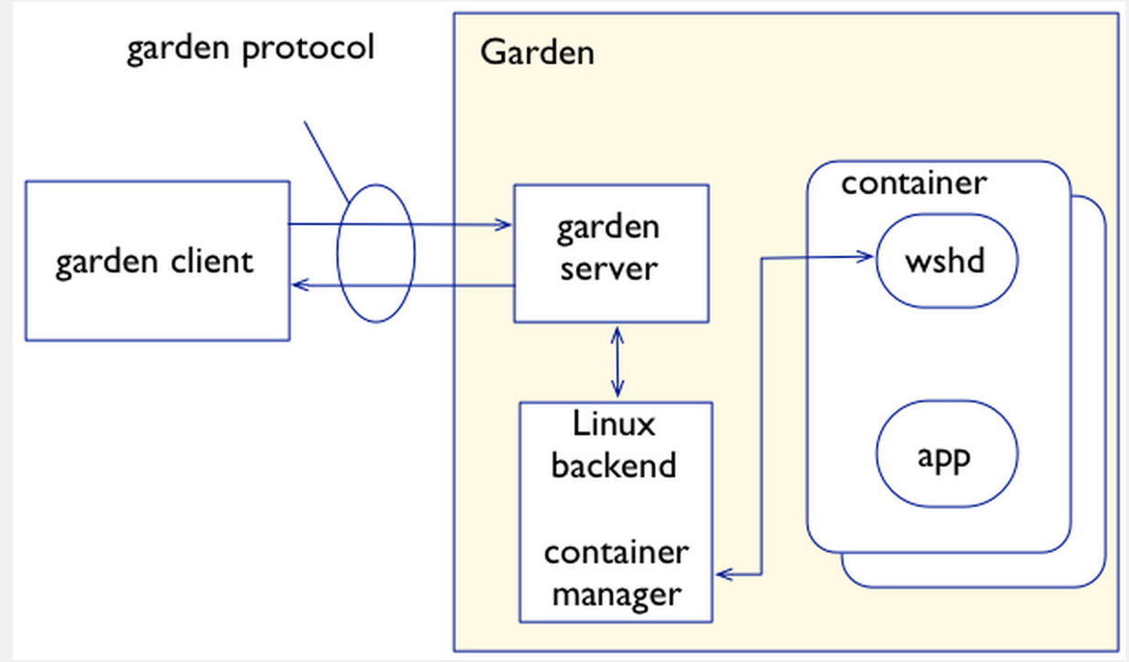
Garden Architecture

Slide 23
Garden – How does it do it?
Namespace
Provide isolation (ex. Network, FS mount points,etc)
Does not use User Namespace as yet
Resource Control
cpuset, cpu, cpuacct,devices and memory in a cgroup for each container
Resources constraints are imposed on process in containers
Networking
Creates a pair of Ethernet devices and assigns one to the container’s network namespace
Routing and firewall for a container
Packet filtering/shaping
Root FileSystem (Extends Warden’s behavior)
Allows containers to use configured root FS or root FS can be built from Docker Image
R/W layer is added so container can update root FS

Slide 24
Garden - API
Capacity – returns the memory and disk capacity of the host machine
Create – creates a container and returns its handle (a string which identifies the container)
Info – returns information about a specified container such as its IP address and a list of processes running in the container
Run – spawns a process in the container and streams its output back to the client
Attach – starts streaming the output of a specified process in a specified container back to the client
List – lists all container handles
LimitBandwidth, LimitCpu, LimitDisk, LimitMemory – adjusts the limits of a specified container for network bandwidth, CPU shares, disk usage, and memory usage, respectively
NetIn – maps a port on the host machine to a port in the specified container
NetOut – whitelists outbound network traffic from the specified container to a specified network and/or port
StreamIn – copies data into a specified file in the specified container’s file system
StreamOut – copies data out of a specified file in the specified container’s file system
Ping – checks that the garden server is running
Stop – terminates all processes in a specified container but leaves the container around (in stopped state)
Destroy – destroys the specified container
Notes:
Capacity – returns the memory and disk capacity of the host machine
Create – creates a container and returns its handle (a string which identifies the container)
Info – returns information about a specified container such as its IP address and a list of processes running in the container
Run – spawns a process in the container and streams its output back to the client
Attach – starts streaming the output of a specified process in a specified container back to the client
List – lists all container handles
LimitBandwidth, LimitCpu, LimitDisk, LimitMemory – adjusts the limits of a specified container for network bandwidth, CPU shares, disk usage, and memory usage, respectively
NetIn – maps a port on the host machine to a port in the specified container
NetOut – whitelists outbound network traffic from the specified container to a specified network and/or port
StreamIn – copies data into a specified file in the specified container’s file system
StreamOut – copies data out of a specified file in the specified container’s file system
Ping – checks that the garden server is running
Stop – terminates all processes in a specified container but leaves the container around (in stopped state)
Destroy – destroys the specified container

Slide 25
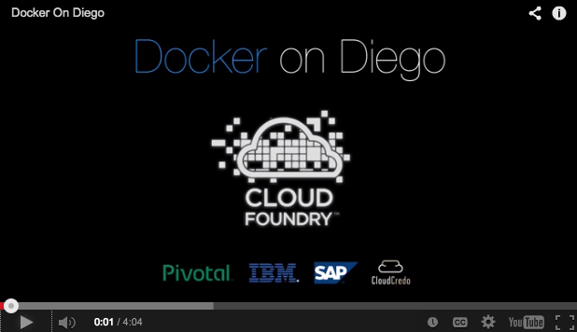
Garden + Diego in Action
The demo covers:
Deploying Docker
Scaling from 1 to 300 instances in less than a minute
Balanced placement with distributed auction
Log aggregation
Health checks
Zero bad requests when 20% of the infrastructure disappears
Respawning the missing instances

Slide 26
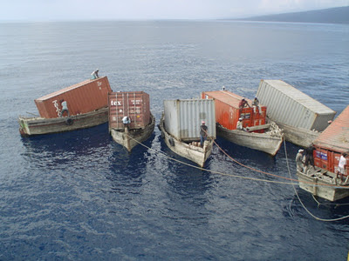
Containers Alone Aren’t Enough… enter PaaS
Orchestration & Management of Application Instances
Apps span multiple VMs
Apps use multiple containers
Dependencies with each other fail
Enterprise management
Value is unlocked when standard common services are built into each managed container
Notes:
Enter Platform as a Service and Pivotal CF. PaaS orchestrates and manages multiple virtual machines and/or containers that depend on each other and run application instances. PaaS monitors and manages the apps that may span multiple VMs, or use multiple containers. And monitor and restart the dependencies.
.
The value of containers is unlocked for the enterprise when containers get all this goodness of PaaS built into each.
Pivotal CF adds many enterprise-grade features for Docker containers.

Slide 27



Differences -- At a Glance
Container technology alone is not enough for enterprises
Feature | Warden | Docker | Garden | PivotalCF (PaaS)
Dev Agility (Buildpacks)
Operator Agility
Multiple Levels of HA
Eco-System (Service Broker)
Notes:
Dev Agility
-- auto detect frameworks
-- push
-- service bindings
Operator Agility
-- Log streaming & Aggregation
-- Dynamic Routing
-- APM & auto-scale
-- 4 levels of HA

Slide 28
Conclusion
Container technology alone is not enough for enterprises
You can take pieces and stitch them together (DIY)
Will need time, $$ & FTE resources
It takes time to get it right
Pivotal is not only paving the path but will be contributing back to the Open Source Community
Garden + Diego will allow you to:
Run Docker Images in Garden containers
Simplified Management
Streamlined Orchestration
Right out of the Box in PivotalCF 1.4!

Slide 29
Helpful Resources
Garden Overview Blog
Garden + Diego in Action
Docker_Spotlight
Experimantal Docker Support in Ops Manager

Slide 30
Thank You
Jemish Patel
Community Engineer
jpatel@pivotal.io
@jemish_p
October 2014

